Slide 1
Hotel Reservation Prediction System Using KNN Classifier
Machine Learning Project using Python
Student Name: Atharv Nikam
Naviotech course – Machine learning
Course: B.Tech CSE / Data Science
Institution: MIT ADT University
Academic Year: 2024–25

Slide 2
Introduction
Revenue Impact
Planning Benefits
Hotel reservation cancellations cause significant revenue loss
Predicting reservation outcomes helps hotels improve planning
ML Analysis
Our Approach
Machine Learning can analyse booking patterns effectively
This project uses K-Nearest Neighbours (KNN) for prediction

Slide 3
Problem Statement
Uncertainty Challenge
Manual Limitations
System Requirements
Hotels face uncertainty due to last-minute cancellations
Manual prediction is inaccurate and inefficient
Need a system to:
Predict whether a reservation will be confirmed or cancelled
Improve resource and revenue management

Slide 4
Objectives
Analyse hotel reservation dataset
Preprocess and clean booking data
Build a prediction model using KNN Classifier
Provide insights for decision-making
Evaluate model accuracy and performance

Slide 5
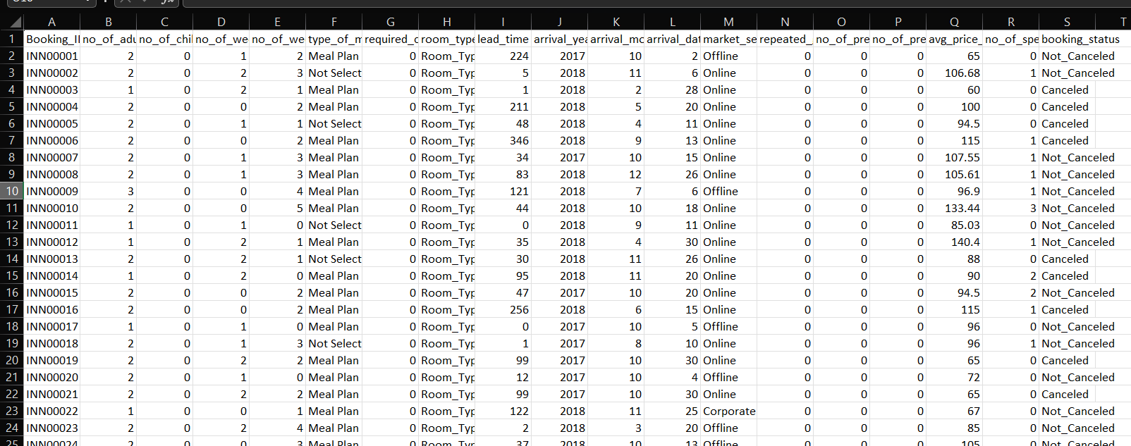
Dataset Description
Dataset: Hotel Reservation Dataset (CSV)
Attributes include:
Number of adults and children
Room type
Lead time
Market segment
Average price per room
Booking status (Target variable)
Target Variable:
Booking Status (Confirmed / Cancelled)

Slide 6
Data Preprocessing
Data Cleaning
Encoding
Removed missing and duplicate values
Converted categorical data using encoding
Scaling
Data Split
Feature scaling applied for distance-based learning
Split data into:
Training set
Testing set

Slide 7
Machine Learning Model – KNN
KNN is a supervised learning algorithm
Works on the principle of:
Steps:
Similar data points have similar outcomes
1
Calculate distance between data points
Distance Metric:
2
Select K nearest neighbours
Euclidean Distance
3
Predict based on majority voting

Slide 8
System Architecture / Workflow/ Algorithm
Load hotel reservation dataset
Preprocess and scale data
Train KNN classifier
Test model with unseen data
Generate prediction and evaluation metrics

Slide 9
Model Evaluation
Evaluation Metrics
Accuracy Score used for evaluation
Results
Confusion Matrix analysed:
  True Positives
Results indicate KNN performs well for reservation prediction
  True Negatives
  False Positives
  False Negatives

Slide 10
Key Findings
Lead Time & Price Impact
Booking Patterns
Lead time and room price strongly affect cancellations
Short lead-time bookings are more likely to be confirmed
Model Reliability
Performance Enhancement
KNN provides reliable prediction for hotel booking outcomes
Feature scaling significantly improves model performance

Slide 11
THANK YOU

