Slide 1
TEAM DELTA
Atharva Parkhe
Vivek Silimkhan
Azvern Dias

Slide 2
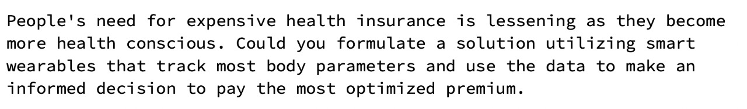
Problem Statement

Slide 3
Solution
Mobile application
Takes sensor data from wearable devices
Predicts risks/chances of having serious diseases

Slide 4
User Flow
User Authentication —> Enter Basic Details —> Import Sensor Data —> Run ML model —> Predict Possible Diseases —> Makes a Recommends The most Optimal Insurance Policy

Slide 5
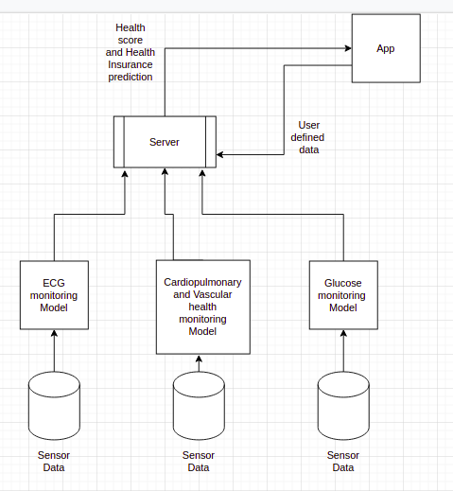
Work Flow

Slide 6
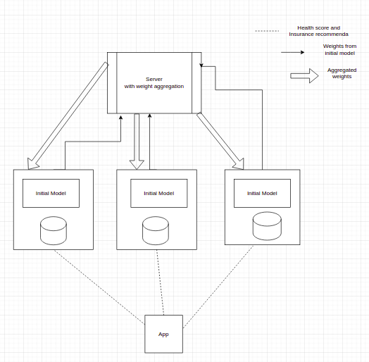
Future Work

Slide 7
Tech Used
Front End - Dart (Flutter)
Back End - Python (Django)

Slide 8
Thank You

