Slide 1
Coupon Recommendation
Problem Statement :
The dataset collected via a survey on the Ecom website via Mechanical Turk. It captures various driving scenarios including destination, weather, passengers, coupon details and user attributes. It records whether the user chooses to accept a coupon. The challenge is to predict coupon acceptance based on these factors.
Objective :
To perform data analysis to explore key patterns and insights from the dataset and build a machine learning model that predicts whether a user will accept a coupon based on user attributes, coupon details and contextual factors.

Slide 2
Data Preprocessing
Removed 291 duplicate records to ensure data quality.
Dropped the Car column with 99% missing values and filled other categorical missing data using the mode.
Checked class balance: 56% accepted vs 44% not accepted, imbalance not severe.
Dropped direction_opposite due to strong correlation with direction_same.
Grouped Occupation into broader sectors to reduce high cardinality.
Combined toCoupon_GEQ15min and toCoupon_GEQ25min into a single feature distance_driving.
Applied Ordinal Encoding for ordered features and One-Hot Encoding for nominal features.
Scaled the final dataset to bring all features to a similar range before model training.
Split data into 80% training and 20% testing sets.

Slide 3
Data Analysis
Users with No Urgent Place destination accept the most coupons.
Travelling with Friends or Partner greatly increases acceptance compared to Alone.
Carry-out & Restaurant (<$20) coupons have the highest acceptance, while Bar coupons the lowest.
Longer coupon expiration leads to higher acceptance.
Frequent visitors to Bars, Coffee Houses and Restaurants are more likely to accept related coupons.
Acceptance remains high even when users travel in the opposite direction of the venue if they have no urgent place to go.
Users are most likely to accept coupons when they are with friends, not in a hurry and the offer is inexpensive, convenient and has longer validity.

Slide 4
XGBoost Modeling & Performance
We tried several models and after fine-tuning XGBoost performed the best.
Recall is 82% It identifies most of the users who are likely to accept a coupon.
Precision is 75% predictions of coupon acceptance are largely accurate.
F1 score is 78% It balances precision and recall effectively.
ROC-AUC is 0.81 which means model effectively distinguishes between users who will accept and those who won’t.
Accuracy is 74% it means overall predictions are solid though recall and precision give a clearer picture due to the imbalanced dataset.
Metrics | Score
Recall | 82%
Precision | 75%
F1-Score | 78%
ROC_AUC | 0.81
Accuracy | 74%

Slide 5
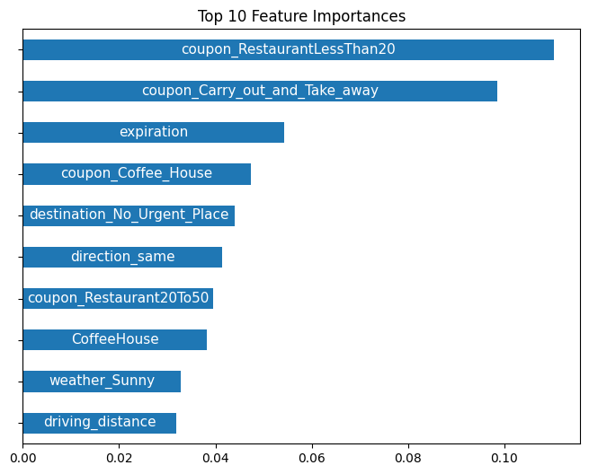
Business Insights & Recommendations
Restaurant < $20 and Carry-Out coupons are the most influential features meaning these types of offers have the highest chance of being redeemed.
Longer coupon expiration is a key factor users prefer offers that are flexible and convenient showing that validity directly impact acceptance.
Coupons are more likely to be used by users with no urgent destination or traveling toward the venue.
Focus coupon campaigns on users with favorable travel context and companions.
Focus on habitual visitors for venue-specific coupons to maximize impact.

