Slide 1

Clinic Management System
Atharv Sathe (20104054)
Mihir Shrivas (20104081)
Jayesh Singh (20104101)
Harsh Yadavade (20104077)
Project Guide
Prof. Ganesh Gourshete

Slide 2
Contents
Introduction
Objectives
Scope
Features / Functionality
Project Outcomes
Technology Stack
Project Design

Slide 3
1. Introduction
Clinic Management System is an Integrated system.
The system will help the user in the clinic, managing the work.
User friendly system.
The project will keep the track of the staff and the patients.
Patient registration, appointment scheduling, drug safety, prescription, personnel management and much more are all part of the Clinic administration process.

Slide 4
Problem Identified :
    Manual Recording takes more space and time.
    Manual Recording lacks the ability to auto-sort records.
    Manual Records can easily be mishandled.
    Dependent on Good Individuals.
    Duplication of Data Entry.
Solution Proposed:
Considering these problems we have developed a system which will overcome all the problems and provide a better experience for all the users.

Slide 5
2. Objectives
The Main Objective of Clinic Management System is to manage the details of Patient, Doctors, Receptionist and Pharmacy.
The Motive of our project is to build an Application Program to reduce the manual work of patient, doctor, pharmacy etc…..
Clinic management is to provide choicest level of wellness and improve care coordination while providing friendly services.
Under clinic management, patient’s records are digitized so as to make data retrieval easy and efficient.

Slide 6
3. Scope
Clinic Management System was primarily developed to improve the clinic system for storing data and information about the patient and the employee.
The system was focused on moving the manual system into computerized system that update and also accommodates the process of viewing and storing information about the patient.
The scope for the system will involve staff, doctor and management of the clinic. The staff will register the patient. The doctor will diagnose the patients and give the medication while the management will view the daily update of clinic operation.
This system which manages complete polyclinics details in a single application and in a single database.

Slide 7
4. Feature /Functionality
Feature 1: Management of Information
Feature 2: Authentication for different users
Feature 3: Patient Satisfaction
Feature 4: Patient can book his own appointment
Feature 5: History of patient records in database

Slide 8
5. Outcome of Project
This system will overcome the problems occur while using the manual system and the previous system.
The system can generate proper scheduling according to the user requirement.
Being in the digital format, patient data can be easily accessed.
The system will be able to improve the workflow of the clinic from registration.

Slide 9
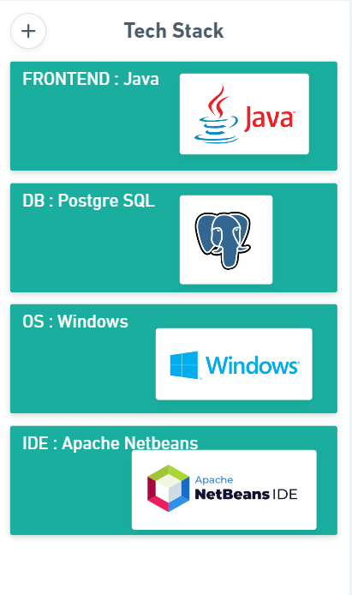

6. Technology Stack
https://drive.google.com/drive/u/0/folders/1VIEf1ysJQ-QqYykrd3l-uebYSAW-iuvs

Slide 10
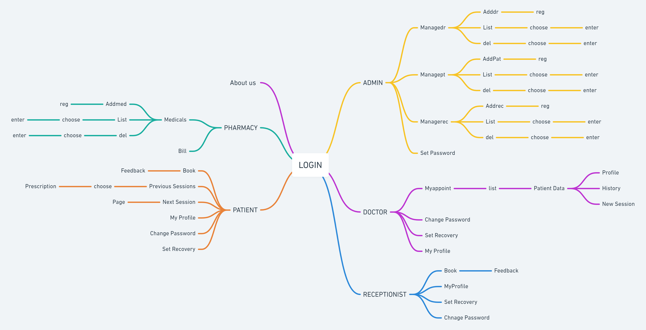

Slide 11
Thank You...!!

