Slide 1

CASEWISE
AI-Powered Case-Based Reasoning for Surgical Pre-Planning
PRESENTED BY:
Vedang Srivastava
Atharv Dixit
Mayur Shenoy
Vedant Parasrampuria
1MS23IS143
1MS23IS155
1MS23IS066
1MS23IS144

Slide 2
The Challenge & Our Answer
CURRENT ISSUES
  Complex surgical decisions
Multiple patient variables
  Scattered historical data
Isolated case knowledge
  Time-intensive planning
Manual case searching
CASEWISE CH SOLUTION
  Intelligent matching
AI-powered retrieval
  Unified knowledge base
1000s of cases accessible
  Instant recommendations
2-4 second response

Slide 3
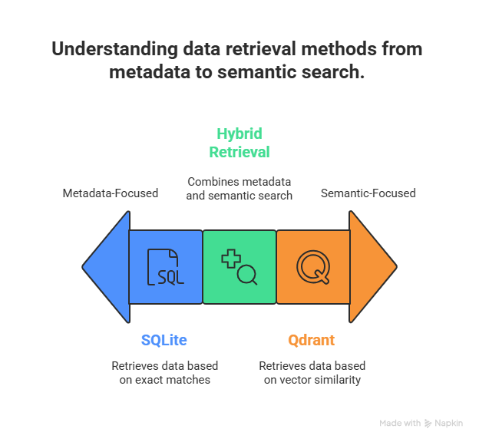
How CaseWise Works
FastAPI Backend:
  RESTful API design
  Pydantic validation
  Async request handling
Embedding Service:
  OpenAI API integration
  Batch processing support
  768-dimensional vectors
Storage Layer:
  SQLite for metadata
  Qdrant for vectors
  Synchronized updates

Slide 4
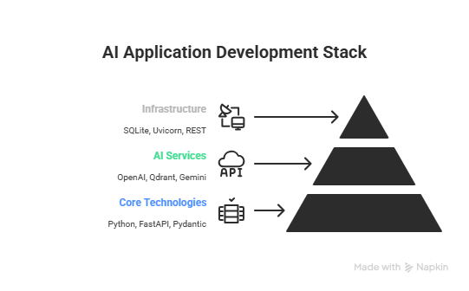
Tech Stack
  ReactJs
  OpenAi Embeddings
  Fast API
  Gemini

Slide 5
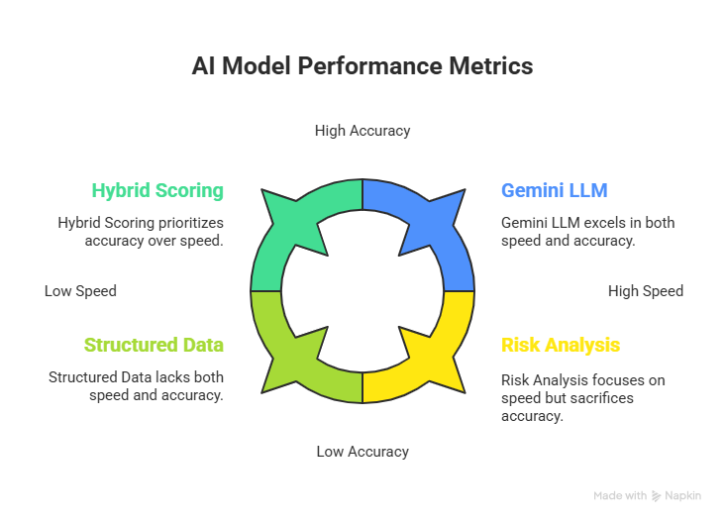
What Makes It Smart

Slide 6
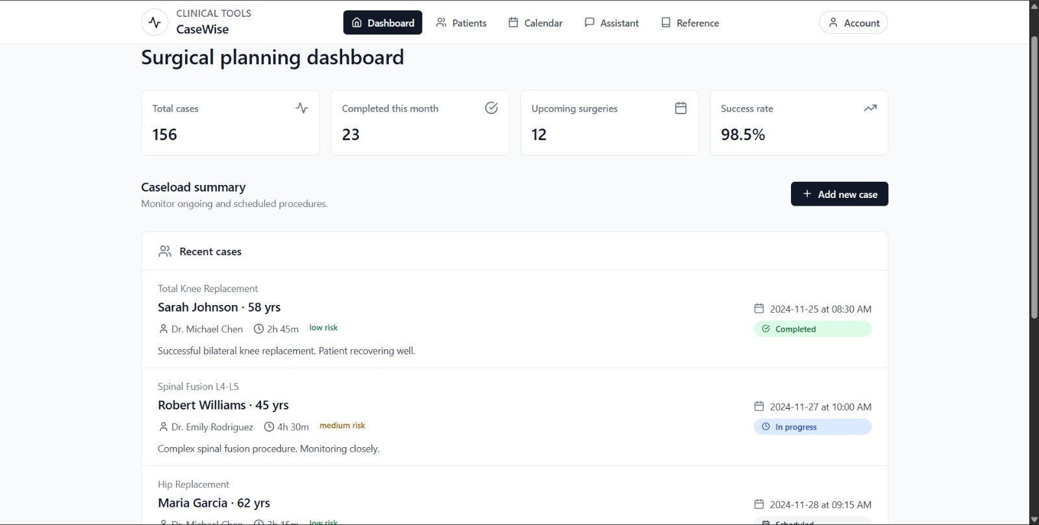
Demo Transition

Slide 7
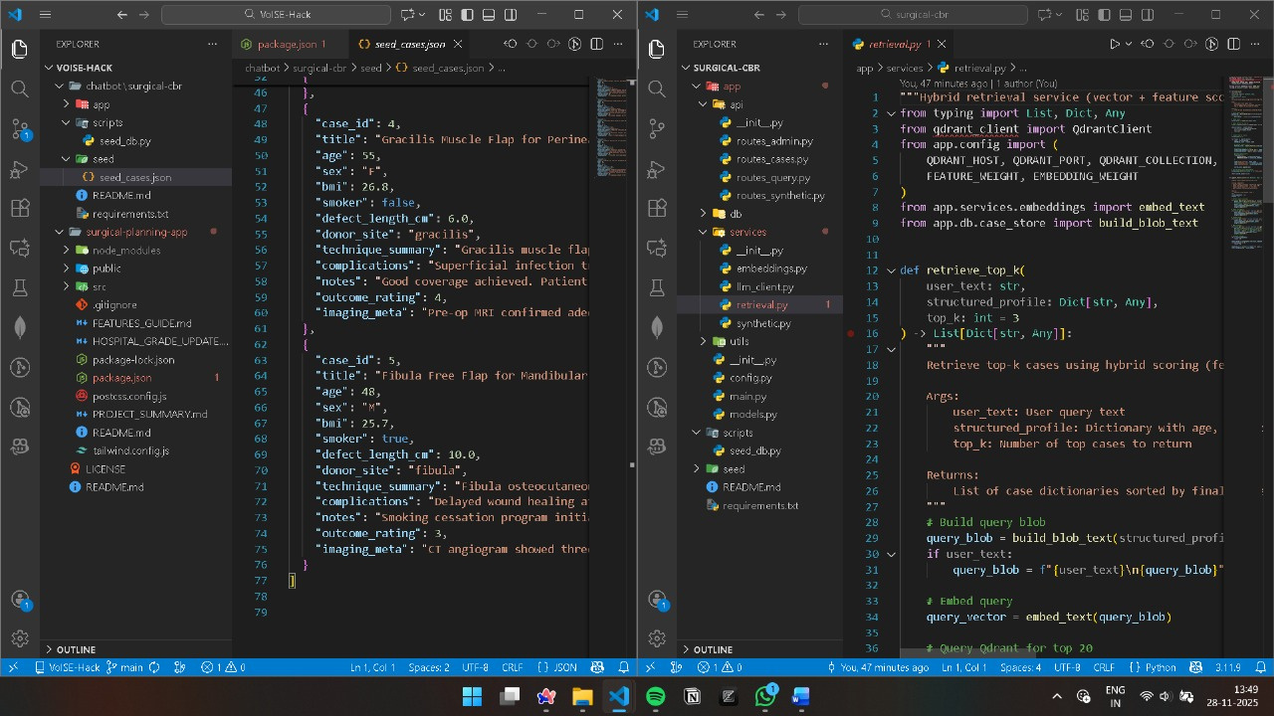

Slide 8
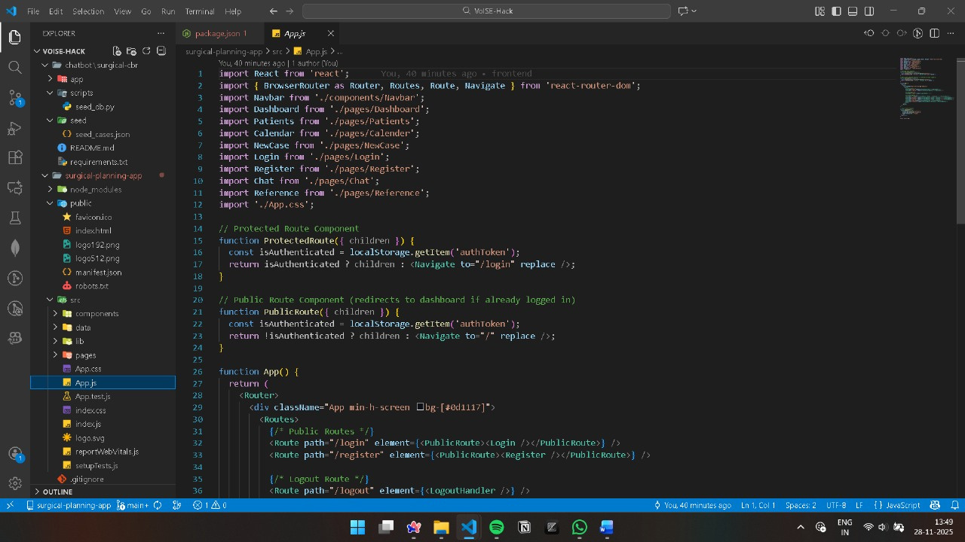

Slide 9
IMPROVEMENTS
  Advanced search and filtering
  Multi-user collaboration
  Role-based access control
  Integration with hospital systems
  Mobile app version
  Dark mode toggle
  Internationalization (i18n)

Slide 10
THANK YOU!

