Slide 1
Computer Architecture (CS F342) Lab-5(a) General-purpose Multi-Cycle based MIPS Microprocessor Design Using Verilog HDL Sem-I, AY-2022-23 Date: Oct. 18, 2022 Submission Date: Oct. 24, 2022: 3AM Marks: 6
BITS-Pilani Goa, India. Dept. of CSIS

Slide 2
Intellectual Property Rights (IPR)
/*########################################################
Note: Please don’t upload the assignments, template file/solution and lab. manual on GitHub or others public repository.
Kindly remove them, if you have uploaded the previous assignments.
It violates the BITS’s Intellectual Property Rights (IPR).
********************************************************/

Slide 3
Design the following modules in the given template
File Name | Module | Marks
A.v | A_Reg | 0.2
B.v | B_Reg | 0.2
MDR.v | MDR_Reg | 0.2
IR.v | IR_Reg | 0.2
ALUOut.v | ALUOut_Reg | 0.2
mux2_1_Data.v | mux2to1_32bits | 0.2
mux4_1_Data.v | mux4to1_32bits | 0.2
controller.v | controlCircuit | 1.2
topModule.v | MIPS_multiCycle | 1.2
testbench.v | testbench | 0.2
For attending the Lab-5(a) [attendance needs to be recorded] |  | 1

Slide 4
PC & genvar
module PC_Reg(input clk, input reset, input regWrite, input [31:0] inR, output [31:0] outR);
genvar i;
generate
for ( i=0; i < 32; i=i+1 )
Dff_register PC(clk, reset, regWrite, inR[i], outR[i]);
endgenerate
endmodule

Slide 5
regDest
All registers are connected with clk & reset
Data & Control Path
iorD
Control Unit
(FSM)
Opcode [31-26]
memtoReg
memRead
aluSrcA
memWr
aluSrcB
irWr
pcWr
bne
IR[31:26]
aluOP[1:0]
pcSrc
pcWr
PcIn
memRead
memWr
irWr
regWr
aluSrcA
iorD
pcSrc
IR[25:21]
bne
mem
Out
ir
0
1
mem
Addr
EN
IR[20:16]
PcOut
PC
EN
0
1
PcIn
PcOut
15:11
regDest
aluIn1
m1
Memory
rd
regRs
A
Aout
m4
1
0
0
1
zero
result
IR[15:0]
m2
Register File
aluOut
ALUOut
Bout
m6
memtoReg
B
Bout
0
1
2
3
aluIn2
regRt
ALU
md
r
0
1
4
result
writeData
m5
m3
aluControl[3:0]
aluSrcB
sign_ext
<< 2
ALUControl
aluOp[1:0]
clk
reset
Testbench
result
IR [5:0]
funct

Slide 6
States’ information
Starting State
IF (T0)
ID (T1)
ADD
LW
BNE
ADDI
SW
EXE (T2)
EXE (T3)
Branch (T4)
ADDI
LW
ADD
SW
MEM (T5)
MEM(T6)
MEM (T7)
MEM (T8)
LW
WB (T9)

Slide 7
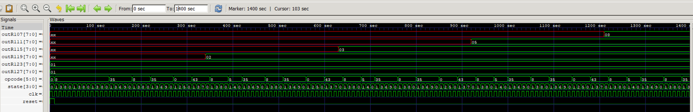
Output
1-st Fib
2-nd Fib
3-rd Fib
4-th Fib
5-th Fib
6-th Fib
Pls. look into the opcode, state & clk, and try to understand it.

Slide 8
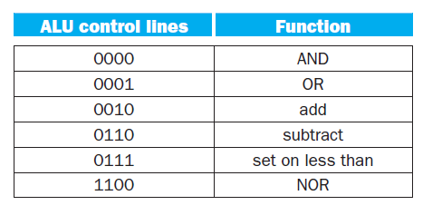
ALU controls and functions
Read Ch-4 (4.4), COD by P&H

Slide 9
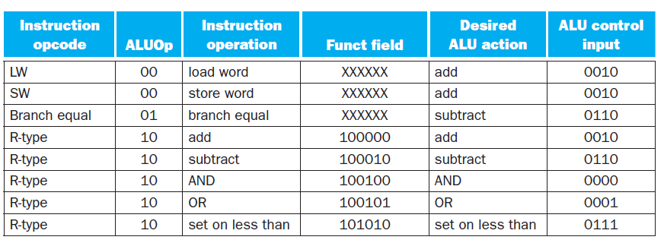
How the ALU control bits are set depends on the ALUOp control bits and different function code for R-type instruction
Read Ch-4 (4.4), COD by P&H

Slide 10
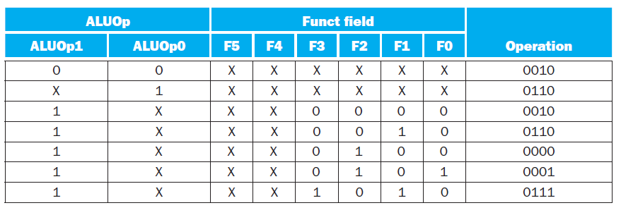
Design of main CU
Read Ch-4 (4.4), COD by P&H

Slide 11
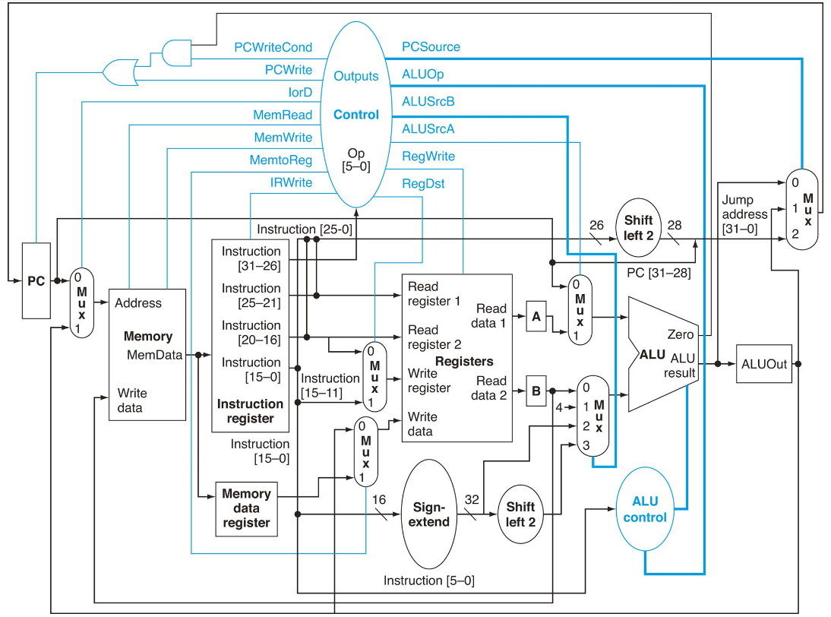

Slide 12
Starting State
IF (T0)
ID (T1)
J
ADD
LW
BNE
ADDI
SW
EXE (T6)
EXE (T2)
EXE (T8)
EXE (T10)
ADDI
LW
ADD
SW
MEM (T7)
MEM(T3)
MEM (T5)
MEM (T9)
LW
WB (T4)

