Slide 1
BUSINESS APPLICATIONS
UNIT – V
INTRODUCTION TO E-BUSINESS SYSTEMS DECISION SUPPORT SYSTEMS

Slide 2
Introduction to e-business systems
E-business, commonly known as electronic or online business is a business where an online transaction takes place.
In this transaction process, the buyer and the seller do not engage personally, but the sale happens through the internet.
Its purpose is to facilitate and streamline business processes.
In addition, it aims to leverage technology to increase efficiency, expand market reach, and enhance the customer experience in the digital age.

Slide 3
FUNCTIONAL BUSINESS SYSTEMS
Functional Areas in an Organization
Information systems can be designed to support the functional areas such as, accounting and finance, sales and marketing, human resources, manufacturing, inventory management, and purchasing of an organization
Such systems are classified as ‘functional information systems’. Functional information systems typically follow the organizational structure

Slide 4
FUNCTIONAL INFORMATION SYSTEMS
Marketing Systems
Manufacturing Systems
Human Resource Systems
Accounting Systems
Financial Management Systems

Slide 5
MARKETING SYSTEMS
Marketing Information Systems provide information technologies that support major activities of the marketing function e.g. promotion and selling.
Components
Interactive Marketing
Customer focused marketing process
Based on using Internet to establish two-way communications between customers or potential customers and the business
Customers become involved in product development, delivery, & service issues

Slide 6
MARKETING SYSTEMS
Market Research
Statistical models help market researchers find the best populations for new and existing products
Targeted Marketing
Database management systems (DBMS) help define potential customers as narrowly as possible e.g. region wise, store wise

Slide 7
MANUFACTURING SYSTEMS
Support the production/operations function
Assists firms in,
Planning, monitoring, & controlling inventories, purchases, & the flow of goods and services
Plant activity scheduling
Material requirement assessment
Material reallocation between orders

Slide 8
MANUFACTURING SYSTEMS
Computer-Integrated Manufacturing (CIM) the manufacturing approach of using computers to control the entire production process
Objectives of CIM
Simplify production processes , product designs and factory organization as a vital foundation to automation and integration.
Automate production processes and the business functions that support them with computers machines and robots.
Integrate all production and support processes using computers telecommunications networks and other information technologies.

Slide 9
HUMAN RESOURCE SYSTEMS COMPONENTS
Employee Record Management
Reduce space needed to store records, time to retrieve them, and costs of both
Promotion and Recruitment
Search databases for qualified personnel
Use intranet to post job vacancies
Use the Web to recruit

Slide 10
HUMAN RESOURCE SYSTEMS COMPONENTS
Training
Multimedia software training is replacing classrooms and teachers e.g. Computer Based Training (CBT)
Training software simulates an actual task or situation and includes evaluation tools
Evaluation
Evaluation software helps standardize the evaluation process using certain measures of objectivity and consistency
Compensation Management
ISs can help manage compensation efficiently and effectively
Calculate salaries, hourly pay, commissions, and taxes

Slide 11
ACCOUNTING SYSTEM
AISs automatically post transactions in the books and automate generation of reports for management and legal requirements
Six widely used accounting systems
Order processing
Captures & processes customer orders and produces data needed for sales analysis and inventory control
Payroll
Receives and maintains data from employee time cards and other work records
Inventory Control
Processes data reflecting changes in items in inventory
Helps provide high-quality service while minimizing investment in inventory &

Slide 12
ACCOUNTING SYSTEM
Accounts Receivable
Keeps records of amounts owed by customers from data generated by customer purchases and payments
Accounts Payable
Keeps track of data concerning purchases from, and payments to, suppliers
General Ledger
Consolidates data received from accounts receivable, accounts payable, payroll, & other accounting information systems

Slide 13
FINANCIAL MANAGEMENT SYSTEMS
Supports financial managers in decisions concerning
The financing of the business
The allocation & control of financial resources within the business.

Slide 14
FINANCIAL MANAGEMENT SYSTEM COMPONENTS
Cash Management: Forecast and manage cash position
Investment Management: Manage short-term and long-term debt, and other securities e.g. bond, stock, certificate of deposits (CDs)
Capital Budgeting: Evaluate risk/return of capital expenditures
Financial Planning: Forecast financial performance and financing needs

Slide 15
CROSS FUNCTIONAL ENTERPRISE SYSTEMS
Information systems that cross the boundaries of traditional business
functions in order to reengineer and improve vital business process all across the enterprise.
The organizations view cross-functional enterprise systems as a strategic way to use IT to share information resources and improve the efficiency and effectiveness of business processes, and develop strategic relationships with customers, suppliers, and business partners.

Slide 16
CROSS FUNCTIONAL ENTERPRISE SYSTEMS
Cross-functional enterprise systems refer to software applications that are
designed to support collaboration, coordination and information exchange between multiple departments with an organization.
These systems can be used to automate and streamline work process, increase operational efficiency and improve decision making.
Examples:
ERP
SCM
CRM

Slide 17
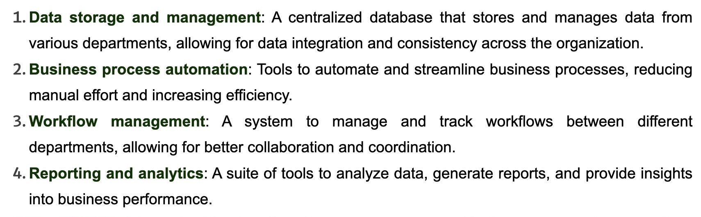
CROSS FUNCTIONAL ENTERPRISE SYSTEMS COMPONENTS

Slide 18
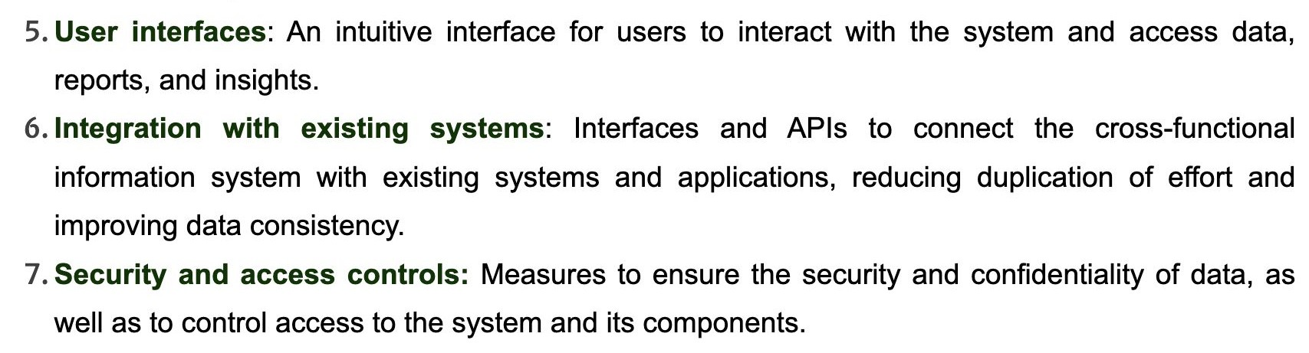
CROSS FUNCTIONAL ENTERPRISE SYSTEMS COMPONENTS

Slide 19
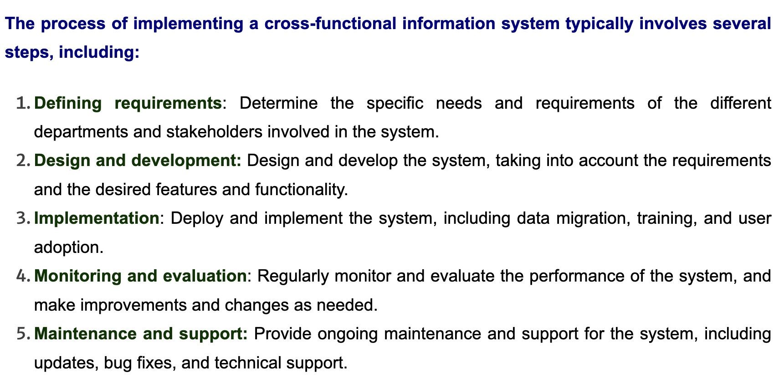

Slide 20
CUSTOMER RELATIONSHIP MANAGEMENT SYSTEMS
Information you need to build and nurture strong, long-lasting relationships with customers:
Exactly who your customers are,
How to contact them,
What kinds of products and services they are interested in, and
How much money they spend on your company.
There is no way to consolidate all of this information to provide a unified view of a customer across the company.
This is where customer relationship management systems help.

Slide 21
CUSTOMER RELATIONSHIP MANAGEMENT SYSTEMS
Customer relationship management (CRM) systems, capture and integrate customer data from all over the organization, consolidate the data, analyze the data, and then distribute the results to various systems and customer touch points across the enterprise.
A touch point (also known as a contact point) is a method of interaction with the customer, such as telephone, e-mail, customer service desk, conventional mail, Facebook, Twitter, Web site, wireless device, or retail store.
Well-designed CRM systems provide a single enterprise view of customers that is useful for improving both sales and customer service.

Slide 22
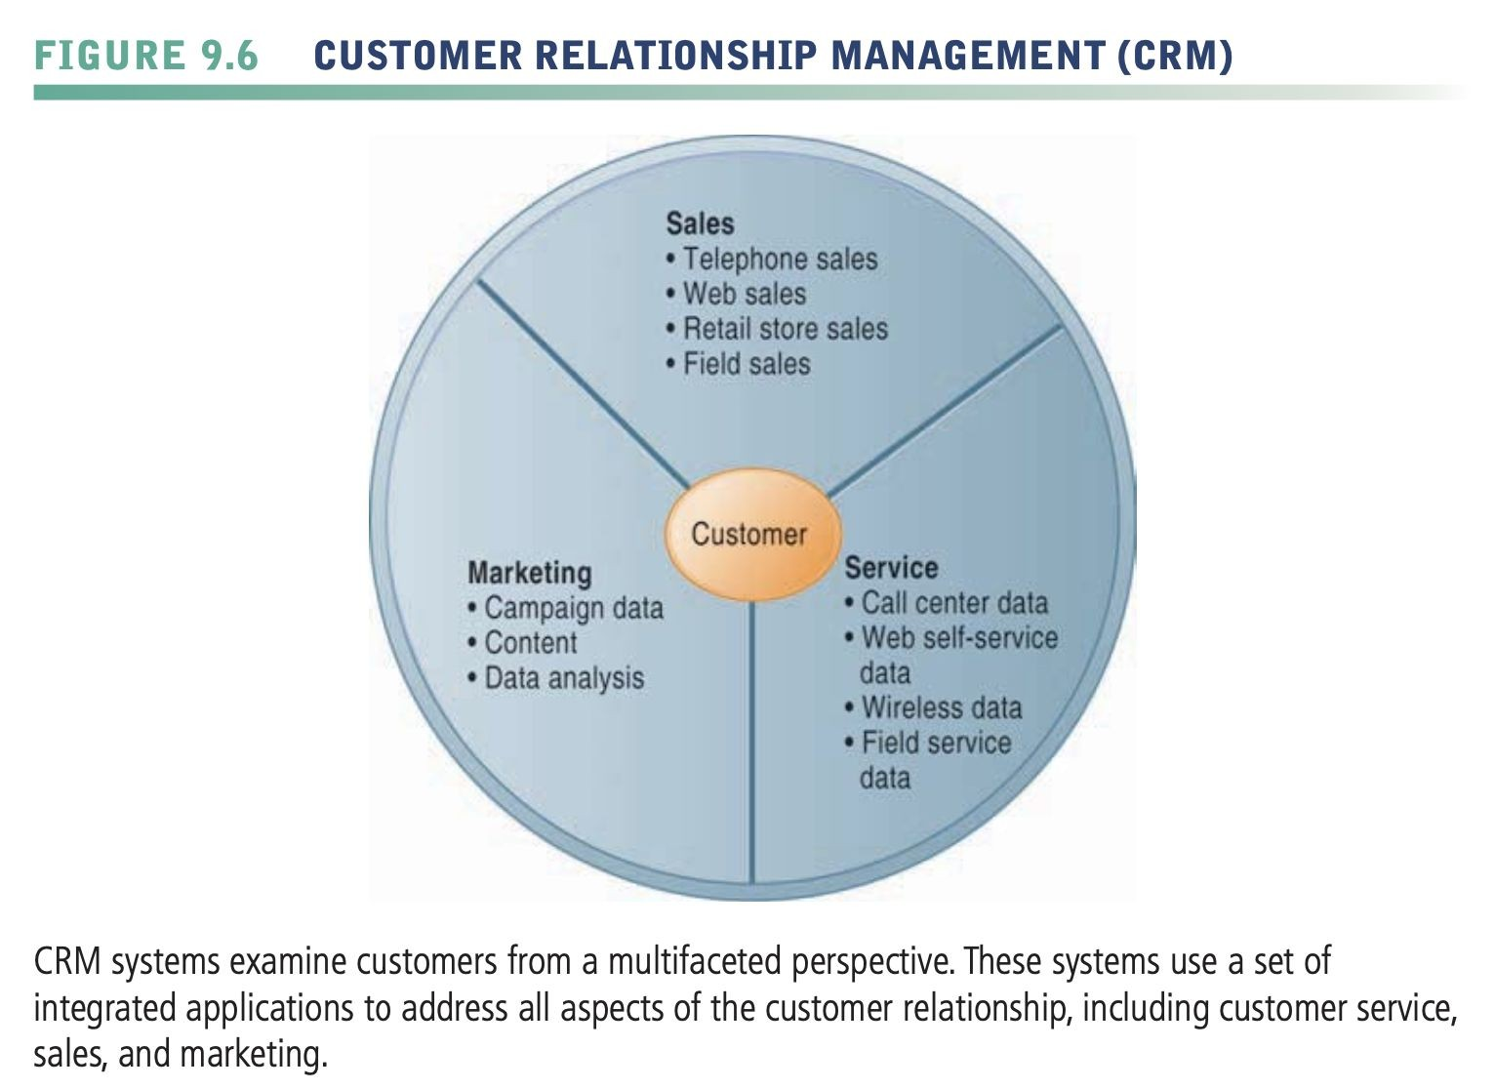
CUSTOMER RELATIONSHIP MANAGEMENT SYSTEMS
Customer relationship management (CRM) systems, capture and integrate customer data from all over the organization, consolidate the data, analyze the data, and then distribute the results to various systems and customer touch points across the enterprise.
A touch point (also known as a contact point) is a method of interaction with the customer, such as telephone, e-mail, customer service desk, conventional mail, Facebook, Twitter, Web site, wireless device, or retail store.
Well-designed CRM systems provide a single enterprise view of customers that is useful for improving both sales and customer service.

Slide 23
CUSTOMER RELATIONSHIP MANAGEMENT: THE BUSINESS FOCUS
Understanding Customer Needs: Businesses focus on comprehending the desires, preferences, and pain points of their customers to tailor products and services accordingly. This involves gathering feedback through surveys, market research, and customer interactions..
Analyzing Data for Insights: CRM involves collecting and analyzing customer data such as demographics, purchase history, and interactions across various channels. By leveraging data analytics tools, businesses gain valuable insights into customer behavior patterns, enabling personalized marketing and sales strategies.

Slide 24
CUSTOMER RELATIONSHIP MANAGEMENT: THE BUSINESS FOCUS
Building Loyalty: CRM emphasizes nurturing long-term relationships with customers by providing exceptional experiences and consistent support. This includes personalized communications, loyalty programs, and proactive problem-solving to enhance customer satisfaction and loyalty.
Aligning Sales and Marketing Efforts: Integrating sales and marketing functions within CRM systems enables seamless collaboration and coordination. By sharing customer insights and aligning strategies, businesses ensure a cohesive approach to customer acquisition, engagement, and retention.

Slide 25
CUSTOMER RELATIONSHIP MANAGEMENT: THE BUSINESS FOCUS
Managing the Customer Lifecycle: CRM facilitates managing the entire customer journey, from initial contact to post-purchase support. This involves effectively nurturing leads, converting prospects into customers, and providing ongoing support and assistance to maximize customer lifetime value.
Providing Excellent Service: Customer service is a critical aspect of CRM, focusing on delivering timely, personalized support across various channels. Businesses strive to address customer inquiries, resolve issues promptly, and exceed expectations to foster positive relationships and satisfaction.

Slide 26
ENTERPRISE RESOURSE PLANNING: THE BUSINESS BACKBONE
Enterprise Resource Planning (ERP) systems indeed serve as the backbone of many businesses, integrating various functions and processes across an organization into one comprehensive system. Here's why ERP is often referred to as the business backbone:
Integration: ERP software integrates different functions like finance, human resources, supply chain, manufacturing, and more into one cohesive system. This integration streamlines operations and facilitates better communication and collaboration across departments.

Slide 27
ENTERPRISE RESOURSE PLANNING: THE BUSINESS BACKBONE
Enterprise Resource Planning (ERP) systems indeed serve as the backbone of many businesses, integrating various functions and processes across an organization into one comprehensive system. Here's why ERP is often referred to as the business backbone:
1. Integration: ERP software integrates different functions like finance, human resources, supply chain, manufacturing, and more into one cohesive system. This integration streamlines operations and facilitates better communication and collaboration across departments.

Slide 28
ENTERPRISE RESOURSE PLANNING: THE BUSINESS BACKBONE
2. Centralized Data: ERP systems centralize data storage, providing a single source of truth for the entire organization. This ensures data consistency and accuracy across different departments, reducing errors and duplication of efforts.
3. Efficiency: By automating repetitive tasks and standardizing processes, ERP systems improve operational efficiency. This allows employees to focus on more strategic tasks rather than spending time on manual data entry or reconciliation.

Slide 29
ENTERPRISE RESOURSE PLANNING: THE BUSINESS BACKBONE
4. Improved Decision Making: With real-time access to accurate data, ERP enables better decision-making at all levels of the organization. Managers can quickly generate reports and analyze key performance indicators to make informed decisions that drive business growth.
5. Scalability: ERP systems are designed to scale with the growth of the business. Whether the company expands into new markets, adds more product lines, or increases its workforce, ERP can accommodate these changes and support the evolving needs of the organization.
6. Regulatory Compliance: Many ERP systems incorporate features to ensure compliance with industry regulations and standards. This helps organizations adhere to legal requirements and avoid penalties or fines.

Slide 30
ENTERPRISE RESOURSE PLANNING: THE BUSINESS BACKBONE
7. Customer Satisfaction: ERP systems often include customer relationship management (CRM) modules, allowing businesses to manage customer interactions, track sales leads, and provide better customer service. This leads to higher customer satisfaction and loyalty.
8. Cost Savings: While implementing an ERP system can involve significant upfront costs, it can result in long-term cost savings through improved efficiency, reduced operational errors, and better resource allocation.
Overall, ERP serves as the backbone of a business by providing the foundation for streamlined operations, enhanced decision-making, and sustained growth.

Slide 31
SUPPLY CHAIN MANAGEMENT: Business Network
A firm’s supply chain is a network of organizations and business processes for procuring raw materials, transforming these materials into intermediate and finished products, and distributing the finished products to customers.
It links suppliers, manufacturing plants, distribution centers, retail outlets, and customers to supply goods and services from source through consumption.
Materials, information, and payments flow through the supply chain in both directions.
Goods start out as raw materials and, as they move through the supply chain, are transformed into intermediate products and finally, into finished products.

Slide 32
EXAMPLE
Let’s look at the supply chain for Nike sneakers as an example. Nike designs, markets, and sells sneakers, socks, athletic clothing, and accessories throughout the world. Its primary suppliers are contract manufacturers with factories in China, Thailand, Indonesia, Brazil, and other countries. These companies fashion Nike’s finished products.
Nike’s contract suppliers do not manufacture sneakers from scratch. They obtain components for the sneakers—the laces, eyelets, uppers, and soles—from other suppliers and then assemble them into finished sneakers.
These suppliers in turn have their own suppliers. For example, the suppliers of soles have suppliers for synthetic rubber, suppliers for chemicals used to melt the rubber for molding, and suppliers for the molds into which to pour the rubber. Suppliers of laces have suppliers for their thread, for dyes, and for the plastic lace tips.

Slide 33
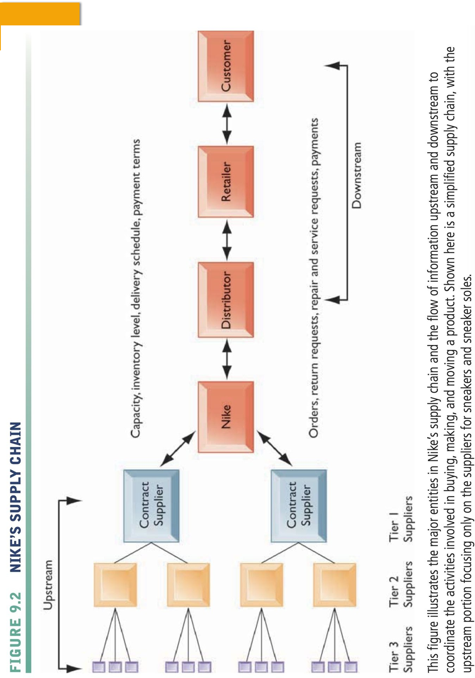
Supply chain Management: Business Network

Slide 34
Electronic Commerce Systems: Fundamentals
Electronic Commerce Systems, or e-commerce, form the backbone of online business transactions, enabling buying and selling of goods and services over the internet. Here are some fundamental aspects:
1. Online Storefronts: These are virtual platforms where businesses showcase their products or services. They can be standalone websites, social media pages, or marketplaces like Amazon or eBay.
2. Payment Gateways: These facilitate secure online transactions by encrypting sensitive information such as credit card numbers. Popular examples include PayPal, Stripe, and Square.

Slide 35
Electronic Commerce Systems: Fundamentals
3. Shopping Carts: Essential for online shopping, these software applications allow users to select items for purchase, review their choices, and proceed to checkout.
4. Digital Marketing: Strategies like search engine optimization (SEO), social media marketing, and email marketing help drive traffic to e-commerce sites and increase sales.
5. Inventory Management: Efficiently tracking stock levels, restocking, and managing product variations are crucial for smooth e-commerce operations.

Slide 36
Electronic Commerce Systems: Fundamentals
6. Mobile Commerce: With the proliferation of smartphones, ensuring that e-commerce platforms are mobile-friendly or have dedicated apps is vital for reaching a broader customer base.
7. Analytics and Reporting: Tracking key metrics such as website traffic, conversion rates, and customer demographics provides valuable insights for optimizing marketing strategies and improving overall performance.operations.

Slide 37
E-COMMERCE APPLICATIONS
Online Shopping
Online Marketing
Finance
Manufacturing
For details, go to the below link: https://www.businessgo.hsbc.com/en/article/8-applications-of-ecommerce-explore-new-opportunities-for-your-business

Slide 38
E-COMMERCE ISSUES
Technological Limitations
Lack of universally accepted security standards
Expensive accessibility
Perception that EC is unsecure
Return and refund policies
For details, go to the below link: https://www.geeksforgeeks.org/e-commerce-issues/

Slide 39
DECISION SUPPORT SYSTEM
A decision support system (DSS) is a computer program application used to improve a company's decision-making capabilities.
It analyzes large amounts of data and presents an organization with the best possible options available.
Decision support systems bring together data and knowledge from different areas and sources to provide users with information beyond the usual reports and summaries. This is intended to help people make informed decisions.

Slide 40
DECISION SUPPORT SYSTEM
Typical information a decision support application might gather and present include the following:
comparative sales figures between one week and the next;
projected revenue figures based on new product sales assumptions; and
the consequences of different decisions.

Slide 41
DECISION SUPPORT SYSTEM COMPONENTS
Knowledge base
Software system
User interface

Slide 42
KNOWLEDGE BASE
A knowledge base is an integral part of a decision support system database, containing information from both internal and external sources.
It is a library of information related to particular subjects and is the part of a DSS that stores information used by the system's reasoning engine to determine a course of action.

Slide 43
SOFTWARE SYSTEM
The software system is composed of model management systems. A model is
a simulation of a real-world system with the goal of understanding how the system works and how it can be improved.
Organizations use models to predict how outcomes will change with different adjustments to the system.

Slide 44
USER INTERFACE
The user interface enables easy system navigation.
The primary goal of the decision support system's user interface is to make it easy for the user to manipulate the data that is stored on it.
DSS interfaces include simple windows, complex menu-driven interfaces and command-line interfaces.

Slide 45
DECISION SUPPORT IN BUSINESS
Agriculture: Farmers use DSS tools for crop planning to help them determine the best times for planting, fertilization and harvesting.
Medicine: Clinical DSS technology has many uses: maintaining research information about chemotherapy protocols, preventive and follow-up care, and monitoring medication orders. DSSs are also used with medical diagnosis software.
Weather forecasting: Some states use DSSs to provide information about potential future hazards such as floods. To do this, they factor in real-time weather conditions, floodplain boundaries information and historic county flood data.

Slide 46
DECISION SUPPORT IN BUSINESS
Real estate: Real estate companies use DSSs to manage data on comparable home prices and acreage.
Education: Universities and colleges use DSSs to know how many students they currently have enrolled. This helps them predict how many students will register for particular courses or whether the student population is sufficient to meet the university’s costs.

Slide 47
Decision Supports Trends
1. Integration of AI and ML: Combining AI and ML makes decision support systems smarter, helping businesses make better decisions by using advanced technology to understand data.
2. Enhanced Data Visualization: By using techniques to show data visually, decision support systems can make it easier for people to understand complex information, making them more useful and easier to use.
3. Integration with IoT: Connecting decision support systems with Internet of Things devices helps organizations get real-time insights and make better decisions by using data from sensors and devices.
.

Slide 48
Decision Supports Trends
4. Personalization and Contextualization: Using AI and ML, decision support systems can give personalized recommendations and insights tailored to individual needs, making the information more relevant and useful.
5.Case Study: Case studies show real examples of how decision support systems have helped businesses, demonstrating the practical benefits of trends like AI integration, data visualization, and IoT usage in easy-to-understand scenarios.

Slide 49
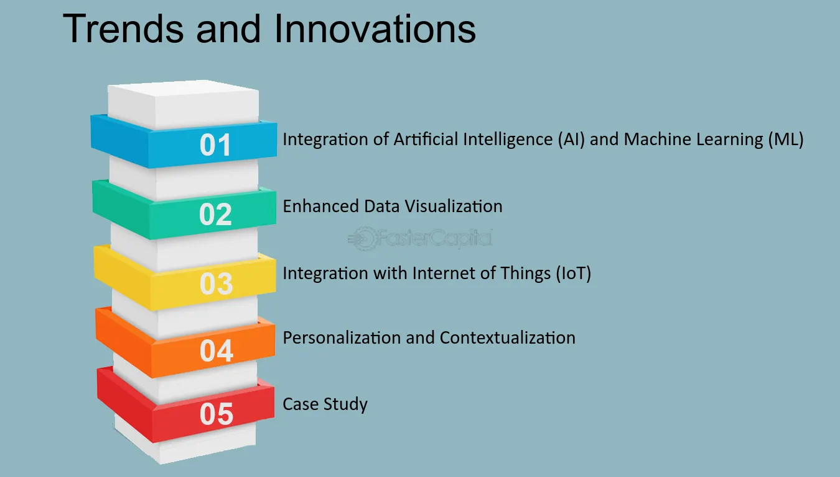
Decision Supports Trends

Slide 50
ONLINE TRANSACTION PROCESSING (OLTP)
OLTP stands for Online Transaction Processing.
It is a type of database processing that is designed to support transaction-oriented applications that require real-time processing and fast response times.
OLTP systems are used to manage day-to-day business operations such as sales, inventory management, and customer service.

Slide 51
ONLINE TRANSACTION PROCESSING (OLTP)
OLTP databases are designed to support frequent small transactions, which
are typically short-lived and involve simple operations such as inserting, updating, or deleting data.
The primary goal of an OLTP system is to ensure data consistency and integrity, even when multiple users are accessing the same data concurrently.
OLTP systems typically use a relational database management system (RDBMS) that allows users to access and manipulate data through structured query language (SQL) commands.

Slide 52
ONLINE TRANSACTION PROCESSING (OLTP)
In OLTP systems, the focus is on transaction processing rather than analytical processing.
OLTP databases are designed to store current and frequently changing data, while historical data is typically stored in a separate database for analysis purposes.
OLTP systems are widely used in various industries, including finance, retail, healthcare, and government.

Slide 53
EXAMPLES OF OLTP SYSTEMS
ATMs, financial transaction systems and online banking applications;
online bookings, ticketing and reservation systems; and
recordkeeping applications, such as health records, inventory control and production scheduling.

Slide 54
DATA MINING FOR DECISION SUPPORT
In order to make a decision, the managers need knowledge.
In case of massive data amounts, issues may occur because of data analysis and necessary knowledge extract.
Data is analyzed through an automated process, known as Knowledge Discovery in data mining techniques.

Slide 55
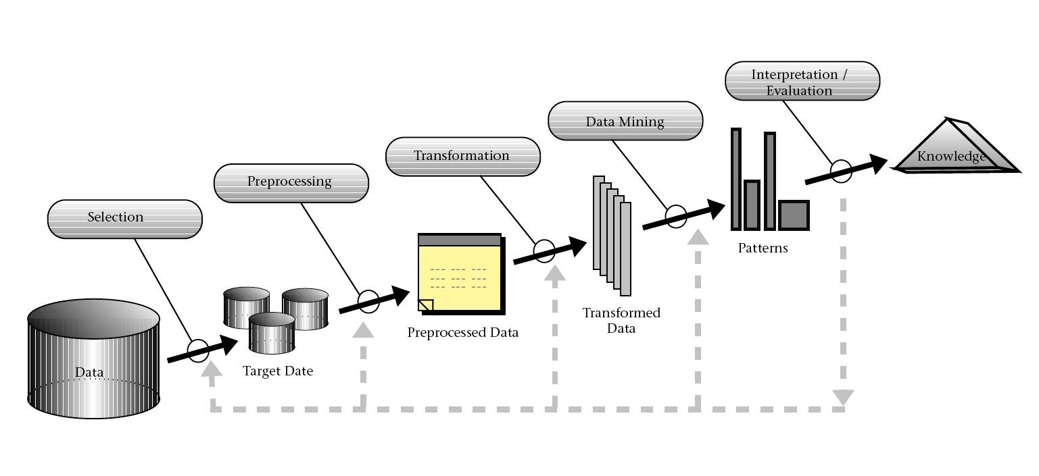
KDD PROCESS

Slide 56
KNOWLEDGE DISCOVERY IN DATABASES (KDD)
The Knowledge Discovery in Databases (KDD) process involves multiple steps, which are typically carried out in a sequential order. The steps involved in the KDD process are as follows:
Data Selection: In this step, data is selected from a database or other data sources based on the requirements of the analysis. The data selection process involves identifying the relevant data sources and selecting the appropriate data subset that will be used for analysis.
Data Pre-processing: The data pre-processing step involves cleaning and preparing the data for analysis. The process typically involves removing missing or duplicate values, correcting errors, and handling inconsistencies. Data pre-processing also includes data normalization, feature selection, and other data transformation techniques that make the data suitable for analysis.

Slide 57
KNOWLEDGE DISCOVERY IN DATABASES (KDD)
Data Transformation: In this step, the pre-processed data is transformed into a format that can be used for analysis. The transformation process includes methods such as aggregation, sampling, discretization, and attribute construction. The objective of data transformation is to reduce the data dimensionality and convert it into a format that can be used for analysis.
Data Mining: Data mining is the core step in the KDD process, which involves applying data mining algorithms to the transformed data to identify patterns, relationships, and associations. Data mining algorithms include classification, clustering, association rule mining, and other machine learning techniques.

Slide 58
KNOWLEDGE DISCOVERY IN DATABASES (KDD)
Pattern Evaluation: In this step, the discovered patterns are evaluated for their usefulness and significance. The evaluation process involves using statistical measures and domain knowledge to assess the validity and usefulness of the patterns.
Knowledge Representation: Finally, the discovered patterns and relationships are represented in a format that can be easily understood by users. The knowledge representation process includes visualization techniques and predictive models that can be used to make predictions and improve decision-making.

Slide 59
KNOWLEDGE MANAGEMENT SYSTEM.
A knowledge management system (KMS) is a customer service software tool used by companies, specifically to organize documentation, frequently asked questions, and other information into easily accessible formats for both internal staff and external customers.
Using knowledge management software can help keep documentation up to date.
It can also help customers find their answers, and manage knowledge access and permissions across user groups.
It’s a tool that’s valuable to both small businesses just starting and global enterprises that need to distribute knowledge to a wide variety of audiences.

Slide 60
WHAT IS KNOWLEDGE MANAGEMENT?
Knowledge management is the process of identifying, gathering, storing, evaluating, and sharing all of the valuable information organizations create in their day-to-day operations.
It involves capturing answers to frequently (and not-so-frequently) asked questions and documenting them in an easy-to-understand format across multiple file types. This could include step-by-step written articles, videos, or images.
A KMS makes knowledge sharing a whole lot easier by having an answer ready and easily accessible to share. But if you just store all of that knowledge in a chaotic Word document, no one will be able to find it or update it.

Slide 61
WHAT IS KNOWLEDGE MANAGEMENT?
Knowledge management acts like the catalog system at the library. It helps you find exactly the right shelf and the right book to answer your questions (and even keeps a record of when it was last checked out).
In a customer service suite, managing knowledge effectively means that accurate answers to common questions are easily accessible to customer support agents and customers.
Exclusive resources to help strengthen your self-service.
Also refer https://www.freshworks.com/knowledge-management-system/

