Slide 1
Unit-2
Problem-solving

Slide 2
Points to be discussed:
Solving Problems by Searching,
Problem-Solving Agents,
Example Problems,
Search Algorithms,
Uninformed Search Strategies,
Informed (Heuristic) Search Strategies,
Heuristic Functions,
Search in Complex Environments,
Local Search and Optimization Problem

Slide 3
solving problems by searching
Define the problem.
Analyze the problem.
Identification of possible solutions.
Choosing the optimal solution.
Implementation.

Slide 4
Why searching is important in problem solving?
important to identify the scope of your task in terms of the problems which will need to be solved.

Slide 5
goal-based agents
problem-solving agents
planning agents.

Slide 6
Problem-solving agents
consider each states of the world as indivisible, with no internal structure of the states visible to the problem-solving algorithms.

Slide 7
Planning agents
split up each state into variables and establishes relationship between them.

Slide 8
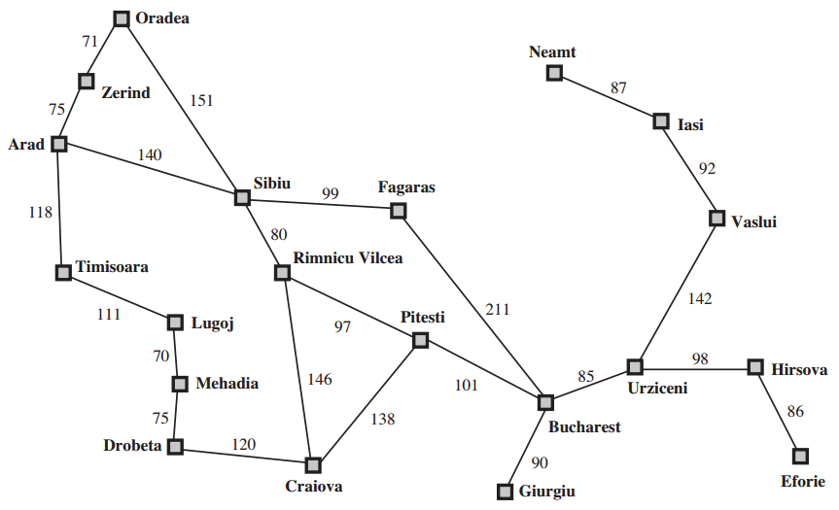
Road map of Part of Romania

Slide 9
Problem is :
The problem is to travel from Arad to Bucharest in a day. For the agent, the goal will be to reach Bucharest the following day.

Slide 10
Problem formulation
Involves deciding what actions and states to consider, given the goal.
For example, if the agent were to consider the action to be at the level of “move the left foot by one inch” or “turn the steering wheel by 1 degree left”, there would be too many steps for the agent to leave the parking lot, let alone to Bucharest.
In general, we need to abstract the state details from the representation.

Slide 11
A problem can be defined formally by 5 components
The initial state of the agent. In this case, the initial state can be described as In: Arad
The possible actions available to the agent, corresponding to each of the state the agent resides in. For example, ACTIONS(In: Arad) = {Go: Sibiu, Go: Timisoara, Go: Zerind}
The transition model describing what each action does. Let us represent it by RESULT(s, a) where s is the state the action is currently in and a is the action performed by the agent. In this example, RESULT(In: Arad, Go: Zerind) = In: Zerind.
The goal test, determining whether the current state is a goal state. Here, the goal state is {In: Bucharest}
The path cost function, which determine the cost of each path, which is reflecting in the performance measure.

Slide 12
Performance measure:
Completeness: Is the algorithm guaranteed to find a solution if there exist one?
Optimality: Does the algorithm find the optimal solution?
Time complexity: How long does it take for the algorithm to find a solution?
Space complexity: How much memory is consumed in finding the solution?

Slide 13
What is uninformed search strategies in artificial intelligence?
‘Uninformed Search’ means the machine blindly follows the algorithm regardless of whether right or wrong, efficient or in-efficient.
These algorithms are brute force operations, and they don’t have extra information about the search space; the only information they have is on how to traverse or visit the nodes in the tree.
Thus uninformed search algorithms are also called blind search algorithms.
The search algorithm produces the search tree without using any domain knowledge, which is a brute force in nature.
They don’t have any background information on how to approach the goal or whatsoever.

Slide 14
Different Types of Search Algorithms:
->Depth First Search:
-> Breadth-First Search
-> Depth Limited Search
-> Uniform Cost Search
-> Iterative Deepening Depth First Search
-> Bidirectional Search (if applicable)

Slide 15
terms which will be frequently used
* State: It provides all the information about the environment.
* Goal State: The desired resulting condition in a given problem and the kind of search algorithm we are looking for.
* Goal Test: The test to determine whether a particular state is a goal state.
* Path/Step Cost: These are integers that represent the cost to move from one node to another node.
* Space Complexity: A function describing the amount of space(memory) an algorithm takes in terms of input to the algorithm.
* Time Complexity: A function describing the amount of time the algorithm takes in terms of input to the algorithm.
* Optimal: Extent of preference of the algorithm * ‘b‘ – maximum branching factor in a tree.
* ‘d‘ – the depth of the least-cost solution. * ‘m‘ – maximum depth state space(maybe infinity)

Slide 16
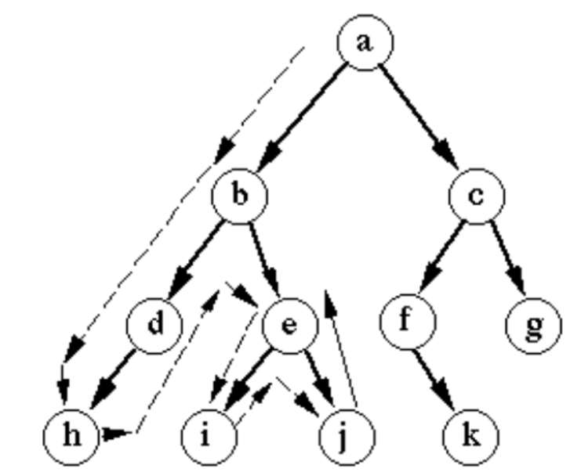
Depth First Search (DFS)

Slide 17
Advantages:
DFS requires very little memory as it only needs to store a stack of the nodes on the path from the root node to the current node.
It takes less time to reach the goal node than the BFS algorithm [which is explained later](if it traverses in the right path).
Disadvantages:
There is the possibility that many states keep reoccurring, and there is no guarantee of finding the solution.
The DFS algorithm goes for deep down searching and sometimes it may go to the infinite loop.

Slide 18
It occupies a lot of memory space, and time to execute when the solution is at the bottom or end of the tree and is implemented using LIFO Stack data structure[DS].
Complete: No
Time Complexity: O(b^{m})
Space complexity: O(bm)
Optimal: Yes

Slide 19
Breadth-First Search(BFS)
It is another search algorithm in AI which traverses breadthwise to search the goal in a tree.
It begins searching from the root node and expands the successor node before going expanding it further expands along breadthwise and traverses those nodes rather than searching depth-wise.

Slide 20
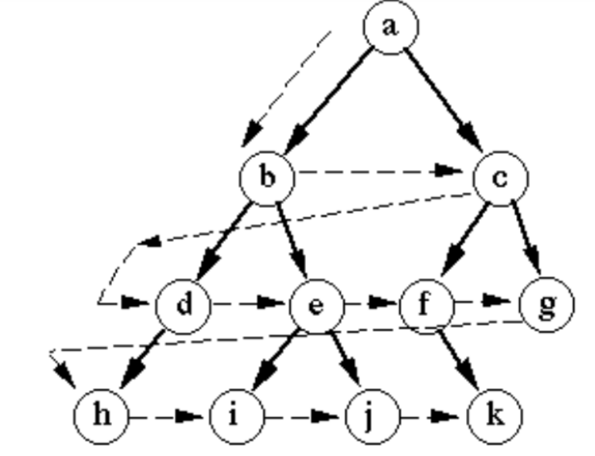

Slide 21
Advantages:
BFS will provide a solution if any solution exists.
If there is more than one solution for a given problem, then BFS will provide the minimal solution which requires the least number of steps.
Disadvantages:
It requires lots of memory since each level of the tree must be saved into memory to expand the next level.
BFS needs lots of time if the solution is far away from the root node.

Slide 22
It requires a lot of memory space and time consuming if the goal state is at the bottom or end. It uses a FIFO queue DS to implement.
Complete: Yes (assuming b is finite)
Time Complexity: O(b^{d})
Space complexity: O(b^{d})
Optimal: Yes, if Step cost = 1 (i.e. no cost/all step costs are same)

Slide 23
Uniform Cost Search(UCS)
This algorithm is mainly used when the step costs are not the same but we need the optimal solution to the goal state.
In such cases, we use Uniform Cost Search to find the goal and the path including the cumulative cost to expand each node from the root node to the goal node.
It does not go depth or breadth, it searches for the next node with the lowest cost and in the case of the same path cost, let’s consider lexicographical order in our case.

Slide 24
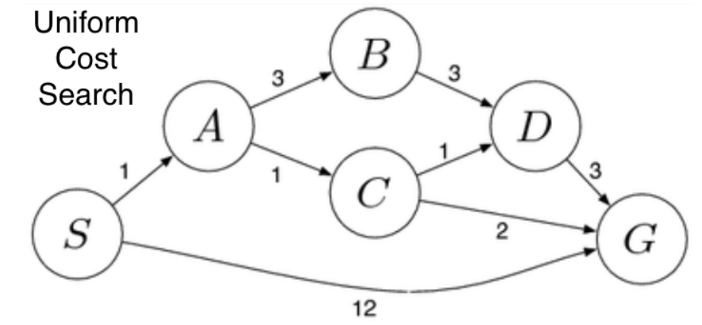

Slide 25
Advantages:
Uniform cost search is optimal because at every state the path with the least cost is chosen.
Disadvantages:
It does not care about the number of steps involved in searching and only concerned about path cost. Due to which this algorithm may be stuck in an infinite loop.

Slide 26
Complete: Yes (if b is finite and costs are stepped costs are zero)
Time Complexity: O(b^{(c/ϵ)}) where, ϵ -> is the lowest cost, c -> optimal cost
Space complexity: O(b^{(c/ϵ)})
Optimal: Yes (even for non-even cost)

Slide 27
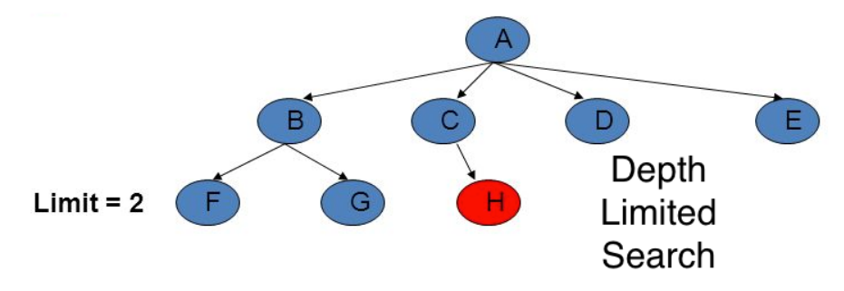
Depth Limited Search(DLS)

Slide 28
Depth-limited search can be halted in two cases:
— Standard Failure Value(SFV): The SFV tells that there is no solution to the problem.
— Cutoff Failure Value(CFV): The Cutoff Failure Value tells that there is no solution within the given depth-limit.

Slide 29
A is at Limit = 0, followed by nodes B, C, D, and E at Limit = 1 and nodes F, G, and H at Limit = 2. Our start state is considered to be node A and our goal state is node H.
To reach node H apply DLS.
set limit to 0 and search for the goal.

Slide 30
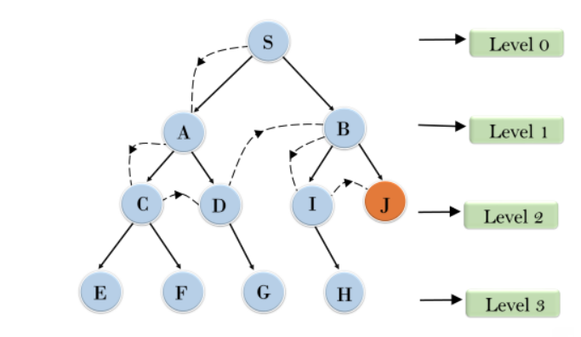

Slide 31
Depth-limited search can be terminated with two Conditions of failure:
Standard Failure: it indicates that the problem does not have any solutions.
Cutoff Failure Value: It defines no solution for the problem within a given depth limit.
Advantages:
Depth-limited search is Memory efficient.
Disadvantages:
The DLS has disadvantages of completeness and is not optimal if it has more than one goal state.
Complete: Complete (if solution > depth-limit)
Time Complexity: O(b^{l}) where, l -> depth-limit
Space complexity: O(bl)
Optimal: Yes (only if l > d)

Slide 32
Iterative Deepening Depth First Search(IDDFS)
It is a search algorithm that uses the combined power of the BFS and DFS Algorithm.
It is iterative in nature.
It searches for the best depth in each iteration.
It performs the Algorithm until it reaches the goal node.
The algorithm is set to search until a certain depth and the depth keeps increasing at every iteration until it reaches the goal state.

Slide 33
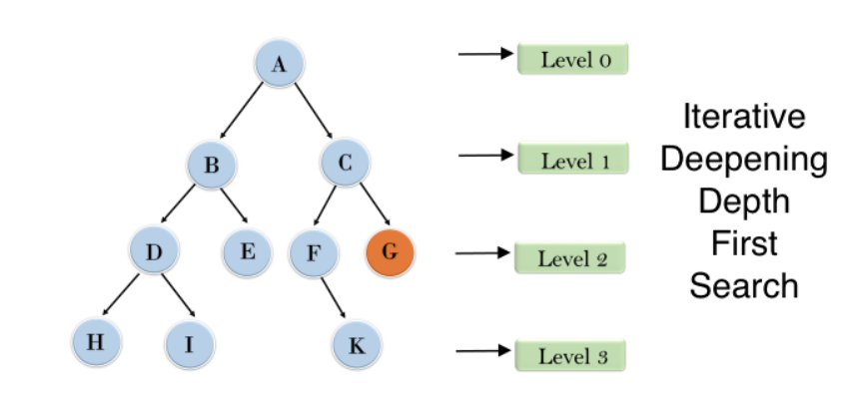

Slide 34
Advantages:
It combines the benefits of BFS and DFS search algorithms in terms of fast search and memory efficiency.
Disadvantages:
The main drawback of IDDFS is that it repeats all the work from the previous phase.
Complete: Yes (by limiting the depth)
Time Complexity: O(b^{d})
Space complexity: O(bd)
Optimal: Yes (if step cost is uniform)

Slide 35
Bidirectional Search(BS)
Forward Search: Looking in-front of the end from start.
Backward Search: Looking from end to the start back-wards.

Slide 36
Bidirectional Search as the name suggests is a combination of forwarding and backward search.
Basically, if the average branching factor going out of node / fan-out, if fan-out is less, prefer forward search.
Else if the average branching factor is going into a node/fan in is less(i.e. fan-out is more), prefer backward search.
We must traverse the tree from the start node and the goal node and wherever they meet the path from the start node to the goal through the intersection is the optimal solution.
The BS Algorithm is applicable when generating predecessors is easy in both forward and backward directions and there exist only 1 or fewer goal states.

Slide 37
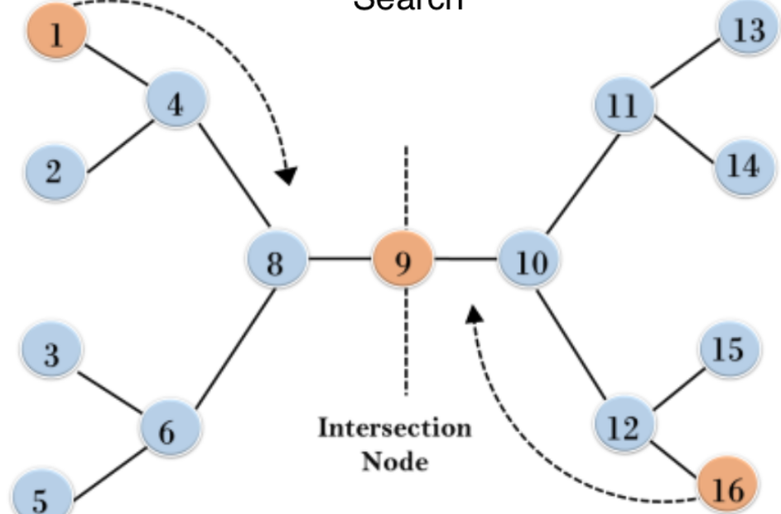
Root node
Goal Node

Slide 38
Advantages:
Since BS uses various techniques like DFS, BFS, DLS, etc, it is efficient and requires less memory.
Disadvantages:
Implementation of the bidirectional search tree is difficult.
In bidirectional search, one should know the goal state in advance.
Complete: Yes
Time Complexity: O(b^{d/2})
Space complexity: O(b^{d/2})
Optimal: Yes (if step cost is uniform in both forward and backward directions)

Slide 39
What is heuristic function?
A heuristic function, also simply called a heuristic, is a function that ranks alternatives in search algorithms at each branching step based on available information to decide which branch to follow. For example, it may approximate the exact solution.
Heuristic is a function which is used in Informed Search, and it finds the most promising path. It takes the current state of the agent as its input and produces the estimation of how close agent is from the goal.

Slide 40
Informed Search/ Heuristic Search in AI
An informed search is more efficient than an uninformed search
Best-first Search (Greedy search)
A best-first search is a general approach of informed search. Here, a node is selected for expansion based on an evaluation function f(n), where f(n) interprets the cost estimate value.
h(n)= estimated cost of the cheapest path from the current node n to the goal node.
If the current node n is a goal node, the value of h(n) will be 0.
Best-first search is known as a greedy search because it always tries to explore the node which is nearest to the goal node and selects that path, which gives a quick solution.
Thus, it evaluates nodes with the help of the heuristic function, i.e., f(n)=h(n).

Slide 41
Best-first search Algorithm
Set an OPEN list and a CLOSE list where the OPEN list contains visited but unexpanded nodes and the CLOSE list contains visited as well as expanded nodes.
Initially, traverse the root node and visit its next successor nodes and place them in the OPEN list in ascending order of their heuristic value.
Select the first successor node from the OPEN list with the lowest heuristic value and expand further.
Now, rearrange all the remaining unexpanded nodes in the OPEN list and repeat above two steps.
If the goal node is reached, terminate the search, else expand further.

Slide 42
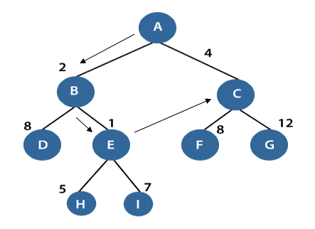
The performance measure of Best-first search Algorithm: Completeness: Best-first search is incomplete even in finite state space. Optimality: It does not provide an optimal solution. Time and Space complexity: It has O(b^{m}) worst time and space complexity, where m is the maximum depth of the search tree. If the quality of the heuristic function is good, the complexities could be reduced substantially. Note: Best first searches combines the advantage of BFS and DFS to find the best solution. Disadvantages of Best-first search BFS does not guarantees to reach the goal state. Since the best-first search is a greedy approach, it does not give an optimized solution. It may cover a long distance in some cases.

Slide 43
f(n)=g(n)+h(n)
Calculation of f(n) for node S:
f(S)=(distance from node S to S) + h(S)
0+10=10.
Calculation of f(n) for node A:
f(A)=(distance from node S to A)+h(A)
2+12=14
Calculation of f(n) for node B:
f(B)=(distance from node S to B)+h(B)
3+14=17
Therefore, node A has the lowest f(n) value. Hence, node A will be explored to its next level nodes C and D and again calculate the lowest f(n) value. After calculating, the sequence we get is S->A->D->G with f(n)=13(lowest value).

Slide 44
A* Search Algorithm
A* search is the most widely used informed search algorithm where a node n is evaluated by combining values of the functions g(n)and h(n). The function g(n) is the path cost from the start/initial node to a node n and h(n) is the estimated cost of the cheapest path from node n to the goal node. Therefore, we have
f(n)=g(n)+h(n)
where f(n) is the estimated cost of the cheapest solution through n.
So, in order to find the cheapest solution, try to find the lowest values of f(n).
Let’s see the below example to understand better.

Slide 45
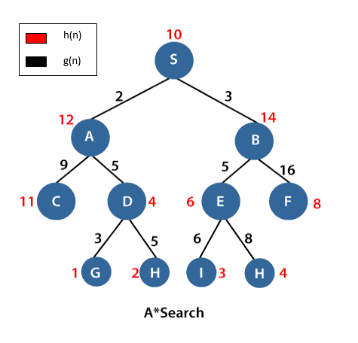
In the above example, S is the root node, and G is the goal node. Starting from the root node S and moving towards its next successive nodes A and B. In order to reach the goal node G, calculate the f(n) value of node S, A and B using the evaluation equation i.e. f(n)=g(n)+h(n) Calculation of f(n) for node S: f(S)=(distance from node S to S) + h(S) 0+10=10. Calculation of f(n) for node A: f(A)=(distance from node S to A)+h(A) 2+12=14 Calculation of f(n) for node B: f(B)=(distance from node S to B)+h(B) 3+14=17 Therefore, node A has the lowest f(n) value. Hence, node A will be explored to its next level nodes C and D and again calculate the lowest f(n) value. After calculating, the sequence we get is S->A->D->G with f(n)=13(lowest value).

Slide 46
The performance measure of A* search
Completeness: The star(*) in A* search guarantees to reach the goal node.
Optimality: An underestimated cost will always give an optimal solution.
Space and time complexity: A* search has O(b^{d}) space and time complexities.
Disadvantage of A* search
A* mostly runs out of space for a long period.

