Slide 1
INFOTACT SOLUTIONS | DATA ANALYTICS INTERNSHIP
CareFlow
Clinical Pathway Process Mining
An Emergency Department event-log dashboard built with Power BI
Prepared by Gorige Sravani
BI and Dashboard Development | Team Group No. 5 | Ref. ITS/DA/1135
Team: Piyusha Sanjay Patil, Atharv Rajendra Talaskar, Gorige Sravani

Slide 2
Why CareFlow?
The problem
Administrators usually see one average ED wait time. It hides the sequence of events behind each visit. Process mining rebuilds that sequence from timestamped event logs.
Scope of the data
The brief describes patients returning to Triage after an X-Ray. The available extract has only five recorded activities and no Triage, X-Ray, doctor or diagnosis events, so that example could not be tested.
The project therefore describes what the data supports and makes no claim about bottlenecks or clinical delays.
Objectives
Prepare an event log (Case_ID, Activity_Name, Timestamp)
Discover recorded sequences and time between events
Build an interactive Power BI dashboard
State clearly what the data can and cannot show
CareFlow | Infotact Solutions
2

Slide 3
Data and approach
1 Data engineering
2 Process mining
3 BI dashboard
Event-log creation, cleaning, standardisation and validation
Directly-follows graph (PM4Py), variants, repeated activities, recorded gaps
Power BI model related by Case_ID, DAX measures, four report pages
The de-identified ED extract
222
5,328
5
24.0
ED visits
Recorded events
Distinct activities
Events per visit (mean)
CareFlow | Infotact Solutions
3

Slide 4
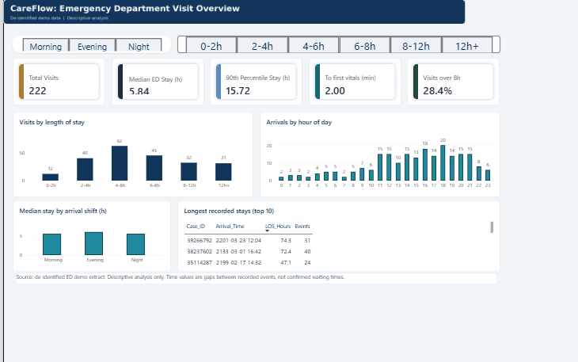
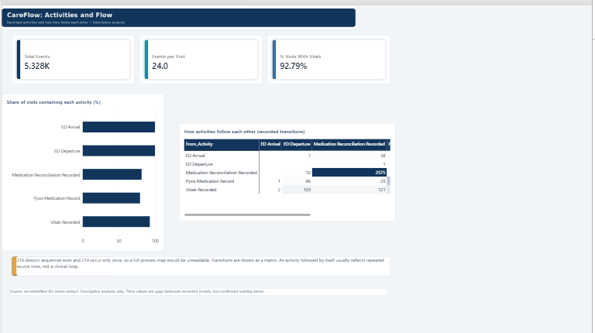
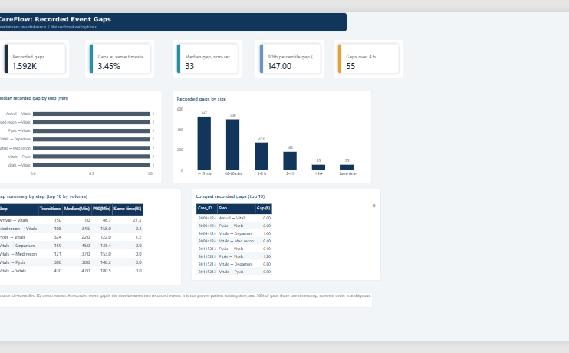
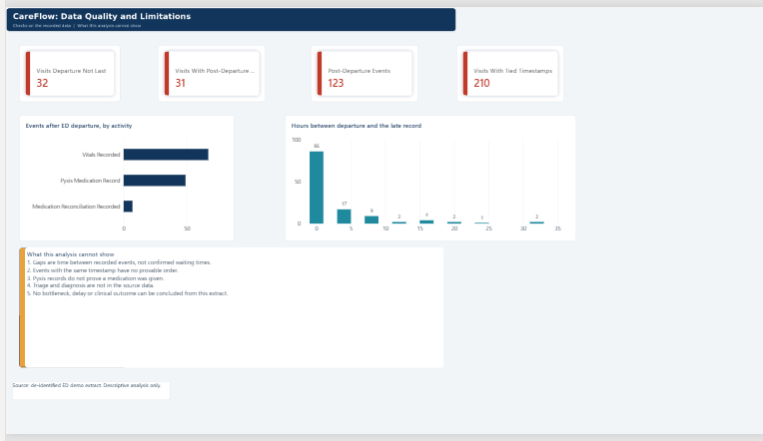
The dashboard: four pages
What each page shows
Overview: visits, length of stay, arrivals by hour and shift
Flow: which activities were recorded and how they follow each other
Gaps: time between recorded events
Data quality: checks and what the analysis cannot show
CareFlow | Infotact Solutions
4

Slide 5
Key findings
5.84 h
28.4%
2 min
92.8%
Median ED stay
Visits over 8 hours
Median time to first vitals
Visits with a vitals record
Length of stay and arrivals
Activities and flow
Most visits lasted 2 to 8 hours; 62 visits (the largest group) stayed 4 to 6 hours
31 visits lasted 12 hours or more
Arrivals peak at 18:00 (20 visits) and are lowest overnight
Median stay by shift is similar: 5.6 h, 6.0 h, 5.6 h
ED Arrival and Departure appear in all 222 visits
Medication Reconciliation in 81.5%, Pyxis records in 79.3%
216 distinct sequences, 214 occur only once, so a transition matrix replaces a process map
Most frequent transitions are repeats of the same activity, likely repeated source rows
CareFlow | Infotact Solutions
5

Slide 6
Data quality and limitations
32
123
210
Visits where Departure is not the last event
Post-departure records (31 visits)
Visits with tied timestamps
What this analysis cannot show
Design choice
Navy and teal show ordinary values. Red is used only for data-quality flags, so colour never suggests poor care.
Gaps are time between recorded events, not confirmed waiting times
Events with the same timestamp have no provable order
Pyxis records do not prove a medication was given
Triage and diagnosis are not in the source data
No bottleneck, delay or clinical outcome can be concluded from 222 de-identified visits
CareFlow | Infotact Solutions
6

Slide 7
Conclusion and next steps
CareFlow delivers a clear path from an event log to a four-page Power BI dashboard. Results are descriptive and kept separate from claims the data cannot support.
To measure true waiting times
Future work
Timestamps for Triage, provider assessment, imaging and disposition
Meaning of records stamped after ED Departure
An agreed workflow for conformance checking
A larger extract to test variants and shift effects
Conformance checking against an agreed workflow
Richer event data
A published version of the dashboard
Thank you
Gorige Sravani | BI and Dashboard Development
CareFlow | Infotact Solutions
7

