Slide 1

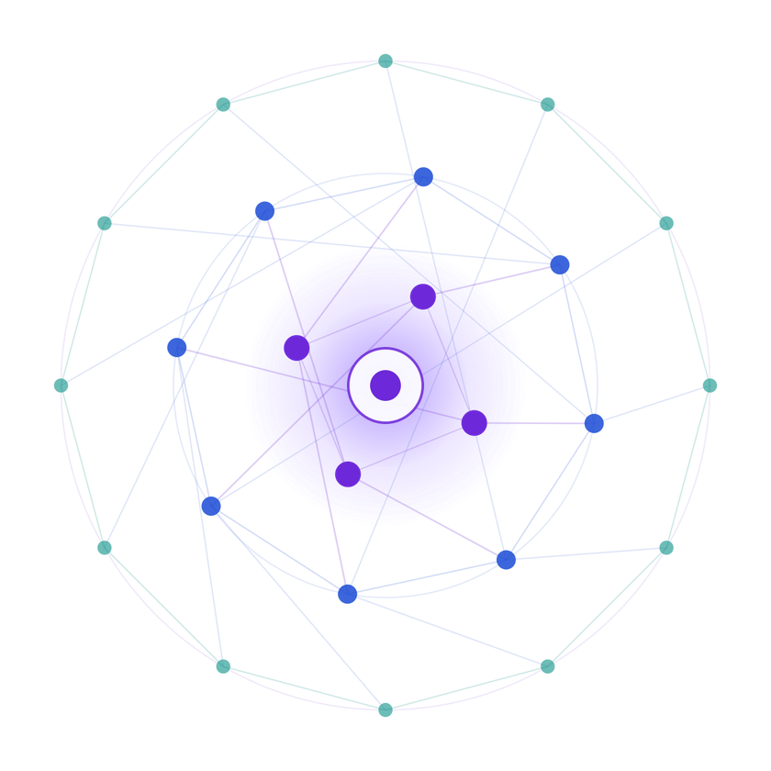
SAMSUNG PRISM
PROJECT CONCEPT
Generative AI
Full-Duplex
Voice AI Agent
Real-time tool calling across
E-Commerce • Travel • Finance • Housing
Hackathon
SUB-SECOND
12 TOOLS
4 DOMAINS
Natural interruption • Local VAD •
WebRTC streaming • Function calling
  Theme ID - 5
  Team Name - Code4Fun
  College Name - SRMIST
  Member Name & Email 1- Aman Kumar Chouhan | ac8126@srmist.edu.in
  Member Name & Email 2- Atharv Tamboli | at2421@srmist.edu.in
  Member Name & Email 3- Ayush Kesarwani | ak2131@srmist.edu.in
  Submission Github link - https://github.com/atharvtamboli/PRISM_GENAI_HACKATHON_Y2026

Slide 2
Theme
WHY THIS MATTERS
Real-Time, Action-Oriented Conversational AI
A voice agent should feel like a conversation—not a sequence of turn-taking API calls.
Full-duplex
Action-oriented
Real-time stack
Multi-domain
User can interrupt the agent while it is speaking; playback stops and new input is processed immediately.
GPT-4o-mini can trigger executable Python functions instead of only generating text.
WebRTC audio + local VAD + streaming STT/LLM/TTS keeps the interaction responsive.
12 tools across E-Commerce, Travel, Finance and Housing.
Design goal: reduce conversational friction while making every response capable of taking an action.

Slide 3
Existing Solutions & Gaps
PROBLEM → RESPONSE
What breaks natural voice interaction?
Our response
Our solution is a real-time AI agent that combines voice and vision to understand users and their surroundings. It can listen, reason, use tools, and respond through voice while also using the camera to detect objects and support navigation. The agent supports interruptions and self-corrections, making the interaction more natural and responsive than a traditional voice chatbot.
Latency
Traditional STT → LLM → TTS flows can take 3–5 seconds.
Half-duplex behavior
Users often have to wait for the bot to finish speaking before they can continue.
API-key sprawl
Separate provider credentials create billing, security and initialization complexity.
TARGET: INTERRUPTIBLE + ACTIONABLE
Weak proof
Hackathon demos may not include repeatable, data-driven voice benchmarking.

Slide 4
Our Solution & Architecture
END-TO-END DATA FLOW
1
2
3
4
5
6
7
MIC / WEBRTC
SILERO VAD
DEEPGRAM NOVA-3
GPT-4o-mini
PYTHON TOOLS
CARTESIA SONIC-3
WEBRTC OUT
User audio enters as a live WebRTC stream.
Local ONNX VAD detects start/stop of speech.
Streaming STT converts speech to text.
Intent + tool selection + response generation.
12 executable functions call the mock API registry.
Streaming TTS synthesizes the response.
Audio returns to the user with interruption support.
INTERRUPT PATH
If the user speaks during TTS, playback halts, the remaining audio queue is discarded, and the new turn starts.

Slide 5
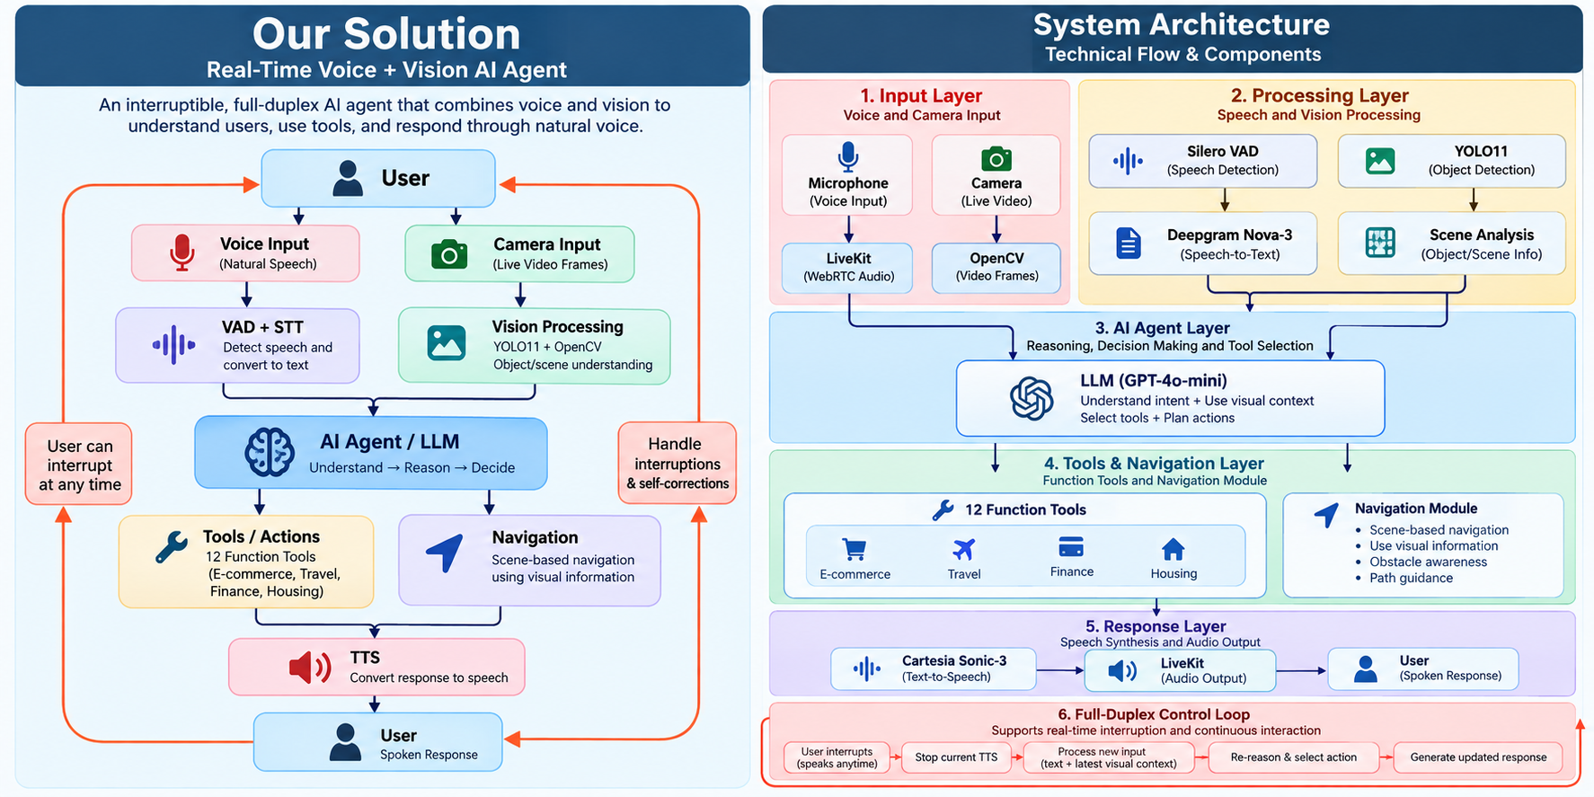

Slide 6
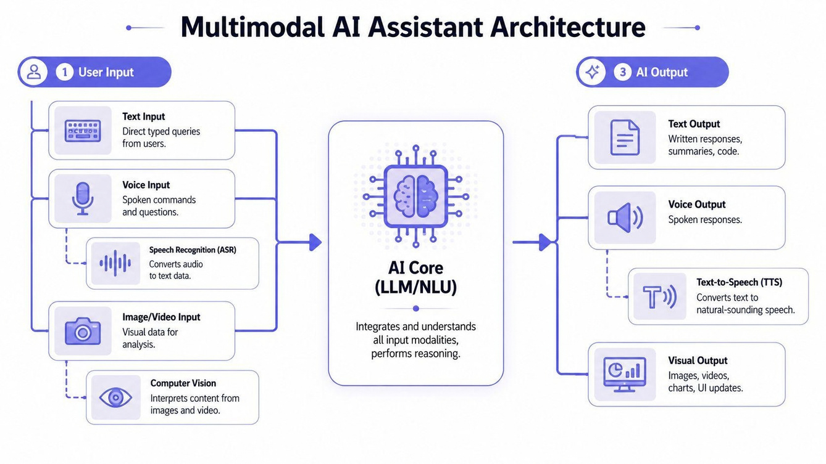
Demo & Product Walkthrough
VOICE → INTENT → ACTION
Example: “Track order ABC123”
USER
“Track order ABC123”
STT
Deepgram transcribes in the stream
LLM
GPT-4o-mini selects track_order()
TOOL
Python function queries mock API registry
VOICE
“Your order is out for delivery.”
E-Commerce
Finance & Billing
Travel & Identity
track_order • search_products • add_to_cart
get_card_benefits • get_exchange_rate • modify_autopay
search_flights • book_flight • update_identity_doc
Housing & Location
search_apartments • calculate_commute • update_search_filter

Slide 7
Tools and Tech Stack Used
BUILDING BLOCKS
LiveKit Cloud
LiveKit Agents
uv
Silero VAD v4
WebRTC signaling + SFU routing
Python agent framework
Fast Rust-based package manager
Local voice activity detection via ONNX
Deepgram Nova-3
OpenAI GPT-4o-mini
Cartesia Sonic-3
FDB-v3 + NeMo + FFmpeg
Streaming speech-to-text
Reasoning + function calling
Streaming text-to-speech
Benchmarking, transcript evaluation & audio tooling
Unified inference routing reduced the need for multiple standalone provider API keys and simplified initialization.

Slide 8
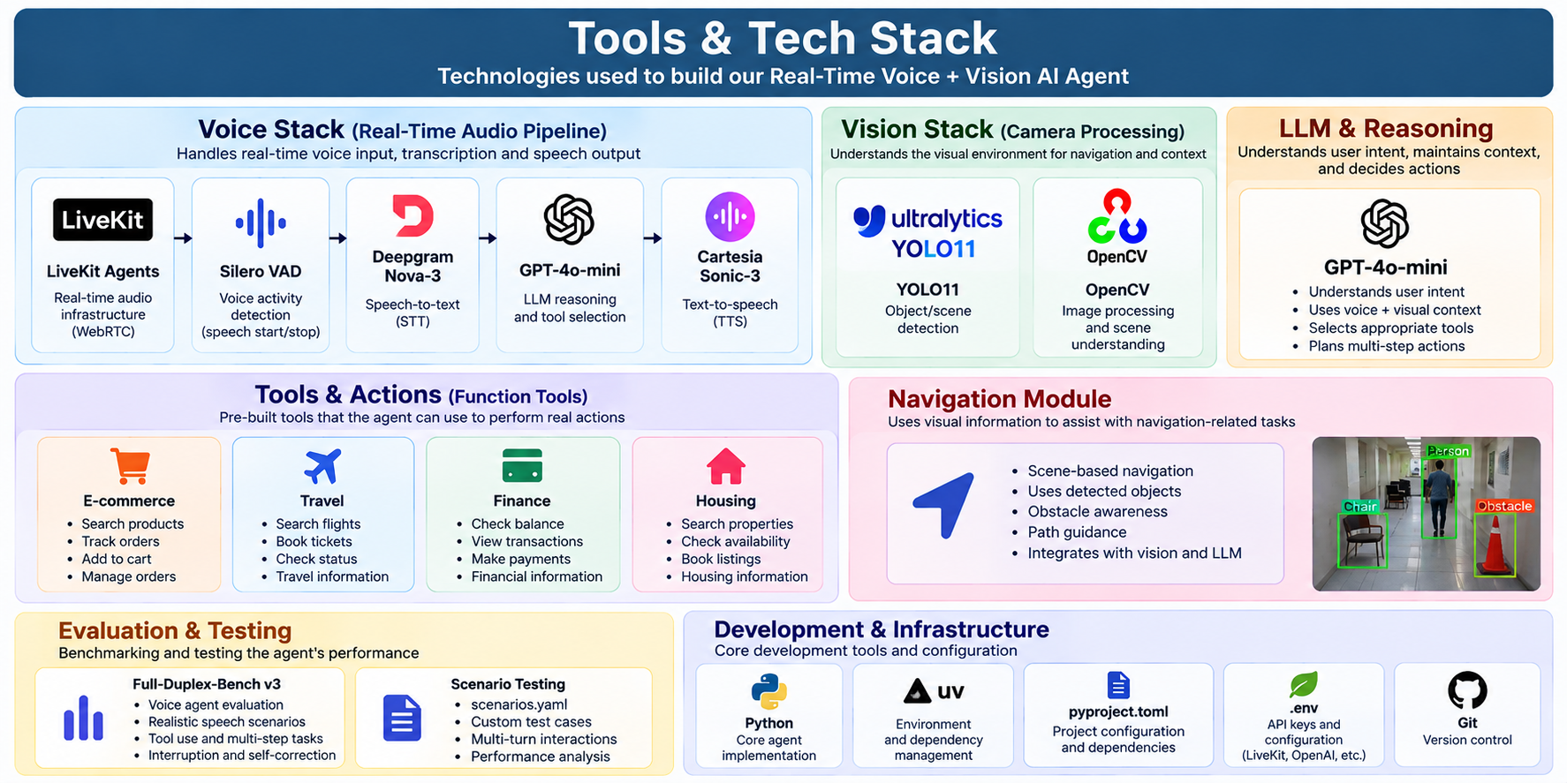

Slide 9
Impact & Use Cases
WHERE IT CAN ACT
4
12
101
SUB-SECOND
DOMAINS
EXECUTABLE TOOLS
FDB-v3 SCENARIOS
TARGET EXPERIENCE
E-Commerce
Travel & Identity
Order tracking, product discovery, cart updates
Flight search/booking, identity document updates
Finance & Billing
Housing & Location
Benefits, currency conversion, autopay changes
Apartment search, commute calculation, filters
The same voice interface can move from “answering” to “doing” across multiple real-world workflows.

Slide 10
Innovation Highlights, Results & Limitations
EVIDENCE + TRADE-OFFS
Full-duplex interaction
RESULTS
LIMITATIONS
Interruptions are first-class: speaking over the agent immediately changes the active turn.
• Successfully navigated 101 predefined scenarios
• Measures first-speech latency
• Measures perceived total latency
• Measures tool-call accuracy
• Current tool registry uses mock APIs
• Current architecture is cascaded STT → LLM → TTS
• Production integrations and human escalation are future work
• Reference document does not provide final numeric latency scores
Executable tool registry
12 Python functions across four domains are triggered from natural-language intent.
Reproducible benchmark
FDB-v3 streams 101 predefined .wav scenarios and measures response latency + tool accuracy.
NEXT VALIDATION: PUBLISH REPRODUCIBLE BENCHMARK RESULTS

Slide 11
Brownie Points: Differentiation
WHY THIS DEMO STANDS OUT
Conversation is interruptible
Voice can execute actions
Not just streaming output: user speech can stop the agent mid-response and restart the interaction.
The LLM is connected to real Python functions, making the assistant action-oriented.
Cross-domain tool surface
Benchmark-first mindset
12 tools cover four common consumer workflows without changing the voice interface.
FDB-v3 gives the project a repeatable way to measure latency and tool-call behavior.
Engineering resilience
The team addressed external-drive filesystem artifacts and consolidated inference credentials.
Core differentiator: a voice interface that can listen, reason, act, speak—and be interrupted.

Slide 12
Thank You

