Slide 1

HAAAC
(AI Assistant)

Slide 2

B.R.A.C.T’s
Vishwakarma institute of information technology,Pune
Class:FY
Division:M
Batch:M1
Name | Roll Number | PRN NO
Aditya Shelar | 1316 | 22110285
Atharv Tembhurnikar | 1317 | 22110317
Amit Jambhale | 1318 | 22110333
Himanshu Biyani | 1322 | 22110413
Chinmay Wasule | 1323 | 22110429

Slide 3
Abstract
An AI assistant is a software that can perform tasks for a user based on verbal commands
HAAAC can perform tasks like setting alarm, translating marathi into english.
HAAAC takes speech command from user and work according to it.
The main agenda of our assistant is to make people smart and give instant and computed results.
Haaac can do Wikipedia searches for you.
HAAAC can open websites like google, youtube, stackoverflow, geeksforgeeks; applications like VS Code, Microsoft Word, etc.
HAAAC can also tell the time and day. It can also set alarm for you.

Slide 4
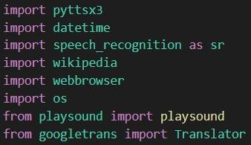
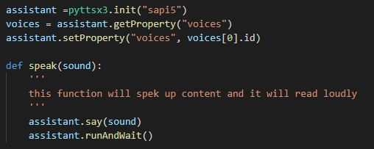
Flow Of Programme
Importing Modules
Adding Voice to assistant
& telling code how to speak

Slide 5
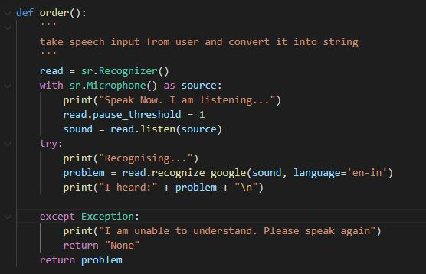
Flow Of Programme
Defining a function to take command from user

Slide 6
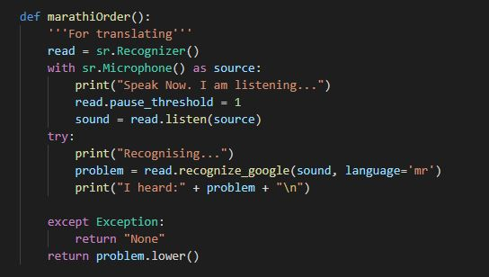
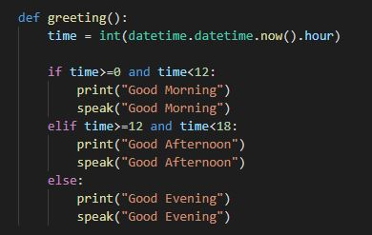
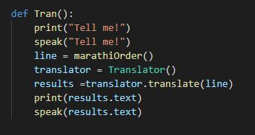
Flow Of Programme
Defining some other functions related to tasks

Slide 7
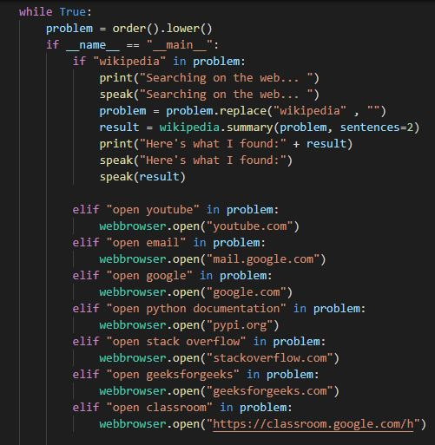
Flow Of Programme
Main execution of code
If (_command-by-user_):
execute this
elif (_command-by-user_):
execute this

Slide 8
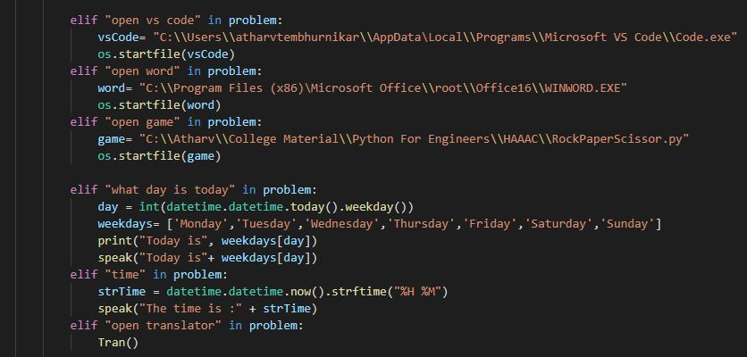
Flow Of Programme

Slide 9
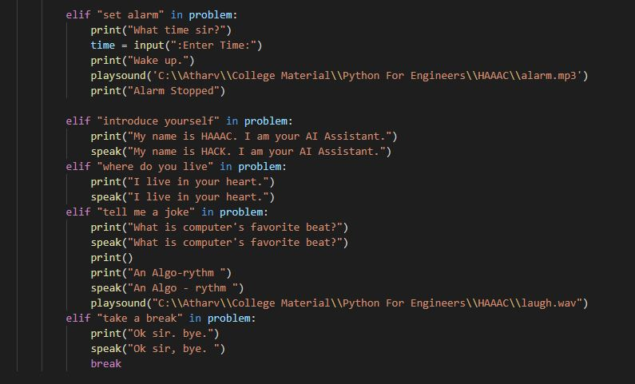
Flow Of Programme

Slide 10
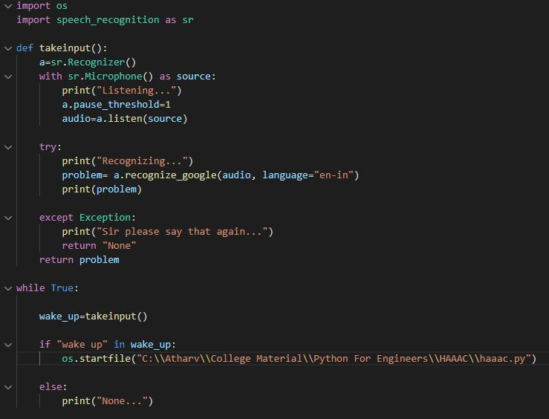
Wake up functionality

Slide 11
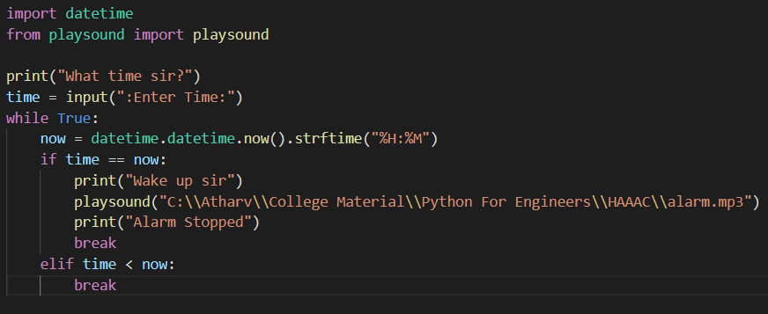
Alarm

Slide 12
Concepts Covered From Syllabus
Modules
Python in built function: print()
User defined functions
While loop
If - elif - else loop
String slicing

Slide 13
Concepts which are out of Syllabus
Modules:
pyttsx3
datetime
speech_recognition
wikipedia
webbrowser
os
gogletrans
playsound
with-try-except, startfile(), open() functions

Slide 14
Problems Faced
The command ‘pip install googletrans’ by default installs the version which is not capable of translation. We have to download specific 4.0.0rc1 version of googletrans.
If we open audio file of alarm using os.startfile(), it opens windows media player and after end of task, that player remains open.
To overcome this, we used playsound module, as it plays audio file and closes it by itself.
When we import file name it won’t execute.For this, we used the full path of that file.

Slide 15
Future Modifications
Converting whole project into .exe file in such a way that anyone can be able to use HAAAC without downloading python.
User interface (GUI) for HAAAC
Specialised (modified) google search
Dictionary can be added (ex. English to Marathi Dictionary)
Alarm can be improved by adding functionalities like snoozing alarm, changing alarm tone (sound effect),etc.
Can be modified such that HAAAC can send messages and emails via whatsapp, telegram and gmail.

Slide 16
Conclusion
In this project ‘HAAAC-AI Assistant’ using python we tried to implement Artificial Intelligence . HAAAC is built using open source software modules with VS Code.
HAAAC not only works on human commands but also gives responses to the user based on the query being asked by the user such as opening applications and performing operations. It greets the user in such a way the user feels comfortable with the HAAAC. The entire system works on the verbal input. HAAAC can perform many tasks like setting an alarm, translating marathi language to english, etc. HAAAC also has a lot of information as it is connected with the internet.

Slide 17
Thank You!

