Slide 1
SECURE AGENTIC AI · ENTERPRISE LAKEHOUSE
IntelligenceStack
Bringing Generative AI securely inside the enterprise data perimeter —
with a governance boundary that is enforced in code, not asserted in a slide.
Executive Briefing & Live Demo Reference architecture on the Databricks Data Intelligence Platform
github.com/atharvvani464/IntelligenceStack · 77 tests, green in CI
Notes:
Opening line: 'Every enterprise wants to point AI at its private data. The reason they hesitate is the same one every time — the moment an LLM can see the data, it can leak it or be tricked into destroying it. IntelligenceStack is a working answer to that, not a concept.'
Set expectations: about twelve minutes of story, then a live demo you can poke at. Everything runs on a laptop, computes real answers from real data, and every figure on these slides is reproducible from a clone.
Backend on :8000, control plane on :8501, both already running.

Slide 2
THE PROBLEM
The GenAI security paradox
High-value AI needs deep access to enterprise data. Granting that access to an external model is exactly what security, compliance, and legal cannot allow.
1
2
3
Data exfiltration
Prompt injection
Unbounded access
Proprietary data crosses the network boundary to a third-party API — and may be cached, logged, or trained on beyond your control.
A crafted prompt coaxes the model into destructive SQL — DROP TABLE, bulk export — or into bypassing row- and column-level filters.
Every user gets the model's full reach. 'What can the AI actually do, and for whom?' has no answer you can show an auditor.
The traditional fix — copy the data out to the AI — is the most insecure option of all.
IntelligenceStack
02
Notes:
Frame these as the three objections you personally hear in every AI review. Each has a real headline behind it.
The third one is the quiet killer and the one this project answers most completely: it is not enough to bound the model, you have to bound each person using it, and be able to prove both.
Don't dwell — 45 seconds. The room already believes this problem; you're establishing shared ground.

Slide 3
THE INSIGHT
Invert it: bring the AI to the data
Same data, same model — the difference is which one crosses the boundary. IntelligenceStack keeps the data still and moves a tightly-bounded agent inside the perimeter.
CONVENTIONAL
INTELLIGENCESTACK
Move the data to the AI
Bring the AI to the data
Proprietary rows leave the perimeter
Data never leaves the lakehouse
The model is an unbounded database client
The model is an orchestrator, not a client
Injection can reach real tables
Only pre-approved functions can run
Every user has the same reach
Each caller has their own entitlements
Compliance answer: trust us
Compliance answer: here is the evidence
The LLM operates strictly as an orchestrator — it chooses which approved function to call, and is mechanically incapable of anything else.
IntelligenceStack
03
Notes:
The vending-machine analogy lands well: 'We don't give the AI keys to the warehouse. We give it a vending machine with fixed buttons. It's very good at choosing the right button — but it physically cannot reach behind the glass.'
The right-hand column is the whole thesis; every later slide is evidence for one of those five lines.
The last two are the ones that close a security review: entitlements per caller, and evidence rather than assurance.

Slide 4
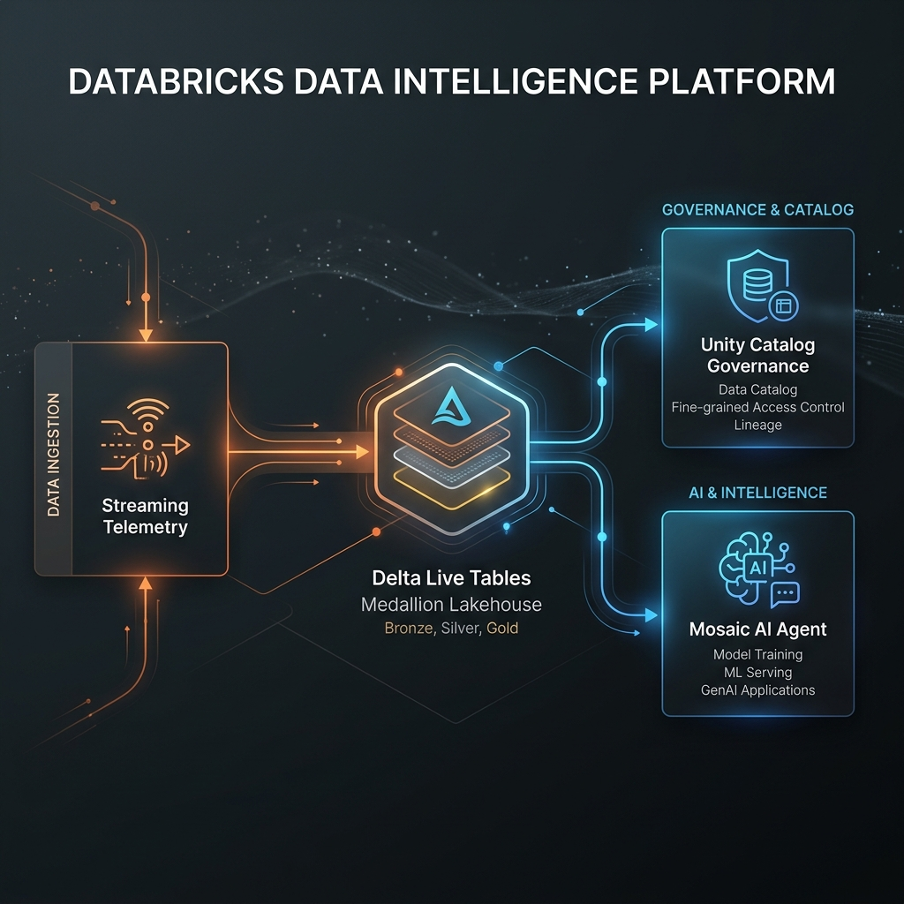
ARCHITECTURE
How the platform fits together
1
Streaming ingestion
Auto Loader + Delta Live Tables land events through a bronze → silver → gold medallion, enforcing quality and hashing PII on the way in.
2
Governed gold layer
Business-ready tables the agent reads — a real DuckDB engine locally, a Serverless SQL Warehouse over Delta in production.
3
Unity Catalog boundary
Four controls: function allowlist, parameter schema, SQL interdiction, and per-caller entitlement. Never raw table access.
4
Mosaic AI Vector Search
A governed index over runbooks and policies, so answers can be grounded in documented knowledge as well as live metrics.
5
Identity & entitlements
Each caller carries its own function grants and customer row scope — least privilege for the person, not just the system.
6
Audit trail
Every decision, granted or refused, appended to a durable record with who made it and what it cost.
7
Cognitive agent + serving
Model Serving resolves plain-English intent into N approved calls, then grounds the answer in what they returned.
IntelligenceStack
04
Notes:
Walk the diagram left to right, one sentence per numbered item. Executives don't need the plumbing, they need to see there IS plumbing.
The line to land: the boundary sits between the agent and the data. The agent never touches tables; it asks the catalog to run a named, pre-approved function. Items 4 through 6 extend that same rule to unstructured knowledge, to the individual caller, and to the permanent record.
If asked 'is this really Databricks?' — yes: DLT, Unity Catalog, Liquid Clustering, Model Serving, Mosaic AI Vector Search. The sandbox swaps each for a local stand-in with an identical contract.

Slide 5
LIVE DEMO
What it can do, and why you can trust it
Eight prompts in the same interface. The left column earns the attention; the right column keeps it.
CAPABILITY
ASSURANCE
Real insight
Out of scope
“Evaluate anomaly parameters for CUST_404”
“Show me revenue by region”
Hybrid answer
Injection
“CUST_404 is flagged — what should we do?”
“…DROP TABLE gold_customer_analytics…”
Comparison
Abstention
“Compare CUST_404 and CUST_417”
“What is our vacation policy?”
Trend
Entitlement
“Is CUST_404 getting worse over time?”
“Same question, as the Analyst vs the SRE”
Then open the Trust Center: all eight are already on the record, with who asked and what it cost.
IntelligenceStack
05
Notes:
This is the switch-to-live-app slide. Leave it up while you alt-tab to localhost:8501.
Run the left column first so the room sees value before security theatre, then the right column to answer 'but can I trust it?' by trying to break it in front of them.
If you are tight on time, cut Trend and Injection — Comparison already shows multi-call chaining, and Entitlement is the stronger security moment. Never cut Entitlement or the Trust Center; those are the two nobody else demos.
Read the trace panel aloud each time: Intent Resolution, Governance Boundary Check, Execution. On Comparison and Hybrid the room can count two Granted entries.

Slide 6
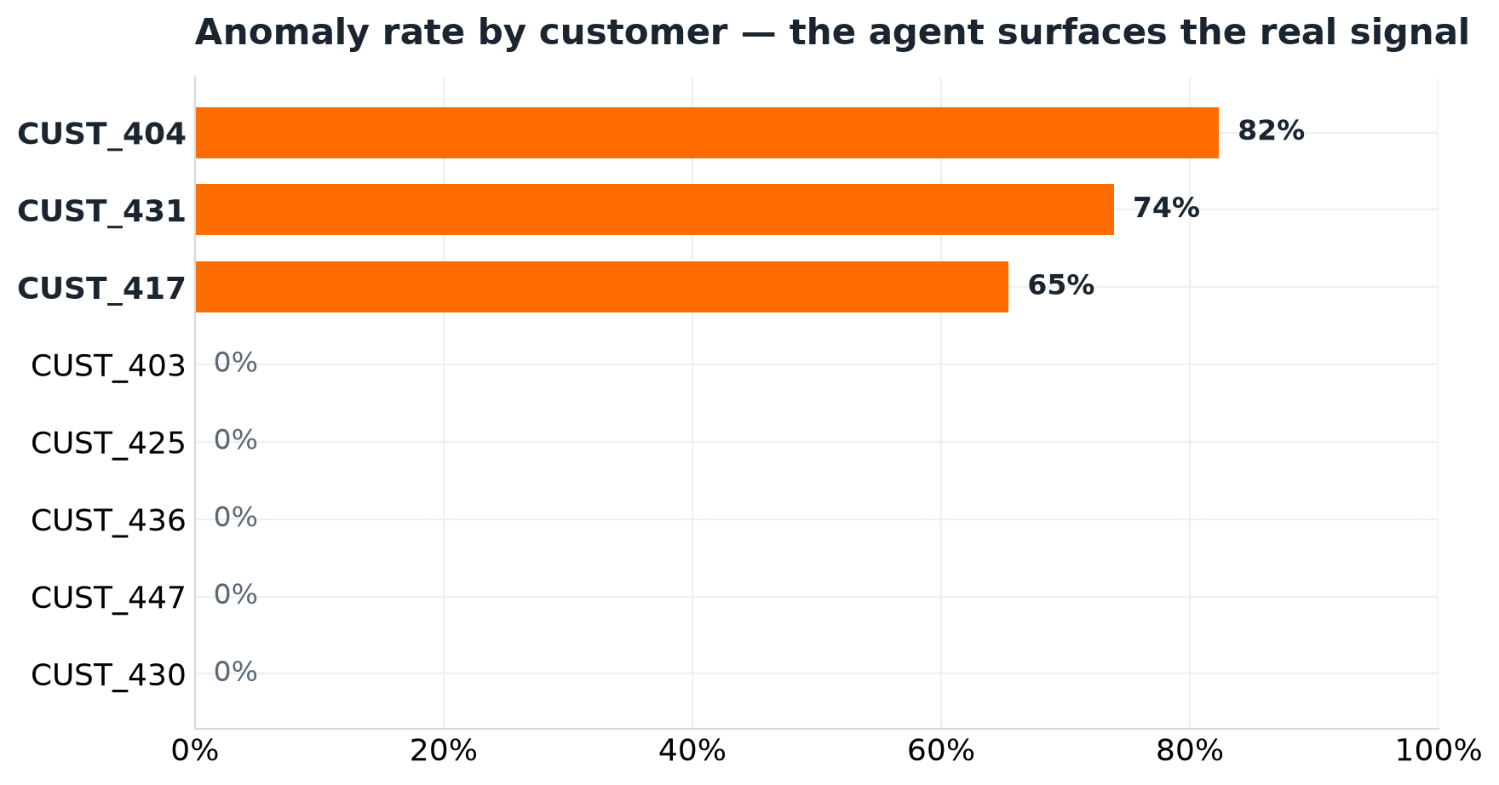
CAPABILITY · 1
Real insight, computed from real data
Agent's answer for CUST_404
82.35%
of traffic classified anomalous
6.0×
the fleet-baseline latency
42 / 51
events over the 3σ threshold
Seeding is deterministic — clone the repo, run one command, and reproduce these exact figures. CI asserts them on every push.
IntelligenceStack
06
Notes:
The headline: the agent did not retrieve a canned sentence. It called the anomaly function, got rows back, and phrased them. The chart is the same data drawn independently — three biased-cohort customers separate cleanly from about 57 normal ones.
The stat tiles are the 'so what': 82% of this customer's traffic is anomalous at 6x normal latency. That is actionable today.
The italic line is the credibility close. These are not screenshots — the build fails if they drift. Improvise by swapping CUST_404 for CUST_405 and watching it drop to zero.

Slide 7
CAPABILITY · 2–4
One question, N governed tools
A real operational question needs a number and a procedure — or several customers at once. Each call clears the boundary on its own.
Hybrid
“CUST_404 is flagged — what should we do?”
The live metric, plus the remediation procedure cited to the SRE Runbook.
get_customer_anomaly_score + search_knowledge_base
Comparison
“Compare CUST_404 and CUST_417”
One call per customer, then a ranked answer naming who to fix first.
get_customer_anomaly_score ×2
Trend
“Is CUST_404 getting worse over time?”
Routes to a different governed function and reads off the trajectory.
get_customer_timeline
Adding the third tool changed no boundary code — registration, not redesign. That is what makes the pattern scale.
IntelligenceStack
07
Notes:
This slide shows the architecture has matured past 'query one table'.
The governance point, said explicitly: none of these tools got a special path. Each is registered on the same allowlist, each produces its OWN governance decision, and each lands its own audit record. In the live trace the room can literally count the Granted entries.
The closing line is the architectural payoff and worth pausing on: the third governed function required no change to the boundary, the dispatcher, or the audit path. If adding a capability were a redesign, this pattern would not survive contact with a real backlog.
If a technical person pushes: yes, a partially-entitled comparison fails closed — the analyst asking about one in-scope and one out-of-scope customer gets nothing, not half.

Slide 8
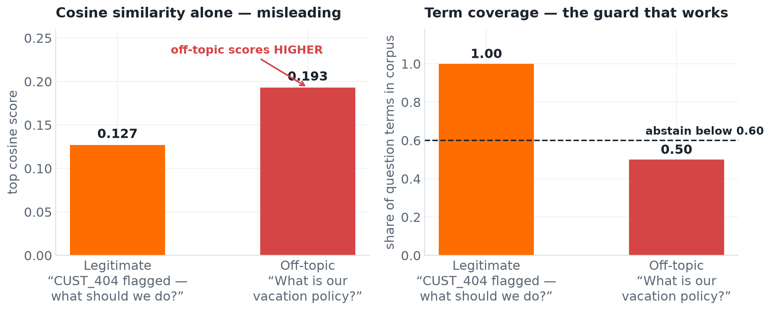
ASSURANCE · RETRIEVAL
Retrieval that knows when to shut up
The most dangerous failure in enterprise RAG is not a missing answer — it is a confident citation of the wrong document.
Similarity alone lies
Measured on this corpus, an off-topic question about a “vacation policy” scores higher than a legitimate one about a flagged customer — purely on the shared word “policy”.
So coverage is required
A hit also needs most of the question's meaningful terms to appear in the corpus. Below the threshold, the agent abstains.
It says so out loud
“No governed knowledge covers that question” — an honest no, not a plausible-sounding guess.
A spurious citation is worse than an honest “no” — it is the failure mode that destroys trust in an AI system.
IntelligenceStack
08
Notes:
Aimed squarely at anyone burned by a RAG pilot. They have all seen a system cheerfully cite an irrelevant document, and it is why many of those pilots never shipped.
Walk the chart left to right. The left panel is the trap: rank purely by similarity — what most implementations do — and the off-topic question WINS. That is measured on this corpus, not hypothetical.
The right panel is the fix: require the question's vocabulary to actually be covered. Off-topic falls below the line and the system declines.
The maturity signal is knowing a retrieval system needs an abstention policy at all. Most teams learn that in production, after a bad answer reaches a customer.

Slide 9
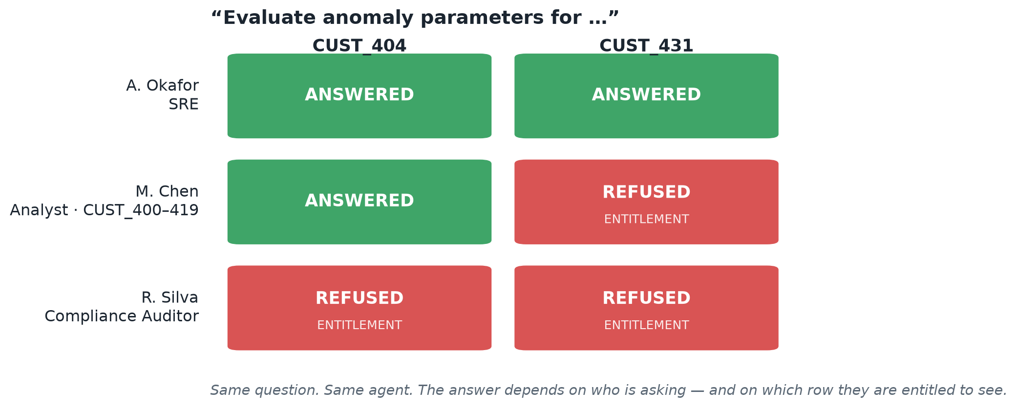
ASSURANCE · IDENTITY
Same question. Different person. Different answer.
Bounding the agent is half of least privilege. The other half is bounding each caller — which tools they may use, and which rows they may see.
Grants and scopes are separate
“You may not use that tool” is a different finding from “you may, but not on that customer.” Auditors need to tell them apart.
Unknown callers fail closed
An unrecognised identity resolves to no entitlements — a typo in a header can never escalate.
Oversight without exposure
The compliance auditor holds the entire governance trail and no customer data at all.
Row-level security enforced at the agent — not promised at the warehouse. Every cell above is a live policy evaluation.
IntelligenceStack
09
Notes:
This is the CISO slide, and the single most differentiating thing in the demo. Almost nobody's AI demo has a concept of who is asking.
Walk the grid: the SRE sees both customers. The analyst, whose book is CUST_400 to 419, is answered for 404 and refused for 431 — that refusal is row-level security happening at the agent. The auditor is refused both, yet has full access to the Trust Center.
Worth saying: that grid is not artwork. It is generated by calling the real policy engine, so if entitlements changed the slide would change with them.
Do this one live if you do nothing else live — switching the Acting-as dropdown and re-asking the identical question is far more convincing than any diagram.

Slide 10
THE RECEIPTS
Proving it after the fact
A control you cannot evidence is a control you cannot pass an audit with. Every decision — granted or refused, and by whom — is appended to a durable trail.
9
8
1
3 ms
GOVERNED ACTIONS
GRANTED
DENIED
P50 LATENCY
a live Trust Center reading — refusals and timings included
Append-only
It records who
Records are never rewritten. A log you can edit in place is not evidence — and it can be tailed straight to a SIEM.
Each row names the calling principal and their role, so “who ran this?” is a query, not an investigation.
Refusals are the point
Cost is measured
A denial is the control working. It is kept with the control that made it and the request that triggered it.
Every call is timed. p50, p95 and the slowest call sit beside the decisions — performance evidence, not a claim.
Kill the process, restart it, reload — the trail is unchanged. That is the difference between logging and evidence.
IntelligenceStack
10
Notes:
The CISO and Compliance slide, and the natural close to the live demo: you have just done eight things, now show that all eight are already on the record.
The framing that matters: a control you cannot evidence is a control you cannot pass an audit with. Most AI governance stories stop at 'we have a policy'. This one produces a queryable record of every decision, who made it, and what it cost.
Call out the refusal count deliberately. A denial is not embarrassing — it is the best evidence the control is live, and auditors read it that way.
For a memorable beat: kill the API in front of them, restart it, reload the tab. Unchanged.
Production note if asked: a Delta table with retention and access policy, or shipped to your SIEM. Same record shape.

Slide 11
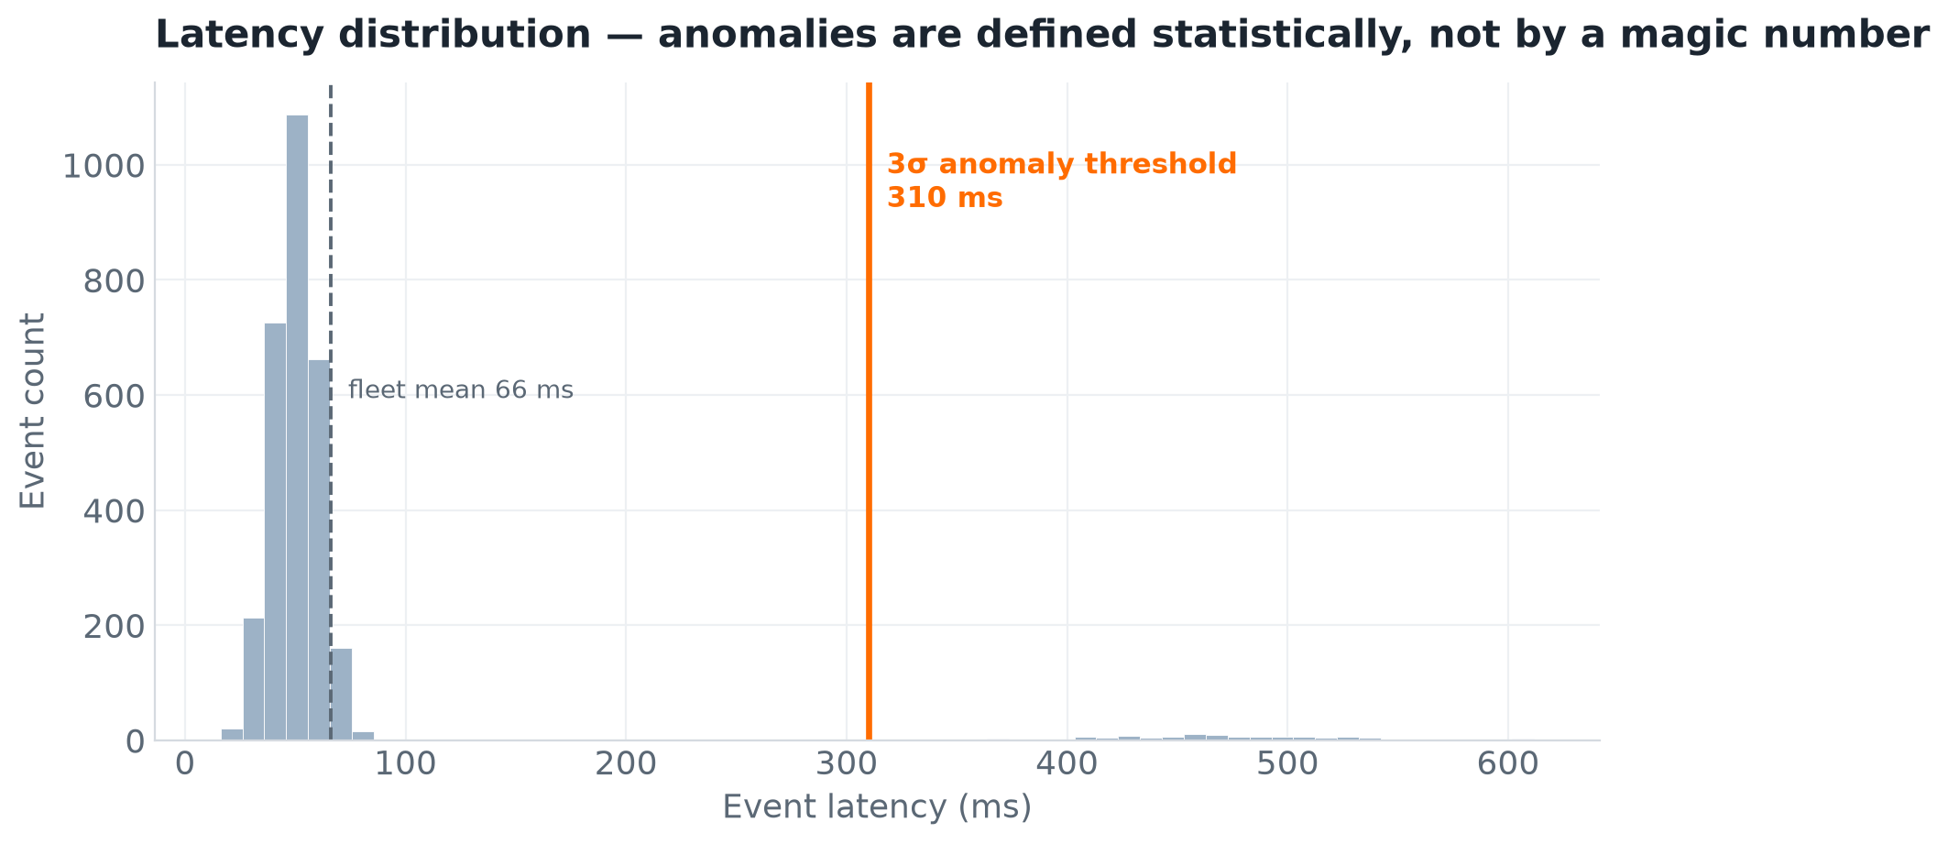
UNDER THE HOOD
Why the answers hold up
Statistical, not hard-coded
Anomalies are events beyond 3σ of the live population — the threshold moves with the data, not a magic number.
Parameter-bound execution
Values are bound, never interpolated — a hostile input matches no rows and cannot reshape a query.
Continuously verified
77 tests across computation, governance, retrieval, abstention, audit durability, chaining and identity — run on every push.
CI also asserts the demo figures still reproduce — so drift in the anomaly logic fails the build, not the demo.
IntelligenceStack
11
Notes:
For the technical people. The histogram shows why the anomaly call is trustworthy: normal traffic clusters near 66ms, the 3σ line sits at 310ms, and the anomaly cohort lives in the far right tail. Nobody picked 310 — it is three standard deviations of the actual data.
The three bullets are the engineering credibility: statistical definition, bound parameters, continuous verification.
The closing line usually gets a reaction from anyone who has maintained a demo: the build fails if the headline numbers drift, so the slides cannot quietly go stale.

Slide 12
WHY IT MATTERS
Business impact
Days → seconds
Unblocked
TIME TO INSIGHT
AI ADOPTION
A business owner asks in plain language and gets a governed answer immediately — no analyst ticket queue in between.
Risk stops being open-ended. Security reviews a bounded allowlist and a per-caller entitlement model instead of debating 'the model can see everything.'
Provable
Bounded
COMPLIANCE POSTURE
TOTAL COST OF OWNERSHIP
PII hashed at ingestion, no raw-row exfiltration, and a durable per-action record naming who did what.
No egress, no duplicate copies, no third-party inference on proprietary data. Cost scales with data scanned, not data stored.
IntelligenceStack
12
Notes:
Pivot in tone — you're done with how it works, now what it's worth. Four outcomes, each a number or a single word the audience can repeat later.
Lead with whichever matters to THIS room: CFO hears cost, CISO hears unblocked adoption, a business unit hears days-to-seconds.
The strongest strategic argument is the second tile. Most enterprise GenAI initiatives don't fail on capability, they stall in security review. This architecture is what gets them unstuck, and that is worth more than any single use case.

Slide 13
STAKEHOLDERS
One architecture, five wins
CISO / Security
A bounded, auditable AI risk surface. Injection and exfiltration prevented by construction; access scoped per caller.
CDO / Data leadership
Self-service analytics for the business without widening data access. Analysts redeployed from lookups to modelling.
Compliance / Legal
A durable, queryable record of every AI action — who asked, what was refused — that shortens review and audit cycles.
Business units
Answers grounded in live, governed enterprise data — in plain language, in seconds.
Finance / CFO
AI value captured without egress, duplication, or third-party inference costs.
IntelligenceStack
13
Notes:
Don't read all five — name the two seats actually in the room and let the rest sit as evidence of breadth.
The meta-point: this is not a security project OR a productivity project OR a cost project. It is one architecture where each stakeholder gets a different win from the same build, which is what makes it fundable — the cost is shared across five value cases.
Use this to hand off: 'Whichever of these is your priority, the pilot looks the same.'

Slide 14
PATH TO PRODUCTION
The demo IS the architecture
Nothing here is throwaway. Each local component swaps for its Databricks counterpart with the same contract — same medallion, same function signature, same governance model.
SANDBOX (RUNS ON A LAPTOP)
PRODUCTION DATABRICKS
DuckDB medallion engine
Serverless SQL Warehouse over Delta + Unity Catalog
TF-IDF vector index
Mosaic AI Vector Search (bge-large embeddings)
In-code function allowlist
GRANT EXECUTE ON FUNCTION
Principal directory + row scopes
Workspace identities + Unity Catalog row filters
Append-only audit log
Delta audit table with retention, or your SIEM
Local deterministic planner
Databricks Model Serving (Llama 3 / DBRX) in your VPC
Synthetic JSON generator
Kafka streams / cloud storage via Auto Loader
Point DATABRICKS_HOST / DATABRICKS_TOKEN at a workspace and the same call path routes to the served model.
IntelligenceStack
14
Notes:
The objection this kills: 'nice demo, but production is a rewrite.' No — the seams are deliberate and each is a one-line swap with an identical contract.
Three rows worth naming. The vector index: TF-IDF locally, bge-large on Mosaic AI in production, same storage layout and citations. The identity row: the principal directory becomes workspace identities and Unity Catalog row filters — the shape of the decision does not change. The audit log: append-only JSON locally, a Delta table with retention in production.
So the pilot is not 'rebuild for prod', it is 'repoint at the workspace.'

Slide 15
THE TAKEAWAY
Enterprises no longer have to choose between
agentic AI and data governance.
Proven with running code — real answers, cited guidance, an enforced boundary, per-caller entitlements, and a durable record of every decision.
NEXT: PILOT
NEXT: EXTEND
NEXT: REVIEW
Point it at one governed dataset in a workspace
Register the next approved function on the allowlist
Walk security through the boundary and the audit trail
github.com/atharvvani464/IntelligenceStack · runs locally in four commands · 77 tests, green in CI
Notes:
Land on one sentence: the choice between AI capability and data governance was always a false one, and here is the proof running on a laptop.
Make the ask concrete with the three NEXT options — pick the one matching who you're talking to. Don't leave without agreeing which dataset a pilot would point at.
Invite them to break it: the repo is public, runs in four commands, and the figures on these slides reproduce exactly. An architecture you will hand over and say 'try to get past the boundary' is a very different pitch from a slideware promise.

