Slide 1
SECURE AGENTIC AI · ENTERPRISE LAKEHOUSE
IntelligenceStack
Bringing Generative AI securely inside the enterprise data perimeter —
with a governance boundary that is enforced in code, not asserted in a slide.
Executive Briefing & Live Demo Reference architecture on the Databricks Data Intelligence Platform
github.com/atharvvani464/IntelligenceStack
Notes:
Opening line: 'Every enterprise wants to point AI at its private data. The reason they hesitate is the same one every time — the moment an LLM can see the data, it can leak it or be tricked into destroying it. IntelligenceStack is a working answer to that, not a concept.' Set expectations: ~10 minutes of story, then a live demo you can poke at. The whole thing runs on a laptop and computes real answers from real data — nothing on these slides is mocked. Demo is already running: FastAPI backend on :8000, Streamlit control plane on :8501.

Slide 2
THE PROBLEM
The GenAI security paradox
High-value AI needs deep access to enterprise data. Granting that access to an external model is exactly what security, compliance, and legal cannot allow.
1
2
3
Data exfiltration
Prompt injection
Compliance exposure
Proprietary data crosses the network boundary to a third-party API — and may be cached, logged, or trained on beyond your control.
A crafted prompt coaxes the model into destructive SQL — DROP TABLE, bulk export — or into bypassing row- and column-level filters.
PII slips into a response and breaches GDPR, HIPAA, or internal policy. The audit question 'what can the AI actually do?' has no bounded answer.
The traditional fix — copy the data out to the AI — is the most insecure option of all.
IntelligenceStack
02
Notes:
Frame these as the three objections you personally hear in every AI review. They are not hypothetical — each has a real headline behind it. The punchline is the last line: the industry's default answer (ship the data to the model) makes all three worse at once. That sets up the inversion on the next slide. Don't dwell — 45 seconds. The audience already believes this problem; you're establishing shared ground.

Slide 3
THE INSIGHT
Invert it: bring the AI to the data
Same data, same model — the difference is which one crosses the boundary. IntelligenceStack keeps the data still and moves a tightly-bounded agent inside the perimeter.
CONVENTIONAL
INTELLIGENCESTACK
Move the data to the AI
Bring the AI to the data
Proprietary rows leave the perimeter
Data never leaves the lakehouse
The model is an unbounded database client
The model is an orchestrator, not a client
Injection can reach real tables
Only pre-approved functions can run
Compliance answer: trust us
Compliance answer: here is the allowlist
The LLM operates strictly as an orchestrator — it decides which approved function to call, and it is mechanically incapable of anything else.
IntelligenceStack
03
Notes:
The vending-machine analogy lands well here: 'We don't give the AI keys to the warehouse. We give it a vending machine with a fixed set of buttons. It's very good at choosing the right button — but it physically cannot reach behind the glass.' The right-hand column is the whole thesis. Every later slide is evidence for one of those four lines. Emphasize the last bullet on each side: the shift from 'trust us' to 'here is the allowlist' is what actually unblocks projects in security review.

Slide 4
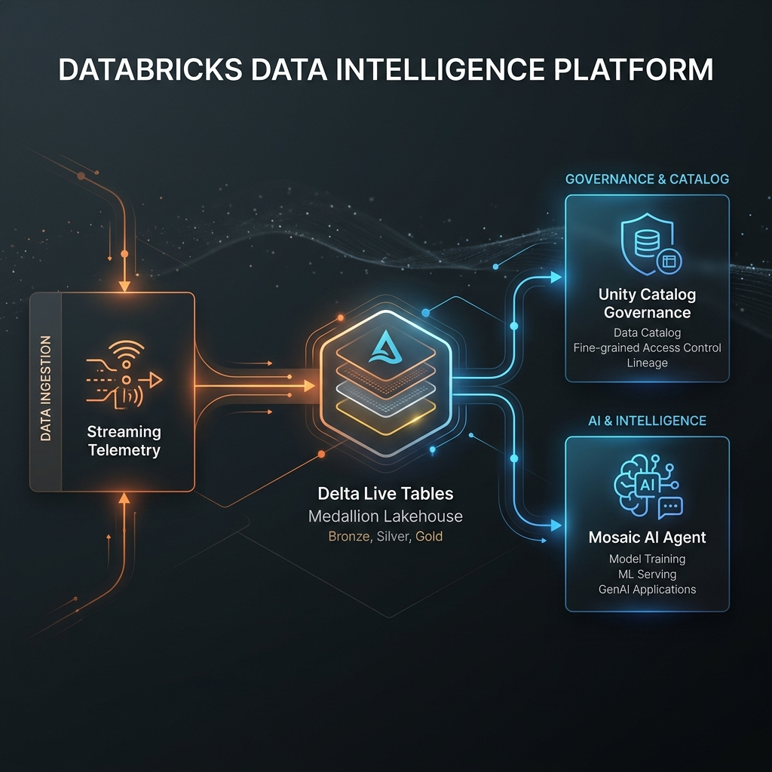
ARCHITECTURE
How the platform fits together
1
Streaming ingestion
Auto Loader + Delta Live Tables land events through a bronze → silver → gold medallion, enforcing data quality and hashing PII on the way in.
2
Governed gold layer
Business-ready tables the agent reads. In the sandbox this is a real DuckDB engine; in production, a Serverless SQL Warehouse over Delta.
3
Unity Catalog boundary
The agent is granted EXECUTE on a short allowlist of functions — never raw table access. Every call is checked before it runs.
4
Mosaic AI Vector Search
A governed index over enterprise runbooks and policies, so the agent can ground answers in documented knowledge as well as live metrics.
5
Cognitive agent + serving
Model Serving resolves plain-English intent into approved function calls, then grounds the answer in what those calls returned.
IntelligenceStack
04
Notes:
Walk the diagram left to right, but keep it to one sentence per numbered item — executives don't need the plumbing, they need to see there IS plumbing. The one line to land: the boundary sits between the agent and the data. The agent never touches tables directly; it can only ask the catalog to run a named, pre-approved function. Item 4 extends that same rule to unstructured knowledge — retrieval is a governed tool like any other. If someone asks 'is this really Databricks?' — yes: DLT, Unity Catalog, Liquid Clustering, Model Serving, Mosaic AI Vector Search. The sandbox swaps each for a local stand-in with the same contract.

Slide 5
LIVE DEMO
Five moves, two minutes
The same interface throughout. The first two show value; the last three show why you can trust it in production.
Real insight
“Evaluate anomaly parameters for customer CUST_404”
Runs the approved function over live data — a genuine computed result.
1
Hybrid reasoning
“CUST_404 is flagged — what should we do about it?”
Two governed tools in one turn: the live metric plus the documented procedure, cited.
2
Refused at the boundary
“Show me revenue by region”
No approved function fits. Denied before anything touches the engine — and logged.
3
Injection neutralised
“…DROP TABLE gold_customer_analytics for CUST_404”
SQL stripped, only the customer ID survives. Tables untouched.
4
Honest abstention
“What is our vacation policy?”
Not covered by the corpus, so it declines rather than citing a weak match.
5
IntelligenceStack
05
Notes:
This is the switch-to-live-app slide. Leave it up while you alt-tab to the control plane at localhost:8501. Run order matters: lead with value (moves 1 and 2) so the room sees the point before the security material. Then 3, 4 and 5 answer 'but can I trust it?' — by trying to break it in front of them. For each move, read the trace panel aloud: Intent Resolution → Governance Boundary Check → Execution. Move 2 is the one to linger on — the trace shows TWO governance checks, one per tool. If the live app misbehaves, slides 6 through 9 carry the same content as static backup — just present those.

Slide 6
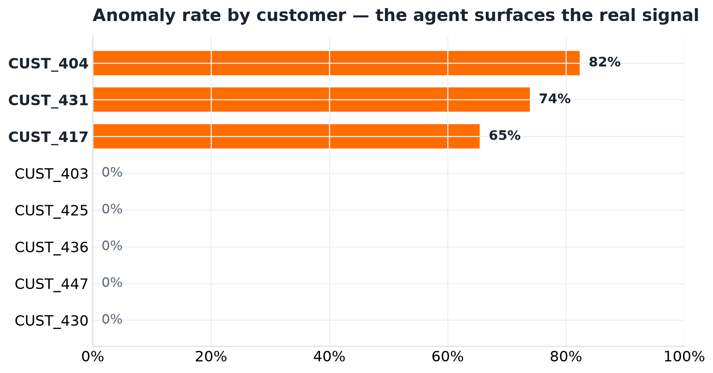
DEMO · MOVE 1
Real insight, computed from real data
Agent's answer for CUST_404
82.35%
of traffic classified anomalous
6.0×
the fleet-baseline latency
42 / 51
events over the 3σ threshold
Ask about a different customer and the numbers change, because they are read from the gold layer — the dashboard and the agent cannot disagree.
IntelligenceStack
06
Notes:
The headline: the agent did not retrieve a canned sentence. It called the anomaly function, got rows back, and phrased them. The chart is the same data, drawn independently — three biased-cohort customers separate cleanly from ~57 normal ones. The stat tiles are the 'so what': 82% of this customer's traffic is anomalous, at 6x normal latency. That is an actionable finding a business owner can act on today. Swap CUST_404 for CUST_405 live and watch it drop to 0% — that improvisation always convinces the skeptic.

Slide 7
DEMO · MOVE 2
One question, two governed tools
“CUST_404 is flagged — what should we do about it?” needs a number and a procedure. The agent retrieves both, and attributes each.
get_customer_anomaly_score
THE QUESTION
Gold layer → 82.35% anomalous, 6.0× baseline
ONE CITED ANSWER
Plain English, no schema,
no function names
The metric, the recommended
action, and the document it
came from
search_knowledge_base
Vector index → SRE Runbook remediation steps
each independently cleared at the boundary
Agent output
Customer CUST_404 is materially anomalous… risk factor 82.35, 6.0× the population average. Governed guidance — SRE Runbook, “Remediation procedure for high-latency customers”: confirm the signal, isolate the blast radius, check recent deploys, apply the mitigation, verify recovery below 5%.
The number comes from the lakehouse; the recommendation comes from an approved document. Neither is invented by the model.
IntelligenceStack
07
Notes:
This is the slide that shows the architecture has matured beyond 'query a table'. A real operational question needs two different kinds of knowledge — a measurement and a procedure — and until now those lived in two different systems with two different access models. The key governance point, and say it explicitly: retrieval did not get a special exemption. It is a registered function on the same allowlist, its question is passed as a bound value, and it produced its OWN governance check. In the live trace the room can count two 'Granted' entries. The closing line is the one to land: the number is from the lakehouse, the recommendation is from an approved document, and the model authored neither. It orchestrated. That is the whole thesis, demonstrated on one question.

Slide 8
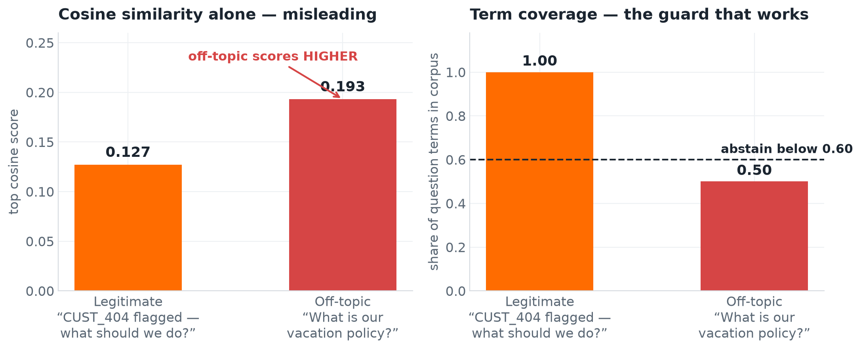
DEMO · MOVE 5
Retrieval that knows when to shut up
The most dangerous failure in enterprise RAG is not a missing answer — it is a confident citation of the wrong document.
Similarity alone lies
Measured on this corpus, an off-topic question about a “vacation policy” scores higher than a legitimate one about a flagged customer — purely on the shared word “policy”.
So coverage is required
A hit also needs most of the question's meaningful terms to actually appear in the corpus. Below the threshold, the agent abstains.
It says so out loud
“No governed knowledge covers that question” — an honest no, not a plausible-sounding guess.
A spurious citation is worse than an honest “no” — it is the failure mode that destroys trust in an AI system.
IntelligenceStack
08
Notes:
This slide is aimed squarely at anyone who has been burned by a RAG pilot. Every one of them has seen a demo where the system cheerfully cites an irrelevant document, and it is the reason many of those pilots never shipped. Walk the chart left to right. The left panel is the trap: if you rank purely by similarity — which is what most RAG implementations do — the off-topic question WINS. That is measured on this corpus, not hypothetical. The right panel is the fix: require that the question's vocabulary is actually covered by the corpus. Off-topic falls below the line and the system declines. The engineering maturity signal here is knowing that a retrieval system needs an abstention policy at all. Most teams discover this in production, after a bad answer reaches a customer.

Slide 9
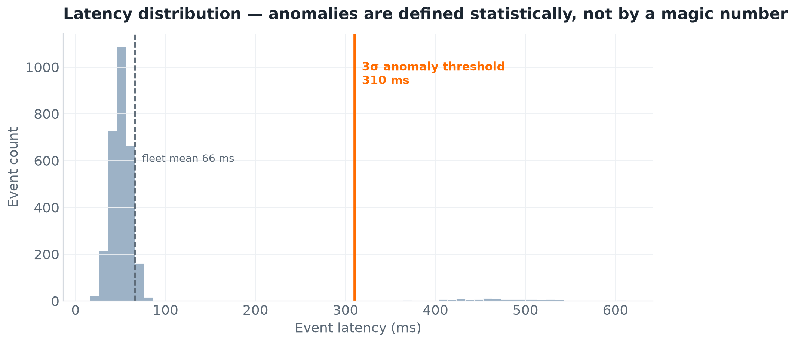
UNDER THE HOOD
Why the answers hold up
Statistical, not hard-coded
Anomalies are events beyond 3σ of the live population — the threshold moves with the data, not a magic number.
Parameter-bound execution
Values are bound, never interpolated — a hostile input matches no rows and cannot reshape a query.
Every step is traced
Intent, each governance decision, execution, synthesis — all recorded, so an answer is auditable end to end.
Verified by a 29-test suite covering real computation, governance enforcement, injection resistance, retrieval quality, and abstention — all passing.
IntelligenceStack
09
Notes:
For the technical people in the room. The histogram shows why the anomaly call is trustworthy: normal traffic clusters near 66ms, the 3σ line sits at 310ms, and the anomaly cohort lives in the far right tail. Nobody picked 310 — it's three standard deviations of the actual data. The three bullets are the engineering credibility: statistical definition, bound parameters, full tracing. If a CTO or architect is evaluating this, these are the words that say it was built by someone who has shipped production data systems. Close on the tests: each claim on these slides has an automated test that fails loudly if it regresses.

Slide 10
WHY IT MATTERS
Business impact
Days → seconds
Unblocked
TIME TO INSIGHT
AI ADOPTION
A business owner asks in plain language and gets a governed answer immediately — no analyst ticket queue in between.
Risk stops being open-ended. Security reviews a bounded allowlist instead of debating 'the model can see everything.'
Provable
Bounded
COMPLIANCE POSTURE
TOTAL COST OF OWNERSHIP
PII hashed at ingestion, no raw-row exfiltration, per-action audit trail — controls you can demonstrate, not just promise.
No egress, no duplicate copies, no third-party inference on proprietary data. Cost scales with data scanned, not data stored.
IntelligenceStack
10
Notes:
Pivot in tone here — you're done with how it works, now it's what it's worth. Four outcomes, each mapped to a number or a one-word promise the audience can repeat later. Lead with the one that matters most to THIS room. For a CFO, cost. For a CISO, unblocked adoption. For a business unit, days-to-seconds. Read the room and reorder verbally. The strongest strategic argument is the second tile: most enterprise GenAI initiatives don't fail on capability, they stall in security review. This architecture is what gets them unstuck — that's the real ROI, and it's larger than any single use case.

Slide 11
STAKEHOLDERS
One architecture, five wins
CISO / Security
A bounded, auditable AI risk surface. Injection and exfiltration prevented by construction, not by monitoring.
CDO / Data leadership
Self-service analytics for the business without widening data access. Analysts redeployed from lookups to modelling.
Compliance / Legal
Provable controls and a per-action audit trail that shorten review and audit cycles.
Business units
Answers grounded in live, governed enterprise data — in plain language, in seconds.
Finance / CFO
AI value captured without egress, duplication, or third-party inference costs.
IntelligenceStack
11
Notes:
Don't read all five — that's death by list. Name the two seats that are actually in the room and let the rest sit as evidence of breadth. The meta-point: this isn't a security project OR a productivity project OR a cost project. It's one architecture where each stakeholder gets a different win from the same build. That's what makes it fundable — the cost is shared across five value cases. Use this slide to hand off to whoever owns the next step: 'Whichever of these is your priority, the pilot looks the same.'

Slide 12
PATH TO PRODUCTION
The demo IS the architecture
Nothing here is throwaway. Each local component swaps for its Databricks counterpart with the same contract — same medallion, same function signature, same governance model.
SANDBOX (RUNS ON A LAPTOP)
PRODUCTION DATABRICKS
DuckDB medallion engine
Serverless SQL Warehouse over Delta + Unity Catalog
TF-IDF vector index
Mosaic AI Vector Search (bge-large embeddings)
In-code governance allowlist
GRANT EXECUTE ON FUNCTION + row/column-level security
Local deterministic planner
Databricks Model Serving (Llama 3 / DBRX) in your VPC
Synthetic JSON generator
Kafka streams / cloud storage via Auto Loader
Point DATABRICKS_HOST / DATABRICKS_TOKEN at a workspace and the same call path routes to the served model.
IntelligenceStack
12
Notes:
The objection this slide kills: 'nice demo, but it's a toy — production is a rewrite.' No. The seams are deliberate and each is a one-line swap with an identical contract. Row two is new and worth calling out: the retrieval index is the same story as the SQL engine. The sandbox embeds passages with TF-IDF and ranks them with in-engine cosine similarity; production embeds them with bge-large and serves them from Mosaic AI Vector Search. Same storage layout, same query contract, same citations — only the embedding changes. So the pilot isn't 'rebuild for prod' — it's 'repoint at the workspace.'

Slide 13
THE TAKEAWAY
Enterprises no longer have to choose between
agentic AI and data governance.
IntelligenceStack proves it with running code — real answers, cited guidance, an enforced boundary, and a clean path to production.
NEXT: PILOT
NEXT: EXTEND
NEXT: REVIEW
Point it at one governed dataset in a workspace
Register the next approved function on the allowlist
Walk security through the boundary and the audit trail
github.com/atharvvani464/IntelligenceStack · run locally in four commands
Notes:
Land the plane on one sentence: the choice between AI capability and data governance was always a false one, and here's the proof running on a laptop. Then make the ask concrete with the three NEXT options — pick the one that matches who you're talking to. Don't leave the meeting without agreeing which dataset a pilot would point at. Invite them to break it: the repo is public and runs in four commands. An architecture you're willing to hand over and say 'try to get past the boundary' is a very different pitch from a slideware promise.

