Slide 1
INTERNSHIP REPORT PRESENTATION
Artificial Intelligence
Internship
AICTE & ICAC Approved Internship Program
Atharwa Patel
Artificial Intelligence Intern
Codec Technologies Pvt. Ltd.
01 July – 01 August 2026
INTERNSHIP CERTIFICATE • COMPLETION DOCUMENT

Slide 2
ABOUT THE STUDENT
Candidate Profile
Internship information from the provided offer letter and certificate
Candidate
Organization
Internship
Atharwa Patel Artificial Intelligence Intern
Codec Technologies Pvt. Ltd. Pan India • Hybrid
1 Month AICTE & ICAC Approved
Role
Duration
Artificial Intelligence Intern — as stated on the internship certificate.
Certificate: 01/07/2026–01/08/2026. Offer letter: 01/06/2026–01/08/2026.
Note: The two supplied documents contain different internship start dates; both dates are preserved here rather than silently changing either source.
Artificial Intelligence Internship • Atharwa Patel
02

Slide 3
ABOUT THE ORGANIZATION
Codec Technologies Pvt. Ltd.
Organization description taken from the supplied internship offer letter
Global Platform
IT & Business Consultancy
Global Reach
A platform dedicated to empowering learners and connecting diverse talent to create meaningful career opportunities worldwide.
Provides dedicated IT and business consultancy services, according to the offer letter.
The offer letter states that Codec Technologies operates across 27+ countries.
Internship provider
Codec Technologies Pvt. Ltd. • Artificial Intelligence Internship
The presentation uses only organization details explicitly provided in the supplied documents.
Artificial Intelligence Internship • Atharwa Patel
03

Slide 4
INTERNSHIP DETAILS
Role, Mode & Duration
Key terms stated in the internship offer letter and completion certificate
Designation
Location & Mode
Reporting
Artificial Intelligence Intern
Pan India Hybrid
Assigned Project Head(s)
Program
Internship Period
1 Month internship program at Codec Technologies, described as an immersive experience for industry-level knowledge and valuable skills.
Certificate: 01/07/2026 to 01/08/2026 Offer letter: 01/06/2026 to 01/08/2026
Artificial Intelligence Internship • Atharwa Patel
04

Slide 5
INTERNSHIP OBJECTIVES
What the Internship Set Out to Achieve
Objectives grounded in the supplied offer letter
Project Work
Training Tasks
Industry Exposure
Complete assigned projects as part of the internship.
Complete training tasks on the platform and via email.
Gain industry-level knowledge through an immersive internship experience.
Skill Development
Performance
Growth Opportunity
Acquire valuable skills through project and training activities.
Participate in weekly performance reviews conducted by the project supervisor.
Exceptional interns may qualify for a scholarship award based on performance reviews.
Artificial Intelligence Internship • Atharwa Patel
05

Slide 6
WORK & LEARNING
Internship Engagement
The supplied documents describe the internship at a program level rather than listing specific technical projects
01 Receive Assignments
02 Learn & Execute
Assigned projects and training tasks are provided through the internship platform and email.
Work through the assigned learning and project activities.
03 Submit Work
04 Performance Review
Complete and submit required projects and training tasks.
Weekly performance reviews are conducted by the project supervisor.
Artificial Intelligence Internship • Atharwa Patel
06

Slide 7
METHODOLOGY
Project & Training Workflow
A source-faithful representation of the workflow described in the offer letter
ASSIGN
LEARN
EXECUTE
REVIEW
COMPLETE
→
→
→
→
Assigned project / training task
Gain knowledge and develop skills
Complete the required activity
Weekly supervisor performance review
Finish internship requirements
This workflow avoids adding technical tasks that are not stated in the supplied internship documents.
Artificial Intelligence Internship • Atharwa Patel
07

Slide 8
TIMELINE
One-Month Internship Journey
Dates shown exactly as documented; the start-date discrepancy is noted
01 June 2026
01 July 2026
01 August 2026
Offer letter issued. Offer letter lists internship start as 01/06/2026.
Certificate lists the internship as conducted from 01/07/2026 to 01/08/2026.
Certificate completion date. Internship role: Artificial Intelligence Intern.
During the Internship
Assigned projects • Training tasks • Industry-level learning • Weekly performance reviews
Artificial Intelligence Internship • Atharwa Patel
08

Slide 9
EXPECTED OUTCOMES
Skills & Capabilities
Outcomes supported by the supplied offer letter and certificate
• Industry-level knowledge through an immersive internship experience.
• Valuable skills developed through assigned projects and training tasks.
• Experience completing structured internship work under assigned project heads.
• Exposure to weekly performance review and feedback.
• Successful completion of the Artificial Intelligence Intern program.
Certificate recognition: Artificial Intelligence Intern • Codec Technologies Pvt. Ltd.
Artificial Intelligence Internship • Atharwa Patel
09

Slide 10
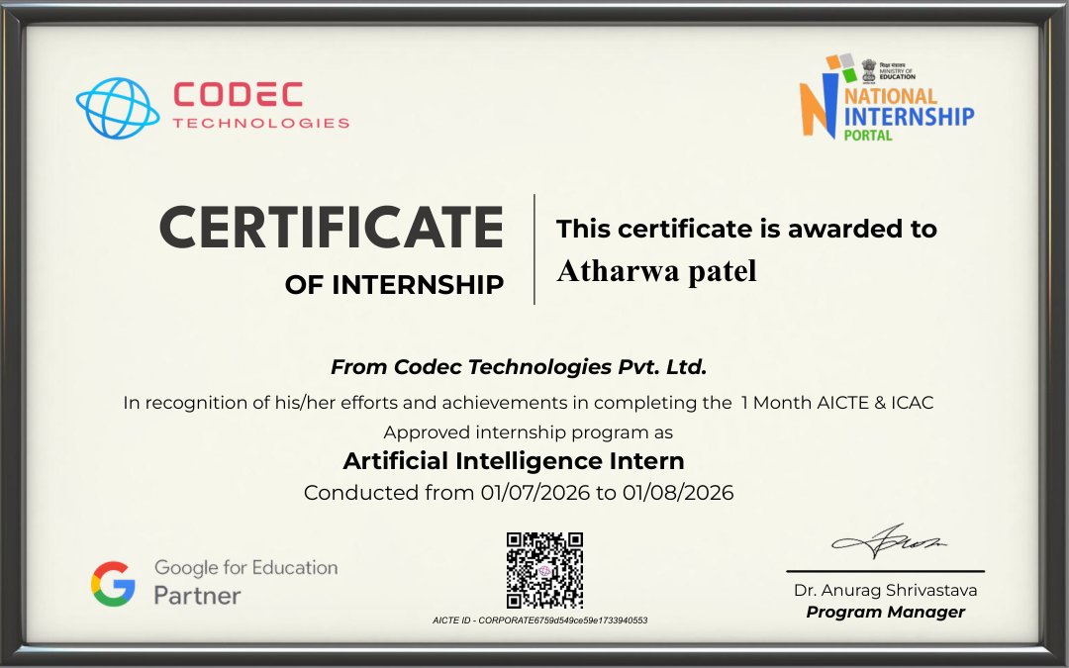
CERTIFICATION
Successfully Completed
Internship certificate supplied with the presentation materials
Name
Atharwa Patel
Role
Artificial Intelligence Intern
Conducted
01/07/2026 to 01/08/2026
Artificial Intelligence Internship • Atharwa Patel
10

Slide 11
THANK YOU
Thank You
Artificial Intelligence Internship
Codec Technologies Pvt. Ltd.
Atharwa Patel
Artificial Intelligence Intern
Certificate period: 01 July – 01 August 2026
Artificial Intelligence Internship • Atharwa Patel
11

