Slide 1
Shimmer IMU sensors
Ευαγγελία Αθανασακη

Slide 2
HARDWARE
ACCELEROMETER (3D): measures the change in velocity
GYROSCOPE (3D): measures the angular velocity
MAGNETOMETER (3D): measures the strength of the magnetic field

Slide 3
HARDWARE
ACCELEROMETER

Slide 4
HARDWARE
GYROSCOPE

Slide 5
HARDWARE
MAGNETOMETER

Slide 6
SOFTWARE
Data we actually get from each device have this format
ACCELEROMETER |  |  | GYROSCOPE |  |  | MAGNETOMETER
X axes | Y axes | Z axes | X axes | Y axes | Z axes | X axes | Y axes | Z axes
-0.6381260517 -0.6380077624 -0.5673273650 0.21909503347 0.23075359958 0.27738063488 | -0.85463565892 -0.81825331906 -0.79494647771 4.72064493121 4.72026912372 4.79104052609 | 9.99691863372 10.0087475664 9.93393015842 8.81426530854 8.78964565140 8.69044442106 | -1.30603847151 -1.06992021997 -0.83719184135 1.24207108972 1.79285476800 0.98309672126 | 0.77993576999 0.84110720293 0.91757149411 1.66692154763 1.03991435999 0.55054289646 | -1.71018442341 -1.11508475673 -0.85897238112 1.24207108972 1.79285476800 0.98309672126 | 0.61133603238 0.61133603238 0.61133603238 0.61740890688 0.61740890688 0.61740890688 | -0.64372469635 -0.64372469635 -0.62348178137 0.02834008097 0.02834008097 0.02834008097 | 0.72 0.72 0.72 0.81500000000 0.815000000001 0.81500000000
They are calibrated so we get them in known SI metrics

Slide 7






SOFTWARE
The output is described by:
Y = Kru + b + n
,
,
,
,
and
K | Sensor’s scale factor
r | is the rotation matrix which defines the actual sensor axes
u | value of the sensed phenomenon
b | is the offset bias vector
n | is the noise vector

Slide 8
THIS PROJECT
What we do
Characterizing four hand movements using all three 3D sensors
up
Down
Right
Left
How we do it
gather measurements (samples) from all sensors for each movement
Repeat each movement 10 times
…so actually we got 40 experiment sets from samples

Slide 9
THIS PROJECT
… and Visually
UP
10
DOWN
10
UP
8
9
DOWN
8
9
UP
DOWN
UP
7
DOWN
7
UP
6
DOWN
6
UP
5
DOWN
5
UP
4
DOWN
4
UP
2
3
DOWN
3
UP
1
DOWN
1
2
UP
DOWN
ACC |  |  | GYR |  |  | MAG
x | y | z | x | y | z | x | y | z
-0.63812 -0.63807 -0.56732 |  |  | -0.63866 0.638007 0.567327 |  |  | 0.638126 0.638007 0.567327
ACC |  |  | GYR |  |  | MAG
x | y | z | x | y | z | x | y | z
-0.63812 -0.63807 -0.56732 |  |  | -0.63866 0.638007 0.567327 |  |  | 0.638126 0.638007 0.567327
10 repetitions of
DOWN movement
10 repetitions of
DONW movement
Num of samples
Num of samples
Final Dataset composed of 40 experiment subsets
RIGHT
10
LEFT
10
RIGHT
8
9
LEFT
8
9
RIGHT
LEFT
RIGHT
7
LEFT
7
RIGHT
6
LEFT
6
RIGHT
5
LEFT
5
RIGHT
4
LEFT
4
RIGHT
3
LEFT
3
RIGHT
1
2
LEFT
1
2
RIGHT
LEFT
ACC |  |  | GYR |  |  | MAG
x | y | z | x | y | z | x | y | z
-0.63812 -0.63807 -0.56732 |  |  | -0.63866 0.638007 0.567327 |  |  | 0.638126 0.638007 0.567327
ACC |  |  | GYR |  |  | MAG
x | y | z | x | y | z | x | y | z
-0.63812 -0.63807 -0.56732 |  |  | -0.63866 0.638007 0.567327 |  |  | 0.638126 0.638007 0.567327
10 repetitions of
RIGHT movement
10 repetitions of
LEFT movement
Num of samples
Num of samples

Slide 10
DATA ANALYSIS
METHODOLOGY
Training phase
Choose 7/10 experiment sets of each movement and elaborate them at the same time
so we end up with 28 training sets
From each training set we extract the values below, to use them as features in clustering
Mean / Rms /Std/ Median
Using features above to separate into cluster our dataset expecting to get four clusters
each labeled as one from our movements
Take the 3/10 experiment sets that left from each movement total sets (12 testing sets)
Extract Mean / Rms /Std/ Median values from each set
calculate the distance of each observation from the centroids that kmeans gave
We classify each observation at the cluster with the min distance
Check the correctness of the results
Testing phase

Slide 11


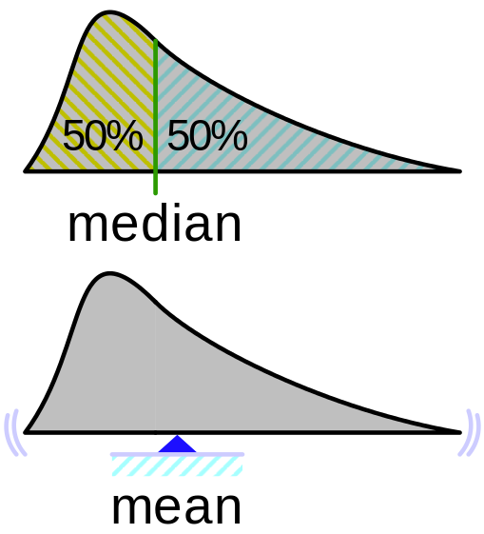



Mean: average of all numbers
Median: the middle number in a set of data
Rms (root mean square): the square root of the mean square
Std (standard deviation): quantifies the amount of variation or dispersion of a set of data values

Slide 12
Data we actually analyze
n-by-p data matrix
n: number of observations (28 = 4movements * 7experiments )
p: features used (4 from each device 36 features )
mean |  |  |  |  |  |  |  |  | rms |  |  |  |  |  |  |  |  | std |  |  |  |  |  |  |  |  | meadian
acc |  |  | gyr |  |  | mag |  |  | acc |  |  | gyr |  |  | mag |  |  | acc |  |  | gyr |  |  | mag |  |  | acc |  |  | gyr |  |  | mag
x | y | z | x | y | z | x | y | z | x | y | z | x | y | z | x | y | z | x | y | z | x | y | z | x | y | z | x | y | z | x | y | z | x | y | z
up
28
observations
4
movements
down
7
repetitions of each
movement
left
right

Slide 13

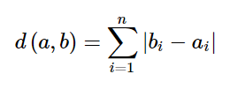
CLUSTER ANALYSIS METHOD
Kmeans
Parameters
Dataset: 28*36 matrix
k=4
Distance metric: cityblock
Why Cityblock?
Is a metric ( 36-dimensional )
Is better in calculating distances in more than two dimensions
Defined on

Slide 14
RESULTS
100% success
Cross-validation (7 different training/testing sets) came up
with 100% success on characterizing hand movements

