Slide 1
Shimmer IMU sensors
Ευαγγελία Αθανασακη

Slide 2
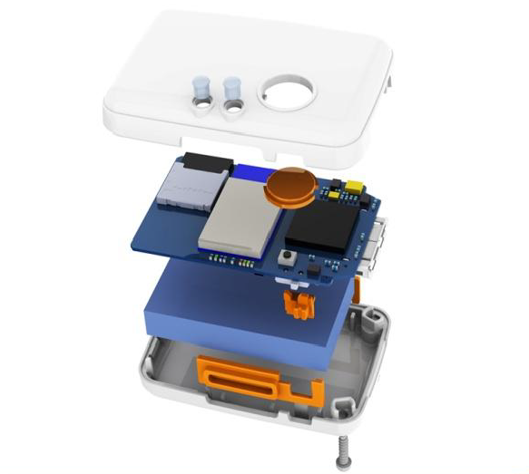
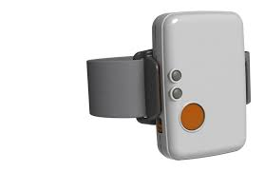
HARDWARE
Shimmer Device:
Sensors included in each device:
Accelerometer (3D), measures changes in velocity
Gyroscope (3D), measures angular velocity
Magnetometer (3D), measures strength of the magnetic field

Slide 3
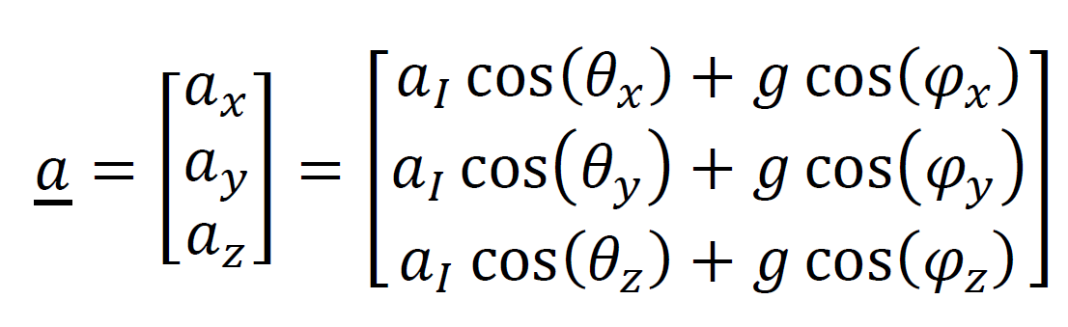
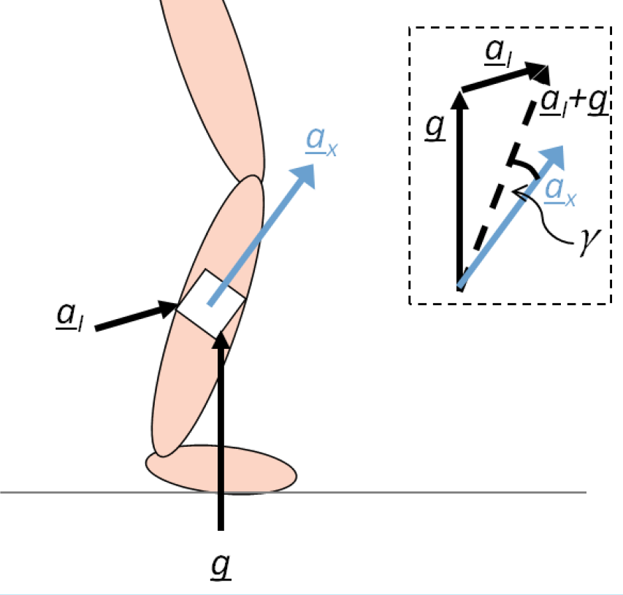


HARDWARE
ACCELEROMETER
Figure 1. Shimmer3 default axis directions
Figure 2. total acceleration vector
g
φ
θ
g | Gravitational acceleration, 1 g ≈ 9.81 m/s2
a | inertial acceleration, rate of change of velocity due to forces on body
θ | angle that the axis α , makes with the inertial acceleration vector α
φ | angle that the axis α , makes with the gravity vector g
χ
χ
Figure 3. Uni-axial magnetometer attached to a leg segment

Slide 4

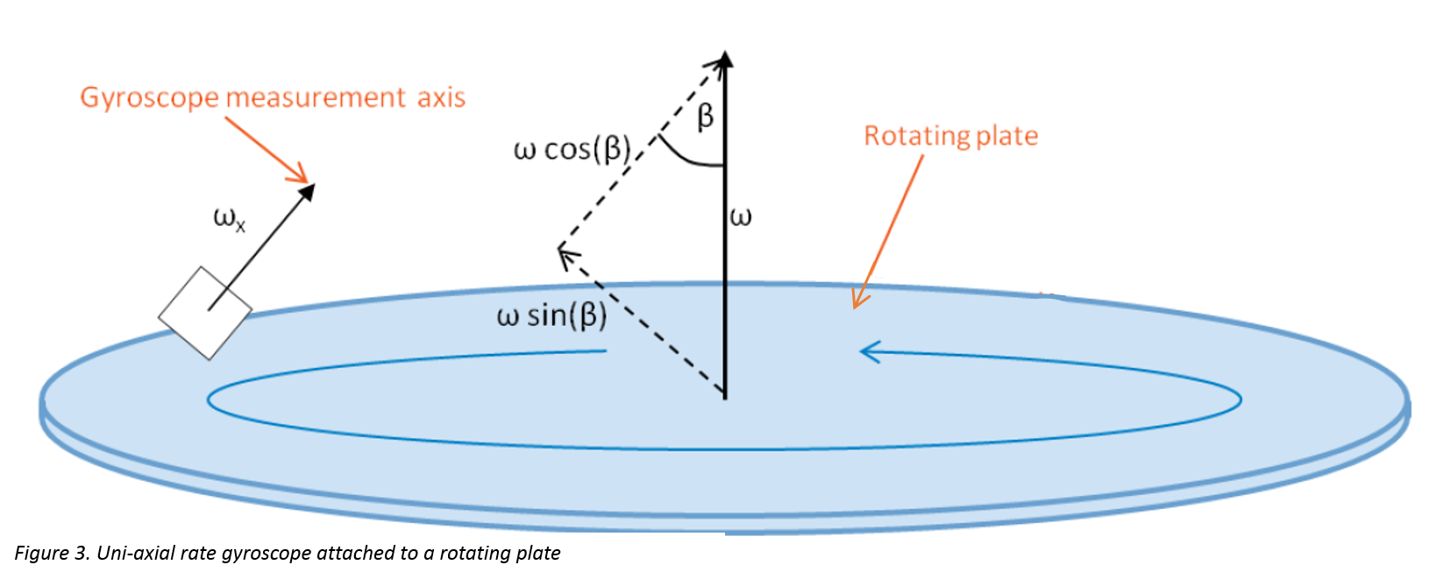
HARDWARE
GYROSCOPE
ω
ω =
ω
ω cos(β )
ω cos(β )
ω cos(β )
x
x
ω =
y
y
z
Figure 1. Shimmer3 default axis directions
z
Figure 2. tri-axial gyroscope rate
ω | the magnitude of the angular velocity vector component along the measuring axis of the rate gyroscope
β | the inclination of the measuring axis with respect to the angular velocity vector

Slide 5
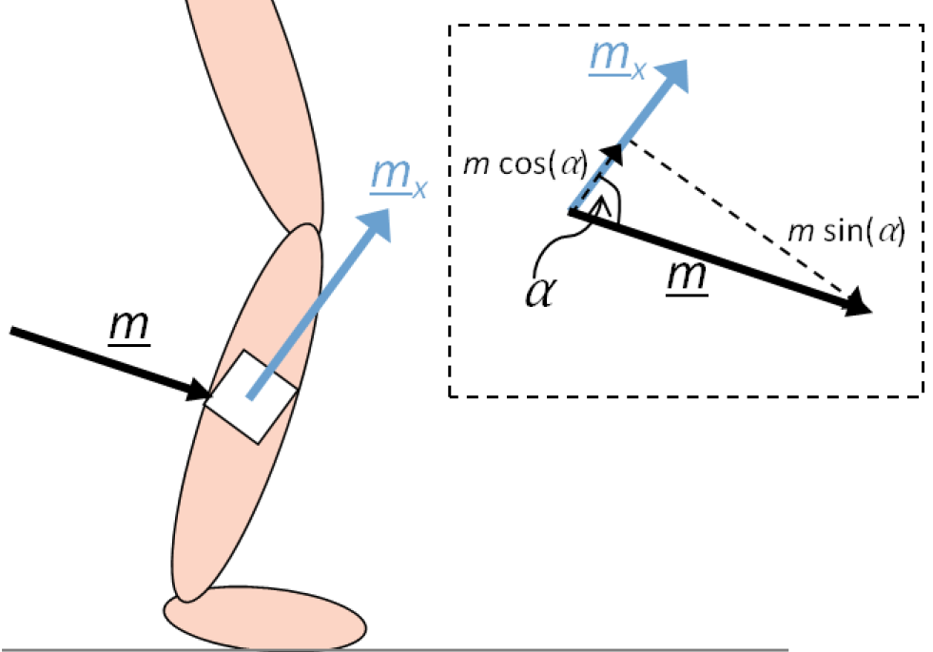
HARDWARE
MAGNETOMETER
m
m =
m
m cos(α )
m cos(α )
m cos(α )
x
x
m=
y
y
z
z
Figure 1. Shimmer3 default axis directions
Figure 2. tri-axial magnetometer rate
m | the magnitude of the magnetic field vector component along the measuring axis of the magnetometer
α | the angle between the magnetometer measuring axis and the magnetic field vector

Slide 6
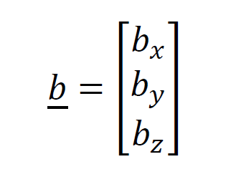
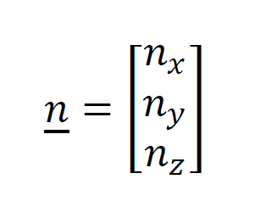
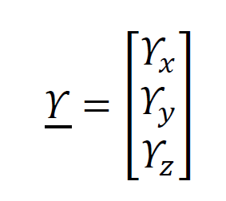
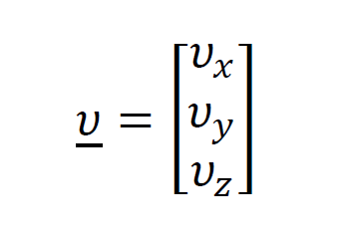
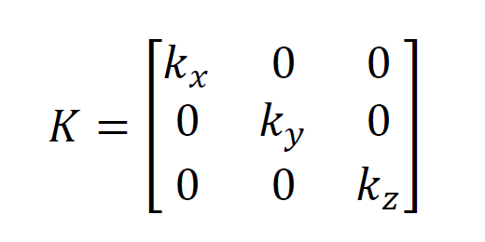
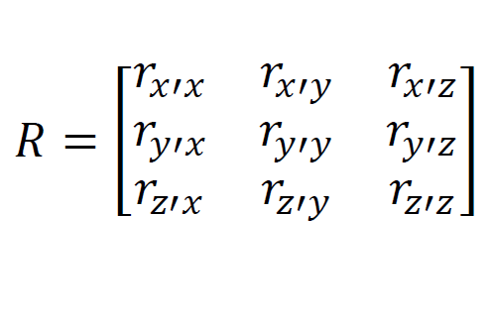
SOFTWARE
The output Y for each sensor (acc/gyr/mag) is:
Y = Kru + b + n
K | Sensor’s scale factor (the change in output per unit of input Volts/g) | Estimated by calibration
r | is the rotation matrix which defines the actual sensor axes | Estimated by calibration
u | value of the sensed phenomenon | Defined in use
b | value of the sensor output when the sensed phenomenon is equal to zero | Estimated by calibration
n | is the noise vector | Defined by manufacturer

Slide 7
SOFTWARE
Data we actually get from each device have this format
(m/s )
(deg/sec)
TIMESTAMP (ms)
1024566650390 1044097900390 1063629150390 3954254150390 3973785400390 3993316650390
ACCELEROMETER |  |  | GYROSCOPE |  |  | MAGNETOMETER
X axes | Y axes | Z axes | X axes | Y axes | Z axes | X axes | Y axes | Z axes
-0.6381260517 -0.6380077624 -0.5673273650 0.21909503347 0.23075359958 0.27738063488 | -0.85463565892 -0.81825331906 -0.79494647771 4.72064493121 4.72026912372 4.79104052609 | 9.99691863372 10.0087475664 9.93393015842 8.81426530854 8.78964565140 8.69044442106 | -1.30603847151 -1.06992021997 -0.83719184135 1.24207108972 1.79285476800 0.98309672126 | 0.77993576999 0.84110720293 0.91757149411 1.66692154763 1.03991435999 0.55054289646 | -1.71018442341 -1.11508475673 -0.85897238112 1.24207108972 1.79285476800 0.98309672126 | 0.61133603238 0.61133603238 0.61133603238 0.61740890688 0.61740890688 0.61740890688 | -0.64372469635 -0.64372469635 -0.62348178137 0.02834008097 0.02834008097 0.02834008097 | 0.72 0.72 0.72 0.81500000000 0.815000000001 0.81500000000
2
(local flux)
Units are in SI (International System of Units)

Slide 8
GESTURE IDENTIFICATION
Objective:
Identify four hand gestures
1. Up
2. Down
3. Left
4. Right
Methodology:
Construct final dataset by combining all gesture subsets
Extract features using statistical metrics
Apply k-means
Get results

Slide 9
1.DATASET
Gather many repetitions of each gesture (each repetition is a subset)
Compose all subsets and create final dataset
9
RIGHT
RIGHT
RIGHT
Final dataset
RIGHT
LEFT
LEFT
LEFT
LEFT
DOWN
Num of samples
DOWN
RIGHT subsets
DOWN
DOWN
UP
UP
LEFT subsets
UP
UP
ACC |  |  | GYR |  |  | MAG
x | y | z | x | y | z | x | y | z
-0.63812 -0.63807 -0.56732 |  |  | -0.63866 0.638007 0.567327 |  |  | 0.638126 0.638007 0.567327
UP subsets
Num of samples
DOWN subsets

Slide 10
rms*: root mean square
stdev*: standard deviation
2.FEATURE EXTRACTION
For each subset from dataset, get mean/median/rms*/stdev* statistical metrics from all three sensors and for all dimensions of each
n-by-36 data matrix
n: total number of subsets
36: features (3 dimensions/3 sensors/4 statistical metrics)
36 features
mean |  |  |  |  |  |  |  |  | rms |  |  |  |  |  |  |  |  | std |  |  |  |  |  |  |  |  | meadian
acc |  |  | gyr |  |  | mag |  |  | acc |  |  | gyr |  |  | mag |  |  | acc |  |  | gyr |  |  | mag |  |  | acc |  |  | gyr |  |  | mag
x | y | z | x | y | z | x | y | z | x | y | z | x | y | z | x | y | z | x | y | z | x | y | z | x | y | z | x | y | z | x | y | z | x | y | z
Total subsets
4 gestures

Slide 11
3.APPLY K-MEANS
Parameters
Data: n observations by 36 features matrix
k=4 (clusters)
Distance metric: cityblock
4.RESULTS
K-fold for cross validation
Get average success percentage

Slide 12





Raw data
VISUAL REPRESENTATION
Feature extraction
70%
30%
Train set
Test set
kmeans
Majority of observations
in each cluster defines the label
Actual
clustering
Predicted
clustering
clusters
up
up
Label 1
Label 3
Classify each
observation
in a cluster
up
down
Final result
Label 2
down
down
71,8% success
Label 4
left
left
left
left
right
up

Slide 13
RESULTS
Size of dataset (subsets for each subject) | Controlled measurements | Left hand involved | Right hand involved | Fixed hand orientation per gesture | results
40 |  |  |  |  | 96,87%
72 |  |  |  |  | 89,29%
28 |  |  |  |  | 29,28%
Controlled measurements: subject had total awareness about taking measurements
Fixed hand orientation per gesture: for all gesture repetitions hand had fixed orientation

