Slide 1
Lagocephalus Prediction
Aegean University
Athanasiou Vasileios
Manolis Maragoudakis

Slide 2
Agenda
Web application demo
Explain the main parts
Web app architecture
CNN model

Slide 3
CODE
https://github.com/athbill/mthesis

Slide 4
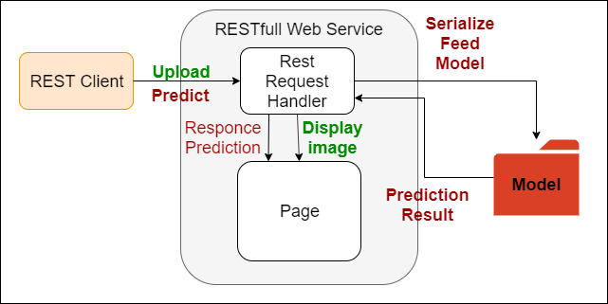
Web App Architecture

Slide 5
CNN Model
File cnn_v4.py
Main components
Convolutional Layers (32, 64, 128)
Pooling Layers (Max Pooling with pool size(2x2) )
Batch Normalization
Dense Layers (64, 1) with activation ‘relu’ & 'sigmoid’ respectively
Dropout 50%

Slide 6
Performance
Accuracy ~74%
Better Results?
Yes if
Get More Data
Bigger Picture
Model Optimization
“Play” with Layers
Use hyperparameter optimization library (e.g. hyperopt lib)

Slide 7
Thank you !!

