Slide 1
Gamified Upper Limb Stroke Rehabilitation System
Webcam hand tracking, single channel EMG, four rehabilitation games and a physiotherapist dashboard
M. Imzan, M. Atheeq, D. Karunakalage, V. Herath | Sri Lanka Technology Campus
Notes:
Final year project presentation. Results quoted in this deck are from the offline experiments on healthy volunteers (docs/model_comparison.md, runs of 2026-10-21). No stroke patient data are presented as clinical results.

Slide 2
Architecture: the camera decides, EMG measures effort
LIVE SYSTEM (one laptop)
EMG sensor + ESP32
MD0437 envelope, GPIO34, 12-bit ADC
EMG processing
200 ms windows, 8 features, grip effort %
Backend
FastAPI + SQLite, offline queue
Fusion engine
camera label + latest EMG, every 50 ms
Rehab games
4 games, 7 levels, grip-effort gate
USB serial, 921600 baud
Webcam
OpenCV frames, about 30 fps
Computer vision
MediaPipe 21 landmarks, 7 gestures
Dashboard
RehabHub (React) for the physiotherapist
OFFLINE RESEARCH (not used to control the games)
EMG dataset
Healthy volunteers, 7 labelled movements, 100 Hz
Machine learning
LDA, SVM, random forest, MOMENT-1, LoRA
Design decision
One EMG channel separates effort, not direction
Notes:
Live path: the MD0437 EMG module and ESP32 stream samples over USB serial; the EMG thread makes 200 ms feature windows and, in Webcam + EMG mode, a grip effort percentage from the patient's relax-then-squeeze check. The vision thread runs MediaPipe and rules for seven gestures. The fusion engine combines the latest camera label and EMG features every 50 ms. Games upload sessions to the FastAPI + SQLite backend (or an offline queue), and the RehabHub dashboard launches games and shows progress. Offline path: the recorded dataset was used to compare LDA, SVM, random forest, MOMENT-1 and LoRA; the result led to the design choice that the camera decides the movement and EMG measures effort. Not built yet: login, patient-therapist messaging, Wi-Fi link.

Slide 3
AI and machine learning algorithms we compared
Each model classifies an EMG window into 7 movements. Tested leave-one-subject-out on 8 healthy volunteers (S02 to S09); chance = 14.3%.
LDA
SVM
RF
M1
LoRA
Linear Discriminant Analysis
Support Vector Machine (RBF, C = 10)
Random forest (200 trees)
MOMENT-1-small
LoRA fine-tuning
Finds straight-line boundaries between movements from the 8 window features.
Curved boundaries with a radial basis function kernel; the strongest classical model.
Votes of many decision trees; robust to features on different scales.
Pre-trained time-series transformer (35.3 M parameters); turns 5.12 s into a 512-value embedding.
Rank 8 adapters on attention q and v plus a new head: 118,279 trainable parameters.
34.7%
200 ms windows
43.8% on 5.12 s
47.3%
5.12 s windows
37.2% on 200 ms
48.1%
on frozen MOMENT-1 features
best result overall
14.2%
untrained head alone
needs a trained classifier
45.9%
fine-tuned MOMENT-1
48.7% on holdout split
Notes:
All values are leave-one-subject-out accuracy over 7 movements on 8 healthy volunteers (S02-S09), from docs/model_comparison.md (runs of 2026-10-21, after the LoRA gradient fix). Classical models use 8 features: RMS, MAV, VAR, STD, PEAK, WL, ZC, SSC. LDA: 34.7% (200 ms) and 43.8% (5.12 s). SVM: 37.2% and 47.3%. Random forest: 34.0% and 40.2% on window features, 48.1% on frozen MOMENT-1 embeddings (best). MOMENT-1 untrained head: 14.2% (chance). Linear probe: 43.0%. LoRA: 45.9% LOSO, 48.7% on the holdout split (test S07-S09).

Slide 4
Longer windows and MOMENT-1 features scored best
48.1%
Best: frozen MOMENT-1 features + random forest
+10.1 pts
SVM from 200 ms to 5.12 s windows (37.2% to 47.3%)
14.3%
Chance level for 7 balanced movements
Notes:
Source: docs/model_comparison.md, leave-one-subject-out table (8 healthy volunteers, S02-S09). Window length mattered more than the model. Frozen MOMENT-1 features with a random forest gave the best result, 48.1% (macro F1 0.443). Healthy volunteers only; not a clinical result.

Slide 5
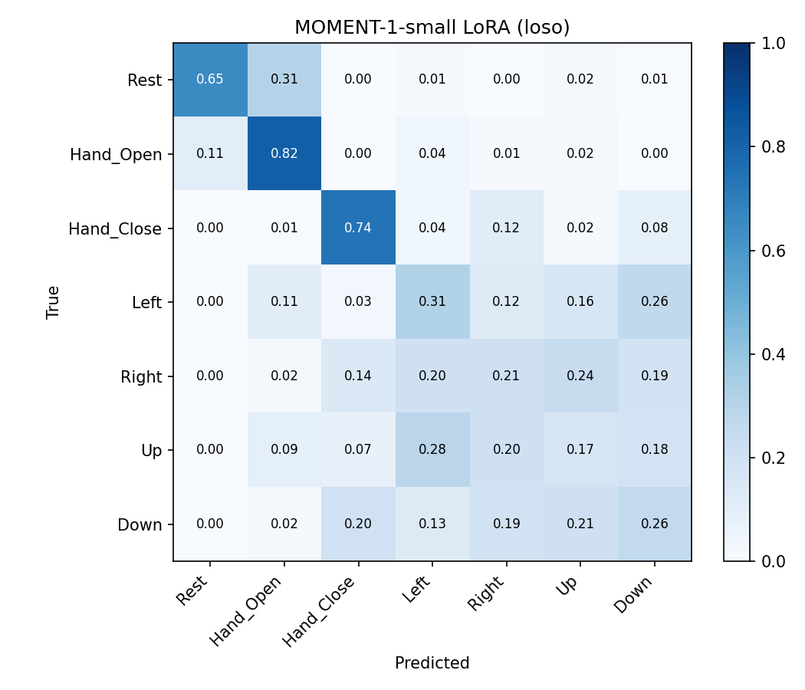
Confusion matrix: grip is learnable, direction is not
82%
Hand Open recognised
and Hand Close 74%: strong activity contrasts
65%
Rest recognised
31% of Rest windows were read as Hand Open
17-31%
Left, Right, Up, Down
near chance: one forearm channel cannot tell direction
So in the games, the camera decides the movement and EMG checks grip effort.
MOMENT-1-small + LoRA, leave-one-subject-out, 8 healthy volunteers, rows sum to 1. Source: models/moment/small_loso_20261021-192025/confusion.png
Notes:
This is the saved confusion matrix of the fine-tuned MOMENT-1 + LoRA model (run small_loso_20261021-192025), pooled over the 8 leave-one-subject-out folds; each row is a true movement and sums to 1. Its diagonal matches the per-movement recall in docs/model_comparison.md: Rest 65%, Hand_Open 82%, Hand_Close 74%, Left 31%, Right 21%, Up 17%, Down 26%. The best model overall (frozen MOMENT + random forest, 48.1%) has a similar pattern but its matrix is not saved in the repository. Healthy volunteers only.

Slide 6
Games turn effort and accuracy into percentages
Session accuracy = correct attempts ÷ all attempts × 100
Results screen stars
1 star
2 stars
3 stars
Free play auto difficulty (last 6 attempts)
−0.5 level
stay
+0.5
0%
40%
50%
80%
100%
Level goal progress on screen
“Level 4: 9 of 12 balloons popped”
Pass the goal in 3 minutes to open the next level the next day (7 levels, about one week per game).
Effort % = (RMS − rest) ÷ (strongest squeeze − rest) × 100
Rest and strongest squeeze come from each patient's relax-then-squeeze check. A fist counts only when effort reaches the level's threshold.
Notes:
Every value on this slide is a rule from the game code, not a measured result. Effort needed per level: src/games/effort.py AUTO_RANGE (25, 60) interpolated over the level difficulties in src/games/levels.py, giving 25.0, 30.8, 36.7, 42.5, 48.3, 54.2, 60.0 percent. Effort percentage formula: effort_pct in src/games/effort.py; rest is the median RMS while relaxed and the strongest squeeze is the 90th percentile RMS while squeezing. Stars: src/games/summary.py (3 stars at 80% accuracy or more, 2 at 50% or more). Auto difficulty: src/games/difficulty.py (raise 0.5 at 80% or more of the last 6 attempts, lower 0.5 at 40% or less). The level progress text is the on-screen example from docs/games.md.

