Slide 1
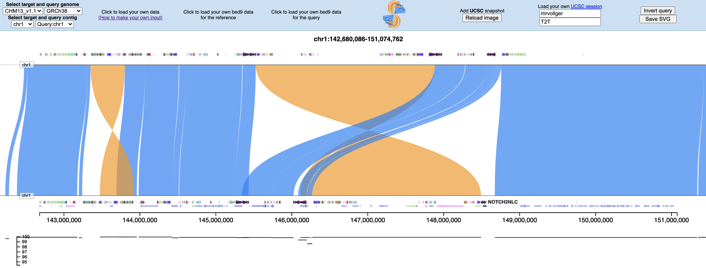
Select from: GRCh38, CHM1, or any HPRC genome
bed9/bed12 annotations on the target or query
Show gene models with exons!
Hover over any annotation to see the name

