Slide 1
Model to select stocks

Slide 2
PROBLEM TO SOLVE
We would like to develop a model to help us select a few stocks to invest for the long term.
Our dataset is the Nasdaq historical stock prices
Our target is the stock annual return for the year after the dataset.

Slide 3

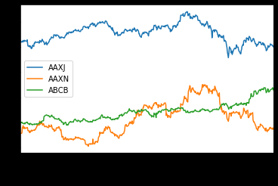
Explore the Dataset
We choose a two-year period for our data, from 2013 to 2014.

Slide 4
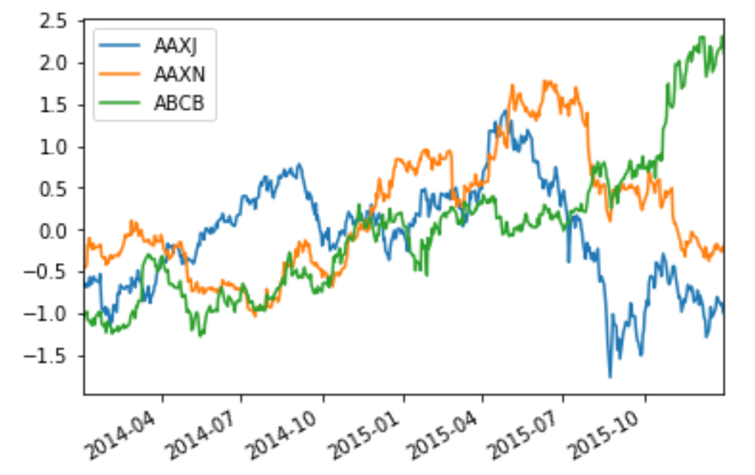
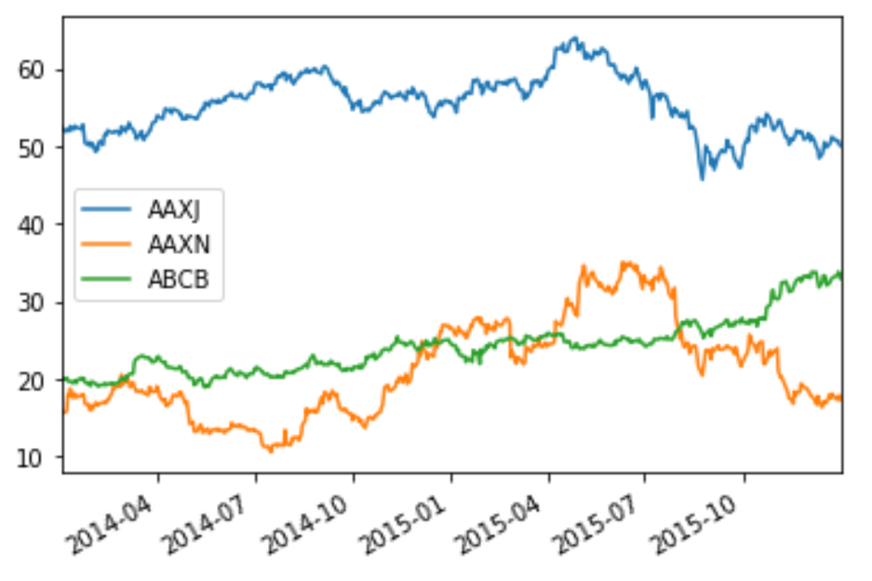
Explore the dataset
Original data
Scaled Data

Slide 5
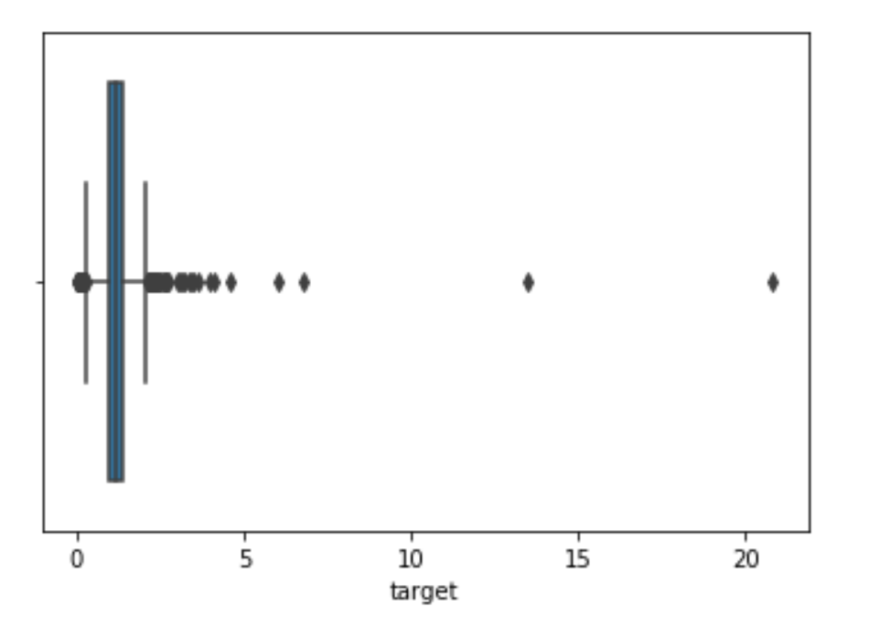
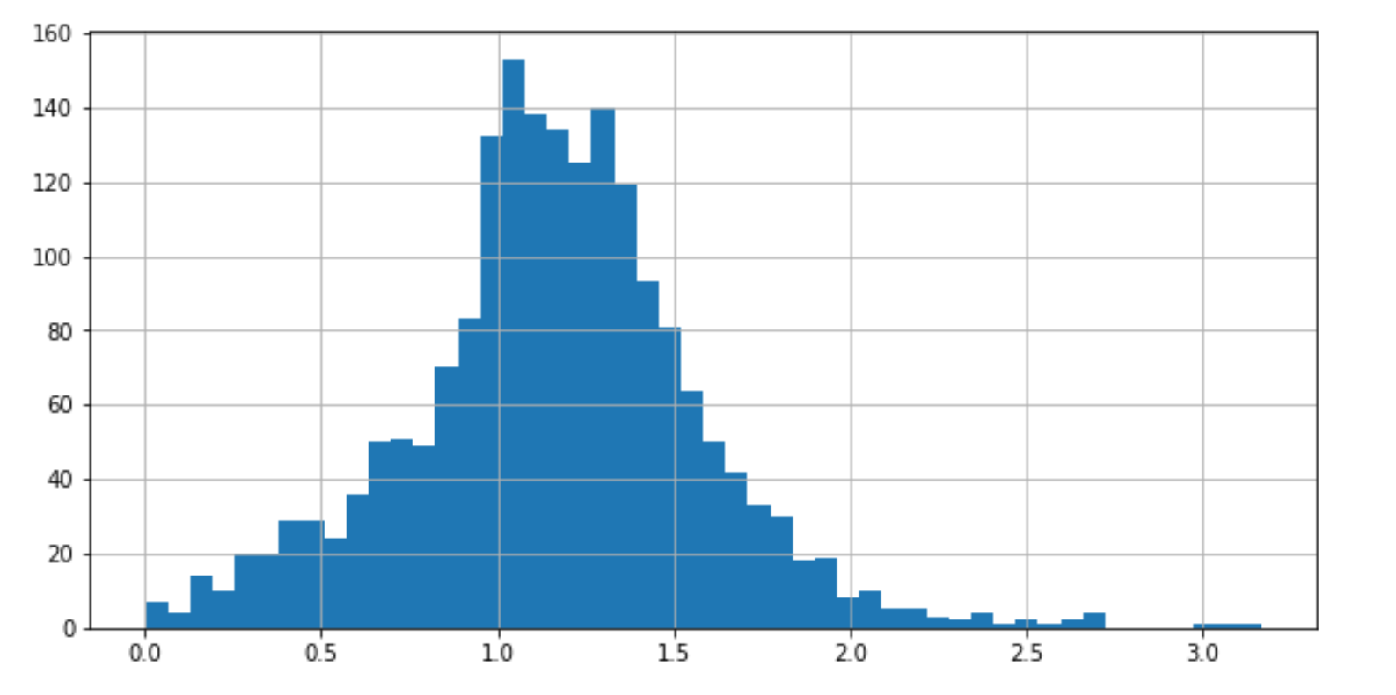
Handling outliers in target data
Original target
After removing outlier

Slide 6
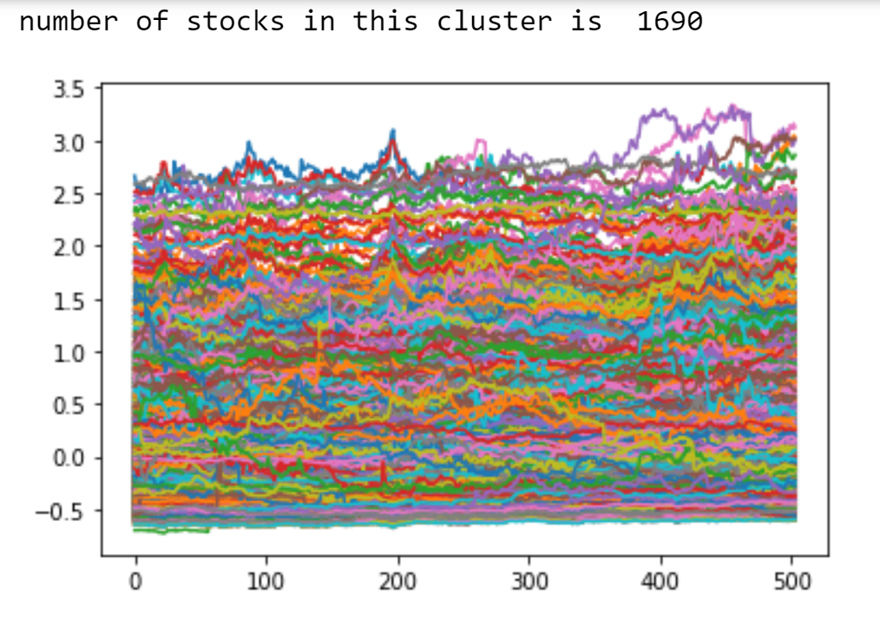
Clustering the dataset
It Seems most dataset are cluster into a straight line.

Slide 7
Classifier mOdel
Logistic Regression
SGD linear classifier
Random Forest
Kneighbor
GridentBoosting

Slide 8
Round 2 training
Voting Classifier
Random Forest
Kneighbor
GridentBoosting

Slide 9


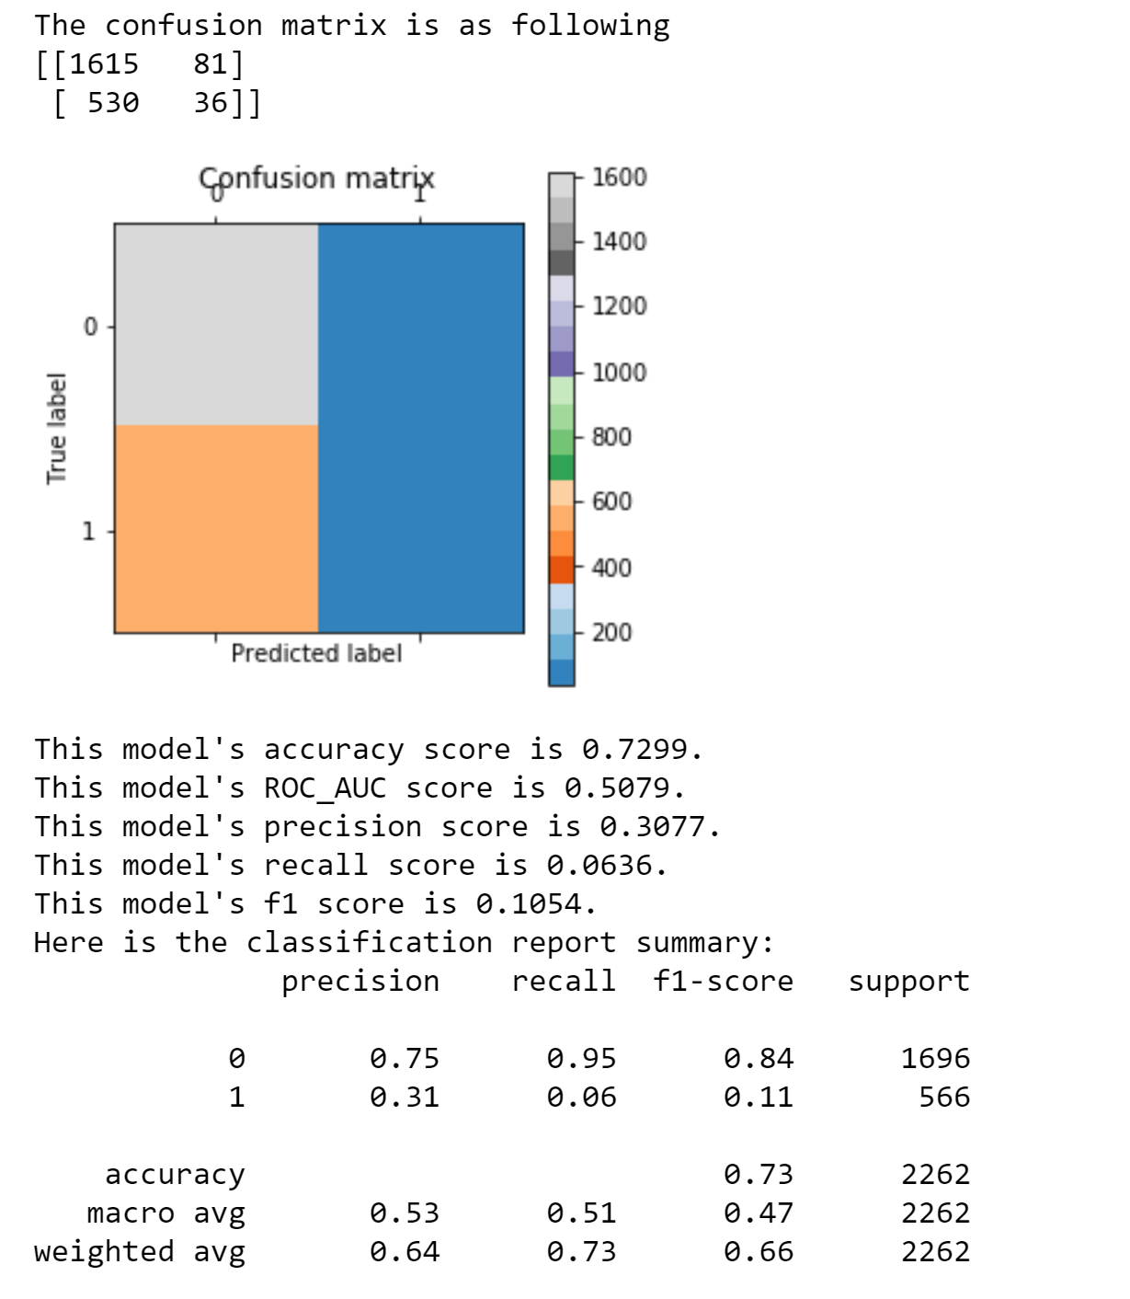
Production result

Slide 10
result
Overfitted Model
Need more data from different years to train the data.
Try to modify the original classifier by Regularization

