Slide 1
Effect of Activating Factor 42 on Gene Expression
Karl Berator & Athena Xiourouppa

Slide 2
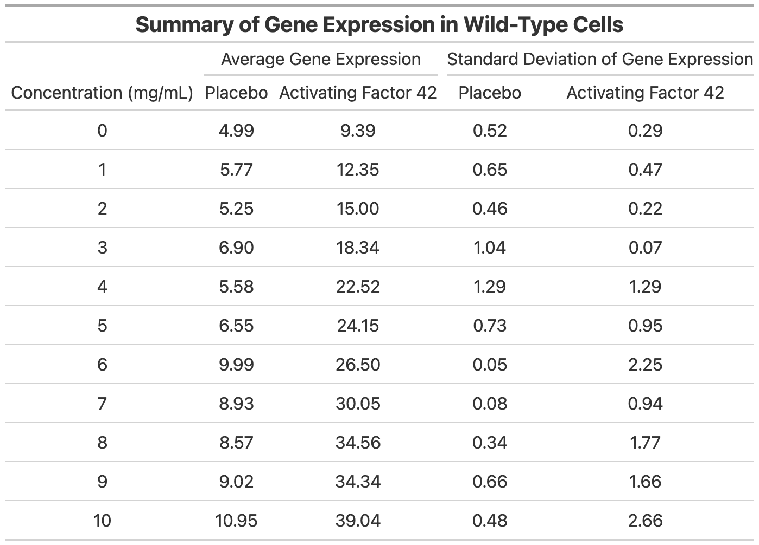
Summary of Gene Expression in Wild-Type Cells
TABLE 1: We notice that the administration of Activating Factor 42 roughly doubles gene expression when compared with the placebo, and the effect grows in magnitude as concentration increases. The standard deviation is generally below one, but as only two trials have been taken, this is not strongly indicative of precision.

Slide 3
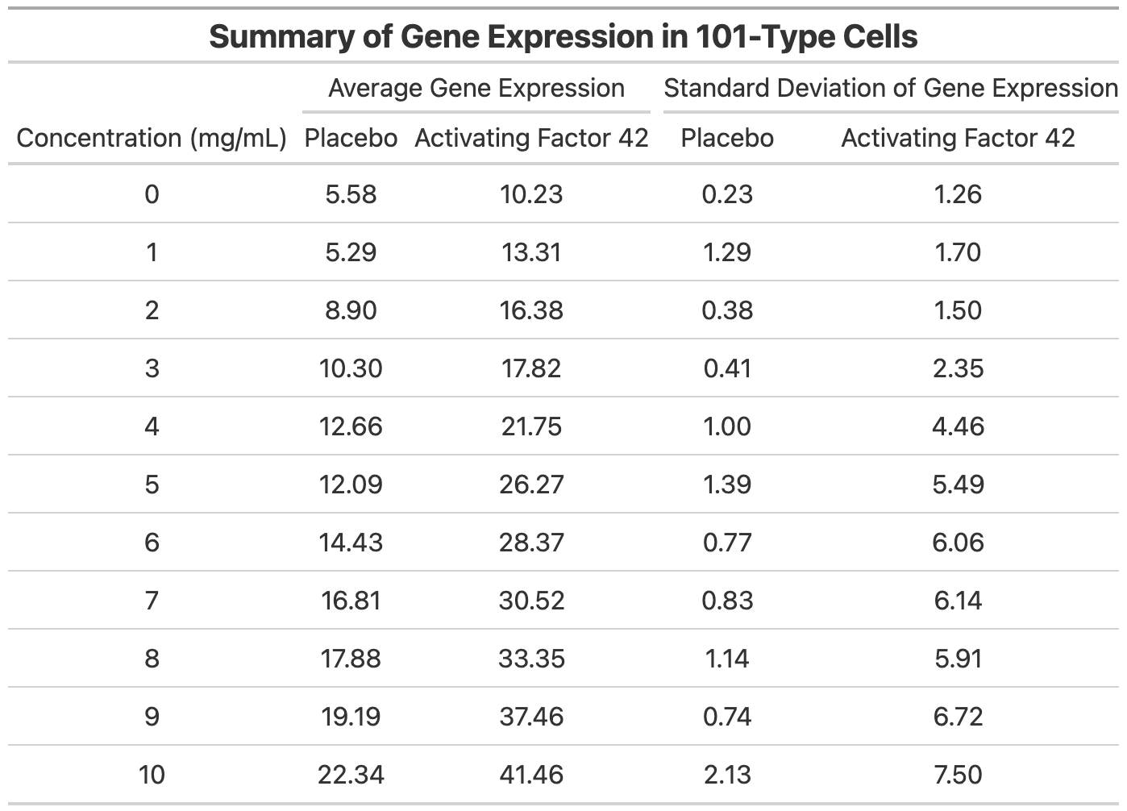
Summary of Gene Expression in 101-Type Cells
TABLE 2: Similar to the wild-type cells in Table 1, we again see a doubling effect in gene expression when Activating Factor 42 is applied, albeit to a slightly lesser extent. Standard deviation is much greater here.

Slide 4
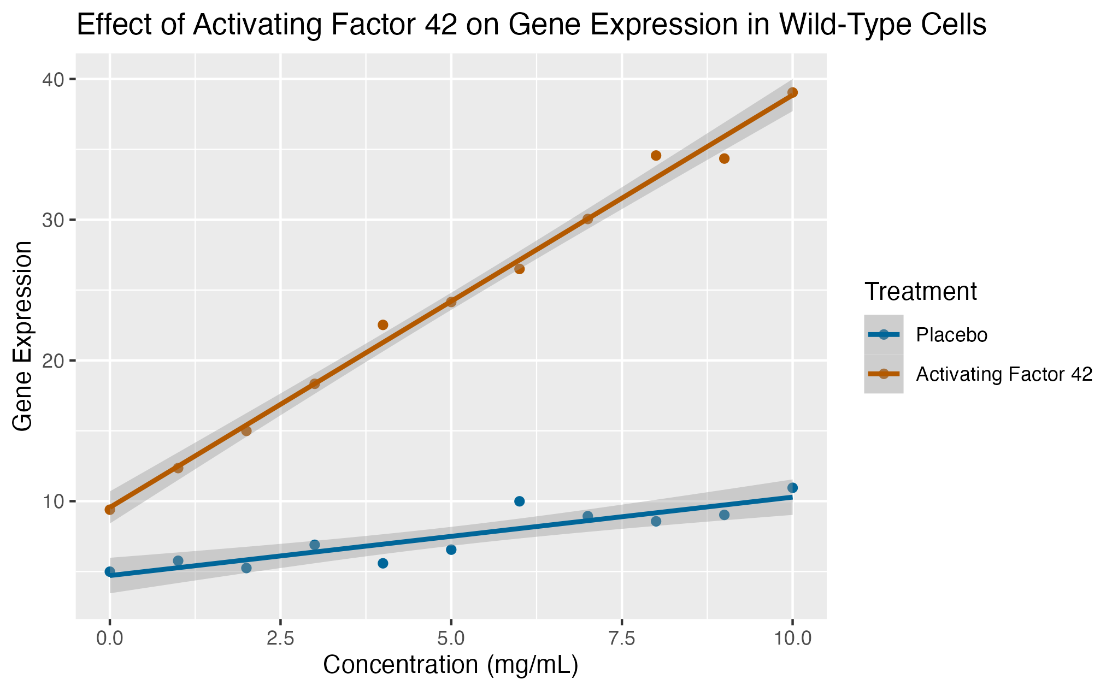
Comparison of Activating Factor 42 with Placebo on Wild-Type Cells
FIGURE 1: We see that gene expression increases with concentration of the treatment, and that Activating Factor 42 increases much more rapidly than the placebo in wild-type cells.

Slide 5
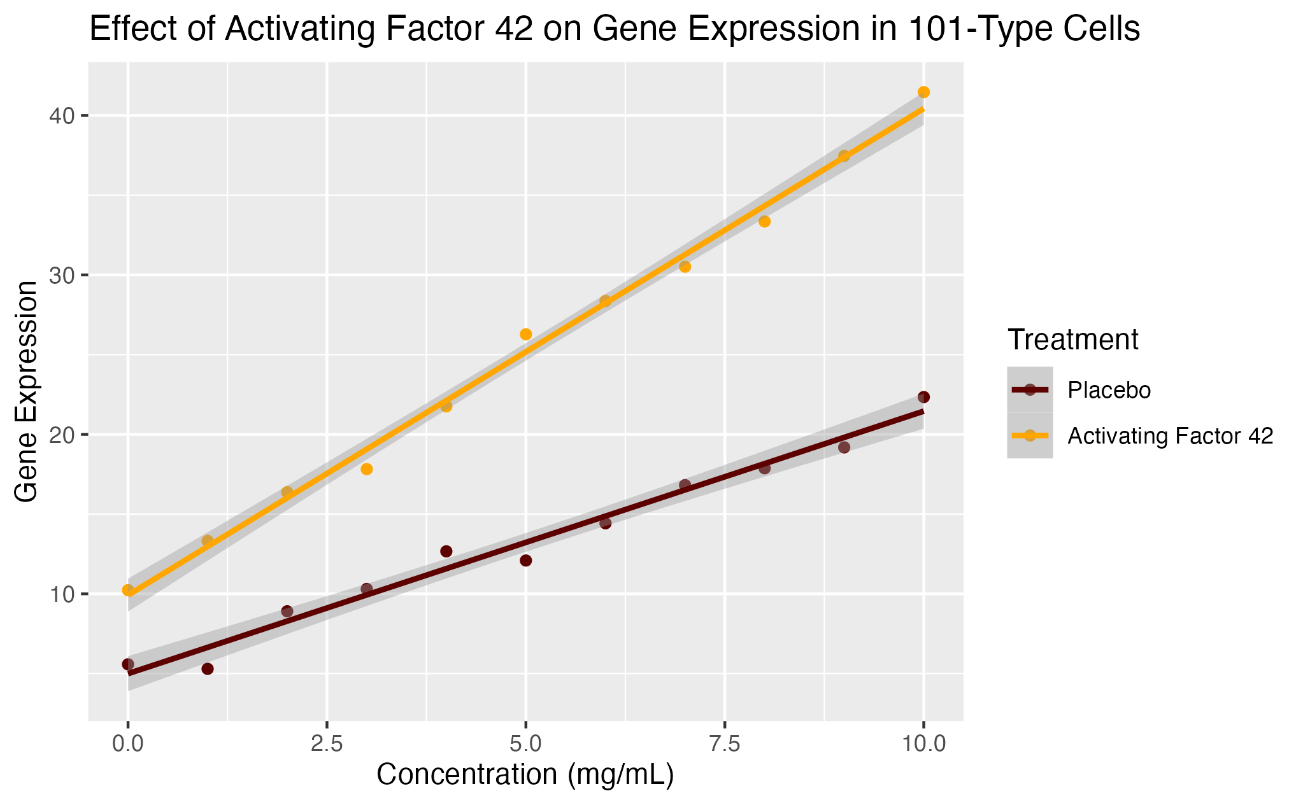
Comparison of Activating Factor 42 with Placebo on 101-Type Cells
FIGURE 2: We see that gene expression increases with concentration of the treatment, and that Activating Factor 42 increases much more rapidly than the placebo in 101-type cells.

Slide 6
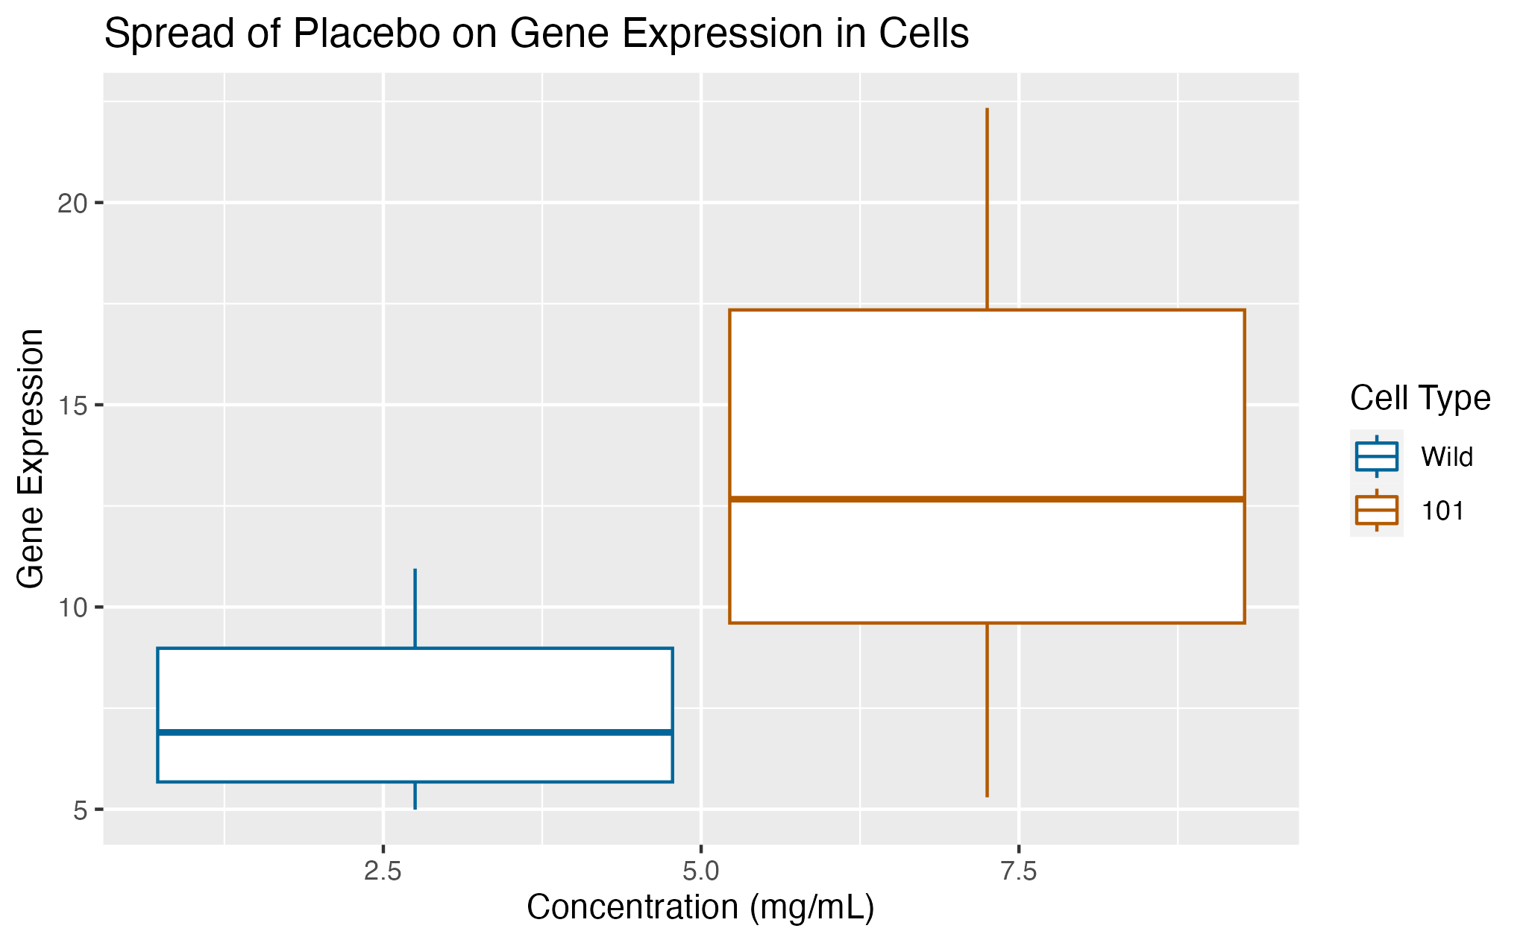
Spread of Placebo in Wild- and 101-Type Cells
FIGURE 3: We see more variability in gene expression for 101-type cells compared with wild-type cells when the placebo is administered. Furthermore, we have higher gene expression on average in 101-type cells.

Slide 7
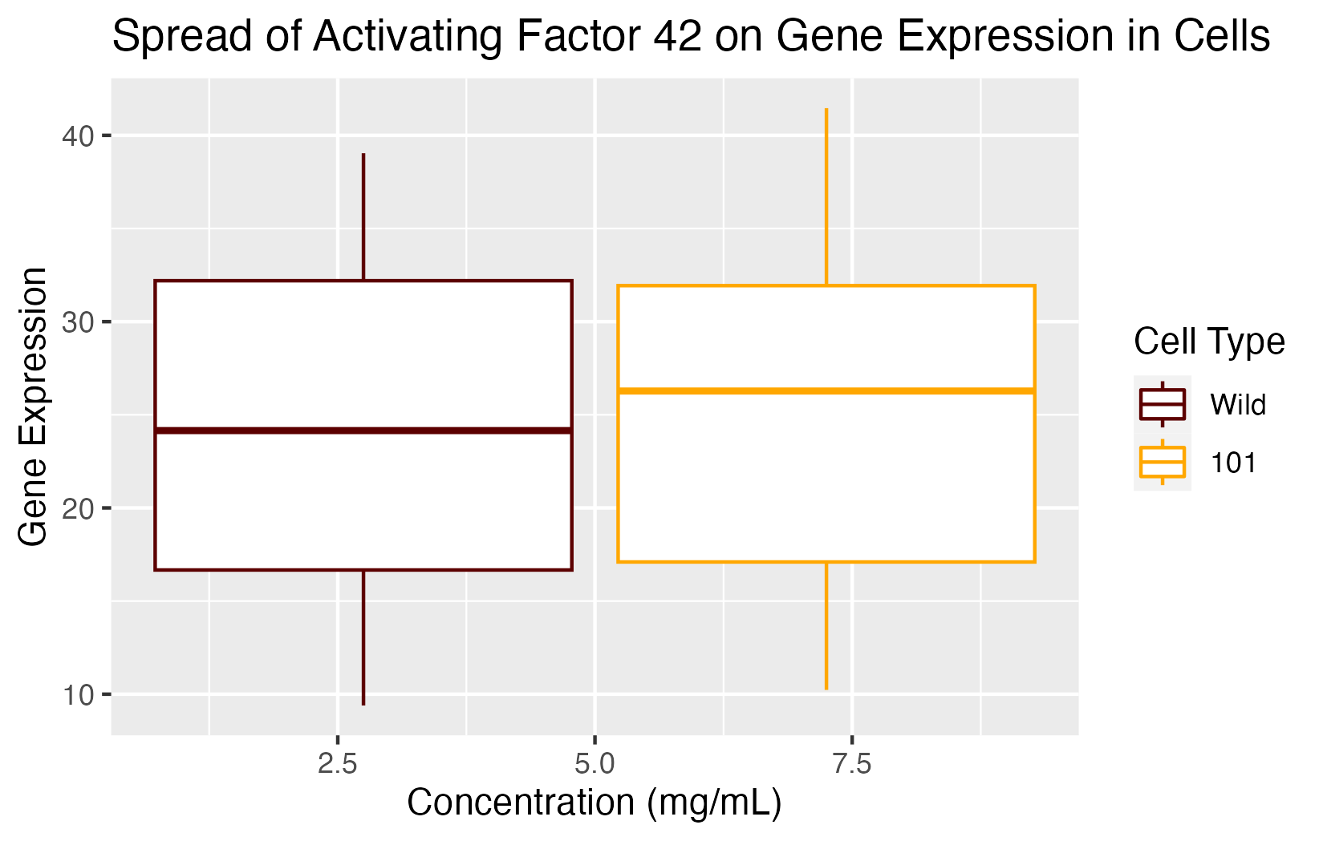
Spread of Activating Factor 42 in Wild- and 101-Type Cells
FIGURE 4: We see roughly equal variability in gene expression for 101-type cells compared with wild-type cells when Activating Factor 42 is administered. 101-type cells also have slightly greater gene expression on average.

Slide 8
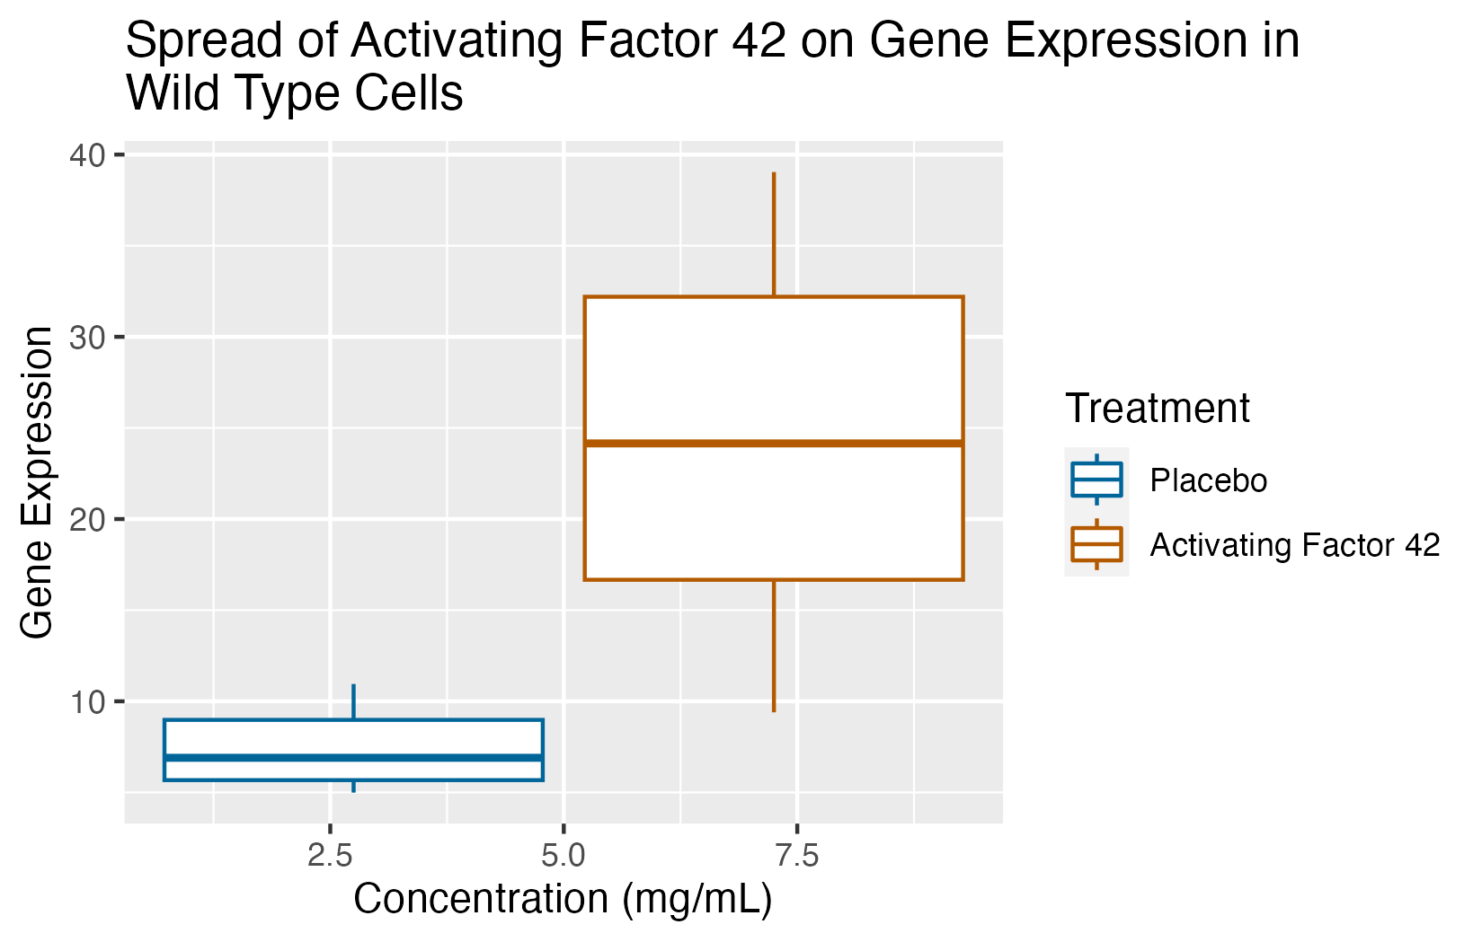
Comparison of Spread of Treatment on Wild-Type Cells
FIGURE 5: We see significantly more gene expression and a greater spread when Activating Factor 42 is administered to wild-type cells.

Slide 9
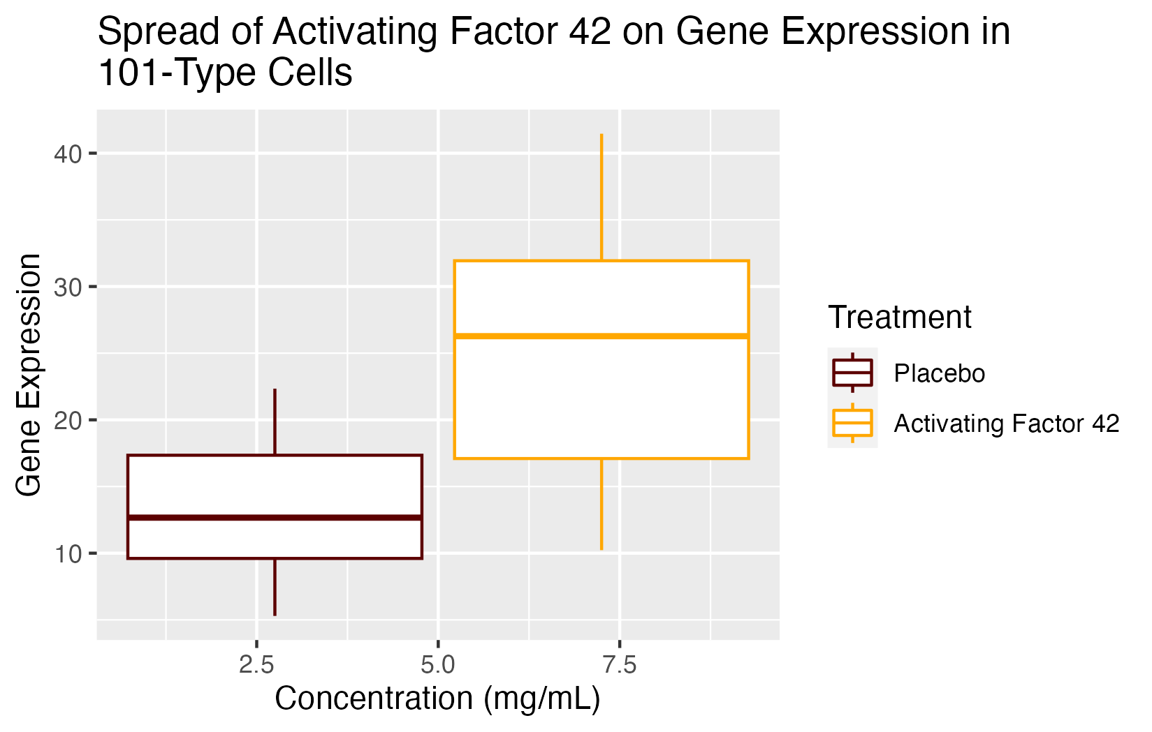
Comparison of Spread of Treatment on 101-Type Cells
FIGURE 6: We see significantly more gene expression and a greater spread when Activating Factor 42 is administered to 101-type cells, although the difference here is smaller than in Figure 5.

