Slide 1


Association between Bilirubin and Survival in Primary Biliary Cirrhosis
Amelia Tran
Mount Holyoke College ’21
Mentor: Dr. Audrey Mauguen
Department of Epidemiology and Biostatistics
Notes:
Hi everyone. My name is Amelia. I’m a rising senior at Mount Holyoke College where I major in Statistics. I’m calling in from Vietnam. This summer, I work under the supervision of Dr. Audrey Mauguen in the Department of Epidemiology and Biostatistics. Our project studies the association between Bilirubin and survival in primary biliary cirrhosis.

Slide 2
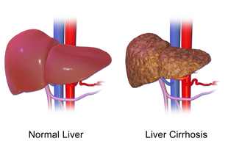
Primary Biliary Cirrhosis (PBC)
Relatively rare disease (1/3000)
Common in women
Symptoms:
Jaundice
Fatigue
Loss of appetite
No symptoms
Immune system attacks liver
Damage bile ducts
Lead to liver fibrosis and cirrhosis
Possibly lead to liver cancer
Treatment:
Medications
Liver transplantation
Notes:
Primary biliary cirrhosis is a chronic liver disease. When someone’s immune system attacks the liver, it causes slow, progressive damage to the bile ducts in the liver. Overtime, it will lead to fibrosis and cirrhosis of the liver. Complications of cirrhosis include swelling of the body or even liver cancer. It is a relatively rare disease (1/3000) and very common in women.
Common symptoms of PBC include yellowing of the skin, fatigue, and loss of appetite. Some patients may have no symptoms at all. Possible treatment includes medications and liver transplantation.

Slide 3
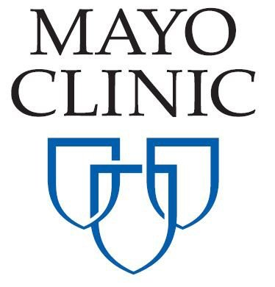

Study data - PBC Clinical Trial
Follow-up for 10 years
312 patients: 154 in placebo group
158 in treatment group
Longitudinal biomarkers: Repeatedly measured
at 6 months, one year, and annually thereafter
e.g: serum bilirubin, albumin, prothrombin, platelets, etc.
Outcome: alive/transplanted vs died
Notes:
The study data is a PBC clinical trial conducted by the Mayo Clinic for 10 years period. It included 312 patients with 154 in the placebo group and the rest in the treatment group. The dataset has covariates age, drug and sex and longitudinal markers which were repeatedly measured at specified visits at six months, one year, and annually thereafter. The outcome of the patients was alive, had liver transplanted or died.

Slide 4
Research objectives
Measure the association between longitudinal bilirubin and survival among PBC patients
Use three different approaches
3. Compare the results from three models
Notes:
The primary aim of this clinical trial was to study the treatment effect of D-penicillin on survival of these patients. My main objective is to study how serum bilirubin is in the association with survival. When the liver fails to excrete bilirubin, high levels of this serum can cause yellow of the skin, which is a common symptom of cirrhosis. It’s interesting to study this relationship. I do this with three different approaches and compare the results from these models.

Slide 5
Methods
Cox Proportional Hazard Model
Time-dependent Cox Model
Joint Model
Notes:
In this project, I use 3 models to analyze the data. They are Cox Proportional Hazard Model, time-dependent Cox model, and Joint Model. There are differences between these models.

Slide 6
Cox PH Model | Time-dependent Cox Model | Joint Model
Notes:
- Cox PH model measures the association between the baseline level of biomarker and survival. Here is the formula. W is a vector of covariates. Gamma is a vector of regression coefficients. The problem is that the Cox PH model can only handle baseline biomarker. However, bilirubin changes over time. This model cannot accommodate that.

Slide 7
Cox PH Model | Time-dependent Cox Model | Joint Model
Notes:
Time -dependent Cox takes into account the progression of longitudinal biomarker. New term y_i(t) in the formula is the value of biomarker at time t for subject i. Because of it, this model captures the longitudinal history up to time t. There’s one problem that it assumes Bilirubin exogenous.
Exogenous covariates are time-dependent and predictable such as age. If we know the age now, we know the age in five years from now and it doesn’t change by the status of patients. However, Bilirubin is endogenous, which means that it is unpredictable. It is generated itself and affected by true failure time. So we use the 3rd model. Joint Model.

Slide 8
Cox PH Model | Time-dependent Cox Model | Joint Model
Notes:
It handles the internal progression of the biomarker by accounting for measurement error which is biological variation induced by the patient.
It has two sub-models. Longitudinal submodel: new term mi(t): true and unobserved value and the measurement error. Survival submodel: we use m(t) instead of y(t).
These two submodels are modeled at the same time jointly. That's why we call it Joint Model. These are the differences among the three models

Slide 9
Methodology
Each model follows this procedure:
Univariable Analysis
Stepwise Variable Selection
Multivariable Analysis
Notes:
The methodology of the project: Each model follows this procedure: I select covariates from univariable analysis at the significance level of 0.10, do the stepwise variable selection with those covariates, and choose ones at significance level of 0.05 to include in the multivariable analysis.

Slide 10
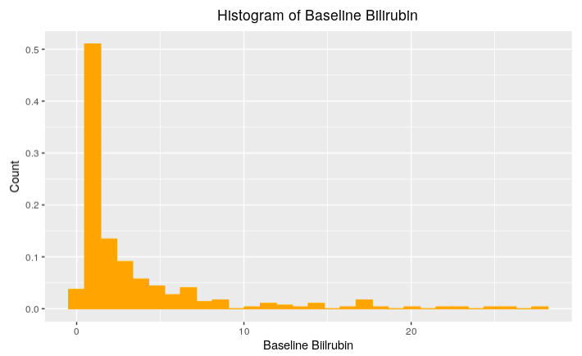
Summary Statistics
Histogram of Baseline Bilirubin
Median age: 50 (IQR: 42 – 57)
Sex: 88.5% females
Median baseline bilirubin: 1.4 (IQR: 0.8 – 3.4)
Median follow-up duration: 6.3 years
Patients: 172 alive/transplanted
140 died
Notes:
Dataset at the first glance: The patients were randomized almost equally (with 51% of the patients in) the treatment group and 49% in the placebo group. The median age was 50. The majority of this study was female patients. The median baseline bilirubin is 1.4 mg/dl. The median follow up duration is 6.3 years. At the end of the study, 172 patients were alive or had livers transplanted, the rest died.

Slide 11
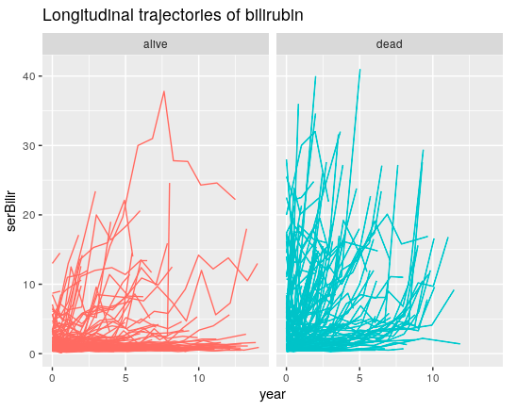
Spaghetti plot of longitudinal bilirubin
Median follow-up duration: 6.3 years
Patients who died seemed to have higher level of bilirubin
Notes:
In this figure, each line represents one patient and they are the levels of bilirubin over time. We can see on the right side, patients who died seem to have higher levels of bilirubin and we will come back to this later.

Slide 12
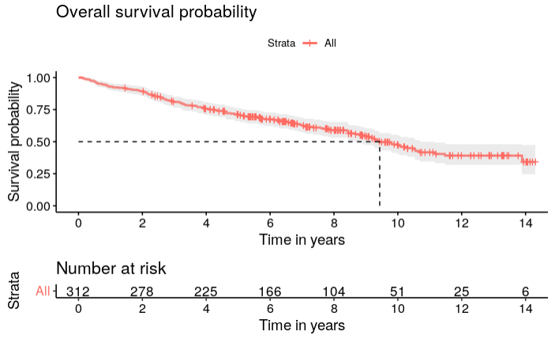
Kaplan-Meier Plots
Median survival time: 9.5 years
After 6 years: 166 patients at risk
Notes:
I explore the data a little more before doing the analysis. I use Kaplan-Meier curve to visualize the survival probability. The median survival time is 9.5 years. After 6 years since the initiation of the study, there were 166 patients at risk.

Slide 13
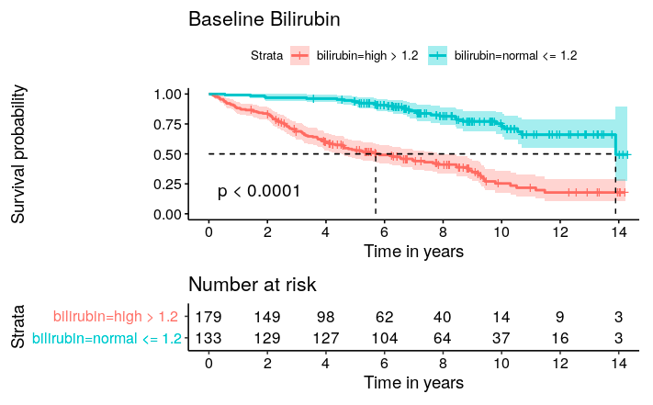
Baseline bilirubin
Log-rank based test for difference
in survivorship between groups
Clinical cutoff: 1.2 mg/dl
Normal baseline bilirubin
High baseline bilirubin
Normal <= 1.2
High > 1.2
Notes:
This is the KM plot of baseline bilirubin. I use the clinical cutoff 1.2 [ mg/dl (deciliter) ] to classify high and normal levels of bilirubin. From the curve, high bilirubin worsens survival. The small p-value from log-rank based test for group difference also confirms this observation.
(We don't know how high matters. I use it to illustrate survival curves. It’s interesting to look at continuous measurements over time to dichotomize at every time point in the future)

Slide 14
Univariable Analysis for Cox Models
Clinical Factor | Hazard Ratio | 95% Confidence Interval | p-value
Drug | 1.00 | (0.72 – 1.39) | >0.9
Age | 1.05 | (1.03 – 1.06) | <0.001
Sex: male | Ref
female | 0.52 | (0.34 – 0.80) | 0.005
Interpretation:
There’s no treatment effect on the survival
One-year increase in the baseline age is associated with a 5% increase in the hazard of death
Female patients have a 48% lower hazard of death than male patients
Notes:
Now we look at the results from three models we want to compare. We first start out looking at the variables at baseline values to understand the data more.

Slide 15
Univariable Analysis for Cox Models
Biomarker | Hazard Ratio | 95% Confidence Interval | p-value
Albumin | 0.19 | (0.13 – 0.28) | <0.001
Alkaline | 1.00 | (1.00 – 1.00) | 0.094
SGOT | 1.01 | (1.00 – 1.01) | <0.001
Platelets | 1.00 | (0.99 – 1.00) | <0.001
Prothrombin | 2.12 | (1.81 – 2.48) | <0.001
Ascites (No/Yes) | 7.58 | (4.78 – 12.0) | <0.001
Hepatomegaly (No/Yes) | 3.06 | (2.14 – 4.38) | <0.001
Spiders (No/Yes) | 2.42 | (1.72 – 3.42) | <0.001
Edema: No edema | ref |  | <0.001
Edema no diuretics | 1.63 | (1.04 – 2.55)
Edema diuretics | 10.9 | (6.61 – 18.0)
Histologic: 1 | ref |  | <0.001
2 | 6.39 | (0.86 – 47.5)
3 | 9.66 | (1.33 – 70.1)
4 | 24.0 | (3.33 – 174)
Notes:
This is the output with longitudinal biomarkers. Since we’re interested in the association between bilirubin and survival, I use the baseline values for all the other biomarkers. All of them are statistically significant at 0.10.

Slide 16
Univariable Analysis – Serum Bilirubin
Univariable Analysis - Serum Bilirubin
Model | Hazard Ratios | 95% Confidence Interval | p-value
Model 1: Cox PH | 1.16 | (1.13 – 1.19) | <0.001
Model 2: Time-dependent Cox | 1.16 | (1.14 – 1.18) | <0.001
Model 3: Joint Model | 1.83 | (1.66 - 2.02) | <0.0001
Interpretation:
Model 1(baseline bilirubin): One unit increase in the baseline bilirubin is associated with 16% increase in the death risk
Model 2 (longitudinal bilirubin): One unit increase in the longitudinal bilirubin is associated with 16% increase in the death risk
Model 3 (longitudinal bilirubin & measurement error): One unit increase in the longitudinal bilirubin is associated with 83% increase in the death risk
Notes:
This is the output from univariable analysis for three models with Bilirubin as the only covariate. Cox PH and time-dependent Cox have the same HR. But the Ci for time-dependent Cox is smaller. It’s because I use the bilirubin with repeated measurements. More information reduces the uncertainty.

Slide 17
Multivariable Analysis – Serum Bilirubin
Multivariable Analysis - Serum Bilirubin
Model | Hazard Ratios | 95% Confidence Interval | p-value
Model 1: Cox PH | 1.11 | (1.06 – 1.15) | <0.001
Model 2: Time-dependent Cox | 1.20 | (1.17 – 1.22) | <0.001
Model 3: Joint Model | 1.82 | (1.64 - 2.03) | <0.0001
High bilirubin worsens survival
Model Adjustment:
Model 1: bilirubin, albumin, age, edema, histologic, SGOT, prothrombin
Model 2: bilirubin, albumin, age, edema, histologic
Model 3: bilirubin, albumin, age, edema
Notes:
This is the output from multivariable analysis. The HR’s are different. But the key point is the same: high bilirubin worsens survival. However, they have different adjusting covariates for each model from the stepwise selection.

Slide 18
Conclusions
1. Association between bilirubin and survival:
Cox PH: HR = 1.11, Time-dependent Cox: HR = 1.20, Joint Model: HR = 1.82
2. Difference in model outputs:
Cox PH: baseline values of bilirubin
Time-dependent Cox: progression of bilirubin over time
Joint Model: progression of bilirubin & measurement error
Notes:
I measured the association between bilirubin and survival from three different models. They have different HR's. This is because, cox PH uses the baseline values of bilirubin. Time-dependent Cox accounts for the progression of bilirubin. And the joint model captures the progression of bilirubin and measurement error.

Slide 19
Conclusions
1. Association between bilirubin and survival:
Cox PH: HR = 1.11, Time-dependent Cox: HR = 1.20, Joint Model: HR = 1.82
2. Difference in model outputs:
Cox PH: baseline values of bilirubin
Time-dependent Cox: progression of bilirubin over time
Joint Model: progression of bilirubin & measurement error
Notes:
Personally, I prefer the JM because it accommodates what the other two Cox models are unable to.

Slide 20
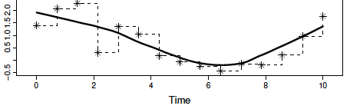

Discussion
Time-dependent Cox
Advantages of Joint Model:
Smooth longitudinal trajectory
Reduce bias
Joint Model
Disadvantages of Joint Model:
Complex
Many parameters p to estimate
Convergence issue
=> Use time-dependent Cox model
Biased estimate of Hazard Ratios
Notes:
There are a few benefits and drawbacks of using the Joint Model. Imagine that this is bilirubin measured repeatedly over 10 years. Time-dependent Cox assumes it to remain constant in the time interval in between the visits. Time-dependent Cox has a step function for longitudinal trajectory. This may result in very biased parameter estimates. While JM uses the true value of bilirubin by including the measurement error. The longitudinal trajectory is much smoother, which reduce bias.
The disadvantages are that this model is very complex and has many parameters p to estimate. It also requires a large sample size to avoid convergence issues. When these conditions are not met, it’s recommended to use a time-dependent Cox model. The trade-off is that HR estimates will be biased.

Slide 21
Limitation
PBC Clinical Data: real dataset
=> Cannot evaluate model performances with true HR
Future Work
Competing Risk Model (alive vs transplanted)
Joint Model for more than one longitudinal biomarker
Notes:
Use competing risk models to separate these two different events.

Slide 22


Acknowledgements
Mentor: Dr. Audrey Mauguen
QSURE faculty: Dr. Kay See Tan, Dr. Margaret Du, Richard Koppenaal, Karissa Whiting
QSURE program
MSKCC

Slide 23
References
Rizopoulos, Dimitris. Joint models for longitudinal and time-to-event data: With applications in R. CRC press, 2012.
Rizopoulos, Dimitris. "JM: An R package for the joint modelling of longitudinal and time-to-event data." Journal of Statistical Software (Online) 35.9 (2010): 1-33.
Schober, Patrick, and Thomas R. Vetter. "Survival analysis and interpretation of time-to-event data: the tortoise and the hare." Anesthesia and analgesia 127.3 (2018): 792.
Albert, Paul S. "Longitudinal data analysis (repeated measures) in clinical trials." Statistics in medicine 18.13 (1999): 1707-1732.
Harrell Jr, Frank E., Kerry L. Lee, and Daniel B. Mark. "Multivariable prognostic models: issues in developing models, evaluating assumptions and adequacy, and measuring and reducing errors." Statistics in medicine 15.4 (1996): 361-387.

Slide 24
Thank you! And question?

Slide 25
Supplementary slides

Slide 26
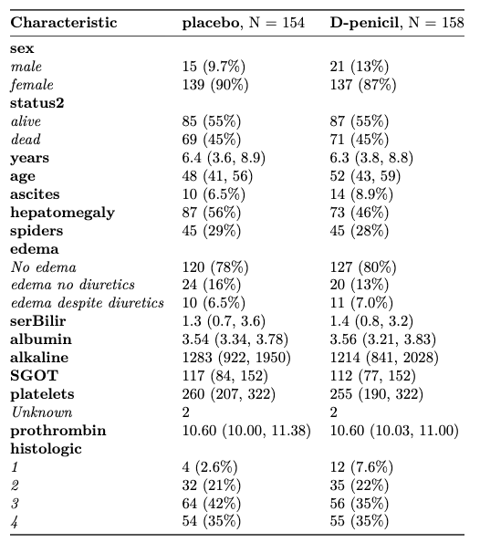
Summary Statistics
Median age: 50 (IQR: 42 – 57)
Sex: 88.5% females
Median baseline bilirubin: 1.4 (IQR: 0.8 – 3.4)
Median follow-up duration: 6.3 years
Patients: 172 alive/transplanted
140 died

Slide 27
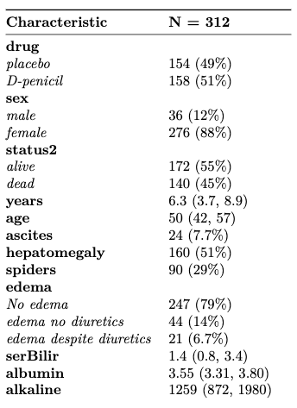
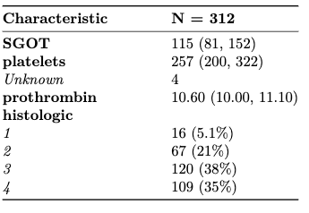
Summary Statistics

Slide 28
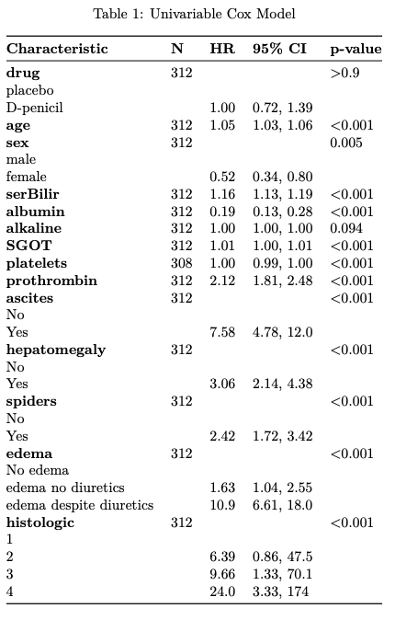
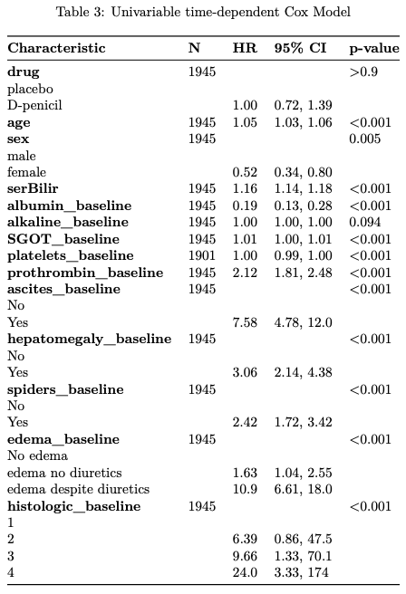
Results from Univariable Analysis

Slide 29
Results from Multivariable Analysis
Subsets of significant covariates from variable selection for Cox PH Model
Multivariable Cox PH Model
Characteristic | HR | 95% CI | p-value
bilirubin | 1.11 | (1.06-1.15) | <0.001
albumin | 0.52 | (0.32-0.85) | 0.008
age | 1.04 | (1.03-1.06) | <0.001
edema |  |  | 0.019
no edema | ref
edema no diuretics | 1.04 | (0.65-1.67)
edema diuretics | 2.37 | (1.33-4.22)
histologic |  |  | 0.014
1 | ref
2 | 4.49 | (0.60-33.8)
3 | 5.79 | (0.79-42.5)
4 | 8.04 | (1.09-59.5)
SGOT | 1.00 | (1.00-1.01) | 0.012
prothrombin | 1.46 | (1.20-1.78) | <0.001
Multivariable Time-Dependent Cox Model
HR | 95% CI | p-value
1.20 | (1.17-1.23) | <0.001
0.59 | (0.36-0.97) | 0.036
1.06 | (1.05-1.08) | <0.001
 |  | 0.003
ref
1.18 | (0.72-1.93)
3.09 | (1.66-5.72)
 |  | <0.001
ref
1.97 | (0.26-14.9)
4.48 | (0.61-33.0)
6.69 | (0.90-49.4)
1.00 | (0.99-1.00) | 0.4
1.11 | (0.91-1.36) | 0.3
Survival Submodel of Joint Model
HR | 95% CI | p-value
1.81 | (1.60-2.04) | <0.0001
0.67 | (0.41-1.08) | 0.1011
1.05 | (1.03-1.07) | <0.0001
 |  | 0.0003
ref
1.97 | (1.18-3.30)
3.11 | (1.64-5.89)
 |  | 0.3422
ref
1.72 | (0.26-11.26)
2.02 | (0.31-13.00)
2.58 | (0.40-16.70)
1.00 | (0.99-1.00) | 0.9569
1.22 | (0.99-1.51) | 0.623

Slide 30
Results from Multivariable Analysis
Subsets of significant covariates from variable selection for Time-Dependent Cox Model
Multivariable Cox PH Model
Characteristic | HR | 95% CI | p-value
bilirubin | 1.15 | (1.11-1.18) | <0.001
albumin | 0.50 | (0.31-0.81) | 0.005
age | 1.04 | (1.02-1.06) | <0.001
edema |  |  | 0.002
no edema | ref
edema no diuretics | 0.97 | (0.60-1.55)
edema diuretics | 2.92 | (1.62-5.27)
histologic |  |  | <0.001
1 | ref
2 | 4.63 | (0.62-34.5)
3 | 6.39 | (0.88-46.7)
4 | 10.9 | (1.49-80.1)
Multivariable Time-dependent Cox Model
HR | 95% CI | p-value
1.20 | (1.17-1.22) | <0.001
0.62 | (0.38-1.01) | 0.005
1.07 | (1.05-1.09) | <0.001
 |  | 0.001
ref
1.26 | (0.78-2.04)
3.31 | (1.80-6.09)
 |  | <0.001
ref
1.85 | (0.24-14.0)
4.35 | (0.59-32.0)
7.09 | (0.96-52.3)
Survival Submodel of Joint Model
HR | 95% CI | p-value
1.84 | (1.65-2.06) | <0.0001
0.60 | (0.37-0.97) | 0.0364
1.05 | (1.03-1.07) | <0.0001
 |  | <0.0001
ref
2.16 | (1.30-3.59)
3.63 | (1.96-6.70)
 |  | 0.0878
ref
0.92 | (0.21-4.12)
1.23 | (0.28-5.29)
1.70 | (0.39-7.38)

Slide 31
Results from Multivariable Analysis
Subsets of significant covariates from variable selection for Joint Model
Multivariable Cox PH Model
Characteristic | HR | 95% CI | p-value
bilirubin | 1.14 | (1.11-1.17) | <0.001
albumin | 0.37 | (0.23-0.58) | <0.001
age | 1.04 | (1.03-1.06) | <0.001
edema |  |  | <0.001
no edema | ref
edema no diuretics | 1.01 | (0.63-1.62)
edema diuretics | 3.32 | (1.83-6.01)
Multivariable Cox PH Model
HR | 95% CI | p-value
1.19 | (1.16-1.21) | <0.001
0.47 | (0.29-0.75) | 0.002
1.07 | (1.05-1.09) | <0.001
 |  | <0.001
ref
1.32 | (0.83-2.10)
4.16 | (2.25-7.70)
Survival Submodel of Joint Model
HR | 95% CI | p-value
1.82 | (1.64-2.03) | <0.0001
0.52 | (0.33-0.82) | 0.054
1.05 | (1.04-1.07) | <0.0001
 |  | <0.0001
ref
2.05 | (1.25-3.36)
3.84 | (2.09-7.06)

Slide 32
Results from Multivariable Analysis
Multivariable Cox PH Model |  |  |  | Multivariable Cox PH Model |  |  | Survival Submodel of Joint Model
Characteristic | HR | 95% CI | p-value | HR | 95% CI | p-value | HR | 95% CI | p-value
bilirubin | 1.11 | (1.06-1.15) | <0.001 | 1.20 | (1.17-1.23) | <0.001 | 1.81 | (1.60-2.04) | <0.0001
bilirubin | 1.15 | (1.11-1.18) | <0.001 | 1.20 | (1.17-1.22) | <0.001 | 1.84 | (1.65-2.06) | <0.0001
bilirubin | 1.14 | (1.11-1.17) | <0.001 | 1.19 | (1.16-1.21) | <0.001 | 1.82 | (1.64-2.03) | <0.0001
Multivariable Analysis - Serum Bilirubin
Model | Hazard Ratios | 95% Confidence Interval | p-value
Model 1: Cox PH | 1.11 | (1.06 – 1.15) | <0.001
Model 2: Time-dependent Cox | 1.20 | (1.17 – 1.22) | <0.001
Model 3: Joint Model | 1.82 | (1.64 - 2.03) | <0.0001

Slide 33
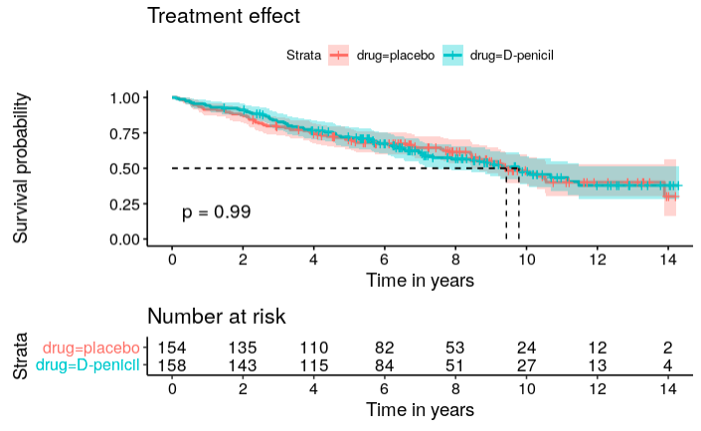
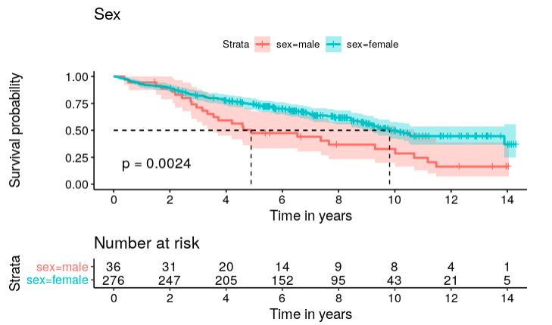
Treatment effect
Sex
Drug
Female
Treatment
Male
Notes:
Survival probability seems roughly similar between placebo and treatment groups in the plot. Females have higher survival probability than males generally. The log-rank based test for survivorship between groups also confirms the observation. P-value of 0.99 indicates that drug is not significant. P-value 0.0024 indicates that sex is statistically significant.

Slide 34
Log-rank based test for difference in survivorship between groups
Treatment effect
Sex
Drug
Female
Treatment
Male
Drug is not statistically significant
Sex is statistically significant
Notes:
Survival probability seems roughly similar between placebo and treatment groups in the plot. Females have higher survival probability than males generally. The log-rank based test for survivorship between groups also confirms the observation. P-value of 0.99 indicates that drug is not significant. P-value 0.0024 indicates that sex is statistically significant.

Slide 35
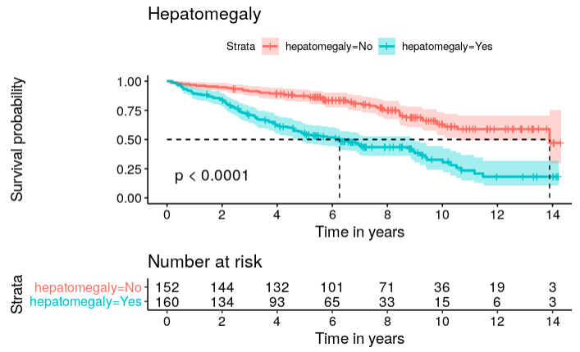
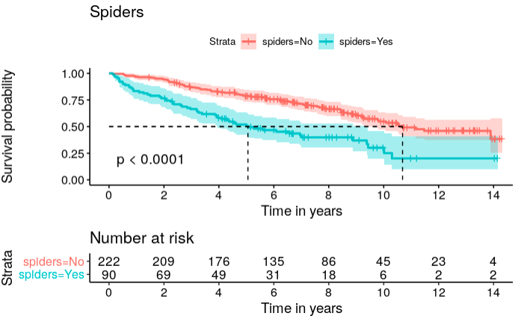
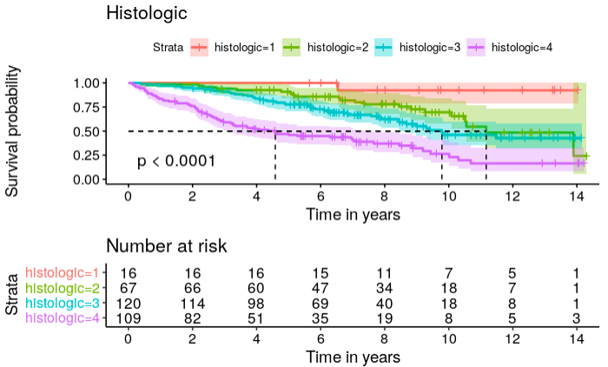
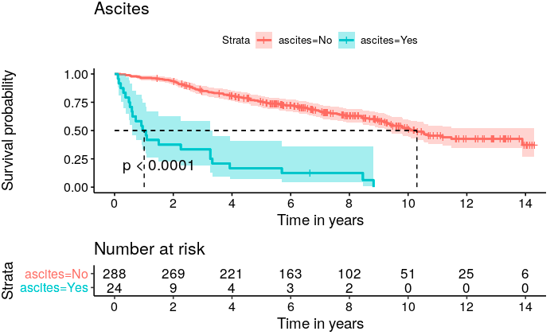
Kaplan-Meier Curves

Slide 36
Joint Model
Longitudinal sub-model: Linear Mixed-Effect model
Response: Level of serum bilirubin over time
Predictors: sex and baseline covariates for ascites, hepatomegaly, spiders, albumin, alkaline, SGOT and prothrombin
Random effect: visit time | id
Bilirubin varies from patient to patient
Survival sub-model: Cox PH model
Response: survival
Covariates: baseline values for albumin, edema and age

