Slide 1



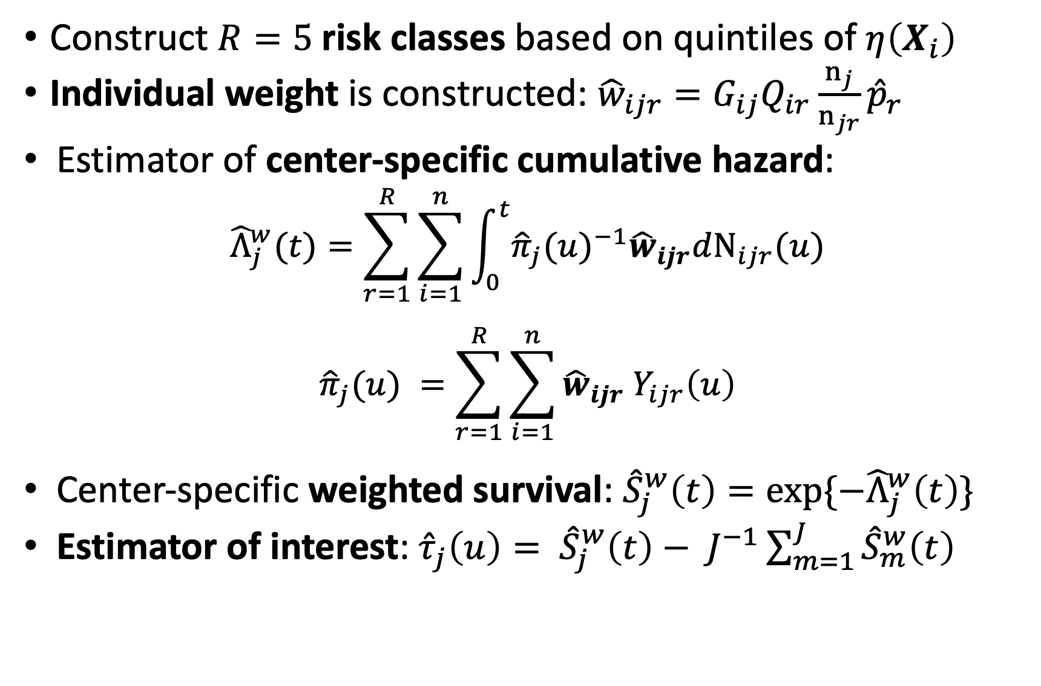
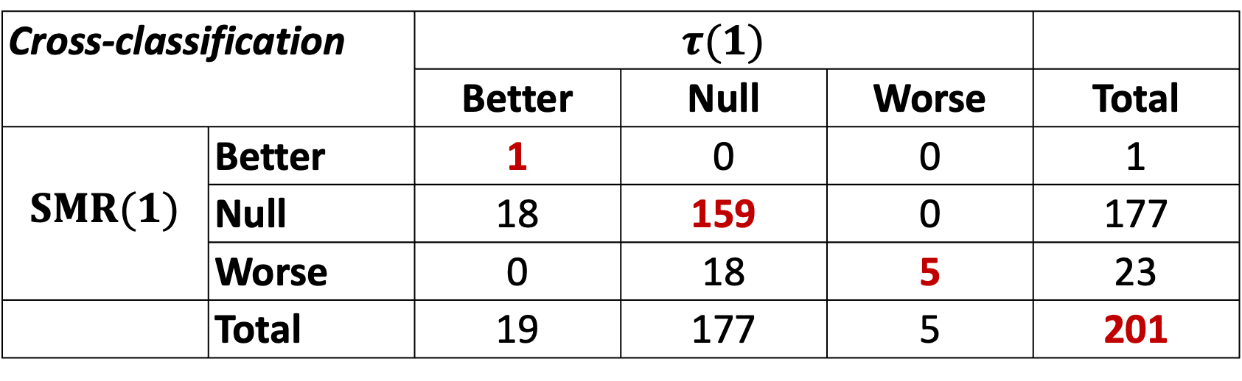
Evaluating a Facility-Profiling Metric based on Survival Probability:
Application to U.S. Transplant Centers
Amelia H. Tran, Peter P. Reese, Douglas E. Schaubel
University of Pennsylvania Perelman School of Medicine
Background of Facility Profiling
Developing Prognostic Score based Estimator
UNOS Data Description
Evaluations of healthcare providers and medical centers of great interest to patients, transplant professionals & medical practitioners
In the US, kidney transplant centers undergo two evaluations: Organ Procurement and Transplantation Network (OPTN) and Centers for Medicare and Medicaid Services (CMS)
Post-transplant survival outcome by transplant center ensures highest-quality care for patients
Standardized Mortality Ratio (SMR) and Prognostic Score based Weighting Approach as evaluation metrics
Wolfe, R. A. (1994). The standardized mortality ratio revisited: improvements, innovations, and limitations. American Journal of Kidney Diseases, 24(2):290–297
Construct $R=5$risk classes based on quintiles of $η\left(X_{i}\right)$
Individual weight is constructed: ${\hat{w}}_{ijr}=G_{ij}Q_{ir}\frac{n_{j}}{n_{jr}}{\hat{p}}_{r}$
Estimator of center-specific cumulative hazard:
$${\hat{Λ}}_{j}^{w}(t)=\sum_{r=1}^{R}{\sum_{i=1}^{n}{\int_{0}^{t}{{{\hat{π}}_{j}(u)}^{−1}{\hat{w}}_{ijr}dN_{ijr}(u)}}}$$
$${\hat{π}}_{j}(u) =\sum_{r=1}^{R}{\sum_{i=1}^{n}{{{\hat{w}}_{ijr} Y}_{ijr}\left(u\right)}}$$
Center-specific weighted survival: ${\hat{S}}_{j}^{w}\left(t\right)=exp⁡\{−{\hat{Λ}}_{j}^{w}\left(t\right)\}$
Estimator of interest: ${\hat{τ}}_{j}\left(u\right)= {\hat{S}}_{j}^{w}\left(t\right)− J^{−1}\sum_{m=1}^{J}{{\hat{S}}_{m}^{w}\left(t\right)}$
Truncate at 1 year post-transplant: 83% censoring
Data from United Network for Organ Sharing (UNOS)
Study population: 58,353 adults with transplants
Exclude centers < 25 transplants: J = 201 centers
Results and Comparison
Cross-classification |  | $$τ(1)$$ | $$τ(1)$$
 |  | Better | Null | Worse | Total
$SMR(1)$ | Better | 1 | 0 | 0 | 1
 | Null | 18 | 159 | 0 | 177
 | Worse | 0 | 18 | 5 | 23
 | Total | 19 | 177 | 5 | 201
SMR Limitations and Motivation for Prognostic Score based Approach
Discussion and Future Work
Center-specific SMR: ${SMR}_{j}{=\frac{O_{j}}{E_{j}}}$ for center $j$
Center effect is determined by $Z_{j}=\frac{{log(SMR}_{j})}{{V\{log(SMR}_{j})\}}$ $\sim N(0, 1)$
SMR limitations: unstable estimator, susceptible to model misspecification, indirect standardization method
Motivation for prognostic score based method
Defined as the association between observed covariates and potential outcome in one restriction group
Prognostic score $η\left(X_{i}\right)$ from center-stratified Cox regression: $λ_{ij}(t;X_{i})=λ_{0j}(t)$ $exp\left(β^{T}X_{i}\right)$where observed data: $(U_{i}, △_{i},X_{i},G_{i})$
Hansen, B. B. (2008). The prognostic analogue of the propensity score. Biometrika, 95(2):481–488.
We evaluate U.S. transplant centers by 1-year graft survival
Metric agreement: 82%
Spearman’s correlation: −0.94
Prognostic score based weighting approach:
Robust to model mis-specification through simulations
Robust to number of risk classes, i.e. R = 5, 10, 20
Fair facility profiling by considering center covariates
Potential future work: evaluating independent censoring assumption and covariate-by-center interaction
Lee, Y. and Schaubel, D. E. (2022). Facility profiling under competing risks using multivariate prognostic scores: Application to kidney transplant centers. SMMR, 31(3):563–575.

