Slide 1



DEDS ESR 1.1:
Semantic-Aware Heterogeneity Management
Md Ataur Rahman
Home: Universitat Politècnica de Catalunya (UPC) Host: Université Libre de Bruxelles (ULB)
Supervisors
Home: Prof. Dr. Oscar Romero, Prof. Dr. Sergi Nadal Host: Prof. Dr. Dimitris Sacharidis
Notes:
Hello, I am Ataur Rahman, today I am going to present my Research Proposal Report for UPC and ULB.
My ESR position is 1.1 which deals with “Semantic-Aware Heterogeneity Management”.

Slide 2
Outline of the Presentation
Ph.D. Project Overview
Motivation
Objectives
Envisioned Pipeline
Current Work and Contribution Plan
Current Focus
Our Approach
Experimental Results
Relevant Work
Conclusion and Future Directions
Timeline and Future Plan
Notes:
I have broken down the contents of my presentation into 2 parts:
In the 1st part I will talk about our overall PhD objectives and envisioned plan.
And in the 2nd Part, I will concentrate more on our current focus and the contribution plan.

Slide 3
Ph.D. Project Overview
Notes:
Let’s begin with the PhD Project Overview.

Slide 4
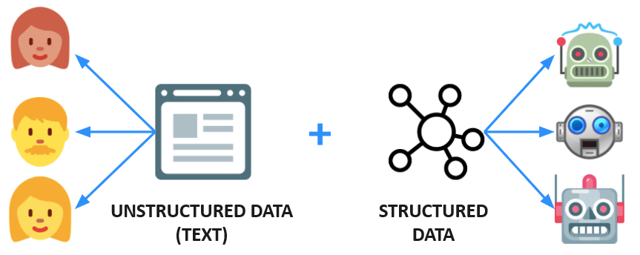
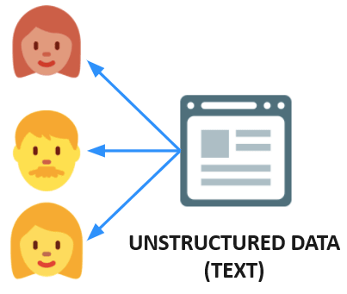
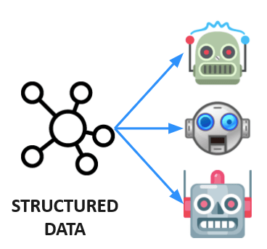
Motivation: Introduction
“Unstructured text data holds a wealth of information, that can serve as a complementary source to enrich and contextualize structured data.”
“Harness this untapped information in text by integrating it with structured data, thereby enhancing completeness and improving overall inferencing capabilities.”
Notes:
Unstructured data such as natural language text is fundamental for human communication.
Whereas Structured data is essential for machines as it organizes information efficiently, enabling faster processing and precise decision-making.
Unstructured text undoubtedly offers rich information that can enhance and provide more context to structured data.
Thus, the primary Goal of this PhD is to –
“Harness this untapped information in text by integrating it with structured data, thereby enhancing completeness and improving overall inferencing capabilities.”

Slide 5
Motivation: Gaps and Open Problems
Solving heterogeneity issues and unifying unstructured data landscapes.
Jurafsky and Martin (2023); Khadir et al. (2021); Kertkeidkachorn and Ichise (2018); Pujara and Singh (2018); Martinez-Rodriguez et al. (2018)
Enhancing data completeness.
Xu et al. (2023); Fernandez-Canellas et al. (2020); Zhang et al. (2017);
Structured (schema-driven) representation of knowledge over data.
Rossiello et al. (2023); Melnyk et al. (2022); Dunn et al. (2022); Anadiotis et al. (2022); Smith et al. (2022); Clancy et al. (2019); Mao et al. (2019);
Beyond simple Knowledge Graph (KG) creation from text.
Hofer et al. (2023); Melnyk et al. (2022); Ji et al. (2021); Tiwari et al. (2021)
Notes:
Our endeavor in Motivated by this 4 points which the existing work in the related domain fails to achieve all together.
Heterogeneity remains a big challenge in data integration due to inconsistencies in data formats and structures. With the ever-increasing volume and diversity of data, there's an urgent need for integrating both structured and unstructured data seamlessly.
One of the most significant advantages of incorporating unstructured textual data is its potential to reduce data sparsity. By leveraging the richness of textual data, we can fill in gaps and missing values in structured data sources, thereby enhancing the completeness and providing a holistic view of the integrated dataset.
Most Conventional methods try to transform textual data into generic data graphs. But we aim for a structured representation in the form of a knowledge graph - Adhering to a specific Schema. Thus, ensuring that data integration is not just about pooling data together but about creating a coherent, quarriable, and unified knowledge base, addressing the challenge of heterogeneity.
Unlike others, our objective goes beyond the mere creation of a knowledge graph from text to a graph that aids in data integration tasks, emphasizing its utility in practical scenarios.
Example: If two databases discuss agricultural practices but use different terminologies (e.g., "fertilizer" vs. "plant food"), conforming to a common schema allows users to query both databases with a single standard query, e.g., "list all fertilizer types".

Slide 6
Objectives
“Incorporate Textual Data in a
Graph-Based Data Integration System.”
O͏bj-1: Bootstrapping conceptualized structures from text (in the form of Knowledge Graphs).
O͏bj-2: Mapping the above structures with an existing Integrated Knowledge Graph.
O͏bj-3: Devising a new Rewriting Algorithm (RA) to query heterogeneous datasets (including textual data) via the Graph-based Data integration system.
O͏bj-4: Formulation of a Prototype that combines the best theory and approaches developed during the above stages.
Notes:
Thus, we set this main objective for our PhD.
Which will try to incorporate Text in a Graph Based Data Integration System that we have.
To achieve our Primary Objective, we have identified these 4 main Sub-Objectives.
We have been working on the first 2 objectives and based on the results we get; we might have to improvise objective 3.
I will talk about these during the second half of the presentation.

Slide 7
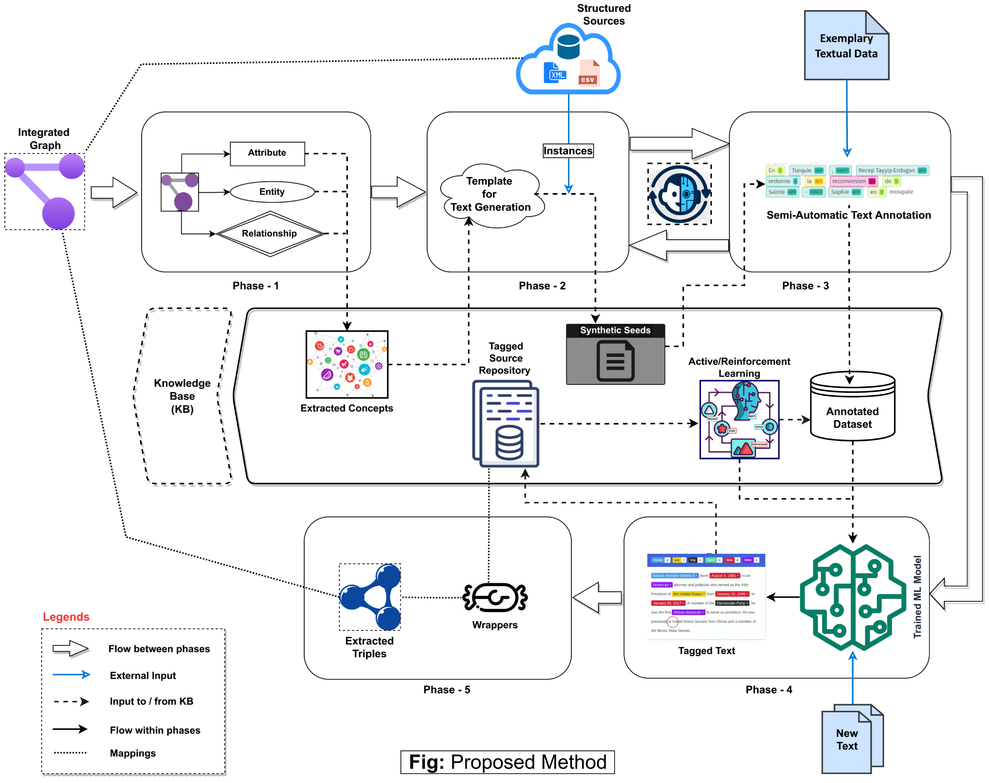

Text Data Integration Pipeline (High-level)
Concept Extraction from Knowledge Graph
Concept-Instance Embedding and Clustering
Semi-Automatic Text Annotation
Knowledge Base
Distantly Supervised Annotated Data
These five phases collectively target Obj-1 and Obj-2.
Knowledge Extraction,
Representation and
Integration
Model Training, Inferencing
and
Enrichment
Notes:
This is what we have envisioned for our Text Data Integration Pipeline. Since we already presented this during our first Winter School, I will not go into fine-grained details (next).
The top-most part mostly involves the:
Utilization of the Concepts Extracted from the IG, and the Instances from the Structured Sources.
in order to Semi-Automatically Annotate an exemplary Text Dataset.
So that we can use that Dataset to Train or Fine-Tune a Machine Learning Model in the later phases.
And the phases in bottom part will focus on:
Training some form of ML model (such s a Language Model) for Tagging completely New Text Sources with Concepts.
And also, to Map and Represent those Tagged Texts with the associated Concepts in the Integrated Graph.
So, in a nutshell – we are planning on using the KG and Structured Data to Annotate the Exemplary Textual data which in turn will:
act as the Training Data for learning a model in order to Tag New Unseen Text based on these knowledge.
Distantly Supervised Dataset: Since we are using the knowledge from our existing knowledge graph (and structured data sources) to automatically generate labels for unlabeled text data without direct human annotation.
Thus, as a whole facilitating Unstructured Data Integration.

Slide 8
Current Work and Contribution Plan
Notes:
Let us talk about what we have been able to achieve so far.

Slide 9

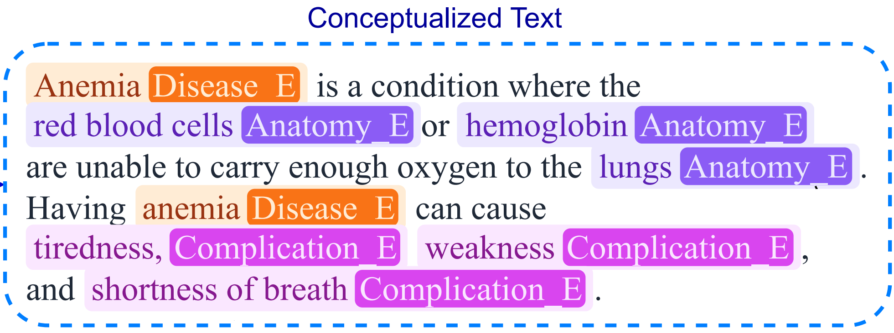
Current Focus
“Mitigating Data Sparsity in Integrated Data through Text Conceptualization”
Source-1
Source-2
Disease | Code | Complication | Anatomy | …
Tuberculosis | 1B10 | difficulty breathing, seizures, … | lungs, brain, … | ✅
Disease | Code
Acne | ED80
Anemia | 3A9Z
Disease | Code | Complication | Anatomy | …
Tuberculosis | 1B10 | difficulty breathing, … | lungs, brain, … | ✅
Acne | ED80 | ❌ | ❌ | ❌
Anemia | 3A9Z | ❌ | ❌ | ❌
Integrated Data
Notes:
We already developed a working Knowledge Graph construction approach.
But for the sake of our first contribution, we are concentrating in an application area where we tried to –
“Mitigate the missing values in the Integrated Data”
Here is an Example of the problem that we are solving for our first paper.
Imagine you have 2 structured sources containing disease related information …
The first source contains Diseases with its corresponding complications, anatomy and few other relevant information.
Whereas the second source only contains some new Disease names with their corresponding ICD-11 code.
Now if you integrate these two sources. Even though the schema will integrate seamlessly, the instances will have missing values in them.
This will result in incomplete queries and other issues if we want to further use these integrated data.

Slide 10
Task Categorization: Based of Application Areas
Information Extraction (IE) techniques are used to turn the unstructured information embedded in texts into structured data.
This can be useful for populating a structured knowledge source (KG, RDB) resulting from the integration of heterogeneous data sources to enable further processing (e.g., querying).
IE typically consists of a sequence of tasks, comprising:
Linguistic Pre-processing
tokenization, POS-tagging, parsing/chunking etc.
Entity Recognition (ER)
Relation Extraction (RE)
Entity Recognition and Relation Extraction can either be used for:
Annotation Task – to annotate a text with entities/relations
Slot Filling (a.k.a. knowledge base population) task –
Entity-centric slot-filling: where the information about the entity of interest (e.g., a person, company, disease) is spread across multiple documents in a large corpus. (Glass, M. et al. 2022)
Knowledge Graph Induction (KGI): is a technique that enables the creation of a unified knowledge graph from structured and textual data (Mihindukulasooriya, N. et al. 2022)
Notes:
Formally, this problem falls in the Category of Entity-centric slot-filling Task.
Where information about a particular entity of interests is spread across multiple text documents and we want to somehow fill a knowledge base such as a Knowledge Graph.
This is known as Knowledge Base Population.
Conventional approaches tackles this issue with Information Extraction and Natural Language Processing Techniques such as:
Entity Recognition
Relation Extraction

Slide 11
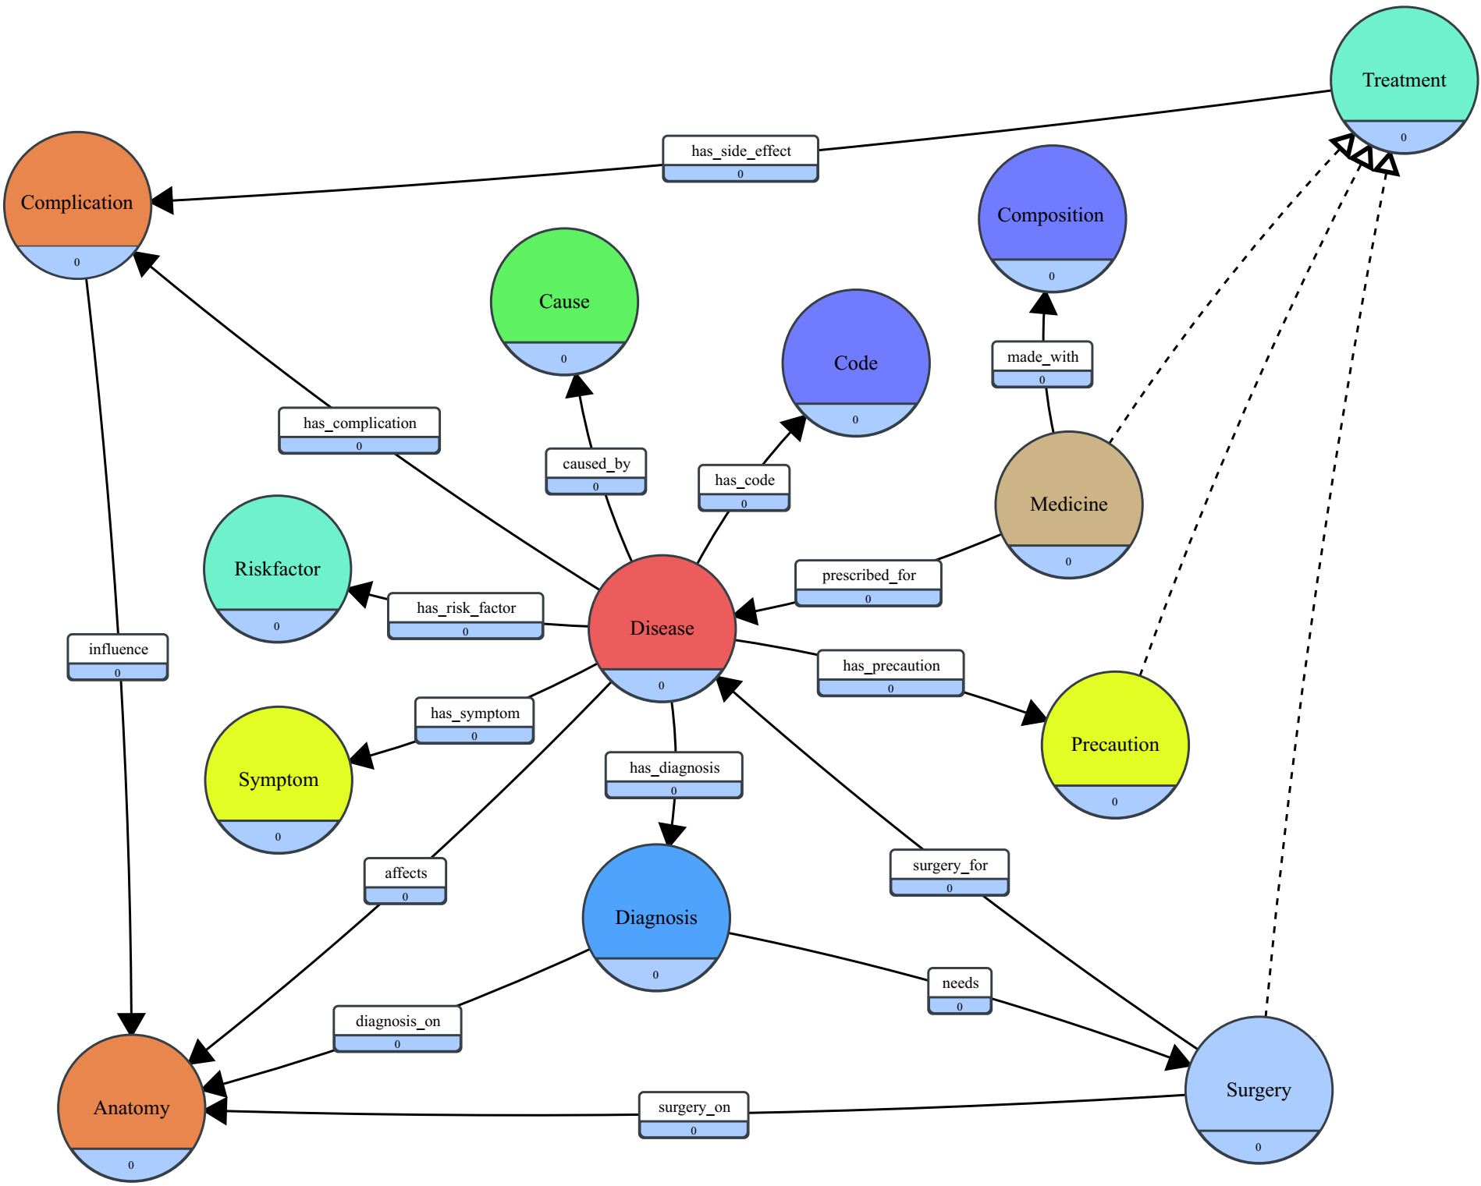
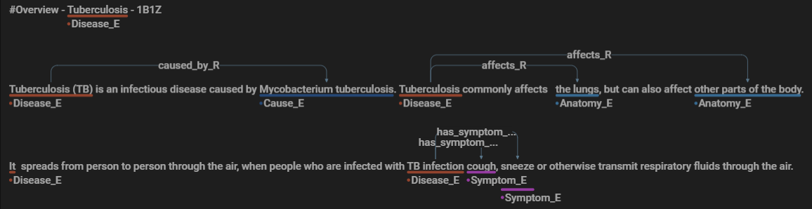
Datasets We Developed
Knowledge Graph (Schema)
Structured Data (CSV’s)
Knowledge Graph (Schema)
Disease | Symptom
Tuberculosis | vomiting, fatigue, weight loss, cough, fever …
ICD-11 | Medicine_Name | Composition
ED80 | Isoniazid (antibiotics) | silicon dioxide, lactose, stearic acid, …
Disease | Precaution | RiskFactor
Fungal Infection | bath twice, use Dettol in the bathing water, keep infected area dry … | parenteral nutrition, immunosuppression, burns, …
# | Train | Val | Test | Total
Disease | 240 | 61 | 13 | 314
Documents | 1438 | 366 | 90 | 1894
Entities | 18539 | 3989 | 2222 | 24750
Relations | 10269 | 2145 | 867 | 13281
Words | 168816 | 38722 | 19237 | 226775
Manually Annotated Text Corpora
Notes:
In order to evaluate and test our solution, we had to build a Dataset that will be representative to the Data Integration problem we are trying to solve.
Most of the existing benchmark data do not encompass a complex enough schema with more than few Entity Type and Relations –
For example, NCBI/i2b2 corpus only contains 2/3 relationship type like -- Disease to Gene or Gene to Gene or Chemical relations.
The dataset we developed consists of 3 things:
A Global Schema that describes the integrated structured sources – in the form of a Knowledge Graph.
Thes individual Structured Data Sources – in the form of 10 different CSV files.
And a large manually annotated text corpora containing proper tags for:
Entities and Relationships between these entities according to the Schema.

Slide 12
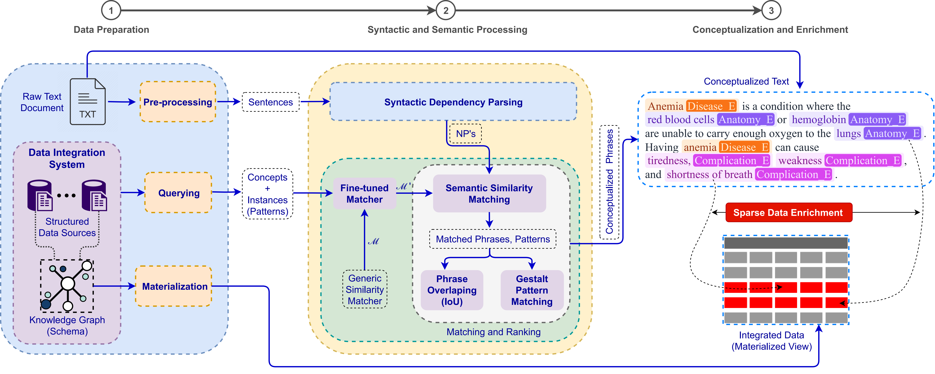
Overview of
Text Conceptualization Architecture
Data Preparation:
Text: pre-processing and sentence segmentation.
Integrated Structured Sources:
Extracting the Concepts and Instances (patterns).
Materialization of the Integrated Data (Evaluation)
Conceptualization and Enrichment:
The original text is conceptualized by projecting the conceptualized phrases into the text (*top-k).
Sparse Data Enrichment:
Imputing sparse data (missing or incomplete) in the materialized integrated sources.
Syntactic and Semantic Processing:
Dependency Parsing: Identifying Noun Phrases (Recall*).
Matching and Ranking:
Fine-tuning a Generic Embedding based Vector Similarity Matcher (*Domain Adaptability/Weak Supervision).
Combining Semantic and Syntactic Similarity to Rank the best matched concepts for a (sub-) noun phrase.
Notes:
This is our concrete pipeline for reducing the data sparsity in the integrated data through text conceptualization.
In Step – 1 we prepare the data:
Here as input we fed the Raw Text Data, The Structured Data Sources along with the Knowledge Graph.
We query the Graph in order to retrieve the Concepts along with the Instances.
We also materialize the Integrated data for Evaluation purpose.
The text document goes through some pre-processing and sentence segmentation.
In Step-2 we do –
Syntactic Processing first in order to get the Noun Phrases per Sentences.
On the other side, we use a Generic Embedding Based Vector Similarity Matcher and Fine-tune it with our Structured Data.
We apply the semantic similarity matching upon the Noun Phrases which produces a list of Matched Phrases and their Confidence above a certain Threshold to which Concept they belong to.
We then Rank this list of matches with two more techniques, just to get the best possible Concept-Phrase pairs.
In Step-3 – We map the whole Text Document with the individual Concept-Phrase pairs:
This ultimately provide us with the Entities Recognized inside the text documents.
Later, we use these entities to fill up the missing values in our materialized integrated data.

Slide 13
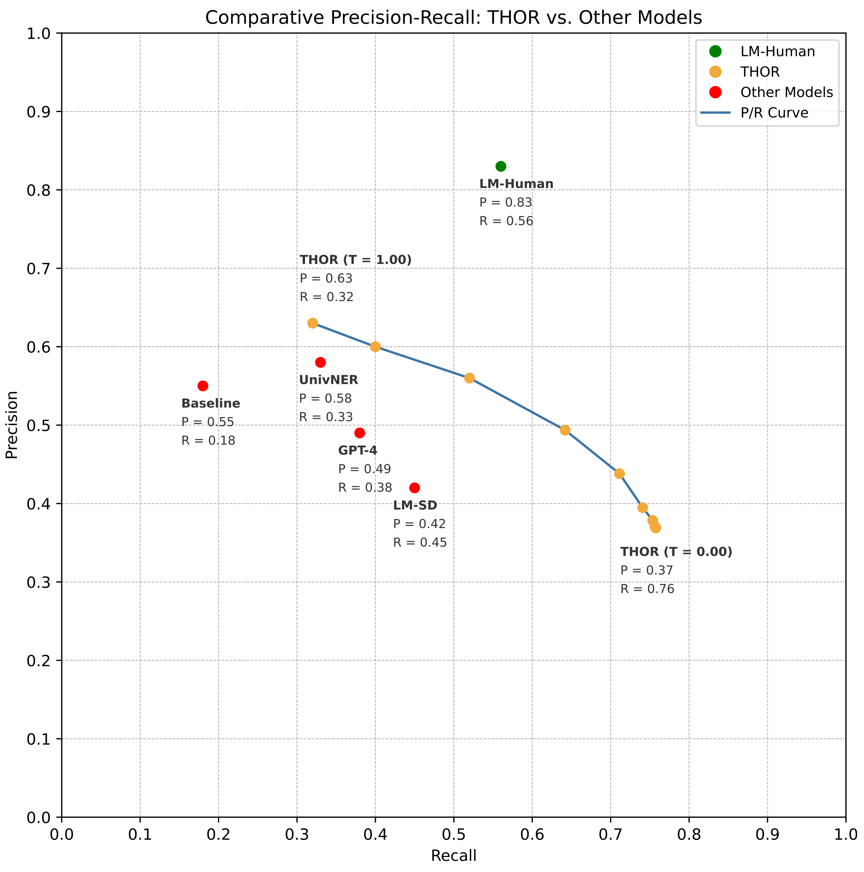
Experimental Results
Experiments | Model Name | Precision | Recall | F1
THOR (our) | THOR (T = 0.0 - 0.3) | 0.37 | 0.76 | 0.50
 | THOR (T = 0.4) | 0.38 | 0.75 | 0.50
 | THOR (T = 0.5) | 0.39 | 0.74 | 0.52
 | THOR (T = 0.6) | 0.44 | 0.71 | 0.54
 | THOR (T = 0.7) | 0.49 | 0.64 | 0.56
THOR (our) | THOR (T = 0.8) | 0.56 | 0.52 | 0.54
 | THOR (T = 0.9) | 0.60 | 0.40 | 0.48
 | THOR (T = 1.0) | 0.63 | 0.32 | 0.42
OTHER (comparison) | Baseline | 0.55 | 0.18 | 0.27
 | LM-SD | 0.42 | 0.45 | 0.43
 | GPT-4 | 0.49 | 0.38 | 0.43
 | UniNER | 0.58 | 0.33 | 0.42
 | LM-Human | 0.83 | 0.56 | 0.66
THOR = Text Homogenization from Oblivion to Reality
Baseline = Exact pattern matching
LM-SD = SOTA Language Model (LM) fine-tuned on our Structured Data
LM-Human = SOTA LM fine-tuned on our Human Annotated Text Data
GPT-4 = SOTA Large Language Model (LLM)
UniversalNER = SOTA LLM fine-tuned for Named Entity Recognition
Notes:
Lets, focus now on the results.
We compared our approach that we call THOR, with the State-of-the-art Language Models that people use in this domain.
We also compared against two most recent Large Language Models (GPT-4 and UniversalNER) which claims to have SOTA results on 80 different Entity Recognition Benchmark.
In all the cases our approach dominates the competitors with a fairly good margin.
The only better model compared to our own, was LM-Human - trained with a lot of manually annotated text data.
We did this experiment in order to show that a Language Model might be your best choice if you have a lot of labelled data at hand, but with a cost of annotation efforts.
This is impractical for Data Integration Domain, where the Schema changes drastically between use cases and and might evolve as well.
This means that you have to invest 6 or more months for annotating the whole dataset again just to recognize a new class.
Our approach is also tune-able to be precision or recall oriented based on the user preferences.

Slide 14
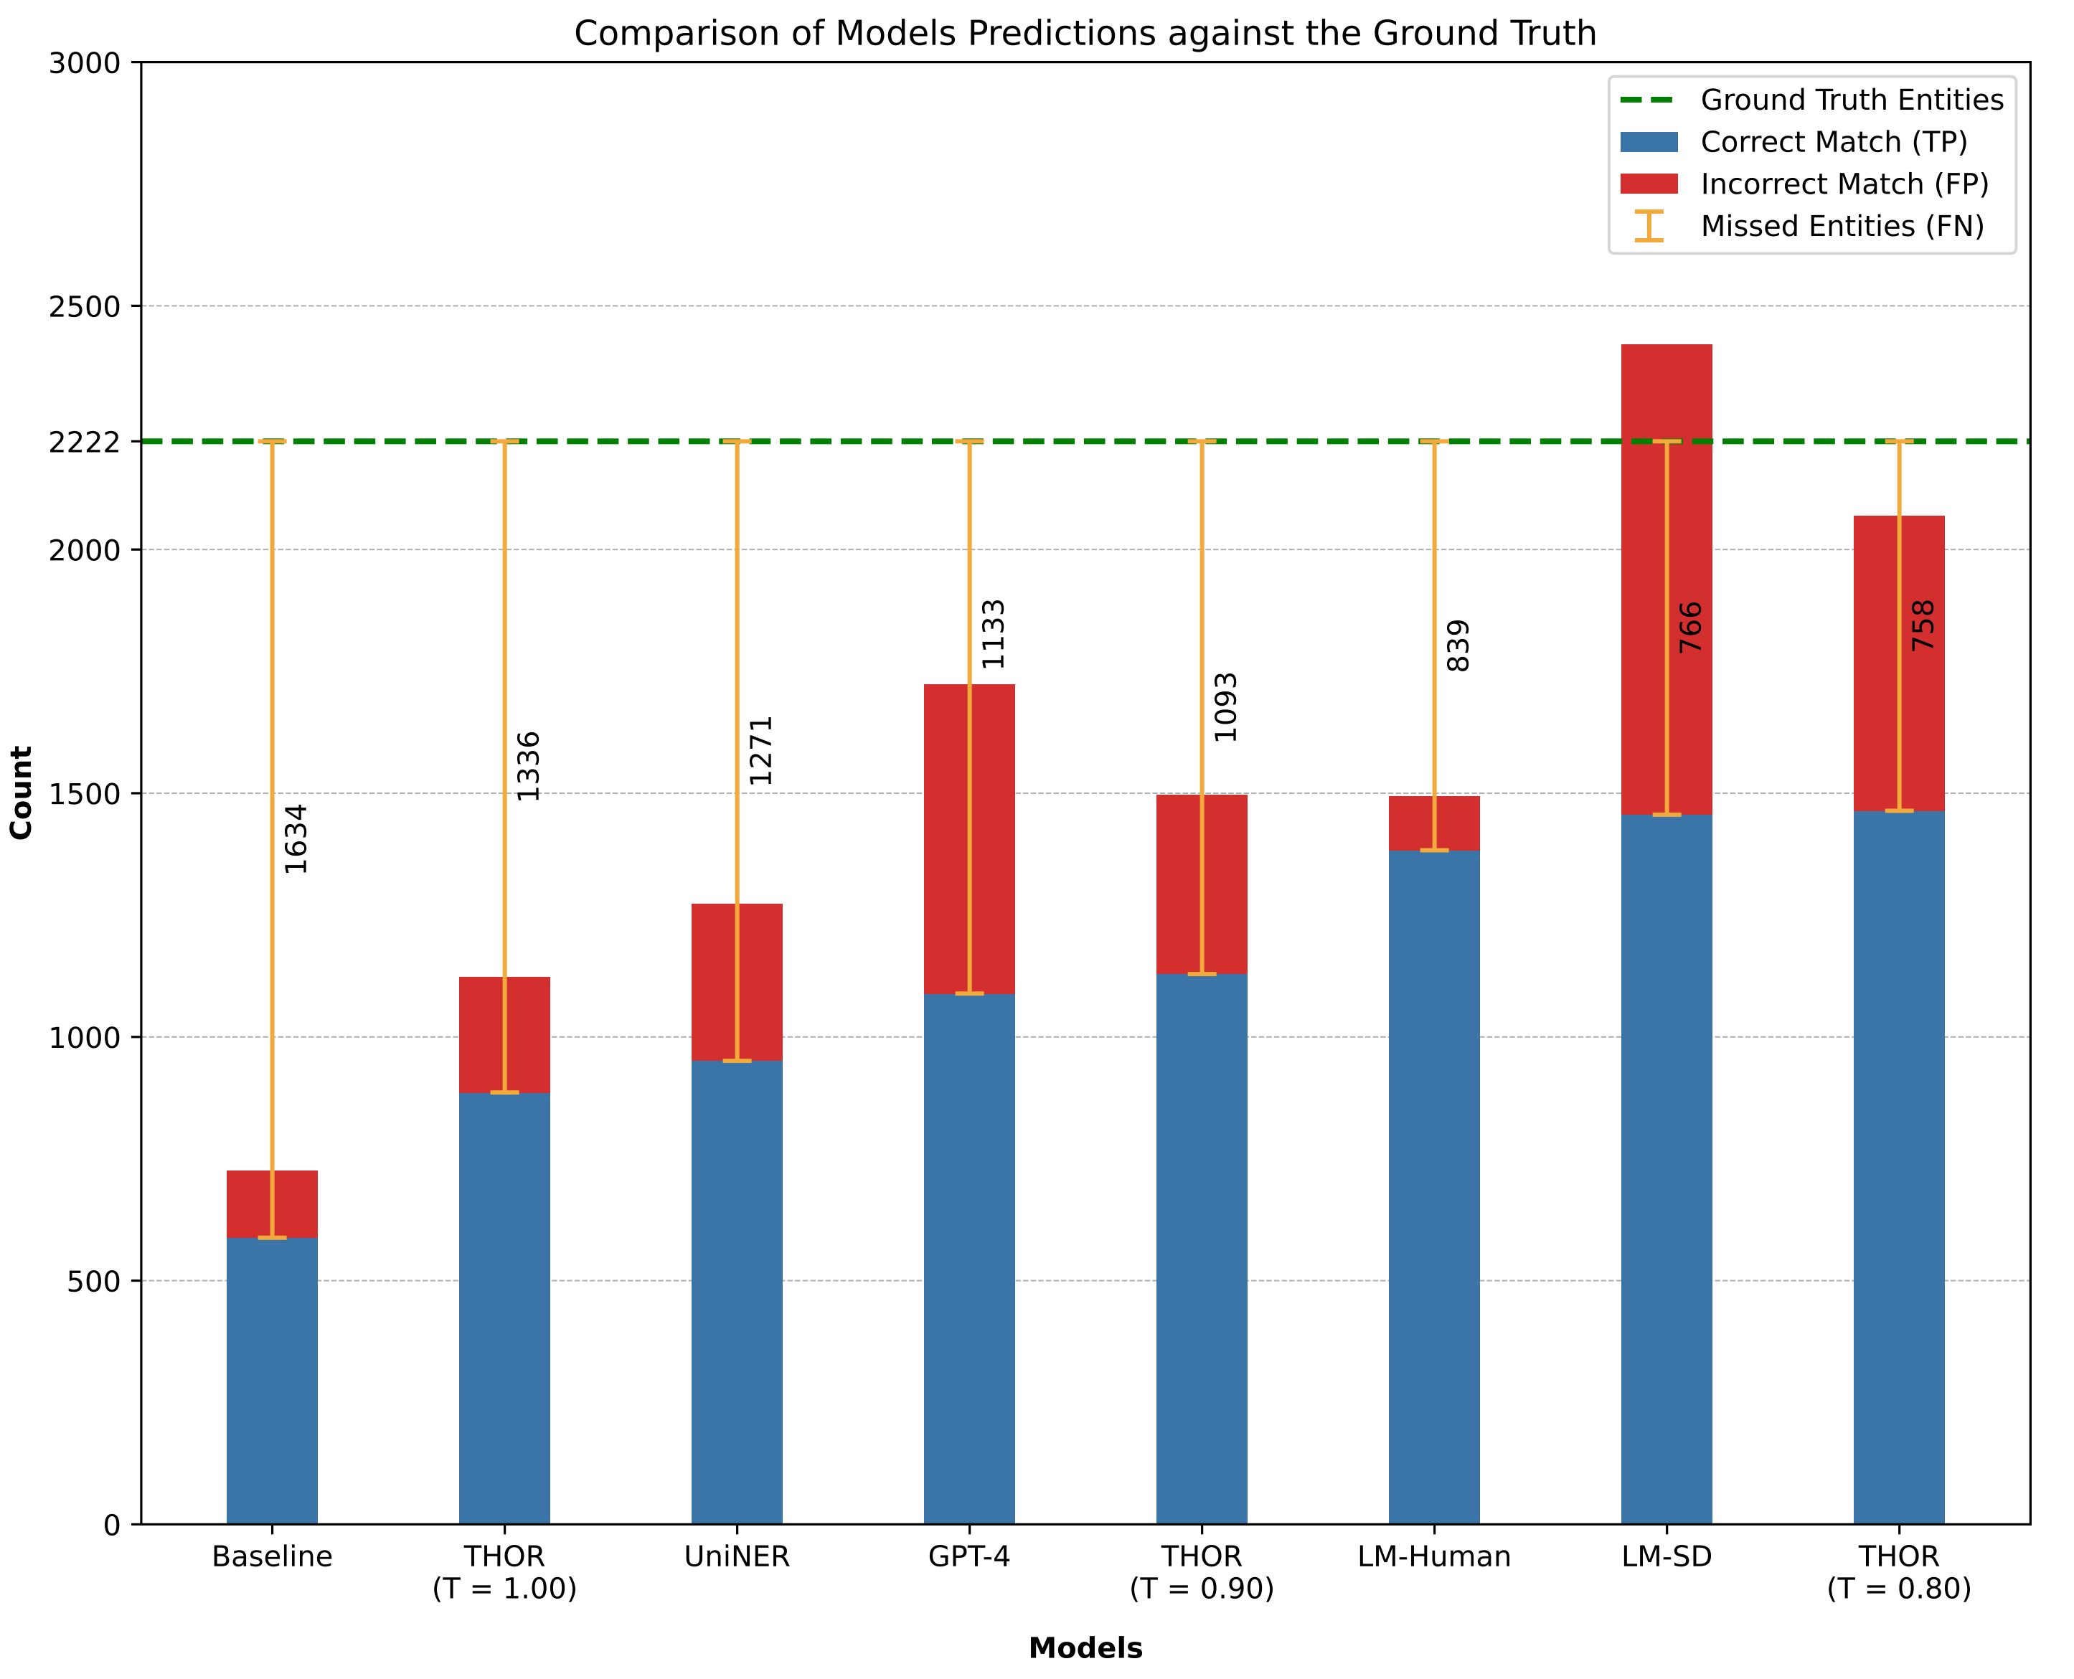
Experimental Results – Raw Predictions
Experiments | Model Name | Ground Truth Entities | Predicted Entities | Correct Match (TP) | Incorrect Match (FP)
THOR (our) | THOR (T = 0.80) | 2222 | 2069 | 1464 | 605
 | THOR (T = 0.90) | 2222 | 1496 | 1129 | 367
 | THOR (T = 1.00) |  | 1123 | 886 | 237
OTHER (comparison) | Baseline | 2222 | 725 | 588 | 137
 | LM-SD |  | 2421 | 1456 | 965
 | GPT-4 | 2222 | 1724 | 1089 | 635
 | UniNER |  | 1272 | 951 | 321
 | LM-Human |  | 1494 | 1383 | 111
Notes:
Here you can see the raw numbers from the predictions of different models.
The goal is to maximize the number of correct predictions while minimizing incorrect ones.
If we observe closely, we can see that our top 3 model shows a better balance in predictions to noise ratio as compared to the other models.
Of-course LM-Human is better in producing less noise --
But this is because it has seen similar textual examples related to the test set during the training phases.

Slide 15
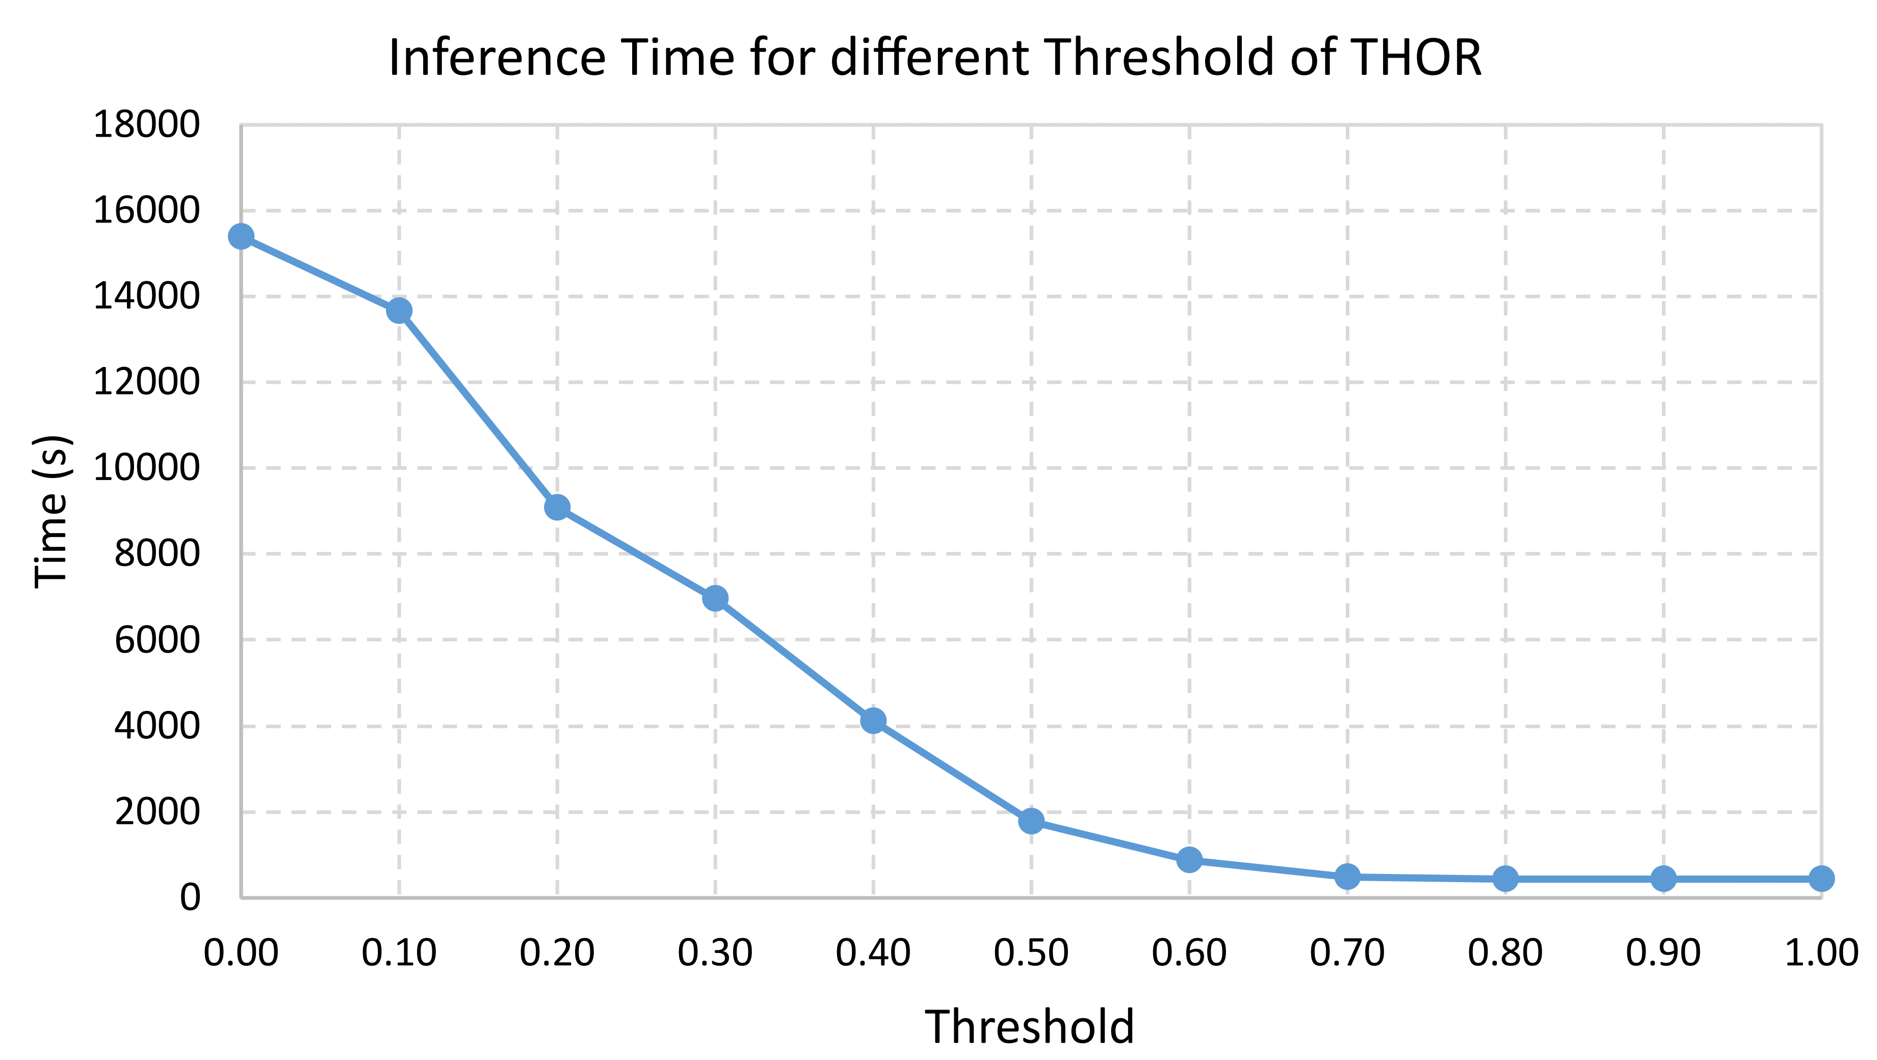
Experimental Results - Inference Time
Thresholds (THOR) | Inference Time (s) | Time (hour/min)
0.00 | 15401 | 4h 16m
0.10 | 13661 | 3h 47m
0.20 | 9087 | 2h 31m
0.30 | 6950 | 1h 56m
0.40 | 4113 | 1h 8m
0.50 | 1781 | 29m
0.60 | 870 | 15m
0.70 | 493 | 9m
0.80 | 427 | 7m
0.90 | 425 | 7m
1.00 | 422 | 7m
Other Models | Training Time | Inference Time
Baseline | - | 9m
UnivNER | - | 34 - 55m
LM-SD | 61m | 20s
LM-Human | 59m | 20s
N.B: THOR’s Inference time depends primarily on the ranking strategies!
Notes:
Inference time is another criteria where our method shines greatly.
Our model improves on time as we go more restrictive on the threshold, which also improves the performance in our case.
On the other hand, the supervised methods either needs a good amount of Training or Testing time.
One thing to mention here is that supervised methods are not practical in a sense that, we need to re-train the model every now and then with the changes in structured sources.
Also, these models tend to need a huge GPU and Memory Resources for training and inferencing purpose.
On top of that they have a limitation on the length of text document.

Slide 16
Relevant Work - Categorization of Existing Approaches
Method | Input | Output | Description | Advantages | Disadvantages | Prominent Literature
Bootstrapping, Semi-supervised | Unlabeled text, relation schema, rules and/or examples | Extraction rules, Relations | Using a small set of seed extraction rules, extract examples, keep prominent ones, iteratively learn more extraction rules and examples | Easy to add new rules, can also be supplied by user | Often low recall and/or manual refinement needed for high precision | Agichtein and Gravano (2000); Etzioni et al. (2004), Carlson et al. (2010)
Rule-based, Pattern-based | Unlabeled text, relation schema, rules, and NE gazetteers | Entities, Relations | Using extraction rules and gazetteers, extract relations | Easy to add new rules, can also be supplied by user | Often low recall, much manual effort to develop | Shen et al. (2007), Reiss et al. (2008), Dong et al. (2014)
Supervised [Including Zero/Few-shot (L)LMs] | Labeled text, relation schema, prompt | Entities, Relations | Using a schema (class description) and labeled training data, train model | Currently highest precision and recall (except for LLM) for schema-specific entity/relation extraction | Up-front effort of labeling data, risk of overfitting training set, hallucination | Hu et al. (2022); Milosevic and Thielemann (2022); Wang et al. (2022); Zhou et al. (2023); Zhang et al. (2017); Han et al. (2019); Soares et al. (2019); Tian et al. (2021)
Open IE, Unsupervised | Unlabeled text | Groups of relations | Discover groups of relations from text using clustering, keep prominent ones | No knowledge about text needed | Difficult to make sense of groups and map to relation schemas | Angeli et al. (2015), Fader et al. (2011)
Distantly Supervised | Unlabeled text, relation schema, examples | Extraction model, Relations | Using a schema and large seed examples of relations, automatically annotate training data, train a model to extract more relations | Extracting relations with high recall and precision | Initial examples required | Shang et al. (2023), Yang et al. (2018), Augenstein et al. (2015), Mintz et al. (2009)
Universal Schema | Several partly populated knowledge bases | Unified knowledge | Take several KBs defined by different schemas, partly populated with relations, predict union of KBs | Integrate relations defined by different schemas after extraction | For small KBs it can be faster to do this manually | Rossiello et al. (2023), Mihindukulasooriya et al. (2022), Ni, J. et al (2022)
Notes:
We also categorized the relevant work that deals with Information Extraction for the similar task.
Our model is somewhat Hybrid in a sense that it falls somewhere between Distantly Supervised and Semi-Supervised approaches.
I will not go into detail but the main pointers to take from here is that, although supervised approaches are performant:
They are not suitable for domain adaptability.
And needs a good amount of labelled data which is not practical for data integration scenarios.
Whereas, Distantly supervised and Weakly Supervised models produces good degree of performance with fewer data.
They are really suitable when your data has little or no context unlike annotated texts.
And shorter in length.

Slide 17
Conclusion and Future Directions
Our contribution so far:
We developed a lightweight yet powerful approach for mitigating data sparsity in the integrated data by imputing the missing values using conceptualized entities from external texts, leveraging a knowledge graph.
Our method significantly outperforms state-of-the-art Large Language Models (both LMs and LLMs) in text conceptualization, particularly in entity recognition tasks.
Compared to methods that necessitate the human annotation process, our approach showcases substantial reductions in time, resource consumption, and effort, highlighting its practicality for real-world applications.
Future Directions:
Traditional pipeline-oriented methods, such as ER and RE, often accumulate errors and can lose information. A dense representation that preserves comprehensive data, similar to advanced language models, might be a more effective approach.
Instead of immediately creating a knowledge graph, considering direct queries and inferences on texts might be advantageous. This method would permit direct mapping of queries to textual sources, skipping some pre-extraction processes.
These representations can later be merged with knowledge graphs, enhancing fact verification and facilitating better decision-making.
Notes:
To Sum it up…

Slide 18
Ph.D. Timeline and Future Plan
Start of PhD: 18/02/2022 (1 year and 4 months)
Courses: All ECTS concluded
Evaluation of our Triple Extraction Framework for an extended Contribution
Feb 2022 – Feb 2023
Mar – Jun 2023
Jul – Sep 2023
Oct – Nov 2023
Dec 2023
Jan – Dec 2024
Jan – Jun
2025
Parental Leave
Literature; DPP; Formulation of solution for O1 and O2; Dataset Creation.
Experimentation, Evaluation, and Comparison
of our developed approach (O1, O2).
Submission of 1st Contribution (ICDE 2024)
Secondment; Host (ULB) Stay; Contributions (O3, O4)
Doctoral Thesis

Slide 19
Thank You!

Slide 20
References
[1] R. Gaizauskas and Y. Wilks. Information extraction: Beyond document retrieval. Journal of Documentation, 54(1), pages 70–105, 1998. DOI: 10.1108/eum0000000007162.2
[2] Isabelle Augenstein, Andreas Vlachos, and Diana Maynard. Extracting relations between non-standard entities using distant supervision and imitation learning. In Proc. of the Conference on Empirical Methods in Natural Language Processing (EMNLP), pages 747–757, Lisbon, Portugal, 2015. Association for Computational Linguistics, DOI: 10.18653/v1/d15-1086. 37, 40, 45, 137
[3] Tim Rocktäschel, Sameer Singh, and Sebastian Riedel. Injecting logical background knowledge into embeddings for relation extraction. In Annual Conference of the North American Chapter of the Association for Computational Linguistics (NAACL), 2015. DOI: 10.3115/v1/n15-1118. 37
[4] Rohit J. Kate and Raymond Mooney. Joint entity and relation extraction using card-pyramid parsing. In Mirella Lapata and Anoop Sarkar, Eds., Proc. of the 14th Conference on Computational Natural Language Learning, pages 203–212, Uppsala, Sweden, 2010. Association for Computational Linguistics. 40.
[5] Sameer Singh, Sebastian Riedel, Brian Martin, Jiaping Zheng, and Andrew McCallum. Joint inference of entities, relations, and coreference. In Proc. of AKBC, pages 1–6. ACM, 2013. DOI: 10.1145/2509558.2509559. 40
[6] Qi Li and Heng Ji. Incremental joint extraction of entity mentions and relations. In Proc. of the 52nd Annual Meeting of the Association for Computational Linguistics (Volume 1: Long Papers), pages 402–412, Baltimore, Maryland, 2014. Association for Computational Linguistics. DOI: 10.3115/v1/p14-1038. 40
[7] Mintz, M., Bills, S., Snow, R., & Jurafsky, D. (2009, August). Distant supervision for relation extraction without labeled data. In Proceedings of the Joint Conference of the 47th Annual Meeting of the ACL and the 4th International Joint Conference on Natural Language Processing of the AFNLP (pp. 1003-1011).
[8] Warren Shen, AnHai Doan, Jeffrey F. Naughton, and Raghu Ramakrishnan. Declarative information extraction using datalog with embedded extraction predicates. In Christoph Koch, Johannes Gehrke, Minos N. Garofalakis, Divesh Srivastava, Karl Aberer, Anand Deshpande, Daniela Florescu, Chee Yong Chan, Venkatesh Ganti, Carl-Christian Kanne, Wolfgang Klas, and Erich J. Neuhold, Eds., VLDB, pages 1033–1044. ACM, 2007.
[9] Frederick Reiss, Sriram Raghavan, Rajasekar Krishnamurthy, Huaiyu Zhu, and Shivakumar Vaithyanathan. An algebraic approach to rule-based information extraction. In Proc. of the 24th ICDE, pages 933–942. IEEE, 2008.
[10] Xin Dong, Evgeniy Gabrilovich, Geremy Heitz, Wilko Horn, Ni Lao, Kevin Murphy, Tomas Strohmann, Shaohua Sun, and Wei Zhang. Knowledge vault: A web-scale approach to probabilistic knowledge fusion. In Proc. of the 20th ACM SIGKDD International Conference on Knowledge Discovery and Data Mining, pages 601–610. ACM, 2014. DOI: 10.1145/2623330.2623623.
[11] Andrew Carlson, Justin Betteridge, Richard C. Wang, Estevam R. Hruschka, Jr., and Tom M. Mitchell. Coupled semi-supervised learning for information extraction. In Proc. of the 3rd ACM International Conference on Web Search and Data Mining, WSDM’10, pages 101–110, New York, NY, 2010. ACM. DOI: 10.1145/1718487.1718501.
[12] Saulo D. S. Pedro and Estevam R. Hruschka Jr. Conversing learning: Active learning and active social interaction for human supervision in never-ending learning systems. In Rubén Fuentes-Fernández Juan Pavón, Néstor D. Duque-Méndez, Ed., Advances in Artificial Intelligence—IBERAMIA 2012, pages 231–240. Springer, 2012. DOI: 10.1007/978-3-642-34654-5
[13] Sergey Brin. Extracting patterns and relations from the world wide web. In Paolo Atzeni, Alberto Mendelzon, and Giansalvatore Mecca, Eds., The World Wide Web and Databases, pages 172–183. Springer, 1999. DOI: 10.1007/10704656
[14] Eugene Agichtein and Luis Gravano. Snowball: Extracting relations from large plain-text collections. In Peter Nürnberg, David Hicks, and Richard Furuta, Eds., Proc. of the 5th ACM Conference on Digital Libraries, pages 85–94, 2000.
[15] O. Etzioni, M. Cafarella, D. Downey, S. Kok, A. Popescu, T. Shaked, S. Soderland, D. S. Weld, and A. Yates. Web-scale information extraction in KnowItAll. In Stuart Feldman, Mike Uretsky, Marc Najork, and Craig Wills, Eds., Proc. of the 13th International Conference on World Wide Web, Rio de Janeiro, Brazil, 2004. ACM.
[16] Andrew Carlson, Justin Betteridge, Bryan Kisiel, Burr Settles, Estevam R. Hruschka Jr., and Tom M. Mitchell. Toward an architecture for never-ending language learning. In Maria Fox and David Poole, Eds., Proc. of the 24th AAAI Conference on Artificial Intelligence, Palo Alto, California, 2010. AAAI Press.

Slide 21
References
[17] Aron Culotta and Jeffrey Sorensen. Dependency tree kernels for relation extraction. In Proc. of the 42nd Meeting of the Association for Computational Linguistics (ACL’04), Main Volume, pages 423–429, Barcelona, Spain, 2004. DOI: 10.3115/1218955.1219009.
[18] Razvan Bunescu and Raymond Mooney. A shortest path dependency kernel for relation extraction. In Raymond Mooney, Chris Brew, Program Co-chair Lee-Feng Chien, Academia Sinica, and Program Co-chair Katrin Kirchhoff, University of Washington, Eds., Proc. of Human Language Technology Conference and Conference on Empirical Methods in Natural Language Processing (EMNLP), pages 724–731, Vancouver, British Columbia, Canada, 2005. Association for Computational Linguistics.
[19] Jason Weston, Antoine Bordes, Oksana Yakhnenko, and Nicolas Usunier. Connecting language and knowledge bases with embedding models for relation extraction. In David Yarowsky, Timothy Baldwin, Anna Korhonen, Karen Livescu, and Steven Bethard, Eds., Proc. of the Conference on Empirical Methods in Natural Language Processing (EMNLP), pages 1366– 1371, Seattle, Washington, 2013. Association for Computational Linguistics.
[20] Zhang, Y., Zhong, V., Chen, D., Angeli, G., & Manning, C. D. (2017). Position-aware attention and supervised data improve slot filling. In Conference on Empirical Methods in Natural Language Processing (EMNLP).
[21] Liu, Yinhan, et al. "Roberta: A robustly optimized bert pretraining approach." arXiv preprint arXiv:1907.11692 (2019).
[22] Joshi, Mandar, et al. "Spanbert: Improving pre-training by representing and predicting spans." Transactions of the Association for Computational Linguistics (ACL) 8 (2020): 64-77.
[23] Mihai Surdeanu, David McClosky, Mason R. Smith, Andrey Gusev, and Christopher D. Manning. 2011. Customizing an Information Extraction System to a New Domain. In Proceedings of the ACL 2011 Workshop on Relational Models of Semantics.
[24] Alexander Yates, Michele Banko, Matthew Broadhead, Michael Cafarella, Oren Etzioni, and Stephen Soderland. TextRunner: Open information extraction on the Web. In Bob Carpenter, Amanda Stent, and Jason D. Williams, Eds., Proc. of Human Language Technologies: The Annual Conference of the North American Chapter of the Association for Computational Linguistics (NAACL), pages 25–26, Rochester, New York, 2007. Association for Computational Linguistics. DOI: 10.3115/1614164.
[25] Anthony Fader, Stephen Soderland, and Oren Etzioni. Identifying relations for open information extraction. In David Yarowsky, Timothy Baldwin, Anna Korhonen, Karen Livescu, and Steven Bethard, Eds., Proc. of the Conference on Empirical Methods in Natural Language Processing (EMNLP), pages 1535–1545, Seattle, Washington, 2013. Association for Computational Linguistics.
[26] Mausam, Michael Schmitz, Stephen Soderland, Robert Bart, and Oren Etzioni. Open language learning for information extraction. In Jun’ichi Tsujii, James Henderson, and Marius Pasça, Eds., Proc. of the Joint Conference on Empirical Methods in Natural Language Processing and Computational Natural Language Learning, pages 523–534, Jeju Island, Korea, 2012
[27] Gabor Angeli, Melvin Johnson Premkumar, and Christopher D. Manning. Leveraging Linguistic Structure For Open Domain Information Extraction. In Proceedings of the Association of Computational Linguistics (ACL), 2015.
[28] Mihindukulasooriya, N.; Sava, M.; Rossiello, G.; Chowdhury, M. F. M.; Yachbes, I.; Gidh, A.; Duckwitz, J.; Nisar, K.; Santos, M.; and Gliozzo, A. 2022. Knowledge Graph Induction enabling Recommending and Trend Analysis: A Corporate Research Community Use Case. CoRR, abs/2207.05188.
[29] Ni, J.; Rossiello, G.; Gliozzo, A.; and Florian, R. 2022. A Generative Model for Relation Extraction and Classification. CoRR, abs/2202.13229
[30] Zhou, Wenxuan, et al. "UniversalNER: Targeted Distillation from Large Language Models for Open Named Entity Recognition." arXiv preprint arXiv:2308.03279 (2023).
[31] Rossiello, Gaetano, et al. "Knowgl: Knowledge generation and linking from text." Proceedings of the AAAI Conference on Artificial Intelligence. Vol. 37. No. 13. 2023.
[32] Dan Jurafsky and James H Martin. Speech and language processing. 3rd, 2023.
[33] Yang, Yaosheng, et al. "Distantly supervised NER with partial annotation learning and reinforcement learning." Proceedings of the 27th International Conference on Computational Linguistics. 2018.
[34] Shang, Yu-Ming, et al. "A pattern-aware self-attention network for distant supervised relation extraction." Information Sciences 584 (2022): 269-279.

