Slide 1




Performance Analysis of Distributed GPU-Accelerated Task-Based Workflows
Thesis Proposal Report
Eleventh European Big Data Management & Analytics Summer School (eBISS 2023)
07/07/2023
Barcelona - Spain
ESR 2.1: Transparent In-situ Data Processing
PhD Candidate: Marcos N. L. Carvalho (UPC | ARC | UoA)
Home Advisors: Anna Queralt (UPC); Oscar Romero (UPC)
Host Advisor: Alkis Simitsis (ARC)

Slide 2
Outline
PhD Project Goal and Objectives
Motivation
Background
Method
Experiments
Conclusion
PhD Project Timeline and Current Status

Slide 3
PhD Project Goal and Objectives
Goal: to propose a novel adaptive learning optimizer to execute Data Science pipelines efficiently by balancing heterogeneous resources (CPU-GPU) in disaggregated architectures:
Given a data set and a workflow, automatically predict the most appropriate processor (e.g., shortest execution time, lower power consumption, etc.) to execute tasks
Integration of our adaptive optimizer in real data processing engines
Current work is targeting Obj. 1
Objectives:
Obj. 1: Learning by doing and experiencing, with real settings of analytics how an heterogeneous system (CPU-GPU) behaves
Obj. 2: Develop a first version of the adaptive learning optimizer in a simplified setting (e.g., single node containing multiple CPU and GPU cores)
Obj. 3: Develop a second version of the adaptive learning optimizer in a disaggregated architecture in a scale-out setting (e.g., multiple nodes containing multiple CPU and GPU cores, interconnected by a fast network)
Obj. 4: A non-invasive solution that can easily integrate our adaptive learning optimizer to any data processing engine

Slide 4
Motivation: Introduction
Popularity of accelerators: GPUs are being adopted in modern distributed infrastructures, making such environments increasingly more heterogeneous [Abadi et al @SIGMOD’20]
Software is also being modernized with the development of distributed GPU-accelerated task-based workflows [Cortes et al Comput. Sci. Rev.’21]
Advantages:
High performance:
Multi-level parallelism:
Task-level parallelism on CPUs
Thread-level parallelism on GPUs
High productivity:
High level of programming abstraction
Drawbacks:
It is not always clear how to use such environments efficiently due to:
Huge design space of execution parameters
Poor combination of execution parameters

Slide 5
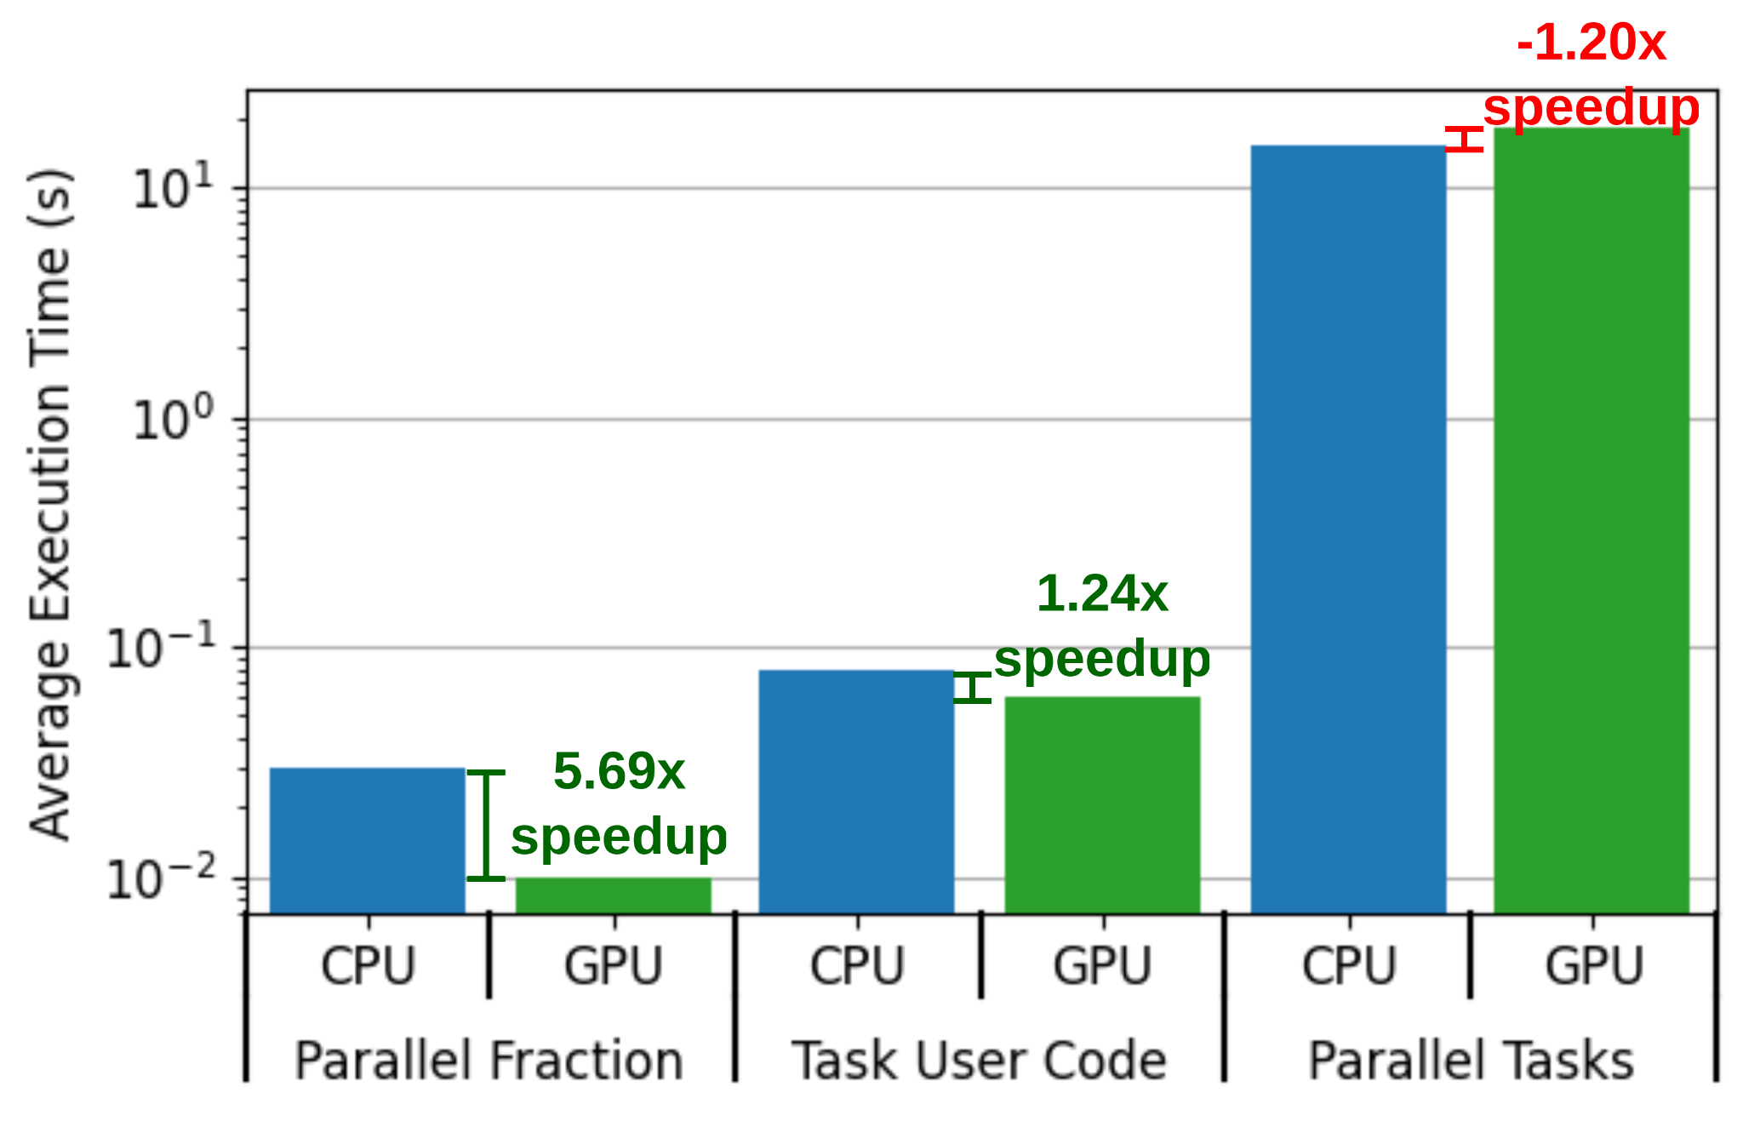
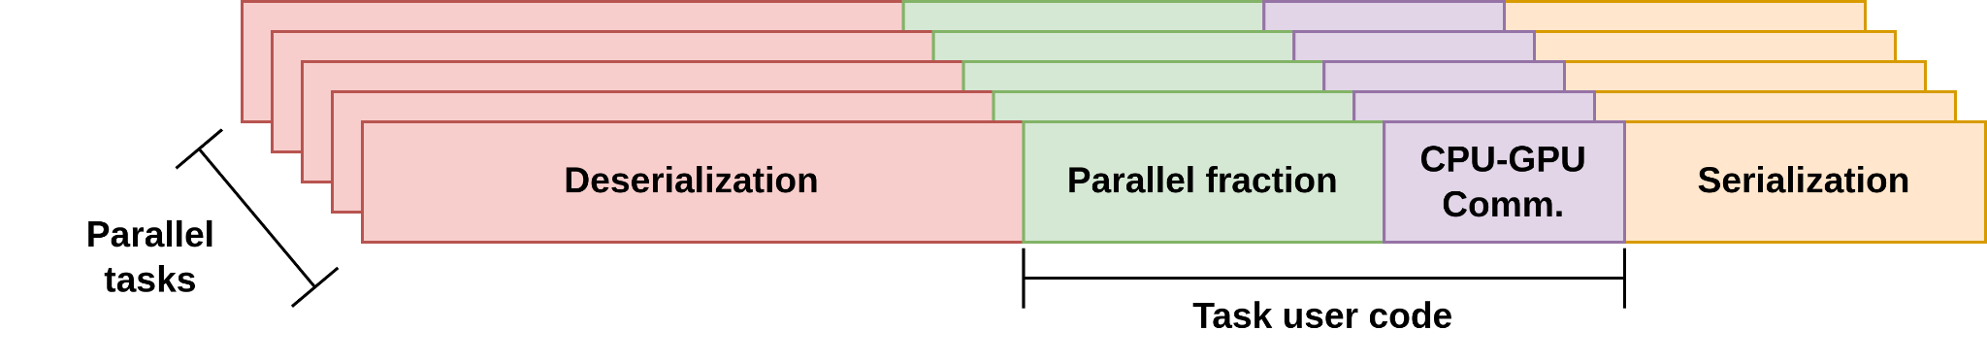
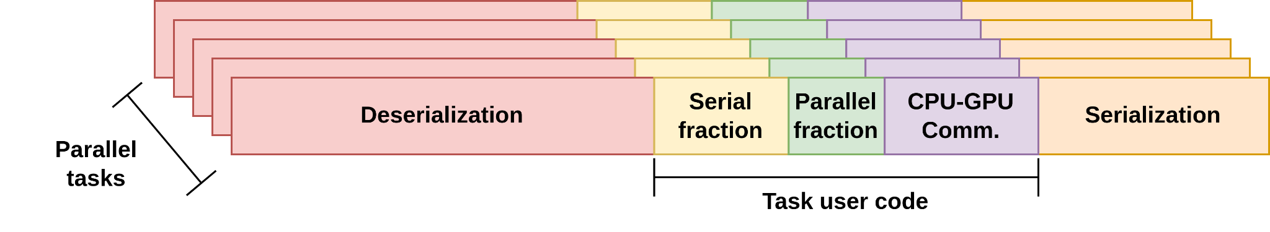
Motivation: Classes of Algorithms and Example
- Classes of algorithms:
- Performance variations in K-means processing:
Massively parallel algorithm (e.g. Matmul)
Slightly parallel algorithm (e.g. K-means)
Goal of this work:
Identify the main factors affecting the performance of such workflows:
Guide users towards expected performance gains in heterogeneous CPU-GPU processing
Help users to decide when is worth using CPU or GPU

Slide 6
Motivation: Related Work
Common observations reported in related work:
CPU-GPU communication is considered as the main bottleneck in heterogeneous CPU-GPU processing
Reduce or hide CPU-GPU communication with computation [Yogatama et al @VLDB’22; Liu et al @TPDS’22; Lutz et al @SIGMOD’20] [Cecilia et al @Sensors’20; Liu et al SoCC’22; Yuan et al BigData’16]
Simply increasing task granularity is not always the best strategy to maximize performance of GPUs [Lee et al @ICDEW’21; Schüle et al @Distrib. Parallel Databases’22]
However, parallel fraction processing has not been considered as a key performance factor
Distributed environments scale out task-level parallelism, but add data (de-)serialization [Manzi et al @IC2E’16; Tseng et al @SIGOPS’18]
However, the impacts of task granularity on data (de-)serialization and how to balance task- and thread-level parallelism have not been studied

Slide 7
Motivation: Contributions
Performance analysis of thread-level parallelism considering the effects of parallel fraction processing
Performance analysis of task-level parallelism on CPUs considering the effects of data (de-)serialization
Feature extraction considering algorithm, data set, resource and distributed execution framework (DEF)

Slide 8


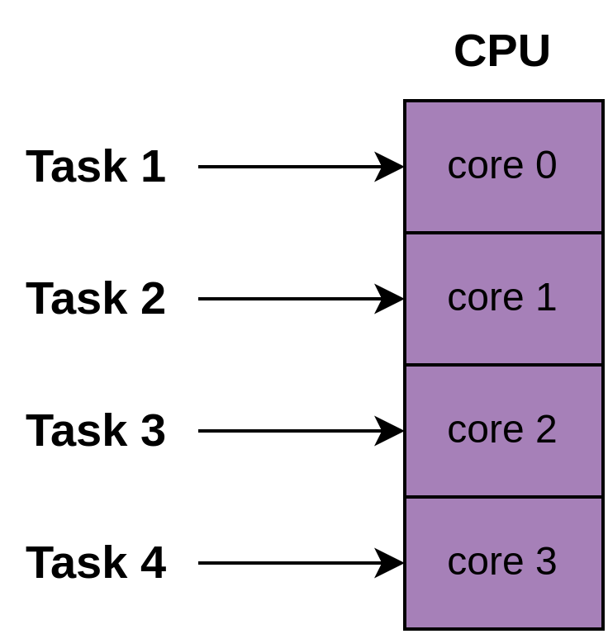
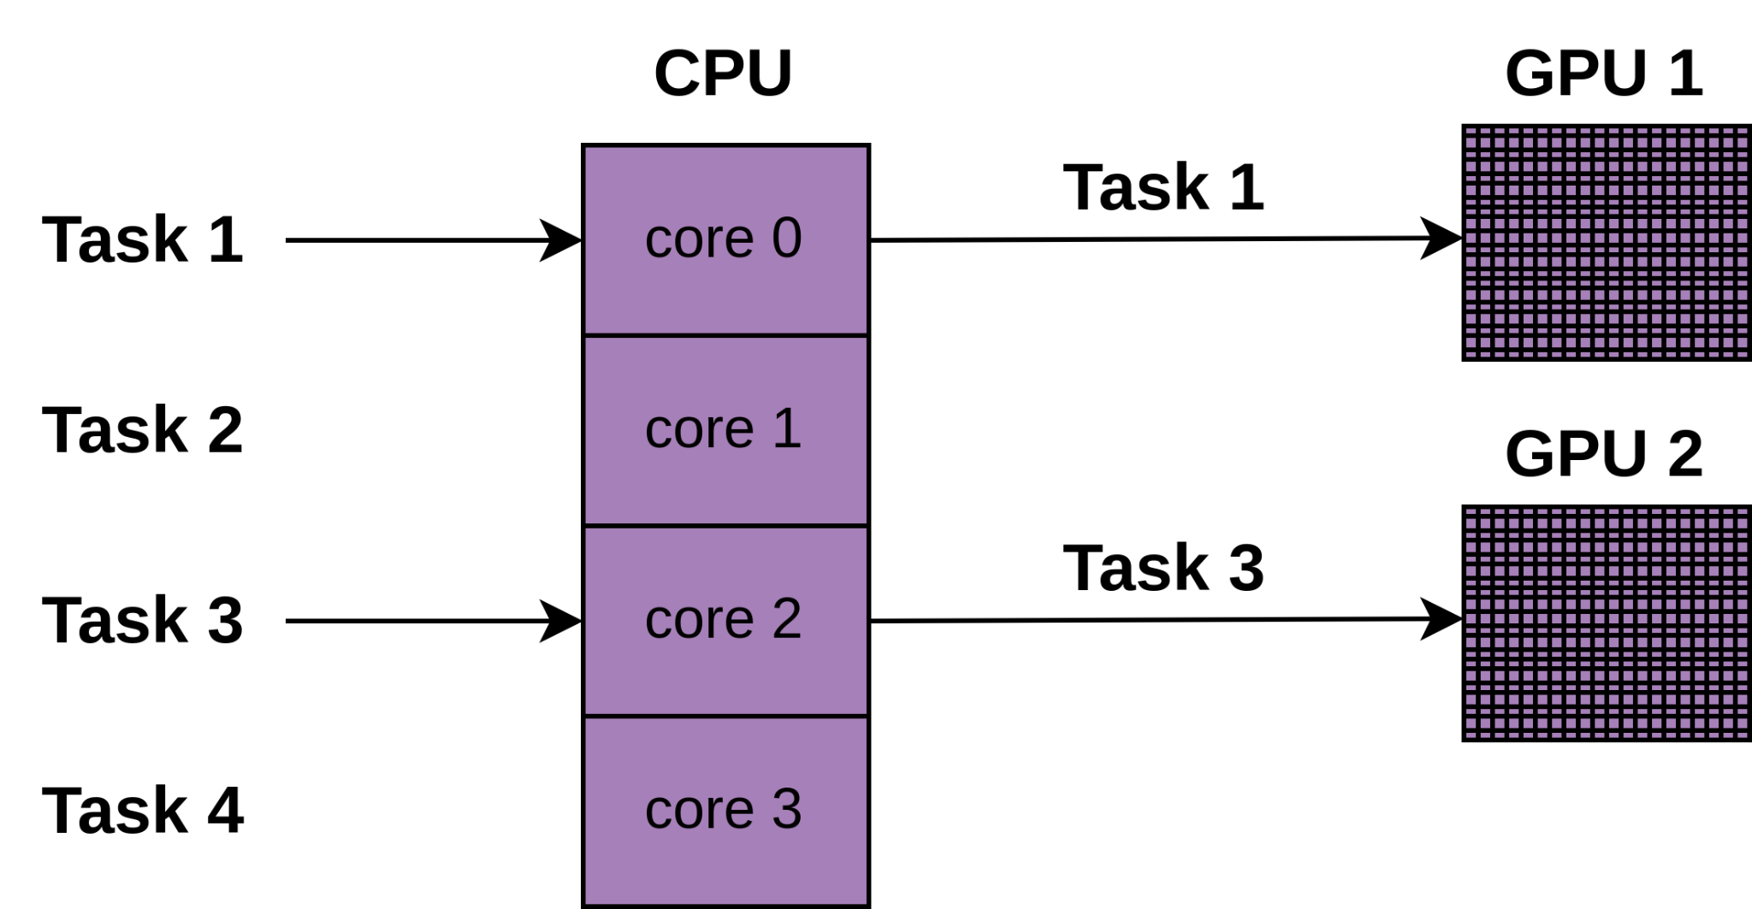
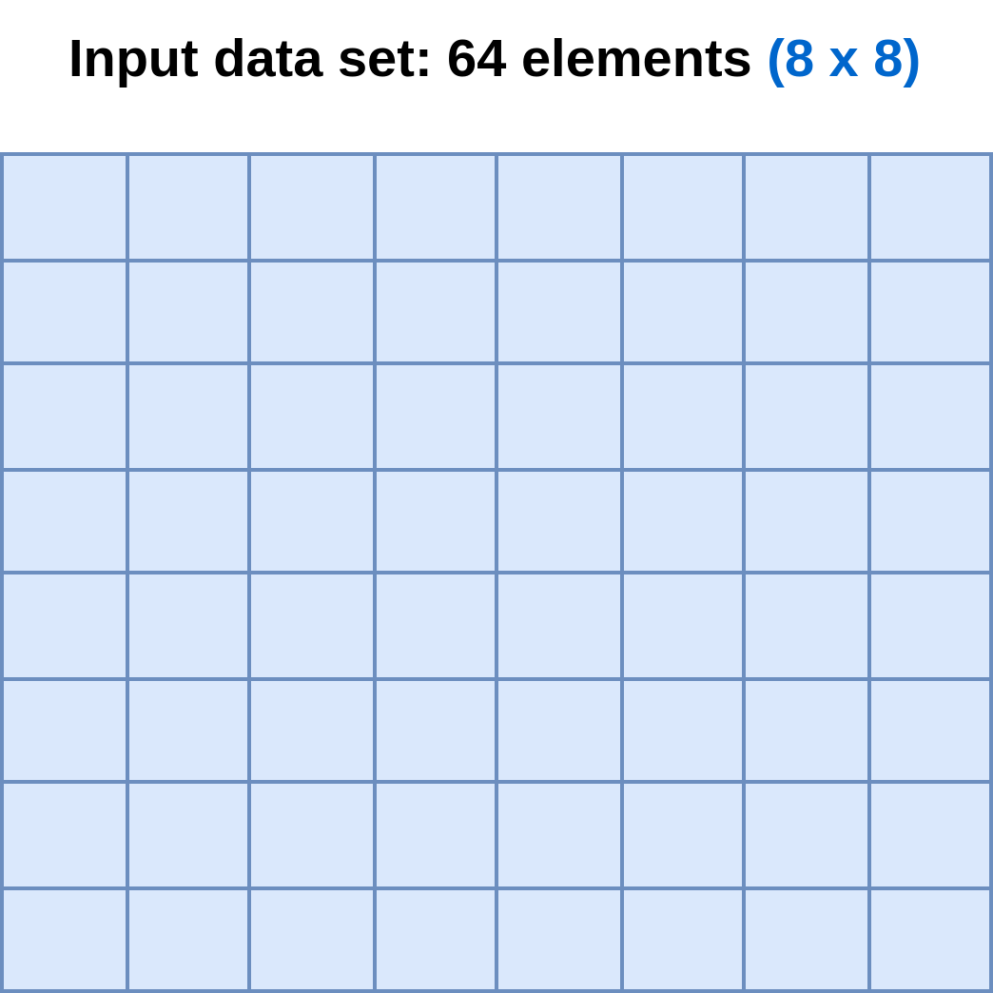
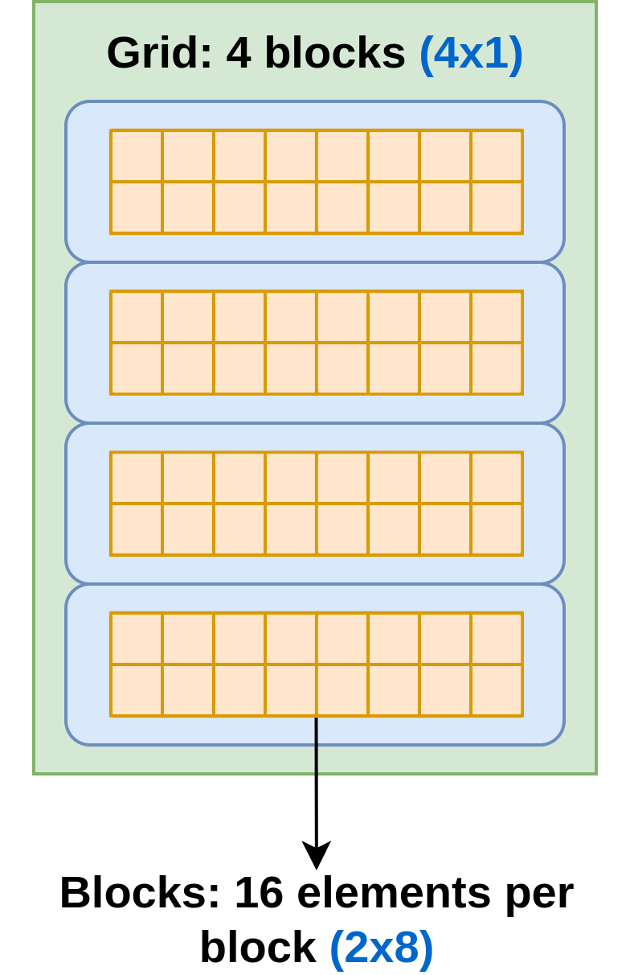
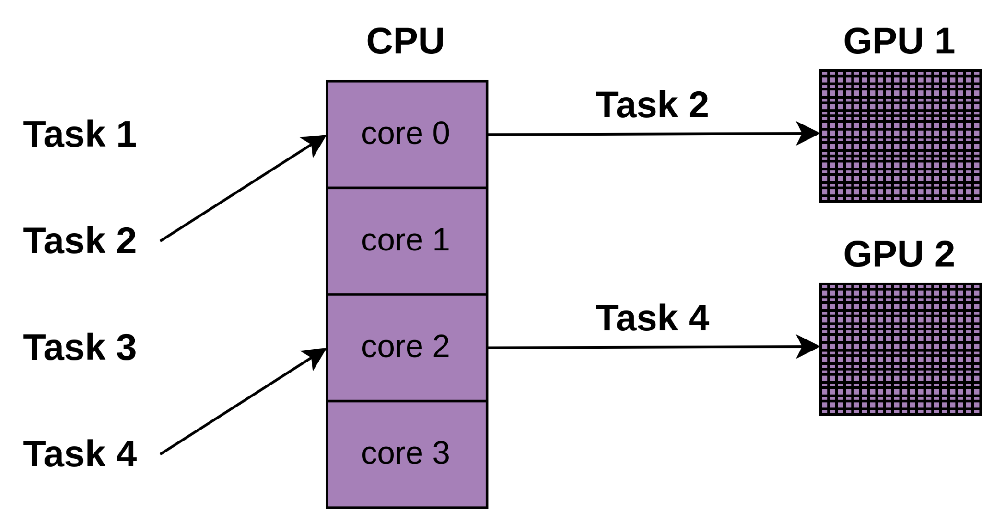
Relationship between , and :
Background: Multi-level Parallelism
Example: K-means processing an 8x8 data set using 2x8 blocks:
#tasks
(task-parallelism)
#blocks per task
(thread-parallelism)

Slide 9
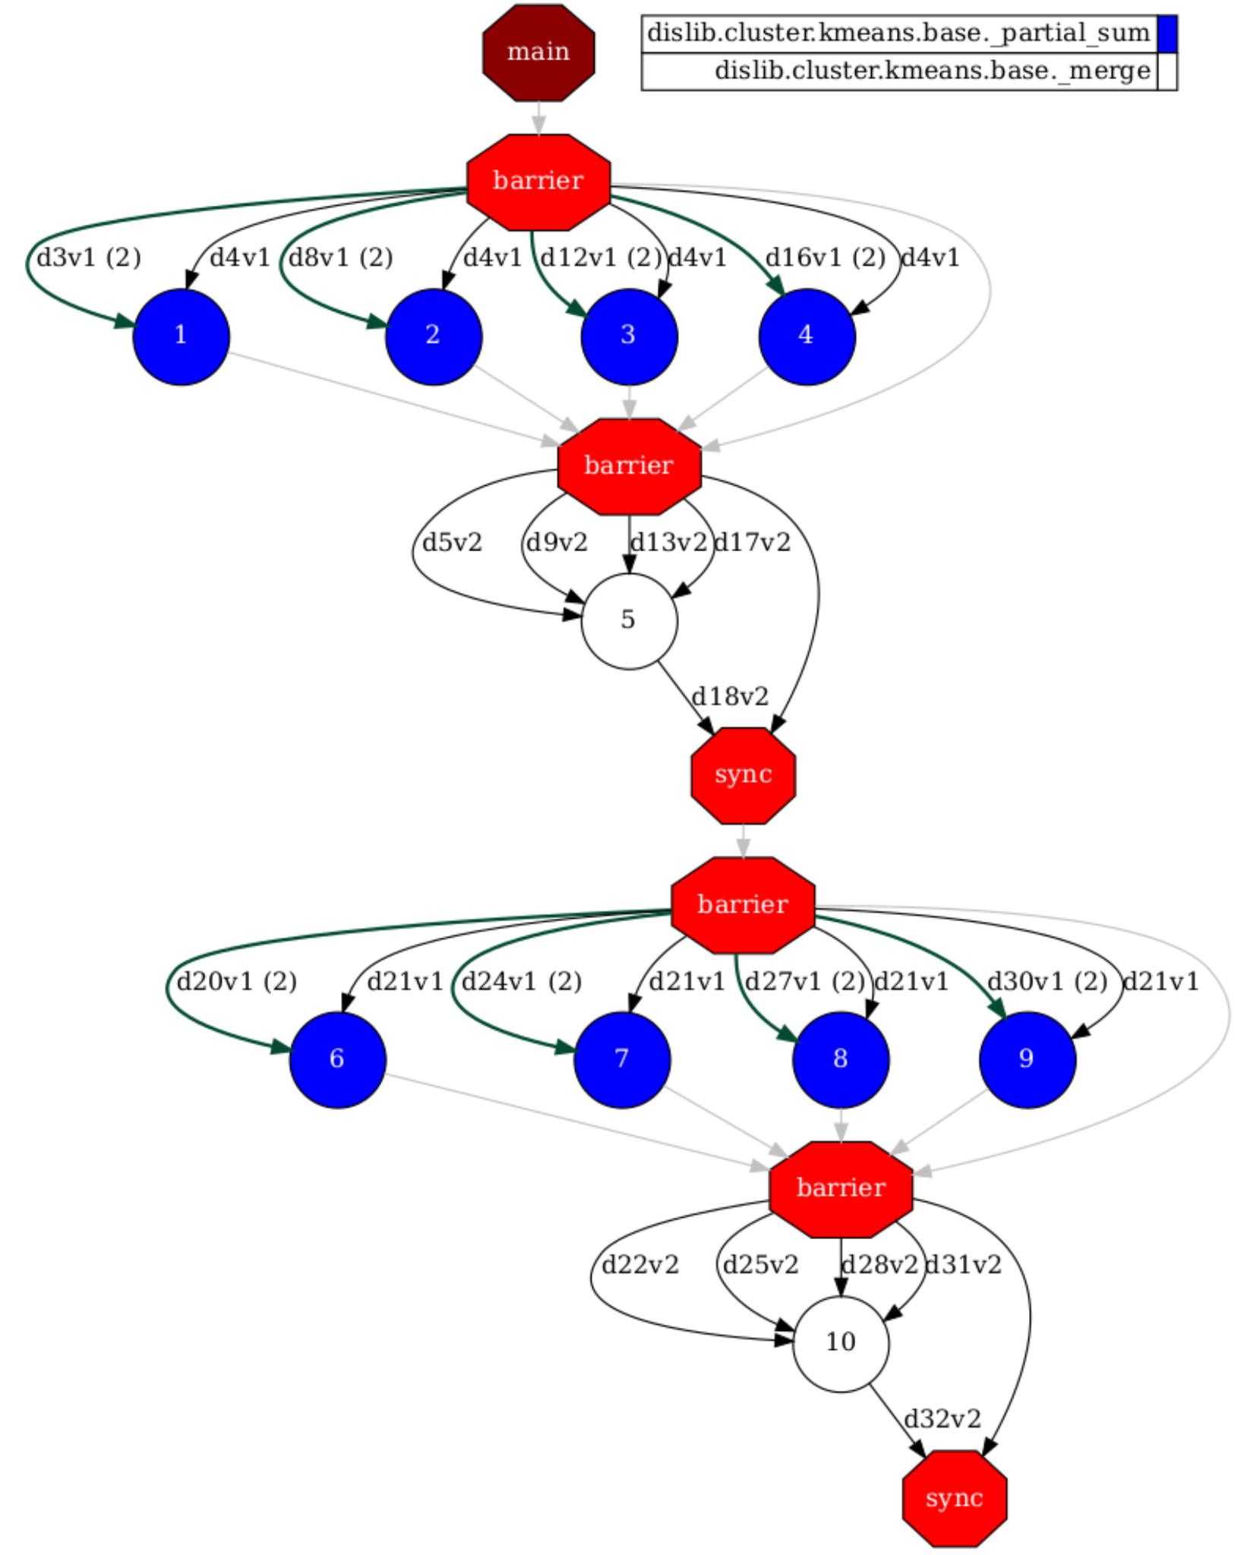
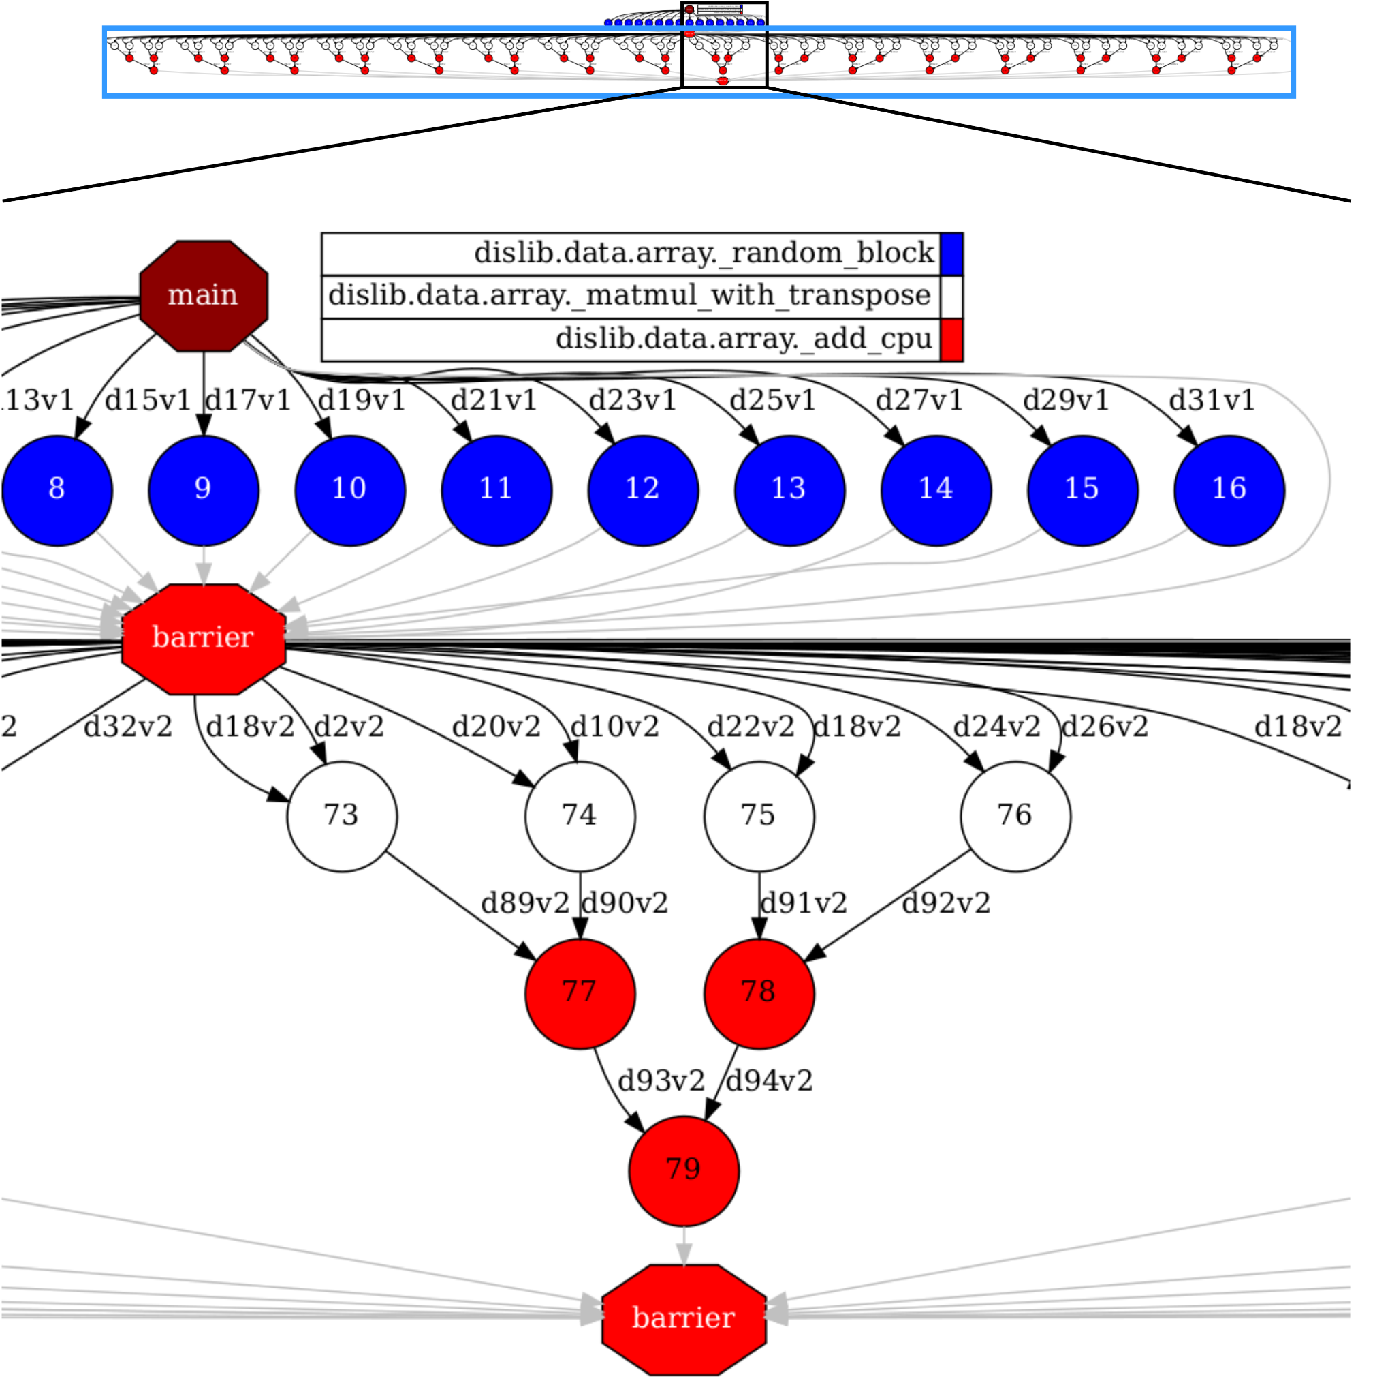
Background: Heterogenous DAGs (different shapes and levels of dependencies)
K-means:
Matmul:

Slide 10
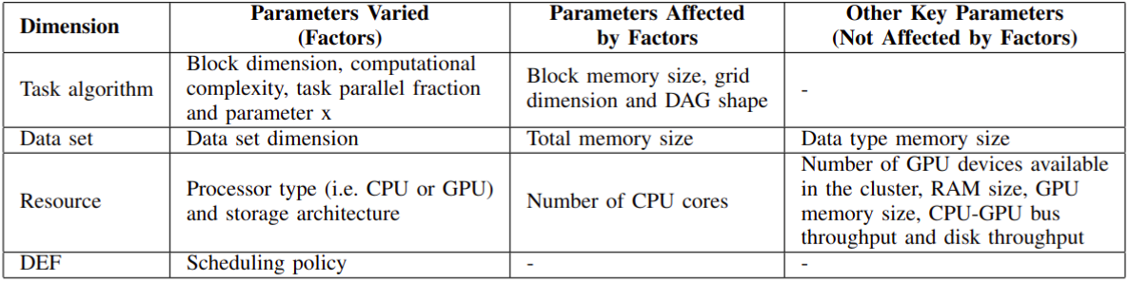
Method: Parameters and Factors to Study

Slide 11
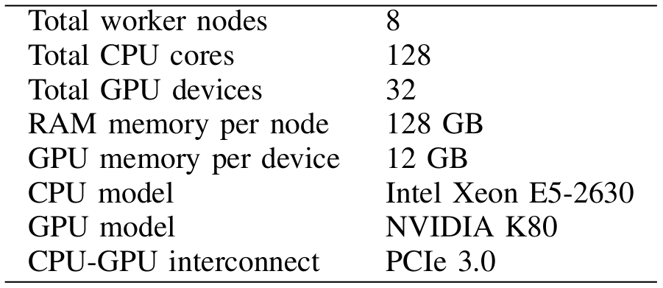
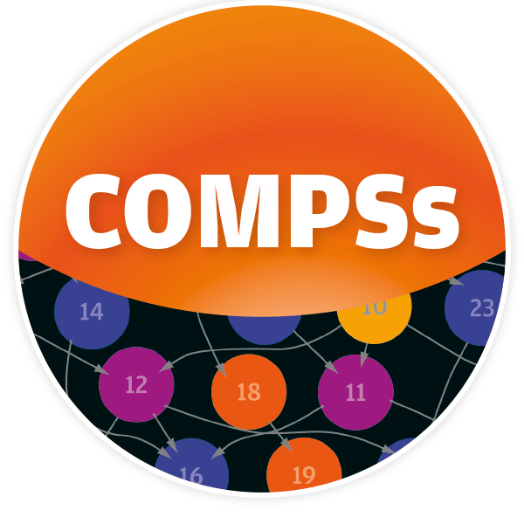
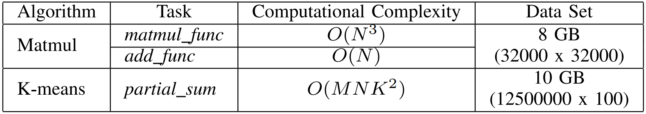

Method: Evaluation technique and workload
Experiments executed in a real HPC environment¹ using the following execution setup:
DEF: COMPSs version 3.0²
Synthetic workloads using the following algorithms (from dislib library version 0.6.4³) and data sets:
where M and N are the number of rows and columns in a block and K is the number of clusters
¹Minotauro supercomputer from Barcelona Supercomputing Center (BSC). More information available at: https://bsc.es/supportkc/docs/Minotauro/overview
²COMP Superscalar (COMPSs) from BSC. More information available at: https://compss-doc.readthedocs.io/en/3.0/
³dislib from BSC. Repository available at: https://github.com/bsc-wdc/dislib/tree/gpu-support

Slide 12
Method: Experiment design
Three main experiments were carried out:
1. End-to-end analysis:
To identify the main overheads
To show their effects on the monitored execution times considering both thread- and task-level parallelism
2. Performance analysis of task user code processing:
To characterize the execution of CPUs and GPUs without performance degradation caused by data (de-)serialization, network communication and task scheduling overheads
Focus: thread-level parallelism
3. * Performance analysis of parallel task processing:
To evaluate the effects of task granularity on these overheads on local and shared disk storage architectures considering different scheduling policies
Focus: task-level parallelism
*Final results are being collected and interpreted to complete this experiment

Slide 13
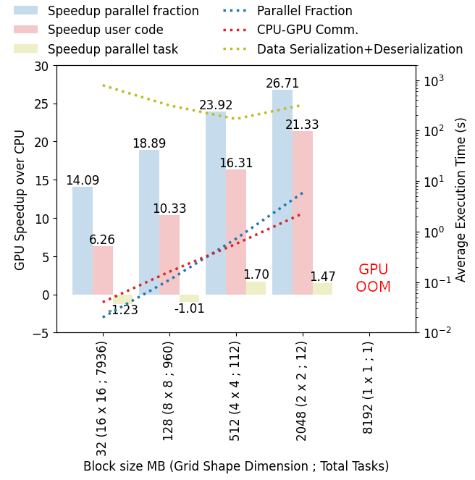
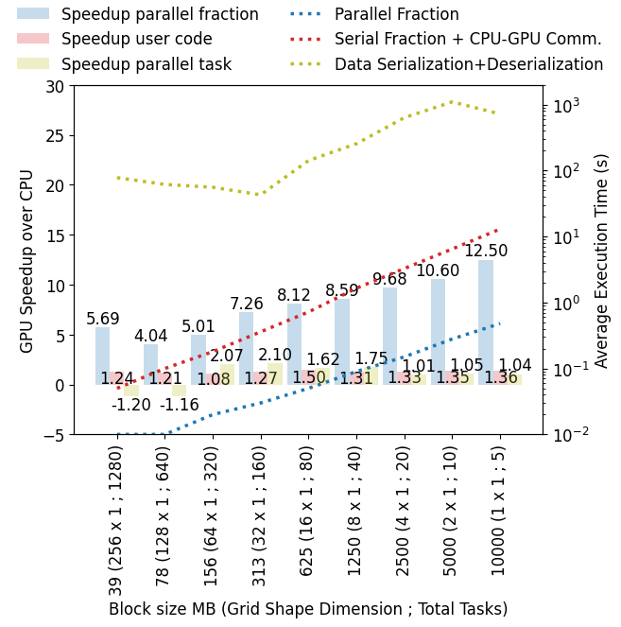
Experiments: End-to-end Analysis
Matmul
K-means

Slide 14
Experiments: End-to-end Analysis
Summary: greater task granularity does not always mean greater GPU speedups over CPU mainly due to the effects of serial fraction processing, CPU-GPU communication and data (de-)serialization overheads
Observations:
1: GPU user code speedups do not change significantly with task granularity when parallel fraction processing is dominated by serial fraction processing and CPU-GPU communication
2: GPU parallel task speedups do not change significantly with task granularity, being maximized when data (de-)serialization is minimum

Slide 15
Conclusion
Overview of the work:
We demonstrated empirically what are the main challenges affecting the performance distributed GPU-accelerated task-based workflows
The performance of such workflows is a result of a number of interrelated factors and simply increasing the amount of data to process is rarely the answer to maximize performance

Slide 16
Phd Project Goal and Objectives
Goal: to propose a novel adaptive learning optimizer to execute Data Science pipelines efficiently by balancing heterogeneous resources (CPU-GPU) in disaggregated architectures:
Given a data set and a workflow, automatically predict the most appropriate processor (e.g., shortest execution time, lower power consumption, etc.) to execute tasks
Integration of our adaptive optimizer in real data processing engines
Current work is targeting Obj. 1
Objectives:
Obj. 1: Learning by doing and experiencing, with real settings of analytics how an heterogeneous system (CPU-GPU) behaves
Obj. 2: Develop a first version of the adaptive learning optimizer in a simplified setting (e.g., single node containing multiple CPU and GPU cores)
Obj. 3: Develop a second version of the adaptive learning optimizer in a disaggregated architecture in a scale-out setting (e.g., multiple nodes containing multiple CPU and GPU cores, interconnected by a fast network)
Obj. 4: A non-invasive solution that can easily integrate our adaptive learning optimizer to any data processing engine

Slide 17
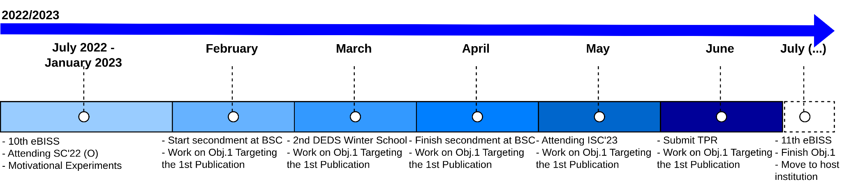

PhD Project Timeline and Current Status
Start of PhD: 22/03/2022 (1 year and 3 months)
All ECTS concluded
Secondment at Barcelona Supercomputing Center (BSC) concluded

Slide 18
References
[1] Abadi, Daniel, et al. "The seattle report on database research." ACM SIGMOD Record 48.4 (2020): 44-53.
[2] Ramon-Cortes, Cristian, et al. "A survey on the Distributed Computing stack." Computer Science Review 42 (2021): 100422.
[3] Yogatama, Bobbi W., Weiwei Gong, and Xiangyao Yu. "Orchestrating data placement and query execution in heterogeneous CPU-GPU DBMS." Proceedings of the VLDB Endowment 15.11 (2022): 2491-2503.
[4] Liu, Jiesong, et al. "Exploring Query Processing on CPU-GPU Integrated Edge Device." IEEE Transactions on Parallel and Distributed Systems 33.12 (2022): 4057-4070.
[5] Lutz, Clemens, et al. "Pump up the volume: Processing large data on GPUs with fast interconnects." Proceedings of the 2020 ACM SIGMOD International Conference on Management of Data. 2020.
[6] Cecilia, José M., et al. "Evaluation of clustering algorithms on GPU-based edge computing platforms." Sensors 20.21 (2020): 6335.
[7] Liu, Haotian, et al. "GHive: accelerating analytical query processing in apache hive via CPU-GPU heterogeneous computing." Proceedings of the 13th Symposium on Cloud Computing. 2022.
[8] Yuan, Yuan, et al. "Spark-GPU: An accelerated in-memory data processing engine on clusters." 2016 IEEE International Conference on Big Data (Big Data). IEEE, 2016.
[9] Lee, Suyeon, and Sungyong Park. "Performance analysis of big data ETL process over CPU-GPU heterogeneous architectures." 2021 IEEE 37th International Conference on Data Engineering Workshops (ICDEW). IEEE, 2021.
[10] Schüle, Maximilian E., et al. "Recursive SQL and GPU-support for in-database machine learning." Distributed and Parallel Databases 40.2-3 (2022): 205-259.
[11] Manzi, Dieudonne, and David Tompkins. "Exploring GPU acceleration of apache spark." 2016 IEEE International Conference on Cloud Engineering (IC2E). IEEE, 2016.
[12] Tseng, Hung-Wei, et al. "Morpheus: Exploring the potential of near-data processing for creating application objects in heterogeneous computing." ACM SIGOPS Operating Systems Review 52.1 (2018): 71-83.
[13] Zhu, Hongyu, et al. "Benchmarking and analyzing deep neural network training." 2018 IEEE International Symposium on Workload Characterization (IISWC). IEEE, 2018.
[14] Lu, Fengshun, et al. "Performance evaluation of hybrid programming patterns for large CPU/GPU heterogeneous clusters." Computer physics communications 183.6 (2012): 1172-1181.
[15] Amela, Ramon, et al. "Executing linear algebra kernels in heterogeneous distributed infrastructures with PyCOMPSs." Oil & Gas Science and Technology–Revue d’IFP Energies nouvelles 73 (2018): 47.
[16] Ben-Nun, Tal, et al. "Workflows are the new applications: Challenges in performance, portability, and productivity." 2020 IEEE/ACM International Workshop on Performance, Portability and Productivity in HPC (P3HPC). IEEE, 2020.

