Slide 1
Data Processing on Heterogeneous CPU-GPU Devices
DEDS Winter School
04/04/2022 - 08/04/2022
Athens - Greece
ESR 2.1: Marcos N. L. Carvalho (UPC / ARC)
Advisors: Oscar Romero (UPC); Anna Queralt (UPC); Alkis Simitsis (ARC)

Slide 2

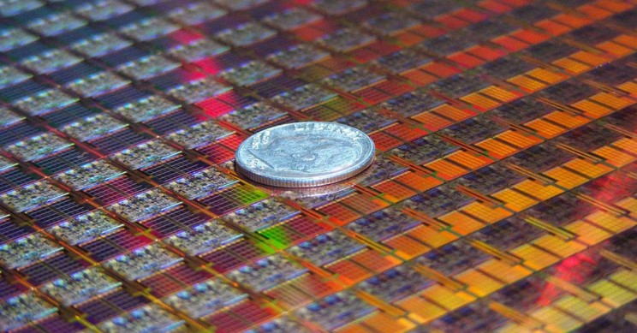
Motivation
To process large amounts of data quickly, data processing engines rely on advances in hardware architecture:
Physical limitations of enhancing microprocessors:
Reducing transistor’s size (near the size of atoms);
Increasing clock frequency (excessive heat dissipation);
Trend: hardware is increasingly becoming heterogeneous:
Integrating specialized processors (e.g. GPUs, FPGAs, etc) into computing systems, to match specific application demands;
Need of an ideal hardware-software to support data processing on such environments:
Place the right task on the right computing unit!

Slide 3
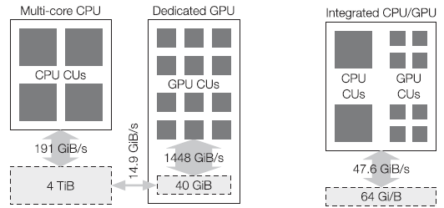
Motivation
Why processing data on heterogeneous CPU-GPU?
CPUs and GPUs are optimized for different usage scenarios:
CPU: optimized for serial processing tasks (few complex cores);
GPU: optimized for parallel processing tasks (many simple cores):
Dedicated GPU (dGPU): slow data transfers / good for scheduling coarse-grained tasks;
Integrated GPU (iGPU): efficient communication / good for scheduling fine-grained tasks;

Slide 4
Motivation
Typical data processing and analytics systems:
Relational queries:
Used in traditional databases (based on relational algebra);
Dominated by selections, projections, joins and ungrouped aggregations;
Data-intensive operations;
Bottleneck: bandwidth-bound;
Analytical queries:
Used in Online Analytical Processing (OLAP) systems;
Mainly composed by joins and grouped aggregations;
Data-intensive operations;
Bottleneck: latency-bound.
Analytics Algorithms:
Used in Machine Learning (ML) and Data Mining (DM) algorithms;
Iterative execution, non-algebraic operators;
Data-intensive operations;
Bottleneck: Compute-intensive;
These systems contain tasks suitable for each processor (CPU or GPU).

Slide 5
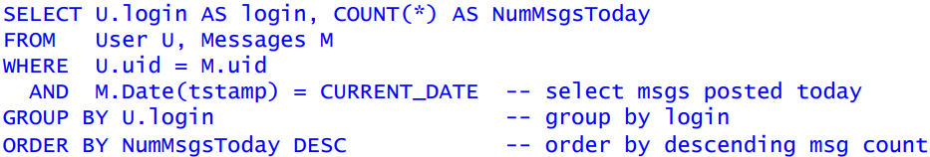
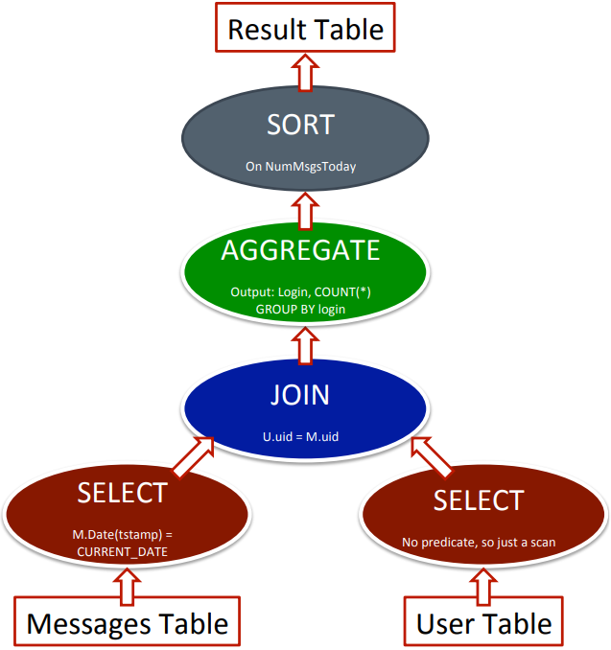
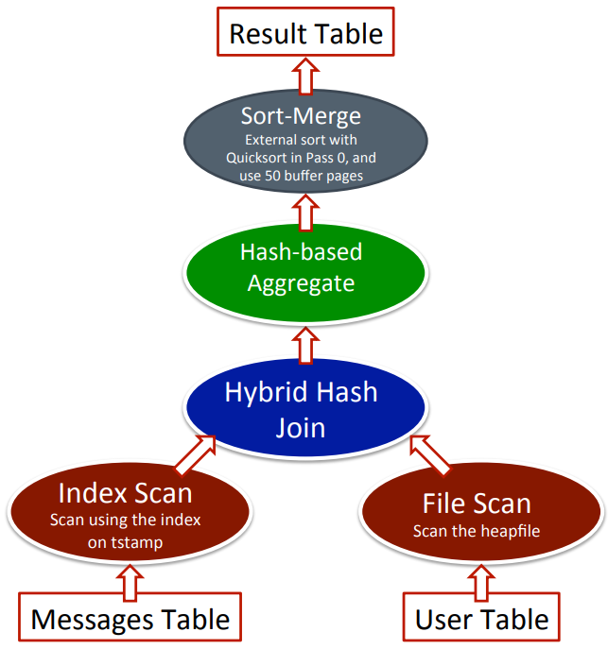
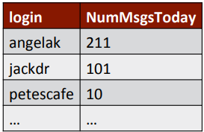
Motivation
Problem: Execution of Directed Acyclic Graphs (DAG) in heterogeneous CPU-GPU environments:
Logical Plan
Physical Plan
Result

Slide 6


Motivation
Problem: Execution of Directed Acyclic Graphs (DAG) in heterogeneous CPU-GPU environments:
Logical Plan
Physical Plan
Result

Slide 7
Related Work
Regarding Query Execution Plans (QEP);
CPU-GPU heterogeneous query plans are better than blindly executing all operations on a single device [2];
Key parameters when improving heterogeneous CPU-dGPU query processing [2]:
Batch data size:
Effect of batch data size;
Data transfer overhead;
Operation Selection:
Type of QEP operation;
Overall composition of the QEP;
Order of the QEP;
Query classification;
Cluster environment;
Overall workload characteristics (e.g. input data format, such as parquet, CSV, etc);
None of these parameters are independently enough to decide the best processor to execute QEP tasks [2] [3];

Slide 8
Related Work
Research gap: a Machine Learn-based algorithm to dynamically improve heterogeneous CPU-GPU query processing engines in disaggregated architectures [1] [4]:
Such algorithm could provide more flexibility to the system, being able to identify complex patterns automatically and easily adapt to changes in the environment in a data-driven way [4][8];
Based on recent advances in Machine Learning (ML) a new trend in query processing research explores replacing programmed heuristics with learned ones [3];
QEP featurization technique is commonly based on one-hot encoding [3];
Reinforcement Learning (RL) is a popular ML technique for query optimization [3];
To select good actions in a timely manner, it is necessary to properly balance exploration and exploitation in the search space [3];

Slide 9
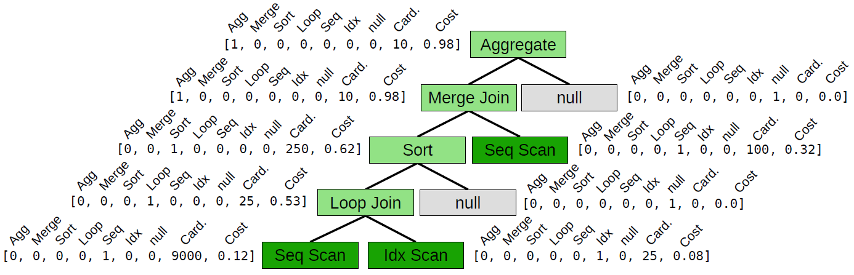
Related Work
Featurization technique: Binarized vector tree [3];
Simplified featurize technique:
Apply one-hot encoding on top of QEP instead of raw query;

Slide 10
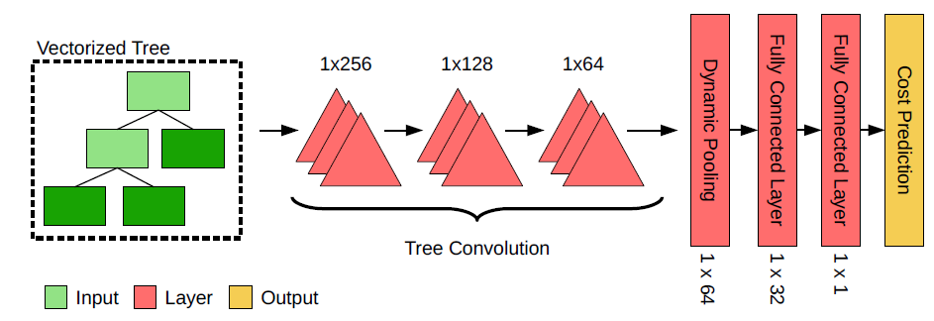
Related Work
Predictive Model: Tree Convolutional Neural Network (TCNN) [3]:
Suitable to recognize complex QEP patterns and automatically learn from the data itself;
Input: Vectorized query plan tree;
Consists of sliding tree-shaped filters;
The operators are stacked in several layers (later layers recognizes more complex patterns);
Output: Cost prediction (e.g. execution time);

Slide 11
Research Question
Would it be possible to use learning techniques to dynamically predict the most appropriate hardware (CPU or GPU) to run Directed Acyclic Graphs (DAG) tasks in a query processing engine in a disaggregated architecture?
System Assumptions:
Environment: CPU + dGPU:
The research community often focuses on dGPUs due to its higher processing capacity related to iGPUs;
Disaggregated architecture: single server or clusterized (master-slave);
Studies demonstrated that it is possible to enhance heterogeneous CPU-GPU QEP tasks in such environments;
Optimization metric: single or multi-criteria
Minimize execution time;
Metric massively used in literature, as it can reveal which processor is faster to execute QEP tasks;
Maximize throughput;
Minimize power consumption.
QEP source: Task-based query processing engines:
Work on top of an existing query optimizer:
Leverage native query optimization implementations;
Support relevant operations for data analytical workloads.

Slide 12

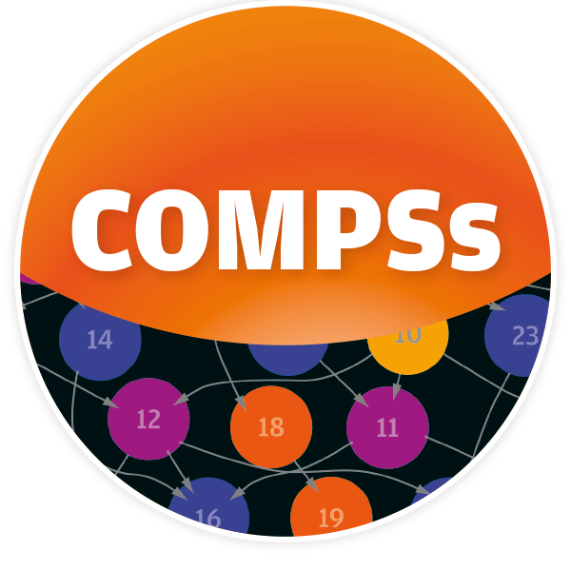
Proposal
Adaptive algorithm to optimize execution DAG tasks by balancing heterogeneous resources (CPU-GPU devices) in disaggregated architectures.
Methodology:
Start with relational queries (e.g. selections, projections, joins, etc);
Create a representative testbed running queries in different processors (CPU-GPU) and learn a model from it;
Learning Algorithm: e.g. Reinforcement Learning: Tree Convolutional Neural Network with Thompson Sampling;
Features: e.g. Vector tree of the QEP;
Use this approach to decide the best processor to execute each task in an execution DAG;
Apply this outcome in a practical way to demonstrate its feasibility:
Integrated in existing query processing engines: Spark, COMPSs, etc;

Slide 13
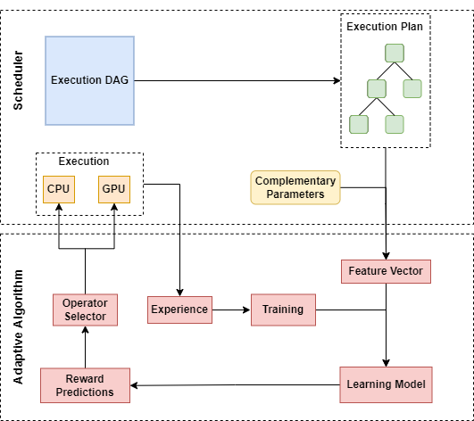
Proposal
System Model:

Slide 14
Proposal
System Model:
These steps should be executed multiple times with DAG tasks in order improve the learn-based model;
1
2
7
6
8
9
3
5
4

Slide 15
Proposal
System Model:
A user-provided execution DAG is converted to a execution plan by the scheduler.
1

Slide 16
Proposal
System Model:
The execution plan and complementary parameters (e.g. batch data size, input data format) are featurized by the adaptive algorithm;
2

Slide 17
Proposal
System Model:
The feature vector is used as input for a learning model;
3

Slide 18
Proposal
System Model:
The learning model provides reward predictions about the best processor (CPU-GPU) to run the DAG tasks;
4

Slide 19
Proposal
System Model:
The reward predictions are transferred to the operator selector;
5

Slide 20
Proposal
System Model:
The operator selector integrated, with a GPU programing model (e.g. CUDA, OpenCL), sends the DAG tasks to heterogeneous CPU-GPU execution based on the reward predictions;
6

Slide 21
Proposal
System Model:
Experiences regarding the execution time spent by each processor are collected;
7

Slide 22
Proposal
System Model:
These experiences are used in the training process;
8

Slide 23
Proposal
System Model:
The training process is used to enhance the learning model predictions;
9

Slide 24
Next Steps
Cover the state of the art heterogeneous CPU-GPU data processing:
Not only QEP;
Formalize the optimization problem:
Define system variables / parameters to consider:
Objective function:
Minimize Execution time:
Should we separate the data transfer time from the total execution time?
Constraints:
What constraints should we consider?
Discover further conclusions about the proposal:
What would be the best featurization technique for our problem?
Which learning technique should we use?
Write the Doctoral Project Plan (DPP).

Slide 25
References
[1] Rosenfeld, Viktor, Sebastian Breß, and Volker Markl. "Query Processing on Heterogeneous CPU/GPU Systems." ACM Computing Surveys (CSUR) 55.1 (2022): 1-38.
[2] Lee, Suyeon, and Sungyong Park. "Performance analysis of big data ETL process over cpu-gpu heterogeneous architectures." 2021 IEEE 37th International Conference on Data Engineering Workshops (ICDEW). IEEE, 2021.
[3] Marcus, Ryan, et al. "Bao: Making learned query optimization practical." Proceedings of the 2021 International Conference on Management of Data. 2021.
[4] Abadi, Daniel, et al. "The seattle report on database research." ACM SIGMOD Record 48.4 (2020): 44-53.
[5] Raza, Syed Mohammad Aunn, et al. "GPU-accelerated data management under the test of time." Online proceedings of the 10th Conference on Innovative Data Systems Research (CIDR). No. CONF. 2020.
[6] Breß, Sebastian, et al. "Ocelot/hype: Optimized data processing on heterogeneous hardware." Proceedings of the VLDB Endowment 7.13 (2014): 1609-1612.
[7] Breß, Sebastian, et al. "Efficient co-processor utilization in database query processing." Information Systems 38.8 (2013): 1084-1096.
[8] Gottschlich, Justin, et al. "The three pillars of machine programming." Proceedings of the 2nd ACM SIGPLAN International Workshop on Machine Learning and Programming Languages. 2018.
[9] McDonald, Carol et al. (2020) Accelerating apache spark 3.0 with gpus and rapids. NVIDIA. [Online]. Available: https://developer.nvidia.com/blog/accelerating-apache-spark-3-0-with-gpus-and-rapids
[10] Patel, Jignesh. (2013) Query Processing. [Online]. Available: https://pdfs.semanticscholar.org/4e34/a45b8d987a77a1e33052d5d34e19e9aae458.pdf

