Slide 1




Performance Analysis of Multilevel Parallel Processing in Heterogeneous CPU-GPU Clusters
2nd DEDS Winter School
06-10/03/2022
Aalborg - Denmark
ESR 2.1: Marcos N. L. Carvalho (UPC / ARC)
Home Advisors: Anna Queralt (UPC); Oscar Romero (UPC);
Host Advisor: Alkis Simitsis (ARC)

Slide 2
Summary
Motivation
Related work and research gaps
Proposal
Multilevel parallelism
Experimental setup
Experiments
Conclusion & Future Work

Slide 3
Motivation
Popularity of accelerators: GPUs are being adopted in several distributed infrastructures, making such environments increasingly more heterogeneous [1]
Software is also being modernized [2]:
Multiple distributed task-based frameworks with support to heterogeneous CPU-GPU devices proposed: Spark [3], COMPSs [4], Dask [5], Parla [6], etc.
The decision of finding the best device to process a task relies on simple heuristics and intuition of users:
It is not always clear to decide the right device [1]: multiple factors must be considered and it can demand a huge effort
Finding an optimal core placement is a NP-hard problem [9]
Goal of this work:
Identify relevant factors that affect the performance (in terms of execution times) in distributed environments equipped with heterogeneous CPU-GPU devices
This is the first study to evaluate empirically the performance of analytics applications in such environments

Slide 4
Related Work: Research Gaps
Research gaps:
Lack of evaluation of execution times related to multilevel parallelism [7]:
Focus only on intra-parallelism or only in the total execution time
No discussion about the side-effects of inter-parallelism and further overheads (e.g. communication, runtime, etc)
Lack of generalization [7][8][10][11]:
No holistic evaluation of factors in distributed CPU-GPU devices:
Limitation of cost-based models [7][8]:
Models consider heterogeneity either from distributed or CPU-GPU, but never both together:
Main reasons: isolated analysis, limited search space and high complexity
Incomplete exploration of features in learn-based models [10][11]:
Focus on parameters related to the application, without considering multilevel parallelism

Slide 5
Proposal
Evaluate the effects on CPU-GPU execution performance in distributed environments when changing parameters related to multiple dimensions:
Extract the relevant high-level features that can affect the execution performance on CPU-GPU clusters
Useful to predict CPU-GPU performance using learn-based models
Identify a set of empirical rules and guidelines to run efficiently programs on distributed CPU-GPU environments
How to demonstrate it?
Using an empirical bottom-up approach:
Running systematic experiments with analytics algorithms in heterogeneous CPU-GPU distributed infrastructures and monitor how different execution times are affected by changing execution parameters

Slide 6


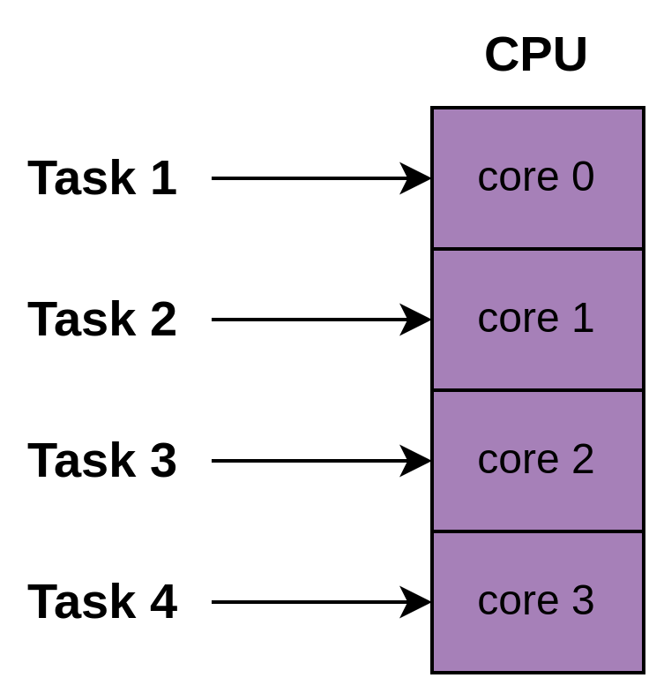
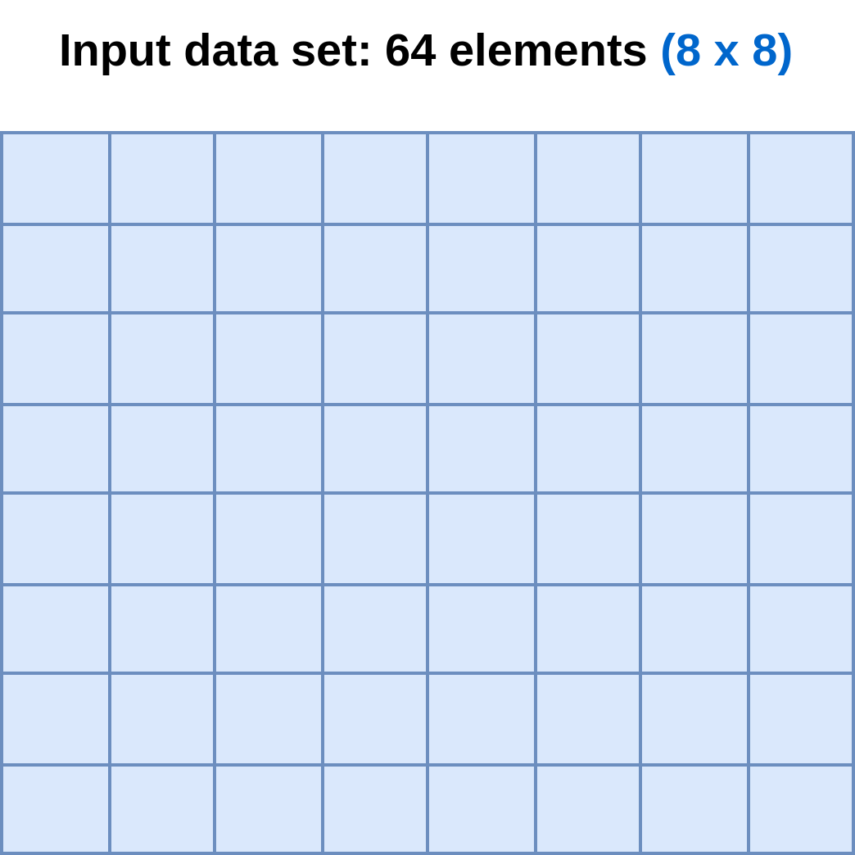
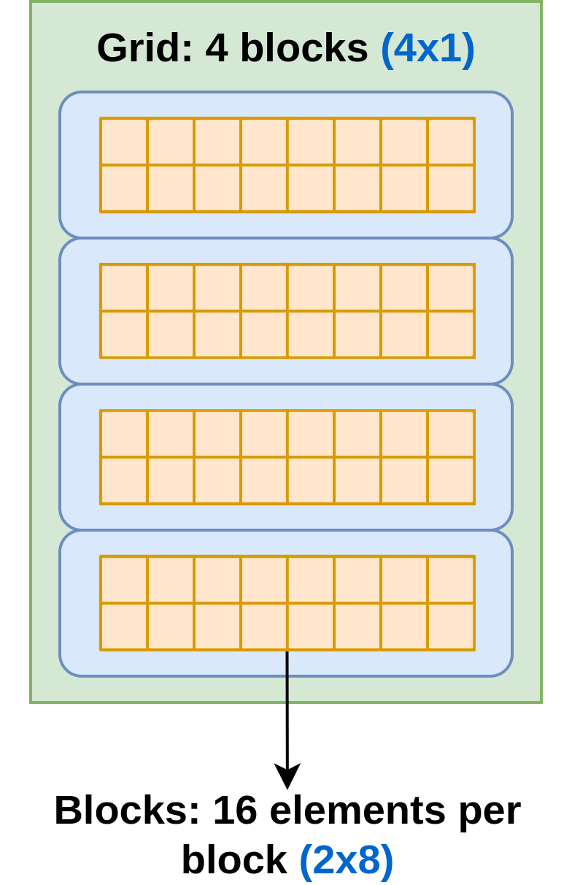
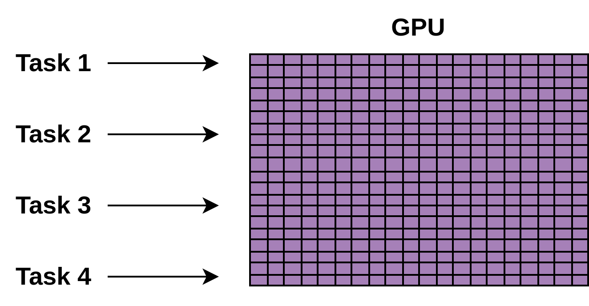
Relationship between , and :
Multilevel Parallelism: Terminology
Example: K-means: Processing an 8x8 data set using 2x8 blocks:
#tasks
(inter-parallelism)
#blocks per task
(intra-parallelism)

Slide 7
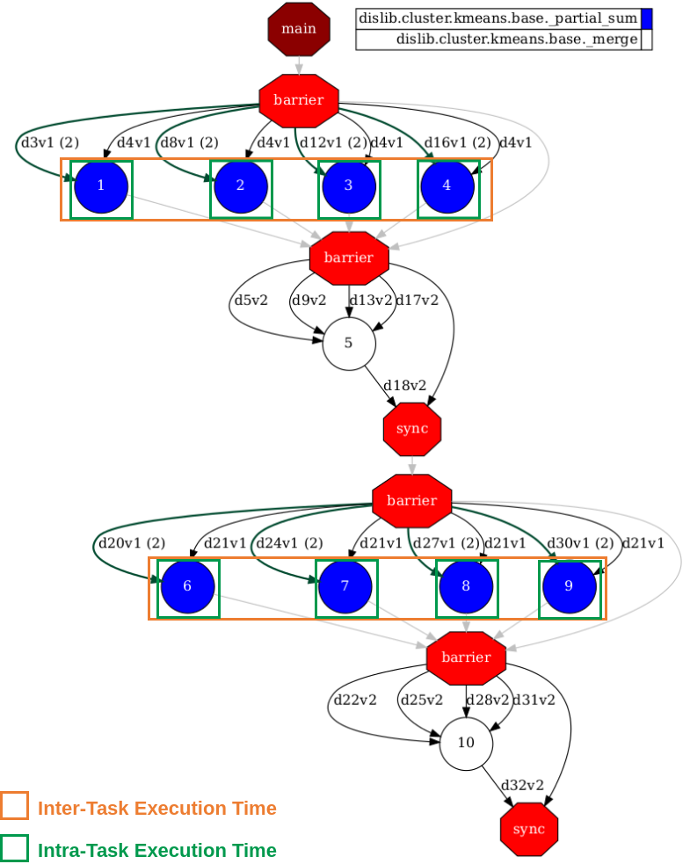
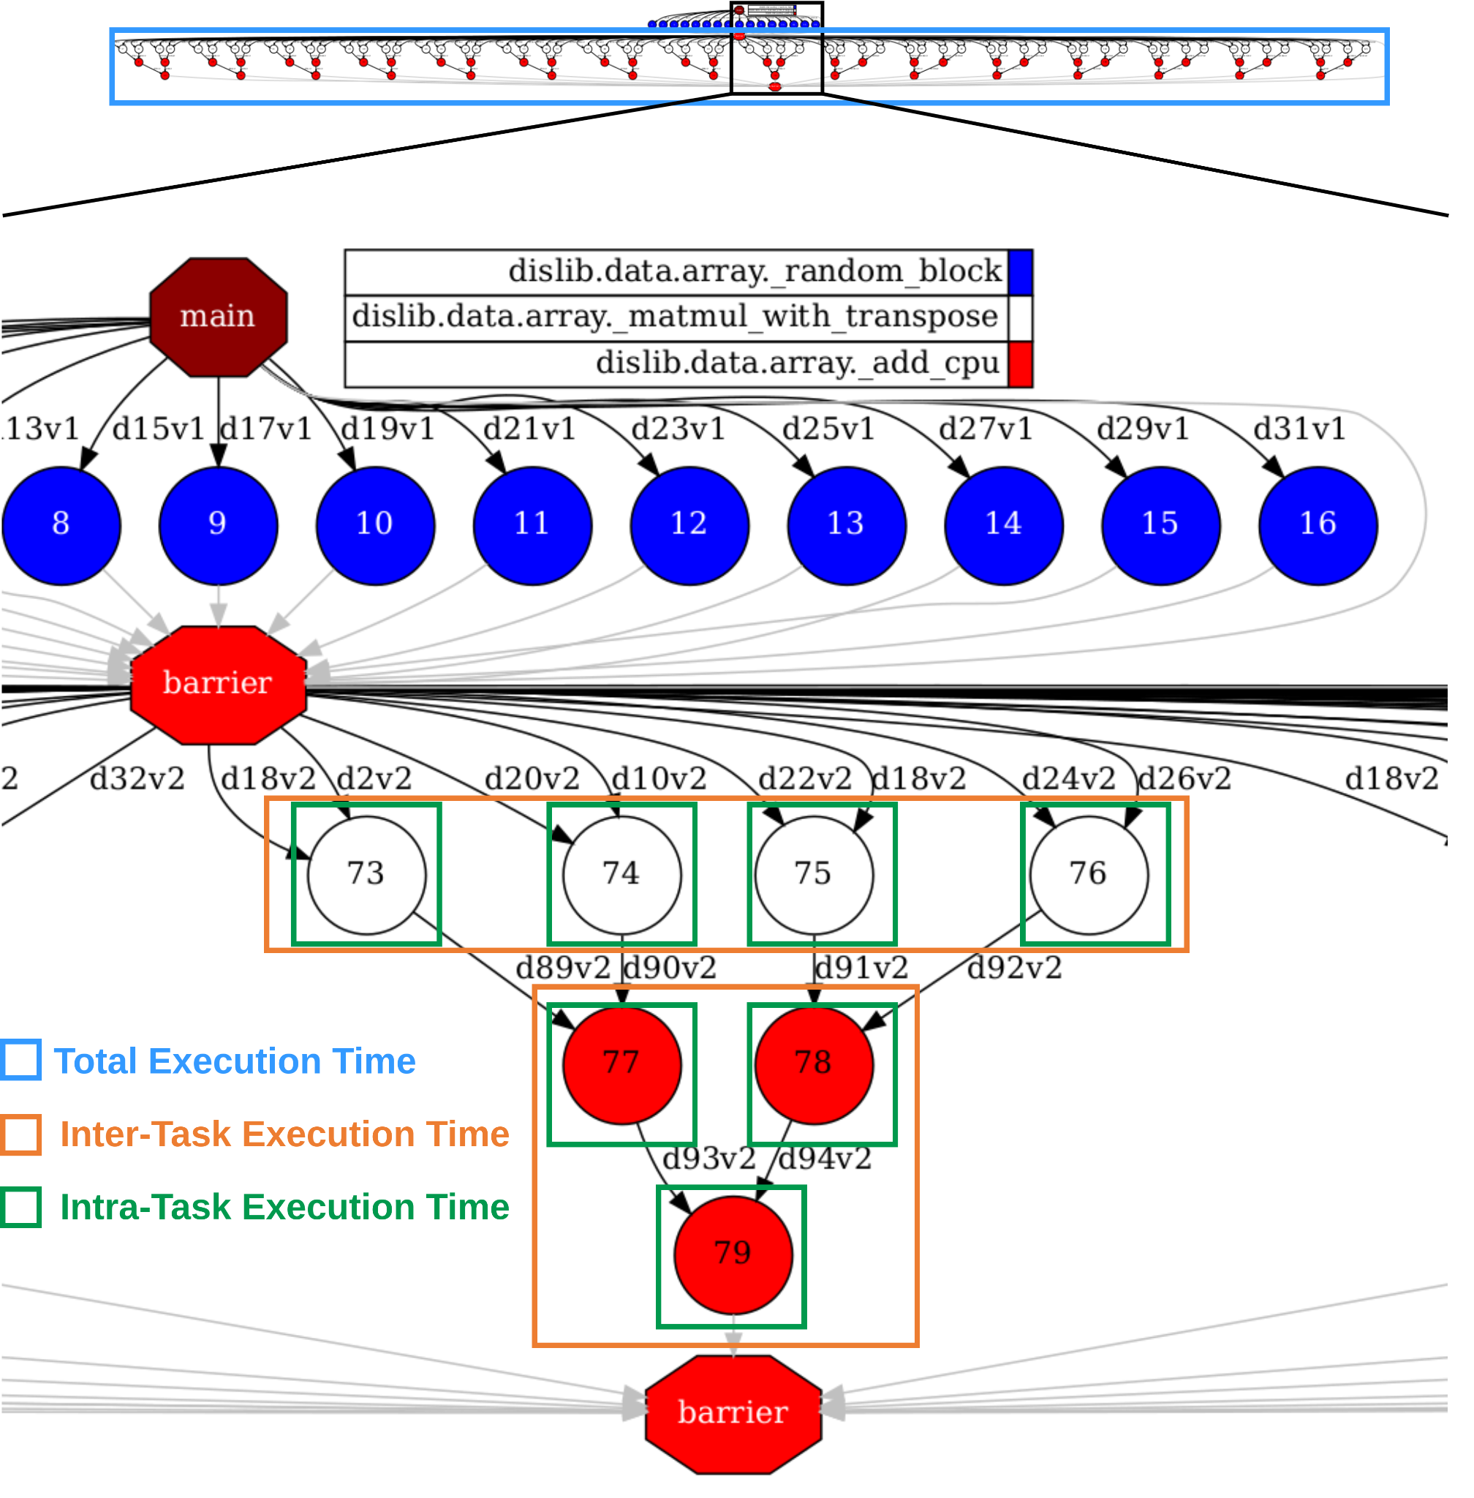
Multilevel Parallelism: Heterogenous DAGs (different shapes and levels of dependencies)
K-means (dislib 0.6.4)
Matmul (dislib 0.6.4)
-> M = 2 iterations
-> N = 8 tasks
-> F = 1 function
-> M = 1 iterations
-> N = 64+48 tasks
-> F = 2 functions

Slide 8
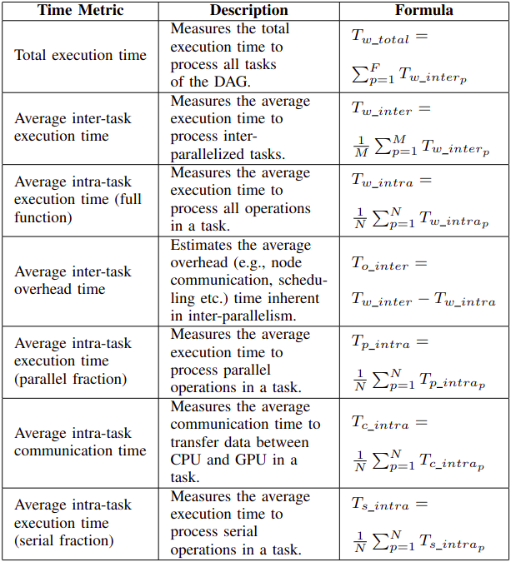
Metrics: Monitored Execution Times

Slide 9
Dimensions: Factors
Required dimensions for performance analysis in distributed CPU-GPU environments:
1. Algorithm
4. Distributed Execution Framework (DEF)
Execution Time
2. Data Set
3. Resource

Slide 10
Details of Dimensions
Algorithms (dislib version 0.6.4) and data sets:
K-means:
partial_sum O(MNK²) function task
100 MB, 1GB and 10GB
Matmul:
matmul_func O(N³) and add_func O(N) function tasks
512 MB, 2 GB and 8 GB
Resource:
Minotauro supercomputer from Barcelona Supercomputer Center (BSC):
Cluster with 38 nodes, each with 2 octa-core CPUs (2 Intel Xeon E52630) and 4 GPUs (2 NVIDIA K80)
Distributed Execution Framework:
COMPSs version 3.0
Schedulers used:
orderstrict.fifo.FifoTS when using shared disk (GPFS)
lookahead.successors.fifolocality.FifoLocalityTS when using local disk

Slide 11
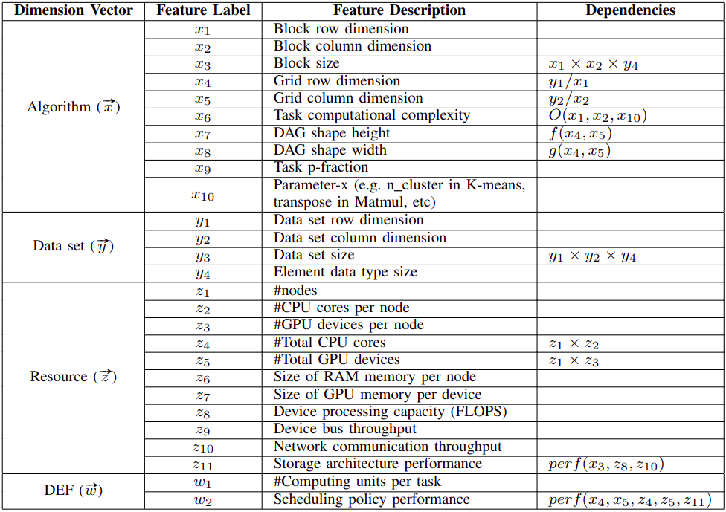
List of Relevant Features

Slide 12
Possible Outcome
Multiple rules can be extracted from the analysis of these features:
Example:
A rule determining the trade-off between task granularity and task computational complexity

Slide 13
Task granularity and computational complexity trade-off
In general:
Coarse-grained tasks are suitable for GPUs
Fine-grained tasks are suitable for CPUs
However, there are exceptions when considering the computational complexity of tasks:
High task granularity, but low computational complexity: CPU
Intra
Parallelism
Task
Complexity
Sequential Processing (CPU)
Task Granularity
(Block Size)
Data Volume
Resource
Usage
Low task granularity, but high computational complexity: GPU
Intra
Parallelism
Task
Complexity
Parallel Processing (GPU)
Task Granularity
(Block Size)
Data Volume
Resource
Usage

Slide 14
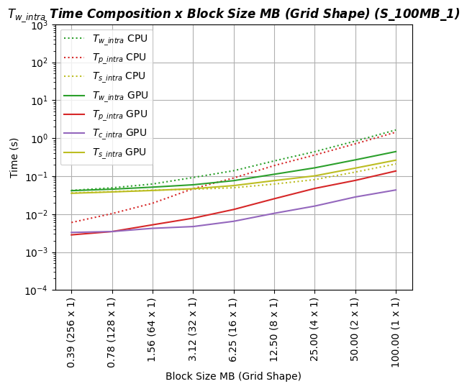
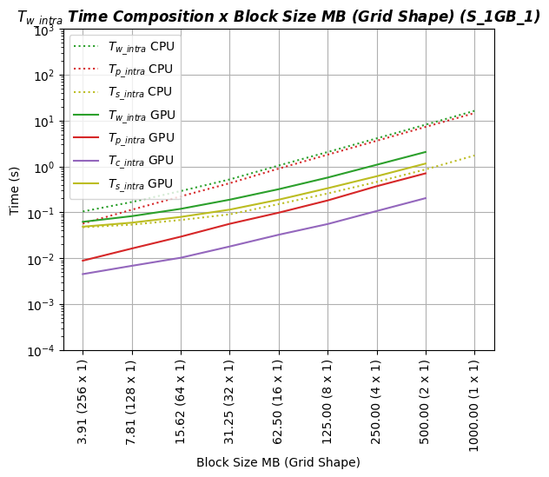
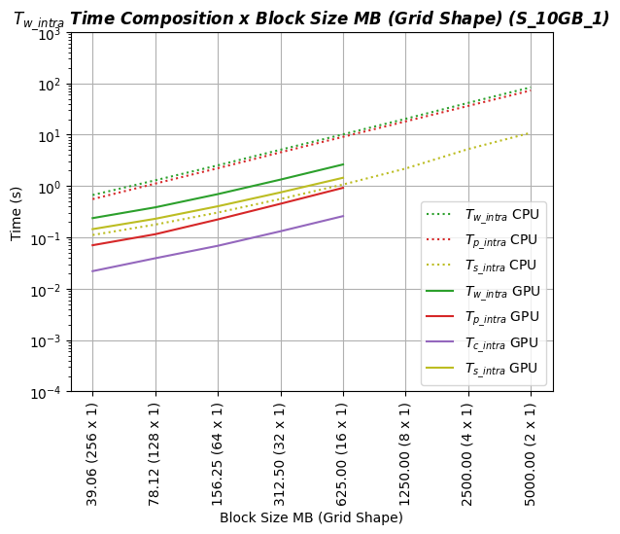
Task granularity and computational complexity trade-off
Algorithm: K-means, #cluster = 1000
Data set: 100 MB (125000 x 100), 1 GB (1250000 x 100) and 10 GB (12500000 x 100), fully dense
Resource: 8 nodes (16 CPU cores and 4 GPU (12GB) devices and 128 GB RAM per node), 16 CPU and 1 GPU computing unit per task, shared disk
DEF: COMPSs, order strict scheduling policy
Lack of memory in GPU
Shifting point
Intra-parallelism
computing > communication
Data set size: 100 MB
Data set size: 1 GB
Data set size: 10 GB

Slide 15
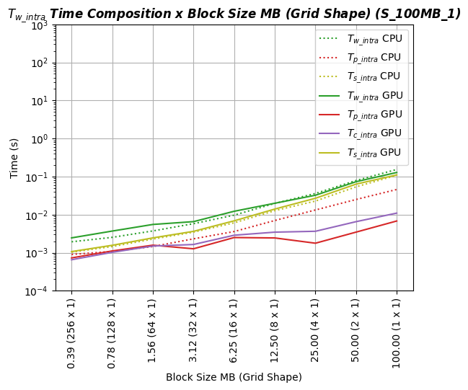
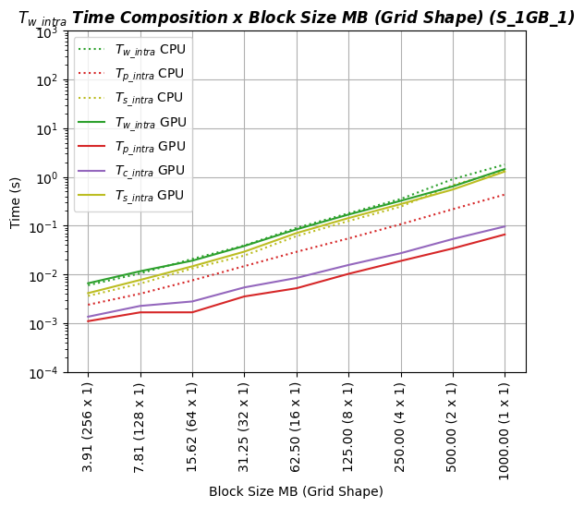
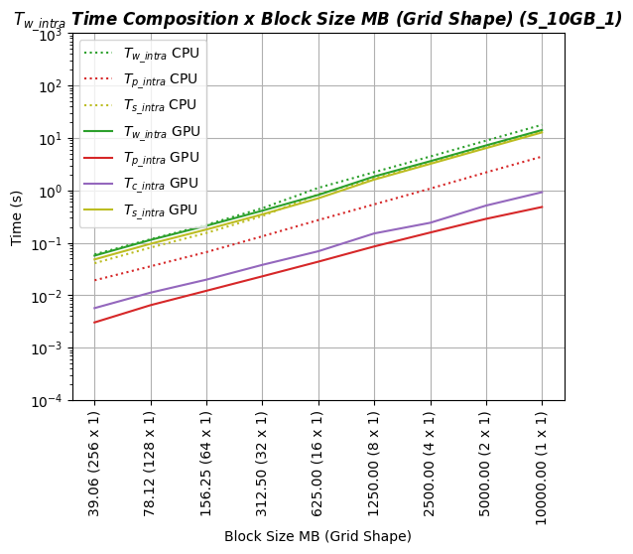
Task granularity and computational complexity trade-off
Algorithm: K-means, #cluster = 10 (lower computational complexity)
Data set: 100 MB (125000 x 100), 1 GB (1250000 x 100) and 10 GB (12500000 x 100), fully dense
Resource: 8 nodes (16 CPU cores and 4 GPU (12GB) devices and 128 GB RAM per node), 16 CPU and 1 GPU computing unit per task, shared disk
DEF: COMPSs, order strict scheduling policy
Overlaps (no clear shifting point)
Intra-parallelism
computing < communication
Data set size: 100 MB
Data set size: 1 GB
Data set size: 10 GB
Sequential fraction > Parallel fraction

Slide 16
Conclusion & Future Work
Overview of the work:
Experiments carried out in this work showed empirically that the execution performance on heterogeneous CPU-GPU clusters depends on several features regarding multiple dimensions: algorithm, data set, resource and distributed execution framework
Guidelines were extracted to demonstrate how these features affect the execution performance
Future work:
Demonstrate how these features can be used by a learn-based model:
Use the features to feed a ML-based model (e.g. ANN) to predict the execution time of a task in a processor
Fine-tuning parameters:
E.g., Use linear regression to find the block size that provides the highest speedup in GPUs

Slide 17
References
[1] Amela, Ramon, et al. "Executing linear algebra kernels in heterogeneous distributed infrastructures with PyCOMPSs." Oil & Gas Science and Technology–Revue d’IFP Energies nouvelles 73 (2018): 47.
[2] Ramon-Cortes, Cristian, et al. "A survey on the Distributed Computing stack." Computer Science Review 42 (2021): 100422.
[3] Zaharia, Matei, et al. "Resilient distributed datasets: A fault-tolerant abstraction for in-memory cluster computing." Presented as part of the 9th {USENIX} Symposium on Networked Systems Design and Implementation ({NSDI} 12). 2012.
[4] Badia, Rosa M., et al. "Comp superscalar, an interoperable programming framework." SoftwareX 3 (2015): 32-36.
[5] Rocklin, Matthew. "Dask: Parallel computation with blocked algorithms and task scheduling." Proceedings of the 14th python in science conference. Vol. 130. Austin, TX: SciPy, 2015.
[6] Lee, Hochan, et al. "Parla: a Python orchestration system for heterogeneous architectures." Proceedings of the International Conference on High Performance Computing, Networking, Storage and Analysis. 2022.
[7] Al‐hayanni, Mohammed A. Noaman, et al. "Amdahl's law in the context of heterogeneous many‐core systems–a survey." IET Computers & Digital Techniques 14.4 (2020): 133-148.
[8] Poolla, Chaitanya, and Rahul Saxena. "On extending Amdahl’s law to learn computer performance." Microprocessors and Microsystems 96 (2023): 104745.
[9] Wu, Nan, et al. "Core placement optimization for multi-chip many-core neural network systems with reinforcement learning." ACM Transactions on Design Automation of Electronic Systems (TODAES) 26.2 (2020): 1-27.
[10] Penney, Drew D., and Lizhong Chen. "A survey of machine learning applied to computer architecture design." arXiv preprint arXiv:1909.12373 (2019).
[11] Wu, Nan, and Yuan Xie. "A survey of machine learning for computer architecture and systems." ACM Computing Surveys (CSUR) 55.3 (2022): 1-39.

