Slide 1
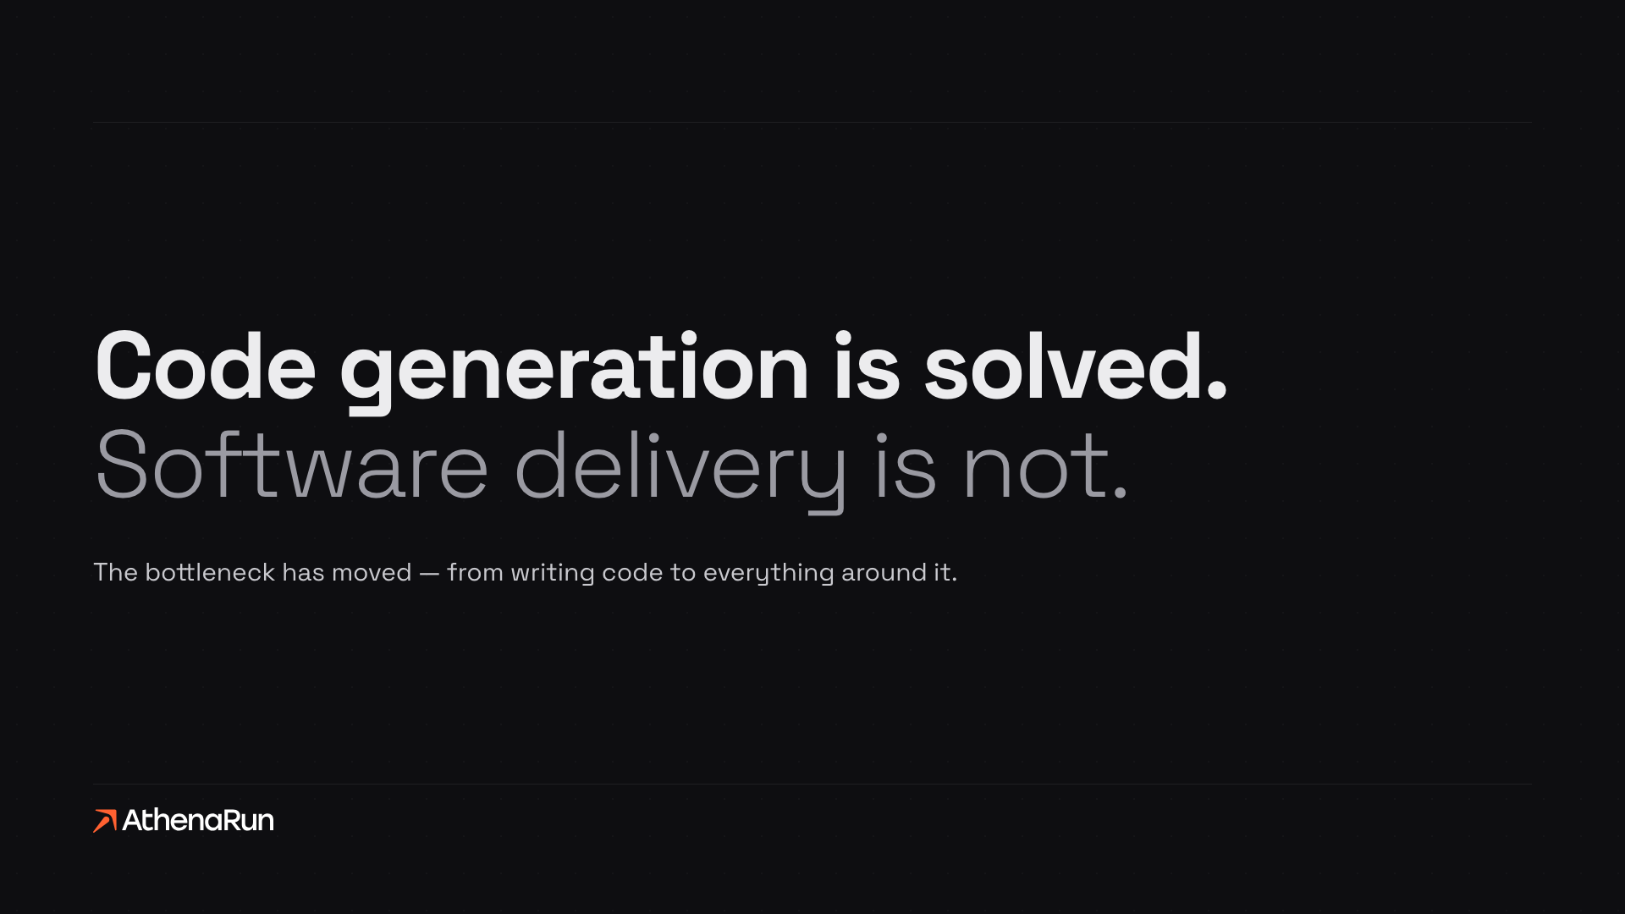
We build the chain, not the generator.

Slide 2



Still manual. And that is where the money goes.
THE PROBLEM
STILL MANUAL
Requirements
Feasibility
Compliance
Approval
Operations
Five steps around the code. Every one of them a handoff, a document, a wait.
THEY BOUGHT THE GENERATOR — THE CHAIN AROUND IT IS STILL MANUAL
61%
of organizations see no EBIT impact from AI
The expensive failures happen before a line of code. That’s the part we automate.
Source: McKinsey, The State of AI in 2025 — 39% attribute any EBIT impact to AI

Slide 3
Complex Software. Is it possible with AI tools?
THE ILLUSION
Starting has never been cheaper: an AI IDE, a chat, a prompt, and something runs. That ease is what makes the engineering behind it easy to underestimate.
DAY ONE
EVERYTHING AFTER
Prototype
Fit
Integration
Assurance
Operation
in an afternoon
Solves the real process?
Lives in your estate?
Someone can sign it?
Survives year two?
WHAT THE GAP COSTS
Easy start
Underestimated engineering
Hidden work
Rework
Lost speed, higher cost
Lost EBIT
None of this is optional. It only gets discovered late.

Slide 4





From idea to build-ready package.
THE CHAIN
One line, a human gate at every step. AI agents support every stage, Discover through AI Memory — from first conversation to a build-ready package.
01
02
03
04
05
Discover
Analyze
Research
Compliance
AI Memory
from conversation
scope + fit
cited, deep
pre-build gate
patterns carried in
human gate at every transition
IDEA TO BUILD-READY PACKAGE

Slide 5



From package to running software.
THE CHAIN
The package is approved. Build through Operate — from approved package to software running in production. Every decision that matters stays with a person.
06
07
08
01–05 · build-ready package
Build
Release
Operate
code + review
human approval
monitoring
LEARN · validated patterns from every build carry into the next
PACKAGE TO RUNNING SOFTWARE

Slide 6




The full lifecycle. Every phase has multiple agents.
LIFECYCLE
Planning through maintenance — the classic software lifecycle, run end to end by agents, with a human gate at every handover.
01 Planning
MULTIPLE AGENTS PER PHASE
Planning agents
scope from first conversation, feasibility and fit
Analysis agents
06 Maintenance
02 Analysis
cited, deep research into the requirements
Design agents
ALL SIX PHASES
architecture, checked at the compliance gate
agent-run
Build agents
implementation with code review
05 Testing
03 Design
Test agents
verification before the release approval
Operations agents
monitoring, patterns back to the library
04 Implementation
human gate at every handover

Slide 7




The payoff. Fewer people. A better starting point.
THE PAYOFF
The chain does the work that used to need a team — every project starts on what the last one learned.
A TYPICAL PROJECT TEAM
WITH ATHENARUN
Business Analyst
Designer
Developer
One developer
or a business user
+ agents on all six lifecycle phases
Fewer roles per project
Eliminates or reduces business analyst, designer and developer headcount per project.
One developer, internally
AthenaRun runs its own projects with a single developer.
A business user can run it
The platform is operated by the business, not only by engineers.
A head start on day one
Customers inherit best practices and documented failure learnings from the first build.
Same scope, a fraction of the team. The library is what makes that safe.

Slide 8
Our moat. Every build makes the next one safer.
THE MOAT
Build
Capture
Reuse
Anyone can generate code. What compounds is what real production builds taught us — every project writes validated patterns and documented failures back into the library, and every next build queries it before a line of code is written.
THE PATTERN LIBRARY
WHY IT'S DEFENSIBLE
Hundreds
Thousands
Earned, not bought.
The library only grows by running real production builds.
validated patterns
documented anti-patterns
It compounds.
The LEARN loop from the chain is what fills this library.
Every project makes the next estimate, gate and build safer.
Capital can’t copy it.
A bigger round buys code, not failures already survived.

Slide 9



References. Three builds, three problems.
REFERENCES
Shipped software, not pilots. Each one replaced a process that was running manually.
CFO App
Lead Generation
Board Assistant
CLIENT / SECTOR
CLIENT / SECTOR
CLIENT / SECTOR
[Kunde oder Branche]
[Kunde oder Branche]
[Kunde oder Branche]
WHAT WE BUILT
WHAT WE BUILT
WHAT WE BUILT
[was gebaut wurde]
[was gebaut wurde]
[was gebaut wurde]
RESULT
RESULT
RESULT
[Ergebnis in einer Zeile]
[Ergebnis in einer Zeile]
[Ergebnis in einer Zeile]
PLACEHOLDER — replace the three bracketed fields per tile before this deck goes to an investor.

Slide 10
One question.
ONE QUESTION
Ich lasse Ihnen eine Frage da, keinen Prospekt.
Welcher Prozess bei Ihnen läuft heute in Excel und sollte es seit einem Jahr nicht mehr?
Wenn Ihnen dazu gerade etwas eingefallen ist — sprechen Sie mich an. Wir machen daraus eine Anwendung. Und wenn Ihnen zwanzig einfallen, reden wir über die Plattform statt über die Anwendung.
[Name · E-Mail · Telefon]

Slide 11
Further questions.
APPENDIX

Slide 12
The market. Three cuts, each one narrower.
MARKET SIZE
Every number below carries its assumption.
TAM
SAM
SOM
CUSTOM SOFTWARE DELIVERY, GLOBAL
EUROPE · REGULATED SECTORS
5 YEARS · CUMULATIVE CONTRACT VALUE
~$65B 2026
$15–20B serviceable
$150M TCV
Analyst range $51–74B. 21% CAGR through 2030.
Delivery requiring a compliance gate and an audit trail.
250 customers × $600k. Both assumptions.
AMBITION
1% of SAM — open source as the adoption lever.

Slide 13
The landscape. Everyone owns a segment. We own the chain.
COMPETITIVE MAP
Coding agents write. App builders assemble. Regulated-agent platforms automate workflows. None run idea to running software end to end.
AthenaRun
Coding agents
App builders
Reg. agent platforms
idea to operate
Devin, Copilot
Reflex, Bubble
Palantir, MightyBot
Requirements from conversation
Compliance advisory before code
Autonomous build + review
Human gate at every release
Operate after go-live
Learning loop across projects
full
partial
none
The others compete on one column. Our moat is the whole row — and the loop nobody else has.

Slide 14
Built by people who’ve done both sides.
TEAM
One sold enterprise software. One built it. Together they’ve seen the pain from both sides.
GO-TO-MARKET
PRODUCT & ENGINEERING
Patrick Knapp CEO
Michael Altermann CTO
–
10+ years in B2B sales & GTM across Seed–Series E startups
–
10+ years in product development and software engineering
–
Closed mid-market and enterprise deals at 6–7 figure ACVs
–
Built and scaled a core logistics platform for daily operations
–
Record €7M enterprise landing deal closed
–
Scaled engineering teams to 20+
–
Scaled business functions to 20+
–
Owns architecture and the autonomous build pipeline
+ Christian Lux, Co-Founder, Full-Stack Developer — highly experienced in AI development and security.

Slide 15
Traction & roadmap. Demand before launch.
TRACTION
Signed intent, a bank contract in signing and a Q4 closing pipeline — then ninety days to convert it.
PIPELINE
NEXT 90 DAYS · Q4 2026
~€50K
International bank
Prove & launch
contract in signing
–
Close the bank contract and the Q4 deals
€10–20K
per deal · several deals
–
Convert the signed LOIs into paying pilots
closing in Q4 2026
–
Platform launch — go-to-market live
€150K
signed LOI pipeline
7 letters of intent
Q1 – Q2 2027
Integrate & scale
BACKED & DISTRIBUTED
Channel partner
Hessen AI Cohort 2026
–
Ship integrations across CRM, ERP and Slack
DISTRIBUTION
STATE ACCELERATOR
–
Scale through the channel partner and accelerators
Cyberlab Cohort 2026
NVIDIA Inception
–
Open the app marketplace, enterprise partnerships
ACCELERATOR · KARLSRUHE
INFRASTRUCTURE
The hard part is done. Contracts in signing, engine shipped — what’s ahead is distribution, not invention.

