Slide 1
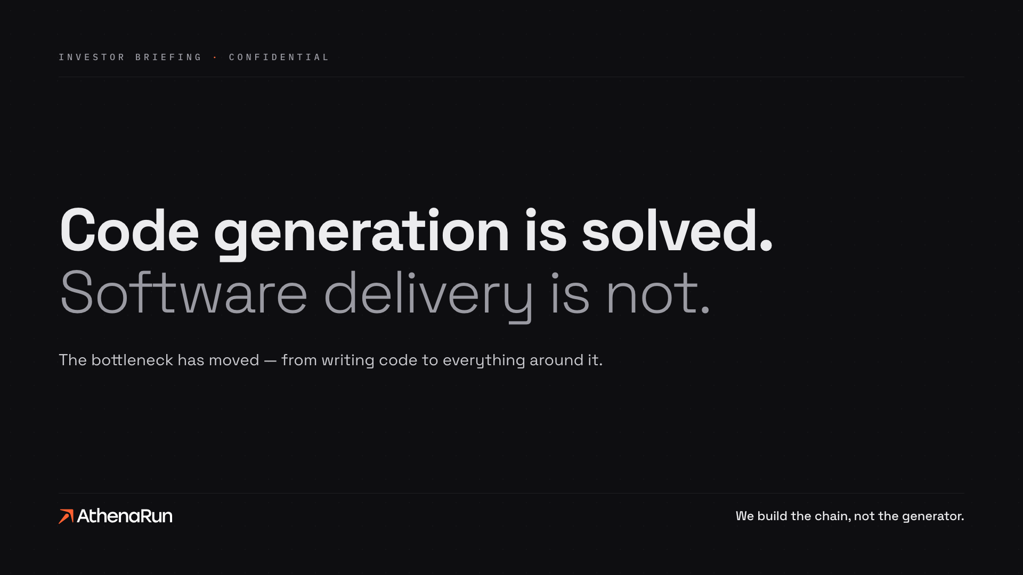

Slide 2
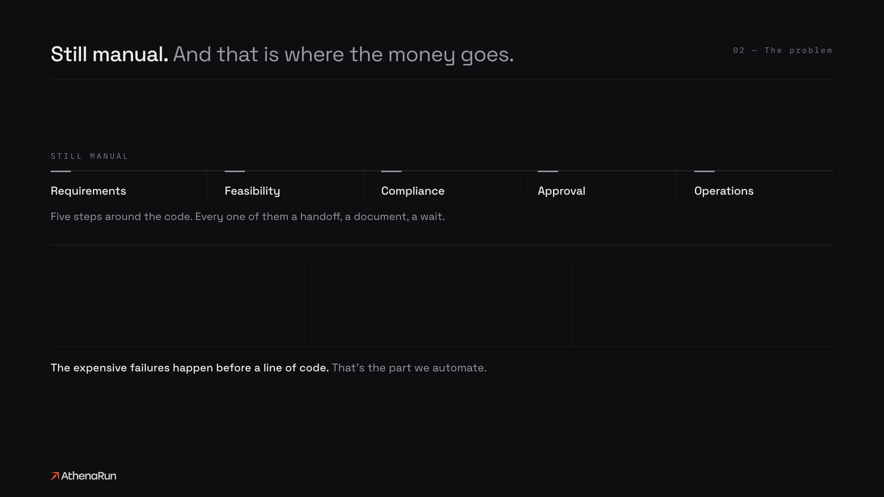
2500%
25%
153%
more software defects by 2028
of planned AI spend deferred to 2027
more architectural design flaws
Sources: Gartner, Predicts 2026 · Forrester, Predictions 2026 · Apiiro, 2025

Slide 3
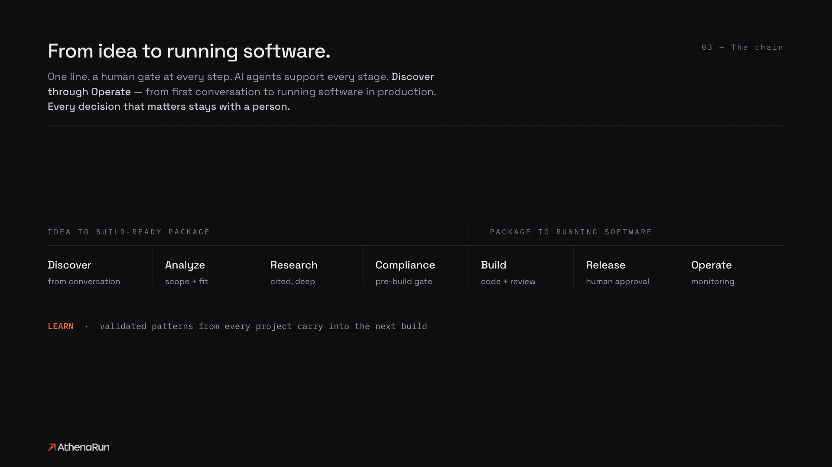

Slide 4
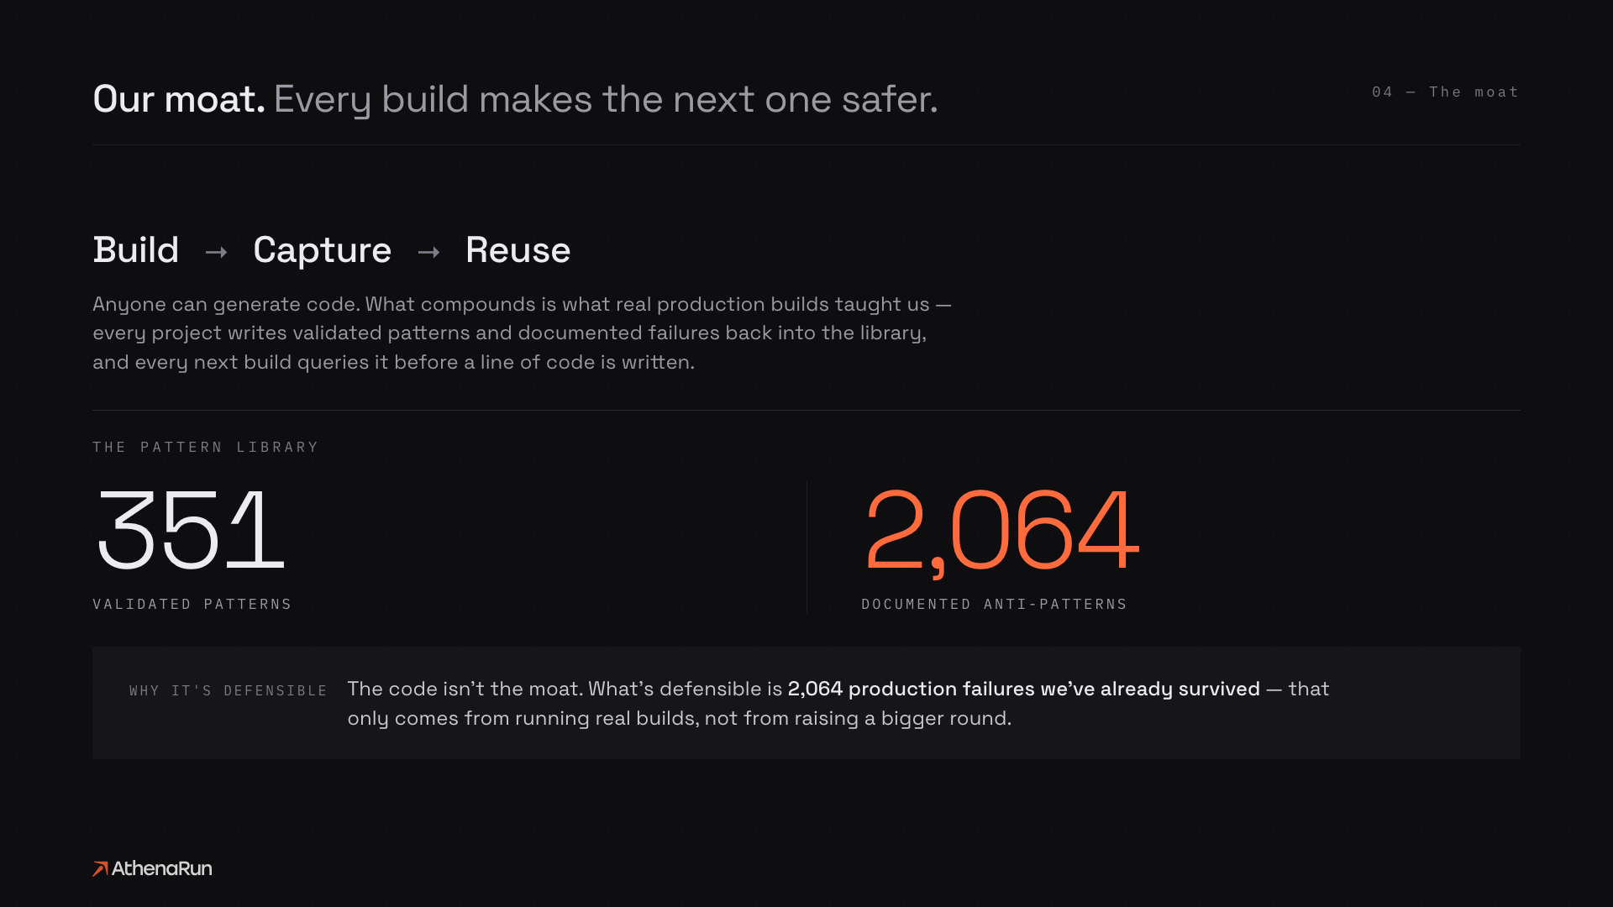

Slide 5
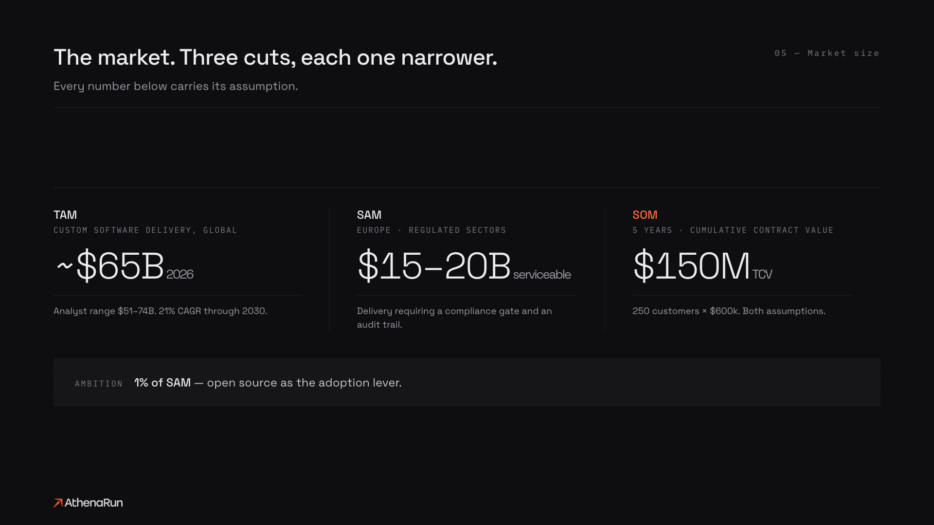

Slide 6
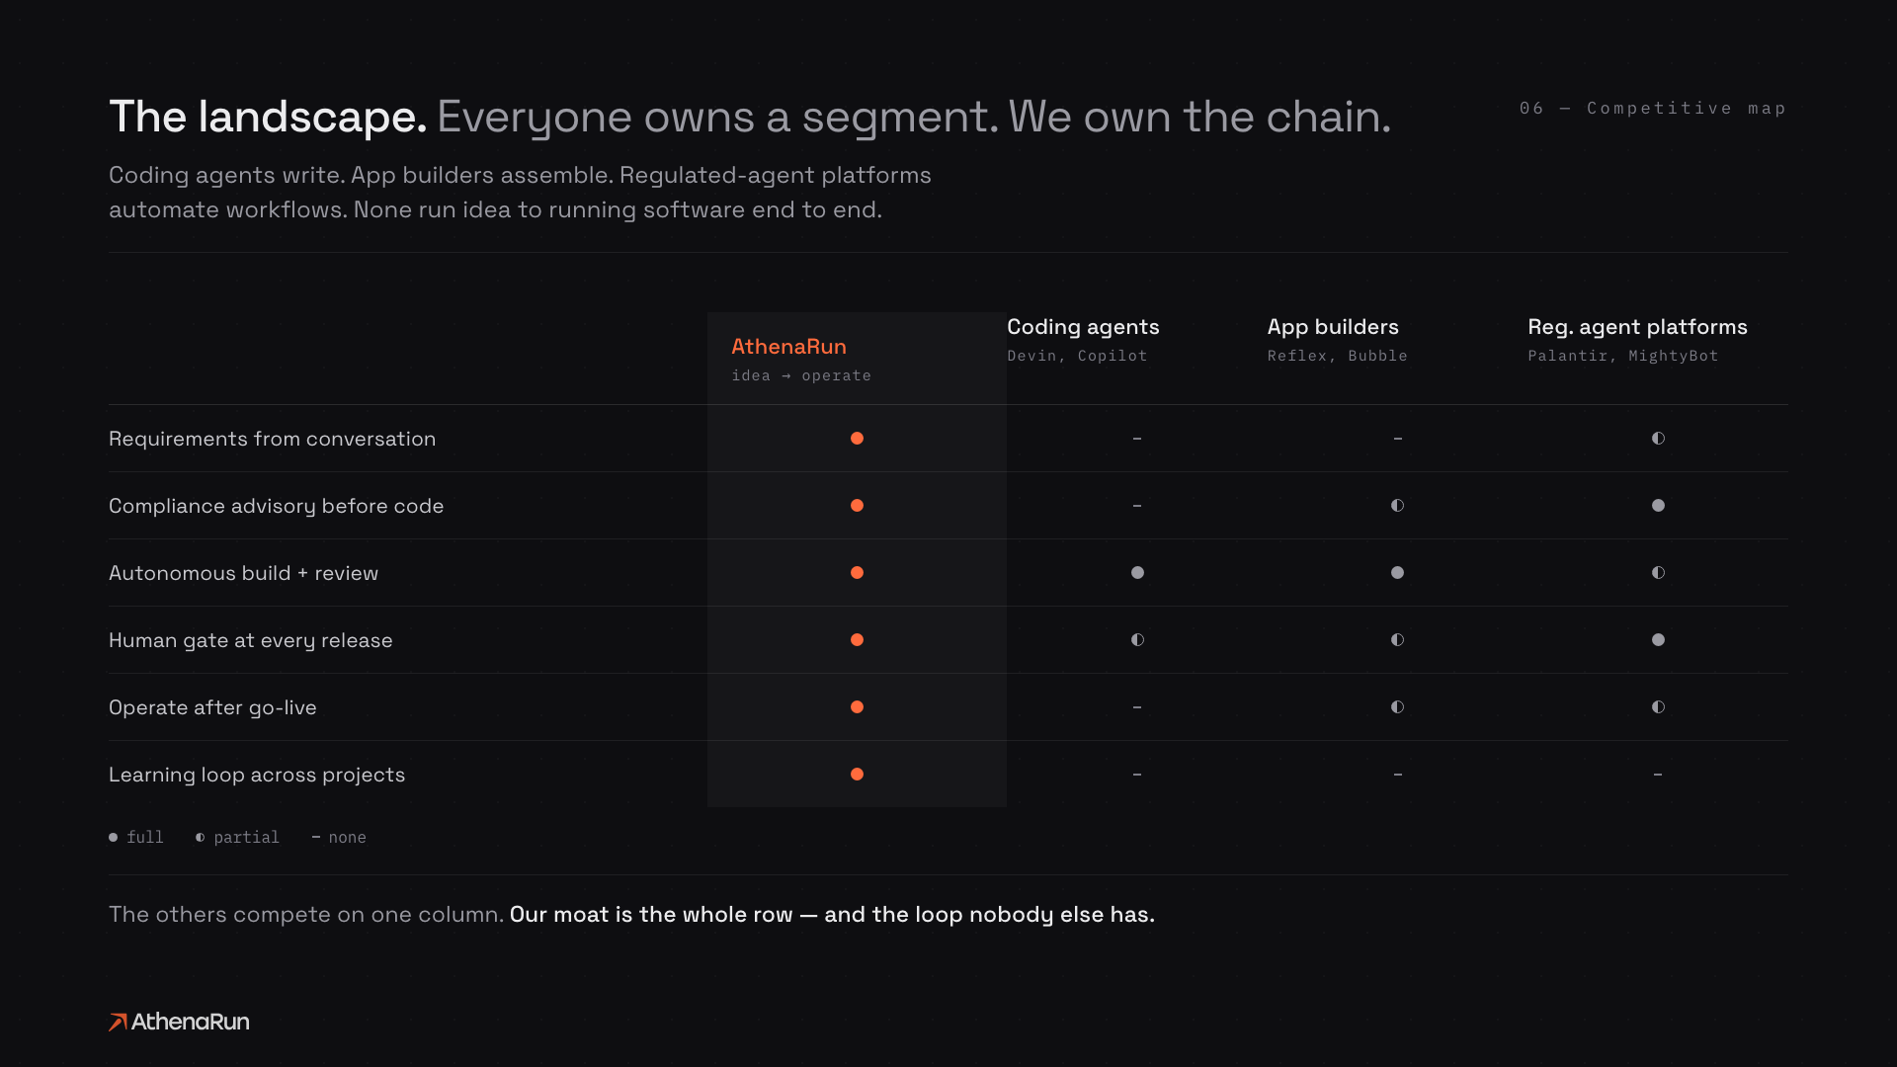

Slide 7
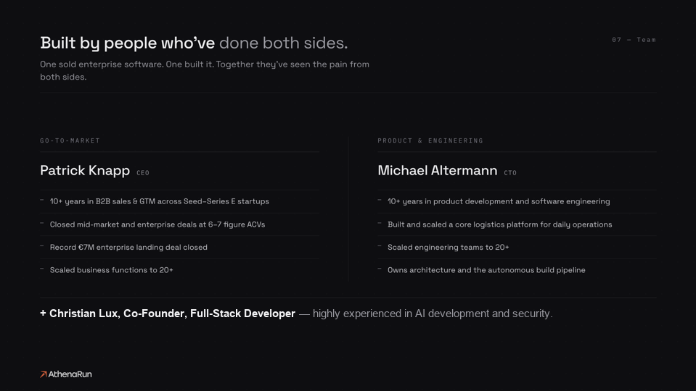

Slide 8


Slide 9


