Slide 1


AthenaRun: Germany's <Software Implementation & Delivery Infrastructure> (SIDI)
The bottleneck has moved from writing code to everything around it.
We build the chain, not the generator.
Enterprise-grade software applications and concepts rapidly accelerated
Frankfurt am Main, Germany

Slide 2


Das System ist nicht schlecht. Es ist von 2015.
DIE AUSGANGSLAGE
Der Prozess ist gewachsen. Das Werkzeug nicht.
EIN KONZERN · ZWÖLF GESELLSCHAFTEN · EIN REPORTING
2015
DANN
DER HERSTELLER
2023
SEITDEM
DER PRÜFER
Das Reporting läuft. Und es läuft gut.
Neue gesetzliche Anforderung.
Nächstes Release: frühestens 2027.
Der Kollege geht. Mit ihm die Logik.
Es läuft daneben, in Excel.
Wer hat was wann freigegeben?
Ihre Systeme haben Daten. Ihr Prozess hat kein Gedächtnis.

Slide 3
Complex Software. Is it possible with AI tools?
THE PROBLEM
Entry barriers to start coding or build tools with an AI IDE, tool or chat are low. That leads companies to underestimate the complexity of proper software engineering — and to a false sense of simplicity.
WHAT PROPER ENGINEERING STILL HAS TO ANSWER
01
02
03
04
Business Fit
Enterprise System Integration
Security & Control
Production & Lifecycle
Scope fit?
Effectiveness?
Process & workflow fit?
Data quality?
Business integration, not a standalone “tool”?
Proper engineering vs. over- or under-engineering?
Proper integration into the system landscape?
Dependencies or API reliability?
Data models & future adjustments?
Data migration?
Real-time operations?
Security & governance architecture?
Sign-on / access / permissions?
Compliance & auditability?
Vulnerability management?
Monitoring & observability?
Time to concept (TTC)?
Time to ship?
Testing & QA?
CI/CD & deployment?
Monitoring & observability?
Error handling and recovery?
Performance & reliability?
Ownership & maintenance?
Technical debt & rework?
Easy start → underestimated engineering → hidden work → rework → lost speed & higher cost → lost EBIT

Slide 4
50% of every pilot never reaches production.
THE COST
The work that survives the demo is not the work that survives production.
OF ORGANIZATIONS SEE NO EBIT IMPACT FROM AI
BETWEEN DEMO AND DEPLOYMENT
61%
50%
Half of every pilot is destroyed before production: hidden work, rework, integration and compliance nobody scoped.
Pilots are tools, and tools don’t move EBIT. Systems do.

Slide 5
Application Engineering Platform
PLATFORM PROCESS · 1/2
Business practices x Software Engineering. Run by AI powered Workflows.
FROM · INTENT
TO · A SIGNED CONCEPT
01
02
03
Scope & Business Fit
Research & Concept
Compliance
requirements and outcome
sources you can check
signed before any code
DISCOVER · ANALYZE
RESEARCH · DESIGN
COMPLIANCE · SIGN-OFF
AI AGENTS RUN EVERY STAGE
GATE · YOU DECIDE
You can stop at any gate — before build budget moves.

Slide 6
Application Engineering Platform
PLATFORM PROCESS · 2/2
Business practices x Software Engineering. Run by AI powered Workflows.
FROM · A SIGNED CONCEPT
TO · AN OPERATING SOFTWARE
04
05
06
Build & Verify
Secure & Release
Operate & Evolve
applied and reviewed
secured and released
monitored and improved
AI MEMORY · BUILD
SECURE · RELEASE
OPERATE · EVOLVE
AI AGENTS RUN EVERY STAGE
OUTPUT · WHAT THIS PRODUCES
Audit-grade output, built and verified: signed audit trail, human in the loop.

Slide 7
Every build makes the next one safer and faster
?
Customer intent feeds the platform. Delivered applications compound its engineering knowledge.
THE COMPOUNDING LOOP
Build
Capture
Reuse
real production work
patterns + failures
queried before code
every build feeds the next
Every project writes validated patterns and documented failures back into the library. Every next build queries it first.
ENGINEERING LIBRARY
Hundreds
Thousands
validated patterns
documented anti-patterns
Standardizing the foundation. Investing in the business idea and customization.

Slide 8



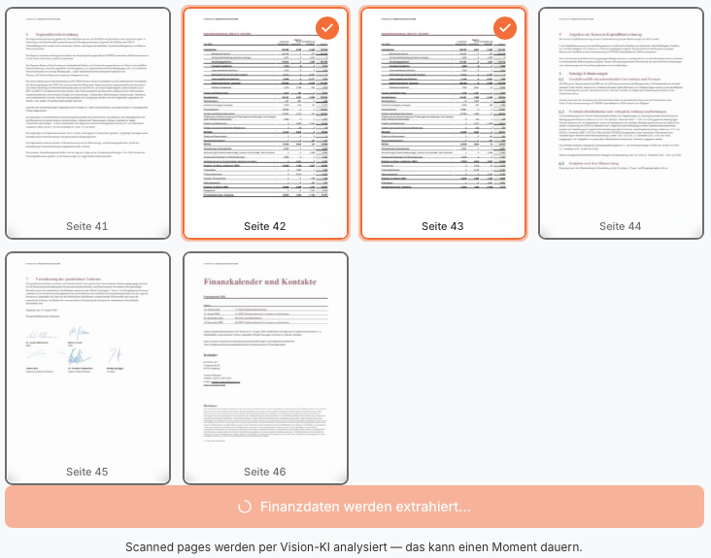
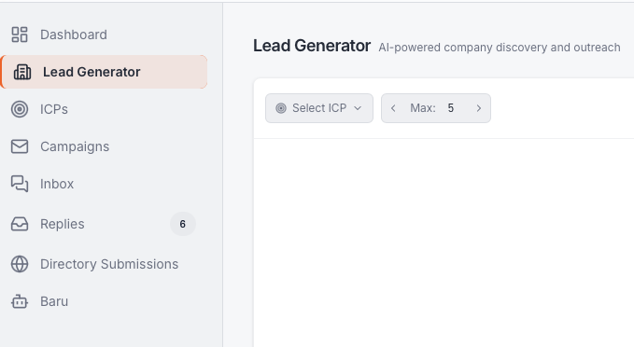
What we’ve built. Three systems, three problems.
Three systems taken end to end through the chain.
LIVE
LIVE
LIVE
CFO Suite
Board Agent
Baru
SECTOR
SECTOR
SECTOR
SME financing · corporate finance
Pharma / CDMO · board level
Pharma / CDMO · board level
WHAT IT DOES
WHAT IT DOES
WHAT IT DOES
Reads a company’s financials and returns a bank-grade credit rating, default probability and pricing as a finished PDF.
Turns a stack of board documents into a cited briefing: a watermarked PDF with a signed audit trail, EU-only.
Turns a stack of board documents into a cited briefing: a watermarked PDF with a signed audit trail, EU-only.
PROOF
PROOF
PROOF
Bank scorecard
158 tests green
Calibrated against a real one. Repositioning to pay-per-use.
Verified end to end
Verified end to end. Offered, not yet deployed.
Three sectors, one chain. The same pipeline produced all three.

Slide 9
One question.
I’ll leave you with a question
Which system would you rebuild today if delivery took twelve weeks instead of two years?
TWO WAYS THIS GOES
We build the application.
We deliver the platform.
One system, taken end to end.
Multiple systems, that’s the platform conversation.

Slide 10
Further questions.
Appendix

Slide 11
The market. Three cuts, each one narrower.
Market size
Every number below carries its assumption.
TAM
SAM
SOM
CUSTOM SOFTWARE DELIVERY, GLOBAL
EUROPE · REGULATED SECTORS
5 YEARS · CUMULATIVE CONTRACT VALUE
~$65B 2026
$15–20B serviceable
$150M TCV
Analyst range $51–74B. 21% CAGR through 2030.
Delivery requiring a compliance gate and an audit trail.
250 customers × $600k. Both assumptions.
AMBITION
1% of SAM. Open source as the adoption lever.

Slide 12
The landscape. Everyone owns a segment.
Competitive map
Coding agents write. App builders assemble. Neither runs idea to running software end to end.
AthenaRun
Coding agents
App builders
idea → operate
Claude, Copilot
Lovable, Replit
Requirements from conversation
Compliance advisory before code
Autonomous build + review
Human gate at every release
Operate after go-live
Learning loop across projects
full
partial
none
The others compete on one column. Our moat is the whole row, and the loop nobody else has.

Slide 13
Built by people who’ve done both sides.
Team
One sold enterprise software. One built it. Together they’ve seen the pain from both sides.
GO-TO-MARKET
PRODUCT & ENGINEERING
Patrick Knapp CEO
Michael Altermann CTO
10+ years in B2B sales & GTM across Seed–Series E startups
10+ years in product development and software engineering
Closed mid-market and enterprise deals at 6–7 figure ACVs
Built and scaled a core logistics platform for daily operations
Record €7M enterprise landing deal closed
Scaled engineering teams to 20+
Scaled business functions to 20+
Owns architecture and the autonomous build pipeline
+ Christian Lux, Co-Founder, Full-Stack Developer, highly experienced in AI development and security.

Slide 14
Traction. Engine validated, first customers lined up.
Traction
MVP ready. Signed letters of intent, a channel partner, and three selective programs backing the company.
BACKED & DISTRIBUTED
DISTRIBUTION
STATE ACCELERATOR
KARLSRUHE
INFRASTRUCTURE
Channel Partner
Hessen AI Cohort 2026
Cyberlab Cohort 2026
NVIDIA Inception
Go-to-market distribution secured through a signed channel partner.
Selected for the state AI accelerator program.
Accepted into the Karlsruhe tech accelerator.
Access to NVIDIA infrastructure and network.
7
€150K
signed letters of intent
pre-sales pipeline
SMEs ready to onboard at launch
combined value of signed LOIs
Demand before launch. Signed intent, secured distribution, and three programs vetting the company, all before the platform is public.

Slide 15
AI writes code.
It doesn’t finish applications.
Enterprise-grade means integrated, tested, audit-proof and signed off by a person.
We deliver the finished application.

Slide 16
Everyone builds tools. Systems are the hard part.
The problem
Code is the cheap part now. What still fails is everything that has to be true before someone signs off on the result.
WHAT SEPARATES A TOOL FROM A SYSTEM
Context
Integration
Verification
Accountability
It needs the house rules, the data model and the edge cases. A prompt does not carry them.
It has to live inside ERP, Slack and the document store, not in a sandbox.
Someone signs the output. That takes tests, calibration and an audit trail.
A person owns the decision. That takes gates, not autonomy.
61%
OF ORGANIZATIONS SEE NO EBIT IMPACT FROM AI
Pilots are tools, and tools don’t move EBIT. Systems do.
SOURCE: MCKINSEY, THE STATE OF AI IN 2025. 39% ATTRIBUTE ANY EBIT IMPACT TO AI

Slide 17
What you get. And where you can stop.
The chain
AI agents run every stage, a person opens every gate. Five deliverables on the way to a finished application, and no build budget moves without a human yes.
FROM · FIRST CONVERSATION
TO · A FINISHED APPLICATION
01
02
03
04
05
Scoped spec
Cited research
Compliance gate
Reviewed build
Running system
requirements and fit
sources you can check
signed before any code
applied and reviewed
released and monitored
DISCOVER · ANALYZE
RESEARCH
COMPLIANCE
AI MEMORY · BUILD
RELEASE · OPERATE
YOU CAN STOP AT ANY GATE, BEFORE BUILD BUDGET MOVES
AI AGENTS RUN EVERY STAGE
OUTPUT · WHAT THIS HAS ALREADY PRODUCED
Audit-grade output, built and verified: signed audit trail, EU-only, 158 tests green.

Slide 18
Our moat. Every build makes the next one safer.
The moat
Anyone can generate code. What compounds is what real production builds taught us.
THE COMPOUNDING LOOP
Build
Capture
Reuse
real production work
patterns + failures
queried before code
every build feeds the next
Every project writes validated patterns and documented failures back into the library. Every next build queries it first.
THE PATTERN LIBRARY
Hundreds
Thousands
validated patterns
documented anti-patterns
The chain fills the library. The library makes the next chain safer. That loop is the moat.

Slide 19
What we’ve built. Three systems, three problems.
Builds
Three systems taken end to end through the chain.
BUILT
LIVE
BUILT
CFO Suite
Baru
Board Member App
SECTOR
SECTOR
SECTOR
SME financing · corporate finance
B2B sales · outbound acquisition
Pharma / CDMO · board level
WHAT IT DOES
WHAT IT DOES
WHAT IT DOES
Reads a company’s financials and returns a bank-grade credit rating, default probability and pricing as a finished PDF.
Finds and qualifies B2B leads, drafts the outreach, and routes every send through a Slack approval.
Turns a stack of board documents into a cited briefing: a watermarked PDF with a signed audit trail, EU-only.
PROOF
PROOF
PROOF
Bank scorecard
€90 / month
158 tests green
Calibrated against a real one. Repositioning to pay-per-use.
Paying customer since June 2026, 150 leads per month.
Verified end to end. Offered, not yet deployed.
Three sectors, one chain. The same pipeline produced all three.

Slide 20
One question.
One question
I’ll leave you with a question, not a brochure.
Which system would you rebuild today if delivery took twelve weeks instead of two years?
TWO WAYS THIS GOES
We build the application.
We deliver the platform.
One system, taken end to end.
Multiple systems, that’s the platform conversation.

Slide 21
Further questions.
Appendix

Slide 22
The market. Three cuts, each one narrower.
Market size
Every number below carries its assumption.
TAM
SAM
SOM
CUSTOM SOFTWARE DELIVERY, GLOBAL
EUROPE · REGULATED SECTORS
5 YEARS · CUMULATIVE CONTRACT VALUE
~$65B 2026
$15–20B serviceable
$150M TCV
Analyst range $51–74B. 21% CAGR through 2030.
Delivery requiring a compliance gate and an audit trail.
250 customers × $600k. Both assumptions.
AMBITION
1% of SAM. Open source as the adoption lever.

Slide 23
The landscape. Everyone owns a segment.
Competitive map
Coding agents write. App builders assemble. Neither runs idea to running software end to end.
AthenaRun
Coding agents
App builders
idea → operate
Claude, Copilot
Lovable, Replit
Requirements from conversation
Compliance advisory before code
Autonomous build + review
Human gate at every release
Operate after go-live
Learning loop across projects
full
partial
none
The others compete on one column. Our moat is the whole row, and the loop nobody else has.

Slide 24
OLD
Built by people who’ve done both sides.
Team
One sold enterprise software. One built it. Together they’ve seen the pain from both sides.
GO-TO-MARKET
PRODUCT & ENGINEERING
Patrick Knapp CEO
Michael Altermann CTO
10+ years in B2B sales & GTM across Seed–Series E startups
10+ years in product development and software engineering
Closed mid-market and enterprise deals at 6–7 figure ACVs
Built and scaled a core logistics platform for daily operations
Record €7M enterprise landing deal closed
Scaled engineering teams to 20+
Scaled business functions to 20+
Owns architecture and the autonomous build pipeline
+ Christian Lux, Co-Founder, Full-Stack Developer, highly experienced in AI development and security.

Slide 25
Core Team
Team
Cross-functional & Execution-driven
CEO/Commercial Strategy/GTM & Business Development
COO/CTO Product Development/Business Development
Patrick Knapp CEO
Michael Altermann COO
10+ years in B2B sales & GTM across Seed–Series E startups
Successful Business Development in multiple Leadership Positions for many years
Closed mid-market and enterprise deals at 6–7 figure ACVs
Highly AI Experienced since 3 Years and GPT 3.5, Data Lover
Record €7M enterprise landing deal closed
Striving for high output and value generation
Scaled business functions to 20+
Owns architecture and the autonomous build pipeline
+ Christian Lux, Co-Founder, Full-Stack Developer, highly experienced in AI development and security.

Slide 26
Traction. Engine validated, first customers lined up.
Traction
MVP ready. Signed letters of intent, a channel partner, and three selective programs backing the company.
BACKED & DISTRIBUTED
DISTRIBUTION
STATE ACCELERATOR
KARLSRUHE
INFRASTRUCTURE
Channel Partner
Hessen AI Cohort 2026
Cyberlab Cohort 2026
NVIDIA Inception
Go-to-market distribution secured through a signed channel partner.
Selected for the state AI accelerator program.
Accepted into the Karlsruhe tech accelerator.
Access to NVIDIA infrastructure and network.
7
€150K
signed letters of intent
pre-sales pipeline
SMEs ready to onboard at launch
combined value of signed LOIs
Demand before launch. Signed intent, secured distribution, and three programs vetting the company, all before the platform is public.

