Slide 1
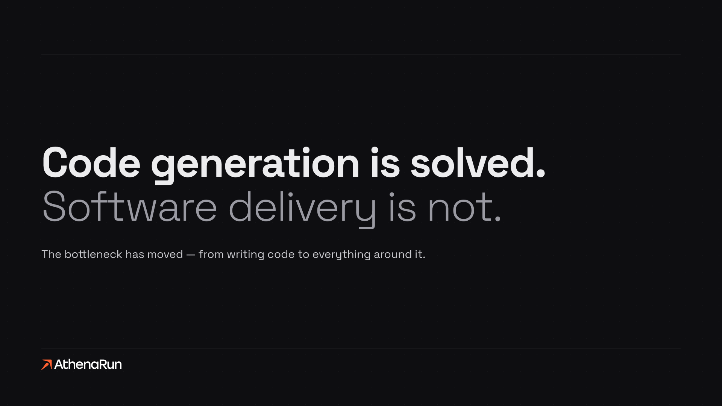
We build the chain, not the generator.

Slide 2


Still manual. And that is where the money goes.
The problem
STILL MANUAL
01
02
03
04
05
Requirements
Feasibility
Compliance
Approval
Operations
Five steps around the code. Every one of them a handoff, a document, a wait.
THEY BOUGHT THE GENERATOR — THE CHAIN AROUND IT IS STILL MANUAL
61%
of organizations see no EBIT impact from AI
The expensive failures happen before a line of code. That’s the part we automate.
Source: McKinsey, The State of AI in 2025 — 39% attribute any EBIT impact to AI

Slide 3
From idea to build-ready package.
The chain
One line, a human gate at every step. AI agents support every stage, Discover through AI Memory — from first conversation to a build-ready package.
01
02
03
04
05
Discover
Analyze
Research
Compliance
AI Memory
from conversation
scope + fit
cited, deep
pre-build gate
patterns carried in
human gate at every transition
IDEA TO BUILD-READY PACKAGE

Slide 4
From package to running software.
The chain
The package is approved. Build through Operate — from approved package to software running in production. Every decision that matters stays with a person.
06
07
08
05 · build-ready package
Build
Release
Operate
code + review
human approval
monitoring
LEARN · validated patterns from every build carry into the next
PACKAGE TO RUNNING SOFTWARE

Slide 5
Our moat. Every build makes the next one safer.
The moat
Build
Capture
Reuse
Anyone can generate code. What compounds is what real production builds taught us — every project writes validated patterns and documented failures back into the library, and every next build queries it before a line of code is written.
THE PATTERN LIBRARY
WHY IT’S DEFENSIBLE
Hundreds
Thousands
Earned, not bought.
The library only grows by running real production builds.
validated patterns
documented anti-patterns
It compounds.
The LEARN loop from the chain is what fills this library.
Every project makes the next estimate, gate and build safer.
Capital can’t copy it.
A bigger round buys code, not failures already survived.

Slide 6



What we’ve built. Three systems, three problems.
Builds
Three systems taken end to end through the chain.
CFO Suite
Baru
Board Member App
SECTOR
SECTOR
SECTOR
SME financing · corporate finance
B2B sales · outbound acquisition
Pharma / CDMO · board level
WHAT IT DOES
WHAT IT DOES
WHAT IT DOES
Reads a company’s financials and returns a bank-grade credit rating, default probability and pricing as a finished PDF.
Finds and qualifies B2B leads, drafts the outreach, and routes every send through a Slack approval.
Turns a stack of board documents into a cited briefing — a watermarked PDF with a signed audit trail, EU-only.
STATUS
STATUS
STATUS
Built and calibrated against a real bank scorecard. Repositioning to pay-per-use.
Live with a paying customer since June 2026. €90/month for 150 leads.
Built and verified, 158 tests green. Offered, not yet deployed.

Slide 7
One question.
One question
I’ll leave you with a question, not a brochure.
Which process at your company still runs in Excel — and shouldn’t have for the past year?
If something just came to mind — talk to me. We’ll turn it into an application. And if twenty things came to mind, we should be talking about the platform instead of the application.
[Name · Email · Phone]

Slide 8
Further questions.
Appendix

Slide 9
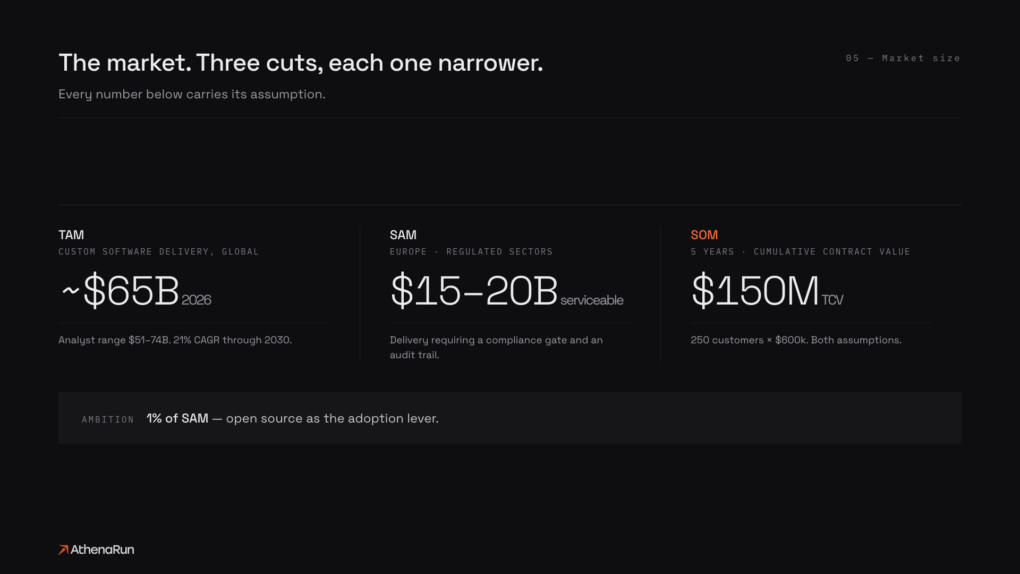
The market. Three cuts, each one narrower.
Market size
Every number below carries its assumption.
TAM
SAM
SOM
CUSTOM SOFTWARE DELIVERY, GLOBAL
EUROPE · REGULATED SECTORS
5 YEARS · CUMULATIVE CONTRACT VALUE
~$65B 2026
$15–20B serviceable
$150M TCV
Analyst range $51–74B. 21% CAGR through 2030.
Delivery requiring a compliance gate and an audit trail.
250 customers × $600k. Both assumptions.
AMBITION
1% of SAM — open source as the adoption lever.

Slide 10
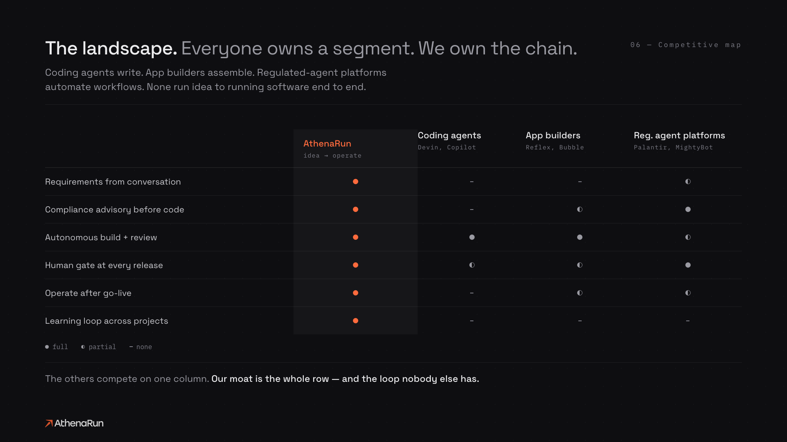
The landscape. Everyone owns a segment.
Competitive map
Coding agents write. App builders assemble. Neither runs idea to running software end to end.
AthenaRun
Coding agents
App builders
idea → operate
Claude, Copilot
Lovable, Replit
Requirements from conversation
Compliance advisory before code
Autonomous build + review
Human gate at every release
Operate after go-live
Learning loop across projects
full
partial
none
The others compete on one column. Our moat is the whole row — and the loop nobody else has.

Slide 11
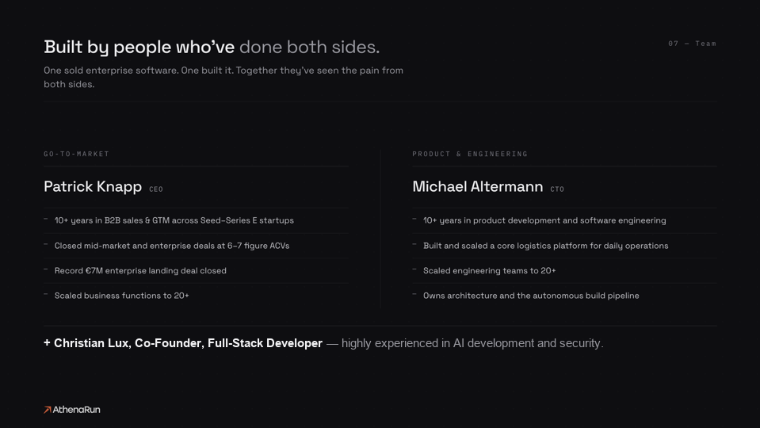
Built by people who’ve done both sides.
Team
One sold enterprise software. One built it. Together they’ve seen the pain from both sides.
GO-TO-MARKET
PRODUCT & ENGINEERING
Patrick Knapp CEO
Michael Altermann CTO
10+ years in B2B sales & GTM across Seed–Series E startups
10+ years in product development and software engineering
Closed mid-market and enterprise deals at 6–7 figure ACVs
Built and scaled a core logistics platform for daily operations
Record €7M enterprise landing deal closed
Scaled engineering teams to 20+
Scaled business functions to 20+
Owns architecture and the autonomous build pipeline
+ Christian Lux, Co-Founder, Full-Stack Developer — highly experienced in AI development and security.

Slide 12
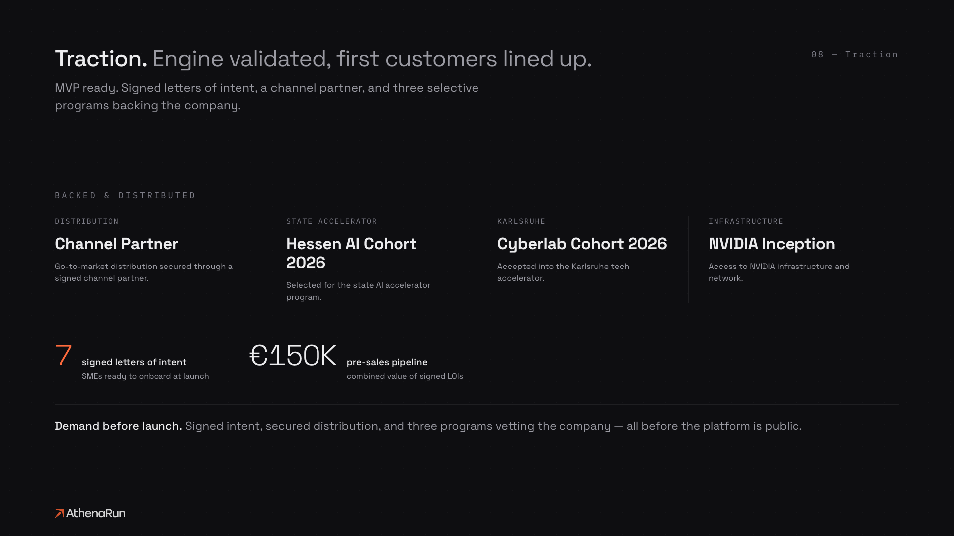
Traction. Engine validated, first customers lined up.
Traction
MVP ready. Signed letters of intent, a channel partner, and three selective programs backing the company.
BACKED & DISTRIBUTED
DISTRIBUTION
STATE ACCELERATOR
KARLSRUHE
INFRASTRUCTURE
Channel Partner
Hessen AI Cohort 2026
Cyberlab Cohort 2026
NVIDIA Inception
Go-to-market distribution secured through a signed channel partner.
Selected for the state AI accelerator program.
Accepted into the Karlsruhe tech accelerator.
Access to NVIDIA infrastructure and network.
7
€150K
signed letters of intent
pre-sales pipeline
SMEs ready to onboard at launch
combined value of signed LOIs
Demand before launch. Signed intent, secured distribution, and three programs vetting the company — all before the platform is public.

