Slide 1
Perceptron Learning Rule
Assuming the problem is linearly separable, there is a learning rule that converges in a finite time
Motivation
A new (unseen) input pattern that is similar to an old (seen) input pattern is likely to be classified correctly

Slide 2
Learning Rule, Ctd
Basic Idea – go over all existing data patterns, whose labeling is known, and check their classification with a current weight vector
If correct, continue
If not, add to the weights a quantity that is proportional to the product of the input pattern with the desired output Z (1 or –1)

Slide 3
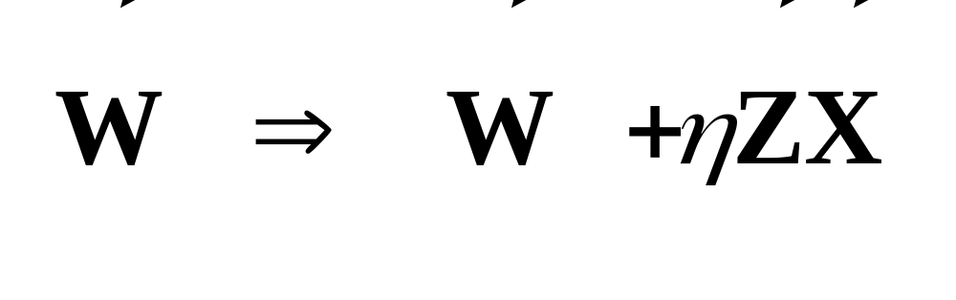
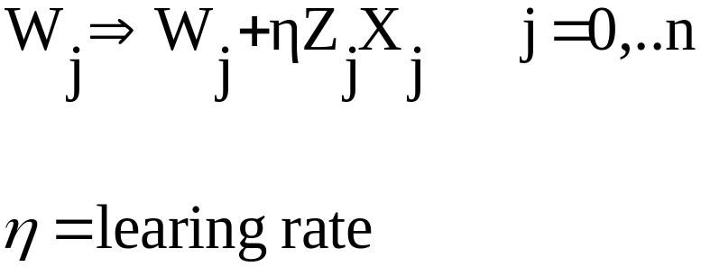
Weight Update Rule

Slide 4
Biological Motivation
Learning means changing the weights (“synapses”) between the neurons
the product between input and output
is important in computational neuroscience

Slide 5
Hebb Rule
In 1949, Hebb postulated that the changes in a synapse are proportional to the correlation between firing of the neurons that are connected through the synapse (the pre- and post- synaptic neurons)
Neurons that fire together, wire together

Slide 6
Example: a simple problem
4 points linearly separable
2
1.5
(1/2, 1)
1
(-1,1/2)
0.5
(1,1/2)
0
Z = 1
Z = - 1
-0.5
(-1,1)
-1
-1.5
-2
-2
-1.5
-1
-0.5
0
0.5
1
1.5
2

Slide 7
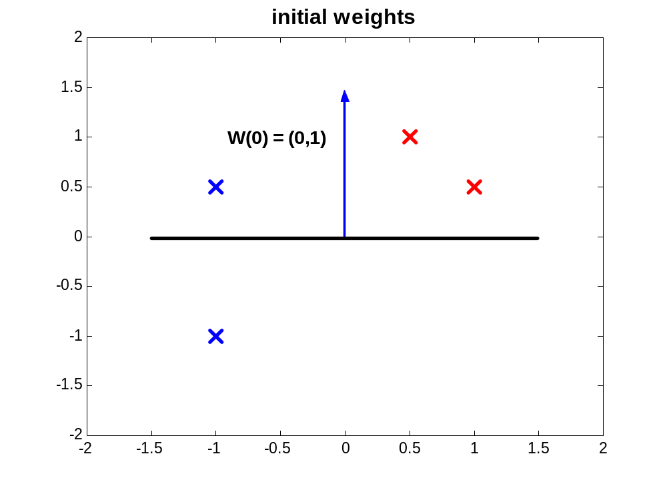

Slide 8
Updating Weights
Upper left point is wrongly classified
eta = 1/3 , W(0) = (0,1)
W ==>W + eta * Z * X
W_x = 0 + 1/3 *(-1) * (-1) = 1/3
W_y = 1 + 1/3 * (-1) * (1/2) = 5/6
W(1) = (1/3,5/6)

Slide 9
first correction
2
1.5
W(1) = (1/3,5/6)
1
0.5
0
-0.5
-1
-1.5
-2
-2
-1.5
-1
-0.5
0
0.5
1
1.5
2

Slide 10
Updating Weights, Ctd
Upper left point is still wrongly classified
W ==>W + eta * Z * X
W_x = 1/3 + 1/3 *(-1) * (-1) = 2/3
W_y = 5/6 + 1/3 * (-1) * (1/2) = 4/6 = 2/3
W(2) = (2/3,2/3)

Slide 11
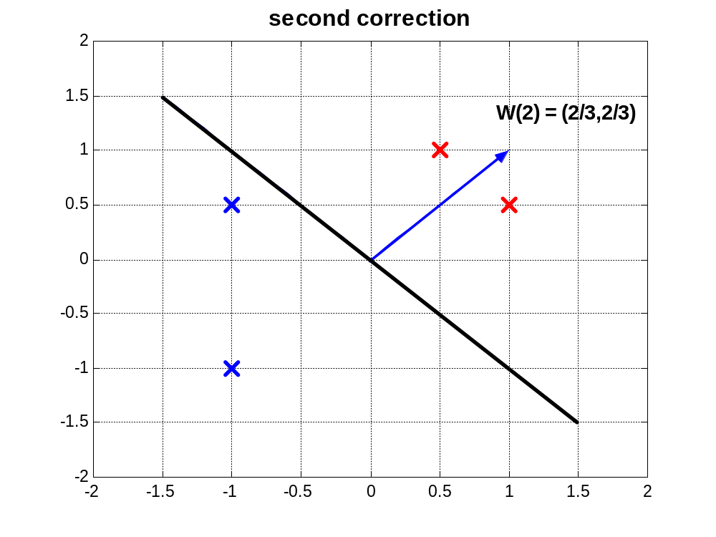

Slide 12
Example, Ctd
All 4 points are classified correctly
Toy problem – only 2 updates required
Correction of weights was simply a
rotation of the separating hyper plane
Rotation can be applied to the right direction, but may require many updates

