Slide 1

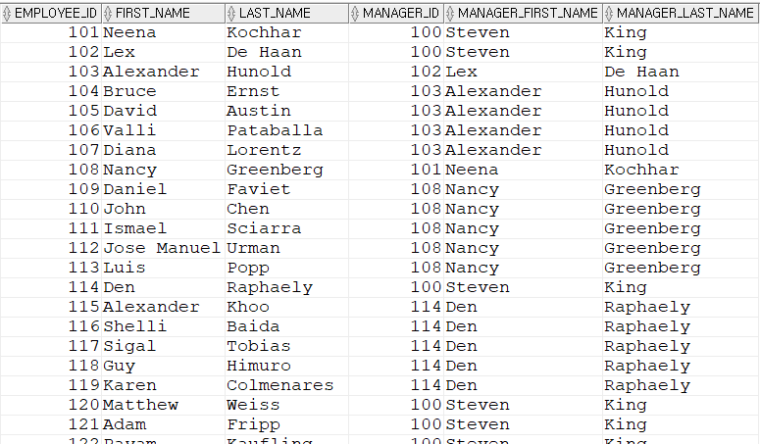
select employee_id, first_name, manager_id from employees;
SELECT e.employee_id, e.first_name, e.last_name, m.employee_id AS manager_id, m.first_name AS manager_first_name, m.last_name AS manager_last_name
FROM employees e
-- e: 직원 관점, m: 매니저 관점
-- 직원의 매니저가 사원 ID로 존재하는 경우
JOIN employees m ON e.manager_id = m.employee_id;

