Slide 1
Extracting Knowledge Graph of COVID-19 through mining of unstructured Biomedical Corpora
GUIDED BY
TEAM MEMBERS
Dr. G. Sudhakaran
Athiban T - 2018103013
Prathesh N - 2018103576
Syed Mohammed Asif M - 2018103612

Slide 2
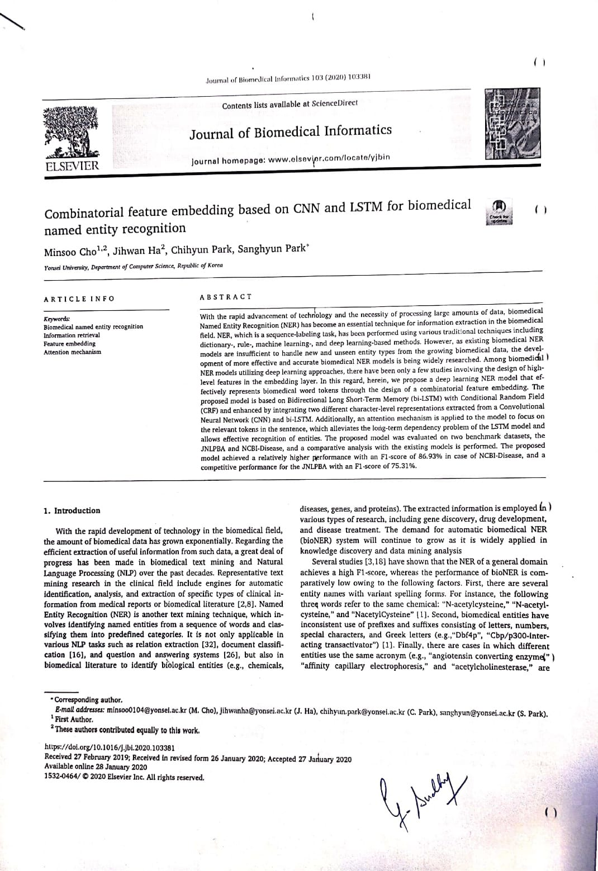
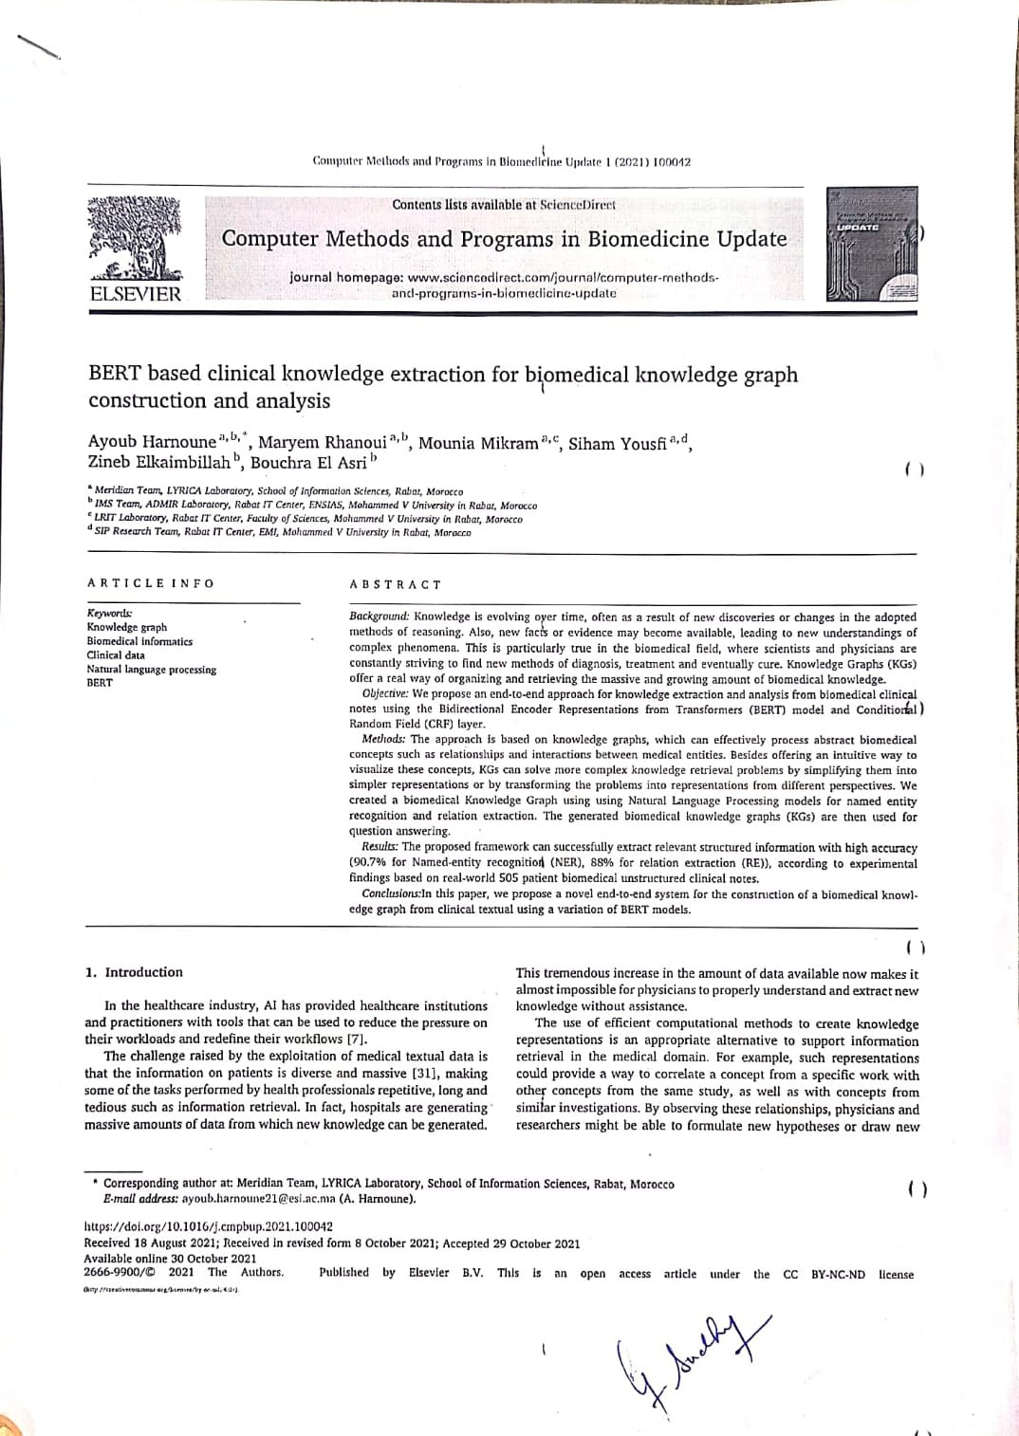
BASE PAPERS

Slide 3
INTRODUCTION
COVID-19 is a global epidemic with a considerable fatality rate and a high transmission rate, affecting millions of people worldwide since its outbreak.
The search for treatments and possible cures for the novel Coronavirus has led to an exponential increase in scientific publications.
Scientific publications regarding COVID-19 contains various data about related diseases, genes, drugs and so on.
The data in such publications are vastly unstructured.
These publications are gathered under the CORD-19 dataset.

Slide 4
OVERALL OBJECTIVES
To extract information from CORD-19 in a fully autonomous way using NLP techniques.
To gather named entities such as diseases, genes, drugs from the CORD-19 dataset.
To extract relations between entities (i.e., drug-induced-disease relations, drug-protein interactions) from the CORD-19 dataset.
To organize the found entities and relations in the form of Knowledge Graph.
To demonstrate the uses of the extracted Knowledge Graph via Representation Learning.

Slide 5
LITERATURE SURVEY
S.No | Name | Methodology | Advantages | Disadvantages
1 | Zheng, S., Rao, J., Song, Y., Zhang, J., Xiao, X., Fang, E., Yang, Y. and Niu, Z., 2020. PharmKG: a dedicated knowledge graph benchmark for biomedical data mining. Briefings in Bioinformatics,. | Extract Knowledge Graph From drugs, diseases and genes databases and also their relations. | Large Knowledge Graph can be obtained. | Generic Knowledge Graph is obtained. Input is structured data which is not common.
2 | Domingo-Fernández, D., Baksi, S., Schultz, B., COVID-19 Knowledge Graph: a computable, multimodal, cause-and-effect knowledge model of COVID-19 pathophysiology. | Evidence text from the prioritized corpus was manually encoded as a triple. (source-relation- target) | Extracted information is mostly correct apart from Human errors | Small Knowledge Graph is obtained. Manual Annotations are time-consuming.

Slide 6
LITERATURE SURVEY
S.No | Name | Methodology | Advantages | Disadvantages
3 | Repke T., Krestel R. (2021) Extraction and Representation of Financial Entities from Text. In: Consoli S., Reforgiato Recupero D., Saisana M. (eds) Data Science for Economics and Finance. Springer, Cham. | Extract Knowledge Graph From Financial text corpus using NER and RE tasks. | Decision Support System, QA System can be easily built. | Lack of Gold Standard Corpus for result evaluation.
4 | Kim, T.; Yun, Y.; Kim, N. Deep Learning-Based Knowledge Graph Generation for COVID-19. Sustainability 2021, 13, 2276. https://doi.org/10.3390/su13042276 | Finding entity dictionary related to COVID-19 and extracting relations from corpus | Unsupervised Method to build Knowledge Graph. | Results can vary massively based on the unsupervised model used.

Slide 7
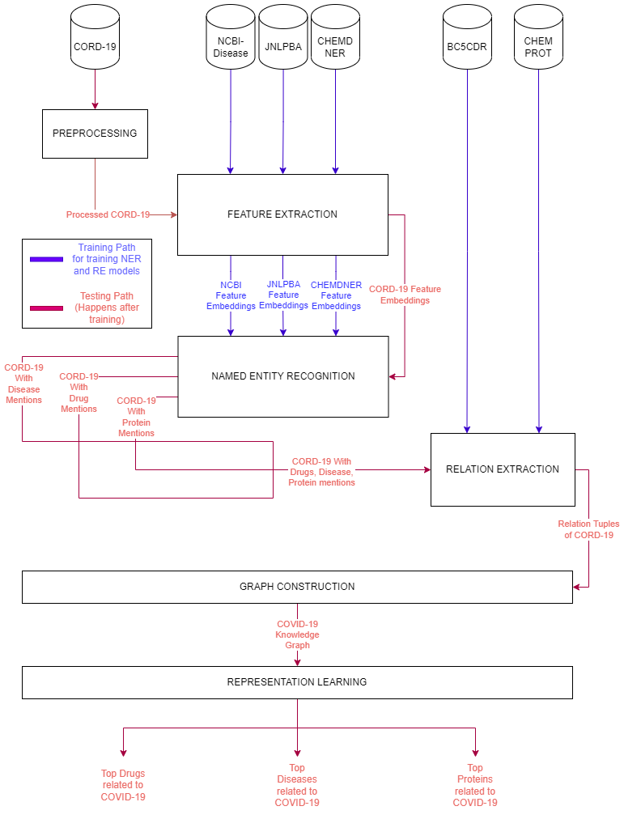
ARCHITECTURE DIAGRAM

Slide 8
LIST OF MODULES
Preprocessing Module
Feature Extraction Module
Named Entity Recognition Module
Relation Extraction Module
Graph Construction Module
Representation Learning Module

Slide 9
PREPROCESSING MODULE
Input : CORD-19 Dataset
Output : Tokenized and Processed CORD-19
In this module, the CORD-19 Dataset is tokenized using Sentence and Word Tokenizer.
The POS Tags for the tokens are also found.
Since the dataset contains large amount of text, this processed result needs to be cached for future use.
The processed CORD-19’s abstract and full text are passed to the next module.

Slide 10
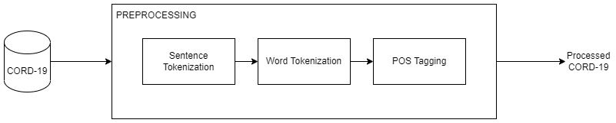
PREPROCESSING MODULE

Slide 11
FEATURE EXTRACTION MODULE
Input : NCBI-Disease, CHEMDNER, JNLPBA, Processed CORD-19
Output : Contextual Word Embedding, Global Word
Embedding, Character Embedding of input
In this module, the datasets needed for Named Entity Recognition Module is fed as input.
Then we use contextual word embedding techiques such as ElMo or Transformer based word embeddings.
The global word embedding is used for averaging multiple uses of same word in different contexts.
Character embedding maps each character into corresponding vectors.

Slide 12
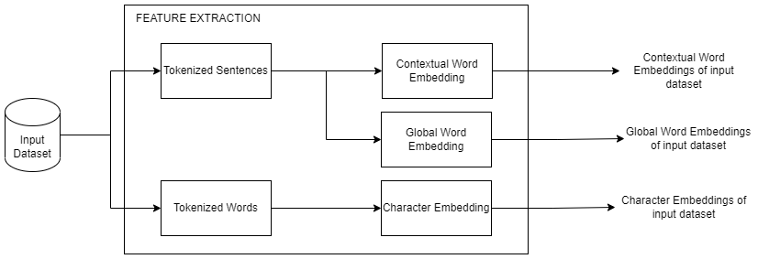
FEATURE EXTRACTION MODULE

Slide 13
NAMED ENTITY RECOGNITION MODULE
Input : Word and Character embeddings of NCBI-Disease, CHEMDNER, JNLPBA, Processed CORD-19
Output : CORD-19 with Disease, Drug, Protein Mentions
The tags are for each word token that are encoded in BIO Scheme.
NCBI, CHEMDNER, JNLPBA dataset embeddings are fed into each BiLSTM-CRF model, and the results are tested. Now there are 3 models.
The Processed CORD-19 is fed into each model and the disease, drug, protein mentions of CORD-19 dataset are found.

Slide 14
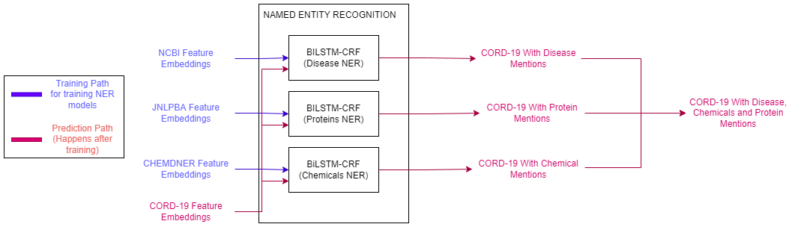
NAMED ENTITY RECOGNITION MODULE

Slide 15
RELATION EXTRACTION MODULE
Input : BC5CDR, CHEMPROT, CORD-19 with entity mentions
Output : Relation tuples of CORD-19
The 2 datasets are preprocessed where the tokens are associated with its entities, and the sentences are processed as the first sentence contains the relation entities and the second sentence contains the text containing the relations.
The BC5CDR dataset is fed into the SciBERT model with 1d-CNN output layer which produces the relations.
The CHEMPROT datasets are fed into SciBERT model and is fine-tuned.
The CORD-19 with entity mentions is fed into the two models and tuples are found.

Slide 16
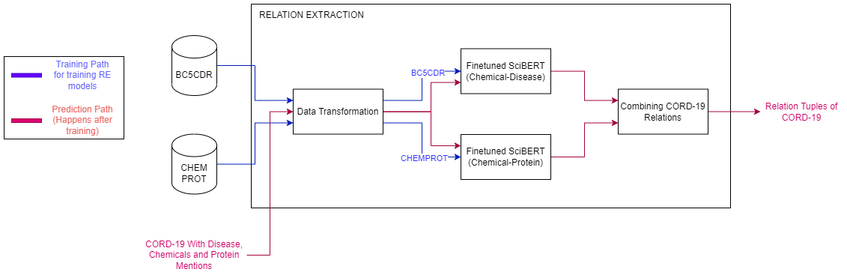
RELATION EXTRACTION MODULE

Slide 17
GRAPH CONSTRUCTION MODULE
Input : CORD-19 Relations along with their entities
Output : COVID-19 Knowledge Graph
We construct a KG which is defined as KG = (E, R, G), where,
E: a set of nodes representing disease/ protein/ drug entities
R: a set of labels representing chemical-protein relation or chemical-disease relation
G ( E × R × E ) : a set of edges that represent facts connecting entity pairs.
Entities with no relations or in-degree less than N can be removed which helps with the density of the resultant knowledge graph.

Slide 18
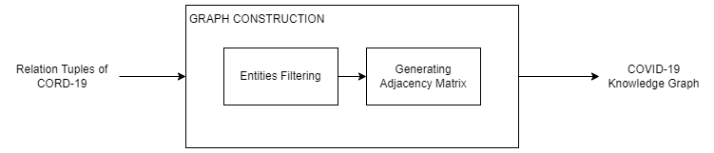
GRAPH CONSTRUCTION MODULE

Slide 19
REPRESENTATION LEARNING MODULE
Input : COVID-19 Knowledge Graph
Output : Top Diseases, Chemicals, Proteins related to COVID-19
We reduce the noise by removing entities with less in-degree than N.
We embed the obtained graph using geometric method such as TransD.
As a result, we get the entity vectors of certain dimensions.
We get COVID-19 vector and compare entities with that to find whether they are similar or not.
Hence the top COVID-19 related entities as found as output.

Slide 20
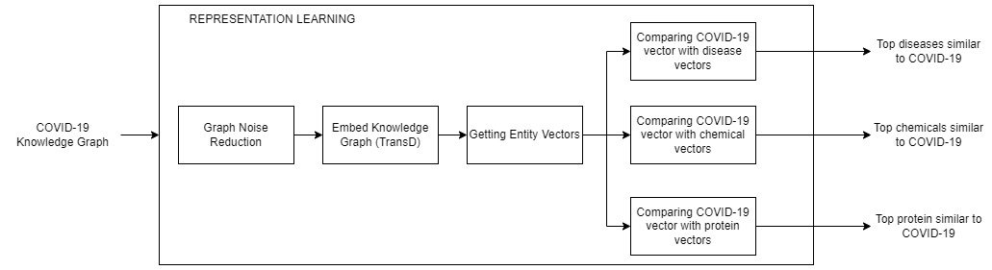
REPRESENTATION LEARNING MODULE

Slide 21
DATASET
CORD-19
500,000 articles related to COVID-19. With over 200,000 full text articles.
NCBI-DISEASE
Text Corpus with annotated 6,892 disease mentions of over 793 Abstracts.
CHEMDNER
Text Corpus with annotated 84,355 chemical mentions of 10,000 Abstracts.

Slide 22
DATASET
JNLPBA
Text Corpus with annotated protein mentions of over 2,000 abstracts.
BC5CDR
Text Corpus with annotated 3116 chemical-disease interactions.
CHEMPROT
Text Corpus with annotated drug-protein relations of over 1,820 PubMed abstracts

Slide 23

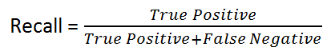


PERFORMANCE MEASURES
Named Entity Recognition and Relation Extraction are classification problems.
So Confusion Matrix can be built.
Hence Precision, Recall, F1-Score, Accuracy measures can be used.

Slide 24
PERFORMANCE MEASURES
The CORD-19 dataset lacks ground truth.
For validating the resultant Knowledge Graph, we can try to verify the relation, by fact checking sites like http://ctdbase.org/.
The Relation Extraction task’s performance is final.
Also, the finally obtained Top COVID-19 related diseases, chemicals and proteins can also be manually verified.

Slide 25
REFERENCES
Ayoub Harnoune, Maryem Rhanoui, Mounia Mikram, Siham Yousfi, Zineb Elkaimbillah, Bouchra El Asri, BERT based clinical knowledge extraction for biomedical knowledge graph construction and analysis, Computer Methods and Programs in Biomedicine Update, Volume 1, 2021, 100042,ISSN2666-9900, https://doi.org/10.1016/j.cmpbup.2021.100042.
Minsoo Cho, Jihwan Ha, Chihyun Park, Sanghyun Park, Combinatorial feature embedding based on CNN and LSTM for biomedical named entity recognition, Journal of Biomedical Informatics, Volume 103, 2020, 103381, ISSN 1532-0464, https://doi.org/10.1016/j.jbi.2020.103381.
Perera, N., Dehmer, M., & Emmert-Streib, F. (2020). Named Entity Recognition and Relation Detection for Biomedical Information Extraction. Frontiers in cell and developmental biology, 8, 673. https://doi.org/10.3389/fcell.2020.00673
Daniel Domingo-Fernandez, Shounak Baksi, Bruce´ Schultz, Yojana Gadiya, Reagon Karki, Tamara Raschka, Christian Ebeling, Martin Hofmann Apitius, and Alpha Tom Kodamullil. 2020. Covid19 knowledge graph: a computable, multimodal, cause-and-effect knowledge model of covid-19 pathophysiology. bioRxiv.
Kim, T.; Yun, Y.; Kim, N. Deep Learning-Based Knowledge Graph Generation for COVID-19. Sustainability 2021, 13, 2276. https://doi.org/10.3390/su13042276 .

