Slide 1
Extracting Knowledge Graph of COVID-19 through mining of unstructured biomedical corpora
GUIDED BY
TEAM MEMBERS
Dr. G. Sudhakaran
Athiban T - 2018103013
Prathesh N - 2018103576
Syed Mohammed Asif M - 2018103612

Slide 2
REVIEW 1
Evaluation Metrics for the project
Relation Extraction task performance can be used.
Precision, Recall, F1 Score is the metrics used for the project

Slide 3
INTRODUCTION
COVID-19 is a global epidemic with a considerable fatality rate and a high transmission rate, affecting millions of people worldwide since its outbreak.
The search for treatments and possible cures for the novel Coronavirus has led to an exponential increase in scientific publications.
Scientific publications regarding COVID-19 contains various data about related diseases, genes, drugs and so on.
The data in such publications are vastly unstructured. These publications are gathered under the CORD-19 dataset.
Our project focuses on extracting useful information from unstructured raw text.

Slide 4
OVERALL OBJECTIVES
To extract information from CORD-19 in a fully autonomous way using NLP techniques.
To gather named entities such as diseases, genes, chemicals from the CORD-19 dataset.
To extract relations between entities (i.e., chemical-induced-disease relations, chemical-protein interactions) from the CORD-19 dataset.
To organize the found entities and relations in the form of Knowledge Graph.
To embed the Knowledge Graph to find entity vectors.

Slide 5
LITERATURE SURVEY
Paper Title, Authors, Year, Journal name, Vol, Issue & PP | Methodology / Algorithm used | Issues / Gaps/ Limitations
Zheng, S., Rao, J., Song, Y., Zhang, J., Xiao, X., Fang, E., Yang, Y. and Niu, Z., 2020. PharmKG: a dedicated knowledge graph benchmark for biomedical data mining. Briefings in Bioinformatics,. | Extract Knowledge Graph From drugs, diseases and genes databases and also their relations. | Generic Knowledge Graph is obtained. Input is structured data which is not common.
Domingo-Fernández, D., Baksi, S., Schultz, B., COVID-19 Knowledge Graph: a computable, multimodal, cause-and-effect knowledge model of COVID-19 pathophysiology. | Evidence text from the prioritized corpus was manually encoded as as a triple. (source-relation- target) | Small Knowledge Graph is obtained. Manual Annotations are time-consuming.

Slide 6
LITERATURE SURVEY
Paper Title, Authors, Year, Journal name, Vol, Issue & PP | Methodology / Algorithm used | Issues / Gaps/ Limitations
Repke T., Krestel R. (2021) Extraction and Representation of Financial Entities from Text. In: Consoli S., Reforgiato Recupero D., Saisana M. (eds) Data Science for Economics and Finance. Springer, Cham. | Extract Knowledge Graph From Financial text corpus using NER and RE tasks. | Lack of Gold Standard Corpus for result evaluation.
Kim, T.; Yun, Y.; Kim, N. Deep Learning-Based Knowledge Graph Generation for COVID-19. Sustainability 2021, 13, 2276. https://doi.org/10.3390/su13042276 | Finding entity dictionary related to COVID-19 and extracting relations from corpus | Results can vary massively based on the unsupervised model used.

Slide 7
LITERATURE SURVEY
Paper Title, Authors, Year, Journal name, Vol, Issue & PP | Methodology / Algorithm used | Issues / Gaps/ Limitations
W. E. Zhang and Q. Nguyen, "Constructing COVID-19 Knowledge Graph from A Large Corpus of Scientific Articles," 2021 IEEE International Conference on Big Knowledge (ICBK), 2021, pp. 237-244, doi: 10.1109/ICKG52313.2021.00040. | Rule based relation and entity extraction from MEDLINE COVID-19 related articles. | Supervision is required for setting the rules to find the entities that we need.
Minsoo Cho, Jihwan Ha, Chihyun Park, Sanghyun Park, Combinatorial feature embedding based on CNN and LSTM for biomedical named entity recognition, Journal of Biomedical Informatics, Volume 103, 2020, 103381, ISSN 1532-0464, https://doi.org/10.1016/j.jbi.2020.103381. | Using Pre Trained Word Embeddings and Char embeddings using LSTM for NER | Most test words are not in word embeddings.

Slide 8
LITERATURE SURVEY
Paper Title, Authors, Year, Journal name, Vol, Issue & PP | Methodology / Algorithm used | Issues / Gaps/ Limitations
Peng, Y., Wei, CH. & Lu, Z. Improving chemical disease relation extraction with rich features and weakly labeled data. J Cheminform 8, 53 (2016). https://doi.org/10.1186/s13321-016-0165-z | Extract Biomedical relations using statistical features. | Manual curation of features needed to find the required relations.
Nada Boudjellal, Huaping Zhang, Asif Khan, Arshad Ahmad, "Biomedical Relation Extraction Using Distant Supervision", Scientific Programming, vol. 2020, Article ID 8893749, 9 pages, 2020. https://doi.org/10.1155/2020/8893749 | Extract relations using already available knowledge base. | External dependency

Slide 9
SUMMARY OF ISSUES
Manual curation takes very long time and the results count will be low.
Lack of ground truth information for correct and easy evaluation.
Rule based information extraction requires manual rule setting which differs based on the information we need.
Usage of External Knowledge Base which may not be available for the concerned task.
Lack of structured data which will be easier to extract.

Slide 10
PROPOSED SYSTEM
To create an automated system to extract entities and their relations from the CORD-19 dataset.
To encounter the out of vocabulary problem for the embeddings, we create a custom SciBERT model to create feature embeddings Named Entity Recognition module.
For the NER, we use BERT embeddings for the tokens and is fed into the BiLSTM-CRF model.
For RE, we use SciBERT to extract relations from the CORD-19 dataset.

Slide 11
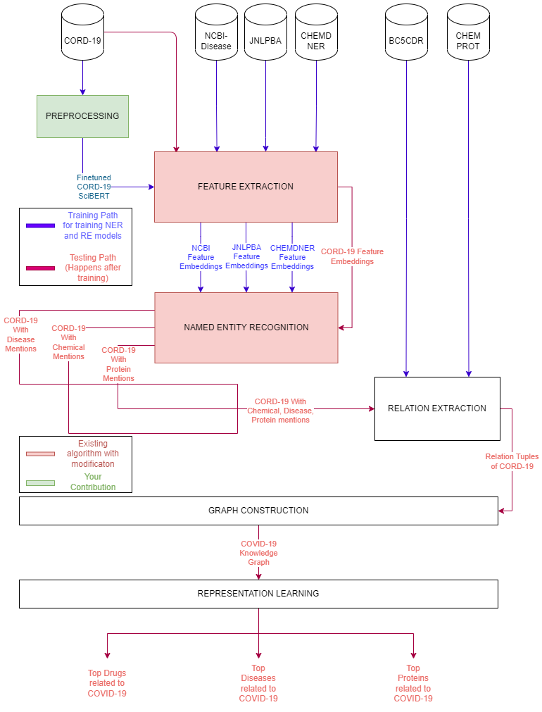
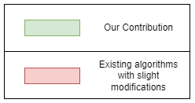
ARCHITECTURE DIAGRAM

Slide 12
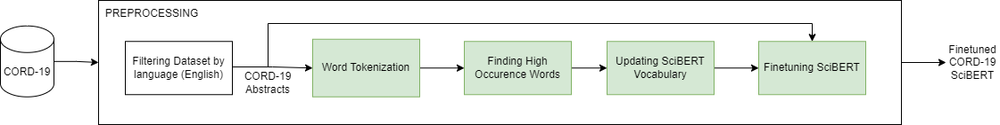
PREPROCESSING MODULE
Input : CORD-19 Dataset
Output : Fine tuned CORD-19 SciBERT

Slide 13
PREPROCESSING MODULE
Initially, the CORD-19 dataset is loaded.
Then all the dataset rows are marked with their corresponding languages. All rows other than english will be removed.
The CORD-19 abstracts are cleaned from punctuations and is word tokenized.
Then the words with occurrence value greater than 450 are taken and SciBERT vocabulary is updated.
Then the SciBERT is fine tuned on CORD-19 abstracts to produce CORD-19 SciBERT.

Slide 14
PREPROCESSING MODULE
function Preprocessing:
dataset=read(cord-19)
dataset=dataset.where(language==”english”)
abstracts=dataset.abstracts
words=word_tokenize(abstracts)
counter=Counter(words)
for word in words:
if counter(word)>450:
scibert.add_word(word)
return scibert.train(abstracts,epochs=5)

Slide 15
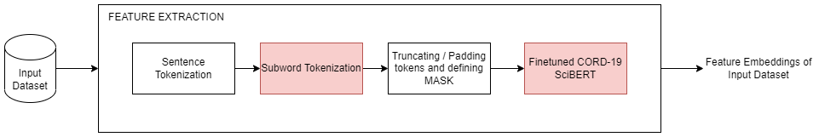
FEATURE EXTRACTION MODULE
Input : NER training and testing datasets (NCBI Disease, JNLPBA, CHEMDNER, CORD-19)
Output : Feature Embeddings of input dataset

Slide 16
FEATURE EXTRACTION MODULE
Initially the dataset is loaded with all the sentences and their corresponding NER tags.
Then the dataset is sentence tokenized.
Then each sentence is tokenized using the CORD-19 SciBERT tokenizer.
Then each sentence is padded / truncated and the corresponding attention mask is generated.
Then the sentence is passed to the CORD-19 SciBERT model and the final hidden state of 768 dimension is taken as features for NER.

Slide 17
FEATURE EXTRACTION MODULE
function FeatureExtraction(dataset):
data=dataset.load()
sentences,tags=sentence_tokenize(data)
embeddings=[]
for sentence in sentences:
tokens=scibert.tokenizer.tokenize(sentence)
tokens,mask=padOrTruncate(tokens,256)
embeddings.append(scibert(tokens,mask))
return embeddings

Slide 18
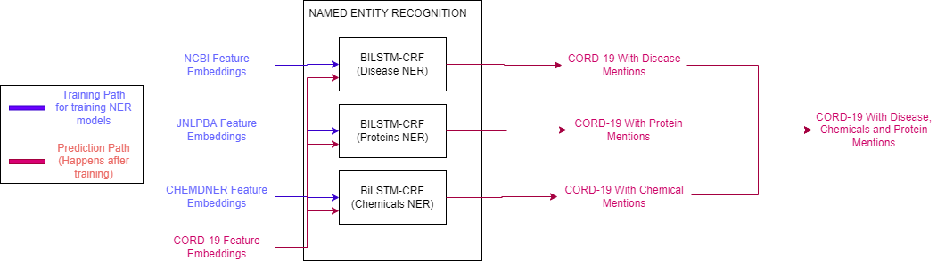
NAMED ENTITY RECOGNITION MODULE
Input : Feature Embeddings of Training and Testing dataset( NCBI-Disease, JNLPBA, CHEMDNER, CORD-19)
Output : CORD-19 with disease, chemical and protein mentions.

Slide 19
NAMED ENTITY RECOGNITION MODULE (TRAINING)
The sentence’s features are fed into the CORD-19 SciBERT model which will be used as embedding layer.
The output is then passed to the BiLSTM layer and is passed to the fully connected layer via Dropout layer.
Then the FC layer output is passed to the CRF layer, where the transition table is learned and the best possible tag sequence is generated.
CRF layer produces negative log likelihood which will be used as a loss function.

Slide 20
NAMED ENTITY RECOGNITION MODULE (TRAINING)
function NER_Training(dataset_sentence_features):
embeddings=cord_scibert(dataset_sentence_features)
lstm_out=biLSTM(embeddings)
drop_out=dropout(lstm_out)
linear_out=Linear(lstm_out,len(labels))
tag,loss=CRF(linear_out)
return tag,loss

Slide 21
NAMED ENTITY RECOGNITION MODULE (TESTING)
NCBI, CHEMDNER, JNLPBA sentences are training via three different BERT-BiLSTM-CRF models.
Then the CORD-19 sentences is passed into the 3 models and the disease, chemical, protein mentions in the dataset are obtained.
Then the mentions are combined and stored in the database for relation extraction.

Slide 22
NAMED ENTITY RECOGNITION MODULE (TESTING)
function NER_Testing(cord_dataset):
diseaseNER=NER_Training(ncbi)
chemicalNER=NER_Training(chemdner)
proteinNER=NER_Training(protein)
outputs=[]
for sent in cord_dataset:
output.append(diseaseNER(sent),chemicalNER(sent),proteinNER(sent))
return outputs

Slide 23
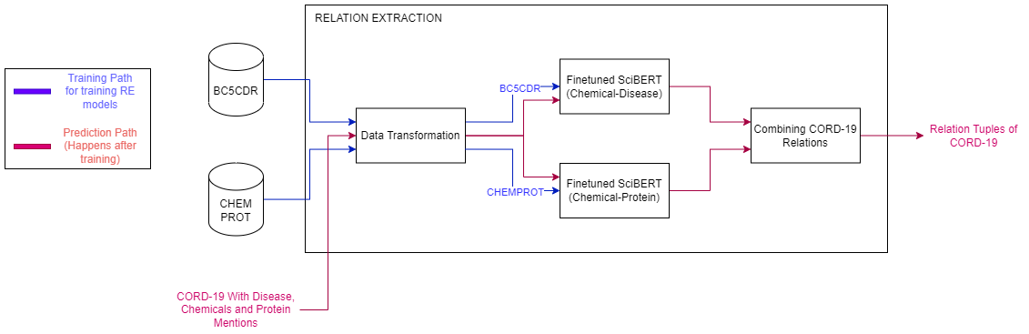
RELATION EXTRACTION MODULE
Input : BC5CDR, CHEMPROT, CORD-19 with entity mentions
Output : Relation tuples of CORD-19

Slide 24
RELATION EXTRACTION MODULE
The 2 datasets are preprocessed where the tokens are associated with its entities, and the sentences are processed as the first sentence contains the relation entities and the second sentence contains the text containing the relations.
The BC5CDR dataset is fed into the SciBERT model with fully connected layer which produces the positive/negative relations between Chemical and Disease.
The CHEMPROT datasets are fed into SciBERT model with fully connected layer and is fine-tuned to find one of 9 relations between Chemical and Protein.
The CORD-19 with entity mentions is fed into the two models and tuples are found.

Slide 25
RELATION EXTRACTION MODULE (TRAINING)
function RE(dataset, number_of_relations):
bert_model=bert(“SciBERT”)
for row in dataset:
text=dataTransformation(row)
features=featureExtraction(text)
pooled_output=bert_model(features)
loss=linear(pooled_output,number_of_relations)
loss.backwards()
return bert_model

Slide 26
RELATION EXTRACTION MODULE (TESTING)
function RE(cord_with_entities):
cid_re=Relation_Model(bc5cdr,len(dataset.relations))
cp_re=Relation_Model(chemprot,len(dataset.relations))
relations=[]
for sent,ent1,ent2 in cord_with_entities:
relations.append(cid_re(sent,ent1,ent2))
relations.append(cp_re(sent,ent1,ent2))
return relations

Slide 27
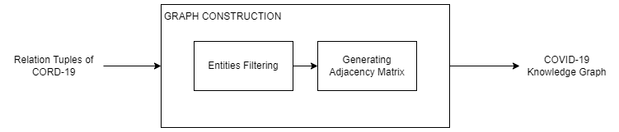
GRAPH CONSTRUCTION MODULE
Input : CORD-19 Relations along with their entities
Output : COVID-19 Knowledge Graph

Slide 28
GRAPH CONSTRUCTION MODULE
We construct a KG which is defined as KG = (E, R, G), where,
E: a set of nodes representing disease/ protein/ drug entities
R: a set of labels representing chemical-protein relation or chemical-disease relation
G ( E × R × E ) : a set of edges that represent facts connecting entity pairs.
Entities with no relations or in-degree less than N can be removed which helps with the density of the resultant knowledge graph.

Slide 29
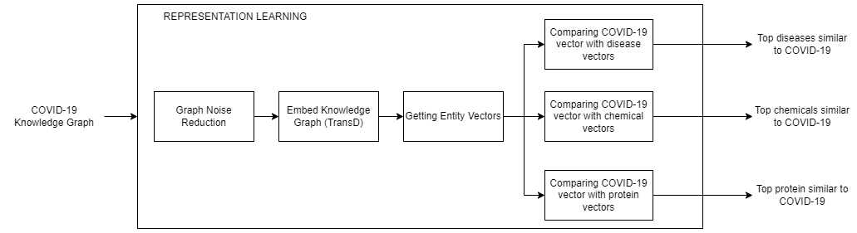
REPRESENTATION LEARNING MODULE
Input : COVID-19 Knowledge Graph
Output : Top Diseases, Chemicals, Proteins related to COVID-19

Slide 30
REPRESENTATION LEARNING MODULE
We reduce the noise by removing entities with less in-degree than N.
We embed the obtained graph using geometric method such as TransD.
As a result, we get the entity vectors of certain dimensions.
We get COVID-19 vector and compare entities with that to find whether they are similar or not.
Hence the top COVID-19 related entities as found as output.

Slide 31
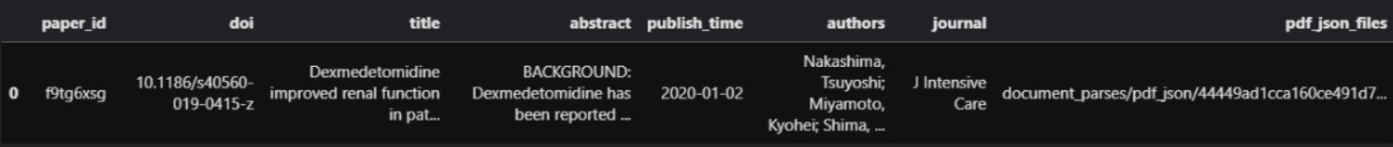
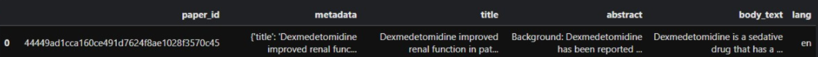
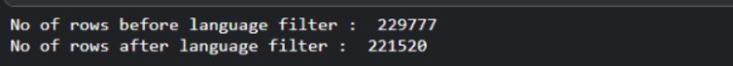
IMPLEMENTATION DETAILS - PREPROCESSING
Detect language and add it as a column
Remove the rows where language is not english

Slide 32
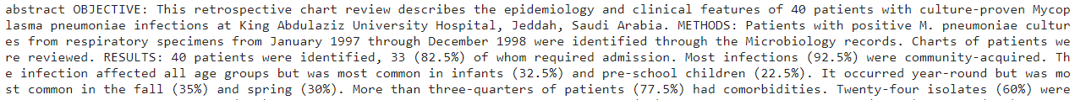
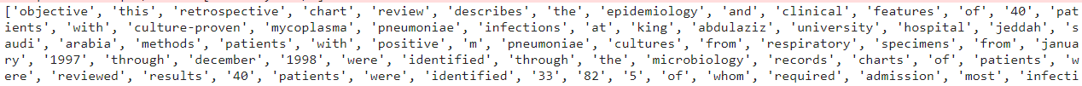
IMPLEMENTATION DETAILS - PREPROCESSING
Word tokenize the abstracts
Finding high occurrence words

Slide 33
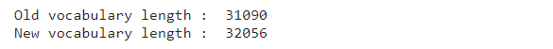
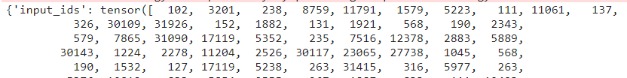
IMPLEMENTATION DETAILS - PREPROCESSING
Updating SciBERT Vocabulary
Some of the newly added vocabulary words are as follows, covid19, coronavirus-2, betacoronavirus, antivirals etc.,
Abstract is tokenized and is converted to ids

Slide 34

IMPLEMENTATION DETAILS - PREPROCESSING
SciBERT is fine tuned using Masked Language Modeling (MLM).
The input tokens are masked with a probability of 15%.
The model produces the softmax activated output of all token words.
Then the softmax output is compared with the one-hot encoded value of the original word and the model is trained.

Slide 35
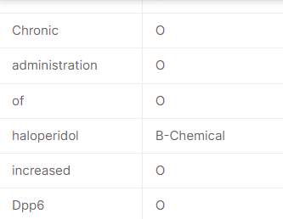
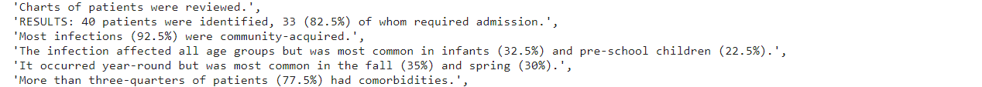
IMPLEMENTATION DETAILS - FEATURE EXTRACTION
Loading the dataset
The dataset is sentence tokenized
All sentences are subword tokenized

Slide 36
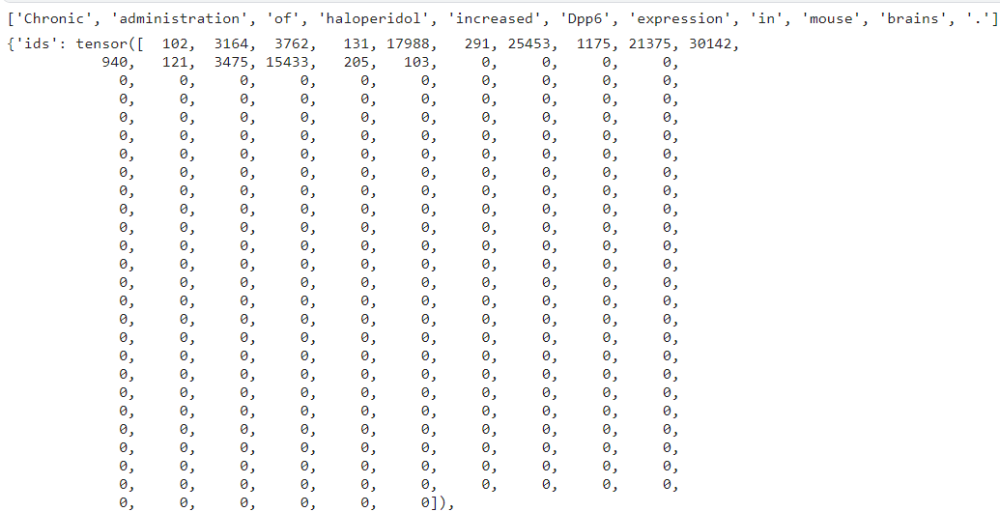
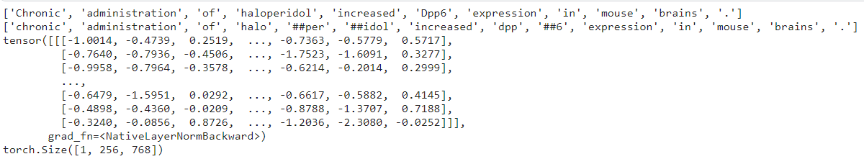
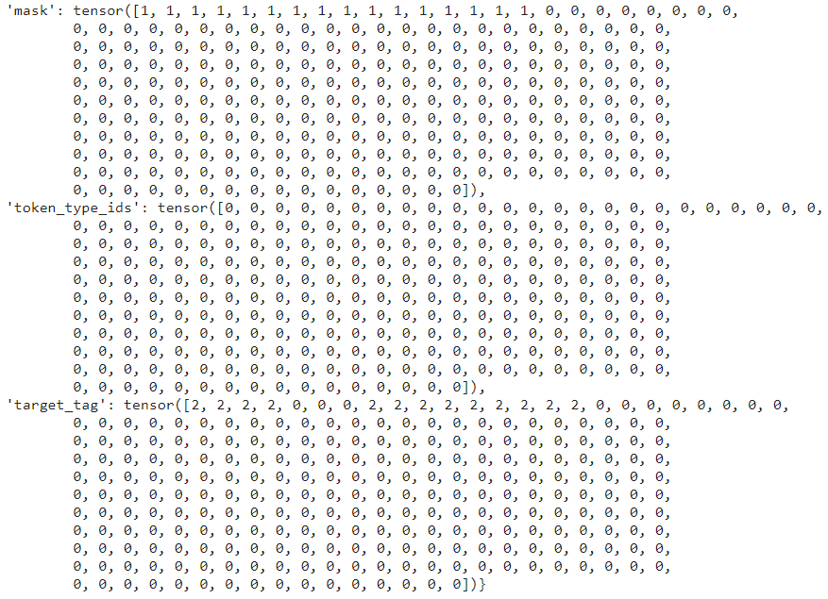
IMPLEMENTATION DETAILS - FEATURE EXTRACTION
Then the sentence is padded or truncated and input ids is generated.
The mask is generated based on the padding tokens and original tokens. The labels are also encoded into integers. Then it passed to SciBERT to get features.

Slide 37
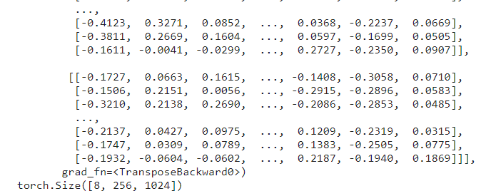
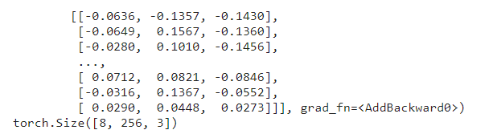
IMPLEMENTATION DETAILS - NER (TRAINING)
def forward(self, ids, mask, token_type_ids, target_tag):
x,_=self.bert(ids,attention_mask=mask,token_type_ids=token_type_ids)
h, _ = self.bilstm(x)
o_tag = self.dropout_tag(h)
tag = self.hidden2tag_tag(o_tag)
mask = torch.where(mask==1, True, False)
loss_tag=-self.crf_tag(tag,target_tag,mask=mask,reduction='token_mean')
loss=loss_tag
return loss
i. BERT Layer Output Shape (batch_size,seq_length,hidden_size)
ii. BiLSTM Layer Output Shape (batch_size,seq_length,output_size)
iii. FC Layer Output Shape (batch_size,seq_length,label_types)
iv. CRF Layer (Negative Log-Likelihood Loss - Negated)

Slide 38
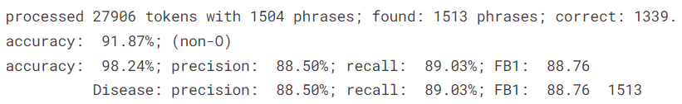
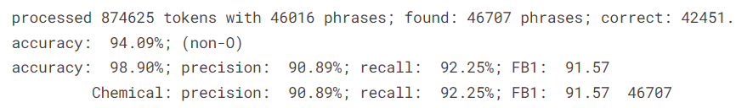
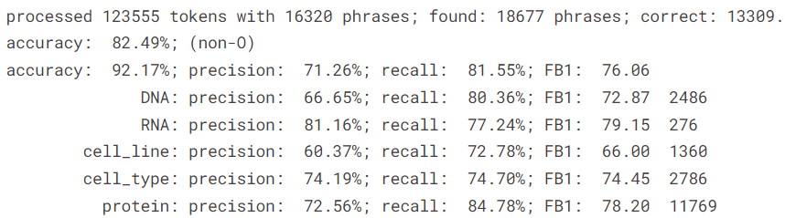
IMPLEMENTATION DETAILS - NER (TRAINING)
v. SGD Optimizer is used
NCBI Disease
CHEMDNER
Model | Labels | Epochs | Batch Size | Seq Length
Disease NER | 3 | 10 | 16 | 256
Chemical NER | 3 | 6 | 16 | 256
Protein NER | 11 | 4 | 16 | 256
JNLPBA

Slide 39
IMPLEMENTATION DETAILS - RE (TRAINING)
def forward(self, ids, mask, token_type_ids, target_tag):
out,_=self.bert(ids,attention_mask=mask,token_type_ids=token_type_ids) ` output = self.dropout_tag(out.pooled_output)
tag, loss = self.linear(output)
return tag,loss
i. Get Entities from Dataset
ii. Get Relations from Dataset and label encoded

Slide 40
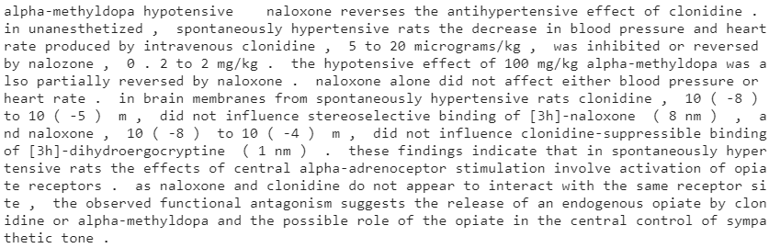

IMPLEMENTATION DETAILS - RE (TRAINING)
iii. Forming Sentences for text classification (Entities in sentence 1+”\t”+text)
iv. Get BERT Features from the above sentence

Slide 41
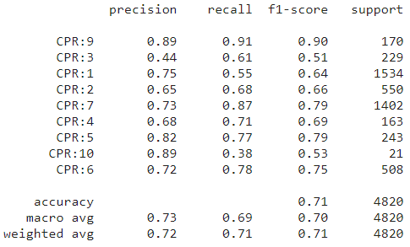
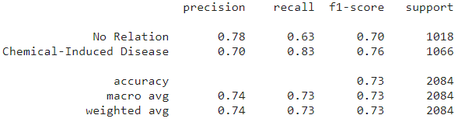
IMPLEMENTATION DETAILS - RE (TRAINING)
v. Hyperparameters
Model | Relation Types | Seq Length | Epoch
Chemical-Disease RE | 2 | 512 | 3
Chemical-Protein RE | 9 | 512 | 4
vi. CHEMPROT Evaluation
vi. BC5CDR Evaluation

Slide 42
DATASET
CORD-19 - 500,000 articles related to COVID-19. With over 200,000 full text articles.
NCBI-DISEASE - Text Corpus with annotated 6,892 disease mentions of over 793 Abstracts.
CHEMDNER - Text Corpus with annotated 84,355 chemical mentions of 10,000 Abstracts.

Slide 43
DATASET
JNLPBA - Text Corpus with annotated protein mentions of over 2,000 abstracts.
BC5CDR - Text Corpus with annotated 3116 chemical-disease interactions.
CHEMPROT - Text Corpus with annotated drug-protein relations of over 1,820 PubMed abstracts

Slide 44

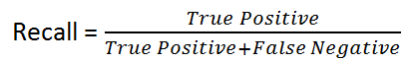

METRICS FOR EVALUATION
Named Entity Recognition and Relation Extraction are classification problems.
So Confusion Matrix can be built.
Hence Precision, Recall, F1-Score measures can be used.

Slide 45
METRICS FOR EVALUATION
Model | Precision | Recall | F1 | Accuracy
Disease NER | 88.49 | 89.02 | 88.76 | 91.87
Protein NER | 71.25 | 81.5 | 76.06 | 82.49
Chemical NER | 90.88 | 92.25 | 91.56 | 94.09
Chemical-Disease RE | 74 | 73 | 73 | 73
Chemical-Protein RE | 72 | 71 | 71 | 71

Slide 46
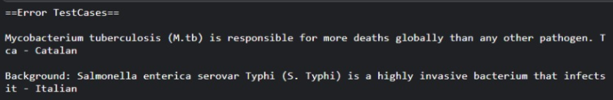
TEST CASES
EXPECTED OUTPUT | ACTUAL OUTPUT
Expect only non-english rows to be removed
Expect Similarity between “coronavirus” and “computer” to be 0.19833344 | 0.6503298

Slide 47
TEST CASES
EXPECTED OUTPUT | ACTUAL OUTPUT
Expect entity “OTFs” to be predicted as Protein in The degeneracy in sequences recognized by the OTFs may be important in widening the range over which gene expression can be modulated and in establishing cell type specificity. | DNA
Expect entity “[ 125I ] T3” to be predicted as Protein in In whole cell experiments at 37 degrees C , nuclear binding of [ 125I ] T3 was saturable ( Kd 34 +/- 6 pmol/l ) and of finite capacity ( approximately equal to 350 sites/cell ). | O
Expect to detect “Multiple B lineage genes” as DNA in Multiple b lineage genes | B lineage genes as “DNA”
Expect to detect “B-cell derived NF-Y A : B : C complex” as Protein in Recombination of the MPC11 plasma B-cell derived NF-Y A : B : C complex with the low molecular mass protein fraction , NF-Y-associated factors ( YAFs ), derived from mature A20 B-cell nuclei , conferred high affinity anion exchange binding to NF-Y as an intact trimeric complex. | NF-Y A : B : C complex as “Protein”

Slide 48
TEST CASES
EXPECTED OUTPUT | ACTUAL OUTPUT
Expect Relation between “ssc” and “corticosteroids” in late-onset scleroderma renal crisis induced by tacrolimus and prednisolone : a case report . scleroderma renal crisis ( src ) is a rare complication of systemic sclerosis ( ssc ) but can be severe enough to require temporary or permanent renal replacement therapy . moderate to high dose corticosteroid use is recognized as a major risk factor for src . furthermore , there have been reports of thrombotic microangiopathy precipitated by cyclosporine in patients with ssc . in this article , we report a patient with src induced by tacrolimus and corticosteroids . the aim of this work is to call attention to the risk of tacrolimus use in patients with ssc . | No relation
Expect no relation between “src” and “cyclosporine” in late-onset scleroderma renal crisis induced by tacrolimus and prednisolone : a case report . scleroderma renal crisis ( src ) is a rare complication of systemic sclerosis ( ssc ) but can be severe enough to require temporary or permanent renal replacement therapy . moderate to high dose corticosteroid use is recognized as a major risk factor for src . furthermore , there have been reports of thrombotic microangiopathy precipitated by cyclosporine in patients with ssc . in this article , we report a patient with src induced by tacrolimus and corticosteroids . the aim of this work is to call attention to the risk of tacrolimus use in patients with ssc . | Positive Relation

Slide 49
REFERENCES
Ayoub Harnoune, Maryem Rhanoui, Mounia Mikram, Siham Yousfi, Zineb Elkaimbillah, Bouchra El Asri, BERT based clinical knowledge extraction for biomedical knowledge graph construction and analysis, Computer Methods and Programs in Biomedicine Update, Volume 1, 2021, 100042,ISSN2666-9900, https://doi.org/10.1016/j.cmpbup.2021.100042.
Minsoo Cho, Jihwan Ha, Chihyun Park, Sanghyun Park, Combinatorial feature embedding based on CNN and LSTM for biomedical named entity recognition, Journal of Biomedical Informatics, Volume 103, 2020, 103381, ISSN 1532-0464, https://doi.org/10.1016/j.jbi.2020.103381.
Perera, N., Dehmer, M., & Emmert-Streib, F. (2020). Named Entity Recognition and Relation Detection for Biomedical Information Extraction. Frontiers in cell and developmental biology, 8, 673. https://doi.org/10.3389/fcell.2020.00673
Daniel Domingo-Fernandez, Shounak Baksi, Bruce´ Schultz, Yojana Gadiya, Reagon Karki, Tamara Raschka, Christian Ebeling, Martin Hofmann Apitius, and Alpha Tom Kodamullil. 2020. Covid19 knowledge graph: a computable, multimodal, cause-and-effect knowledge model of covid-19 pathophysiology. bioRxiv.

Slide 50
REFERENCES
Kim, T.; Yun, Y.; Kim, N. Deep Learning-Based Knowledge Graph Generation for COVID-19. Sustainability 2021, 13, 2276. https://doi.org/10.3390/su13042276.
Zheng, S., Rao, J., Song, Y., Zhang, J., Xiao, X., Fang, E., Yang, Y. and Niu, Z., 2020. PharmKG: a dedicated knowledge graph benchmark for biomedical data mining. Briefings in Bioinformatics,.
Repke T., Krestel R. (2021) Extraction and Representation of Financial Entities from Text. In: Consoli S., Reforgiato Recupero D., Saisana M. (eds) Data Science for Economics and Finance. Springer, Cham.
Kim, T.; Yun, Y.; Kim, N. Deep Learning-Based Knowledge Graph Generation for COVID-19. Sustainability 2021, 13, 2276. https://doi.org/10.3390/su13042276
W. E. Zhang and Q. Nguyen, "Constructing COVID-19 Knowledge Graph from A Large Corpus of Scientific Articles," 2021 IEEE International Conference on Big Knowledge (ICBK), 2021, pp. 237-244, doi: 10.1109/ICKG52313.2021.00040.
Minsoo Cho, Jihwan Ha, Chihyun Park, Sanghyun Park, Combinatorial feature embedding based on CNN and LSTM for biomedical named entity recognition, Journal of Biomedical Informatics, Volume 103, 2020, 103381, ISSN 1532-0464, https://doi.org/10.1016/j.jbi.2020.103381.

