Slide 1
Extraction of Knowledge Graph of COVID-19 through mining of unstructured biomedical corpora
GUIDED BY
TEAM MEMBERS
Dr. G. Sudhakaran
Athiban T - 2018103013
Prathesh N - 2018103576
Syed Mohammed Asif M - 2018103612

Slide 2
OVERALL OBJECTIVE
To extract information from CORD-19 in a fully autonomous way using NLP techniques.
To gather named entities such as diseases, proteins, chemicals from the CORD-19 dataset.
To extract relations between entities (i.e., chemical-induced-disease relations, chemical-protein interactions) from the CORD-19 dataset.
To organize the found entities and relations in the form of Knowledge Graph.
To embed the Knowledge Graph to find entity vectors.

Slide 3
INTRODUCTION
COVID-19 is a global epidemic with a considerable fatality rate and a high transmission rate, affecting millions of people worldwide since its outbreak.
The search for treatments and possible cures for the novel Coronavirus has led to an exponential increase in scientific publications.
Scientific publications regarding COVID-19 contains various data about related diseases, proteins, chemicals and so on.
The data in such publications are vastly unstructured. These publications are gathered under the CORD-19 dataset.
Our project focuses on extracting useful information from unstructured raw text.

Slide 4
LITERATURE SURVEY
Paper Title, Authors, Year, Journal name, Vol, Issue & PP | Methodology / Algorithm used | Issues / Gaps/ Limitations
Kim, T.; Yun, Y.; Kim, N. Deep Learning-Based Knowledge Graph Generation for COVID-19. Sustainability 2021, 13, 2276. https://doi.org/10.3390/su13042276 | Finding entity dictionary related to COVID-19 and extracting relations from corpus | Results can vary massively based on the unsupervised model used.
Domingo-Fernández, D., Baksi, S., Schultz, B., COVID-19 Knowledge Graph: a computable, multimodal, cause-and-effect knowledge model of COVID-19 pathophysiology. | Evidence text from the prioritized corpus was manually encoded as as a triple. (source-relation- target) | Small Knowledge Graph is obtained. Manual Annotations are time-consuming.
Peng, Y., Wei, CH. & Lu, Z. Improving chemical disease relation extraction with rich features and weakly labeled data. J Cheminform 8, 53 (2016). https://doi.org/10.1186/s13321-016-0165-z | Extract Biomedical relations using statistical features. | Manual curation of features needed to find the required relations.

Slide 5
LITERATURE SURVEY
Paper Title, Authors, Year, Journal name, Vol, Issue & PP | Methodology / Algorithm used | Issues / Gaps/ Limitations
W. E. Zhang and Q. Nguyen, "Constructing COVID-19 Knowledge Graph from A Large Corpus of Scientific Articles," 2021 IEEE International Conference on Big Knowledge (ICBK), 2021, pp. 237-244, doi: 10.1109/ICKG52313.2021.00040. | Rule based relation and entity extraction from MEDLINE COVID-19 related articles. | Supervision is required for setting the rules to find the entities that we need.
Kim, T.; Yun, Y.; Kim, N. Deep Learning-Based Knowledge Graph Generation for COVID-19. Sustainability 2021, 13, 2276. https://doi.org/10.3390/su13042276 | Finding entity dictionary related to COVID-19 and extracting relations from corpus | Results can vary massively based on the unsupervised model used.
Repke T., Krestel R. (2021) Extraction and Representation of Financial Entities from Text. In: Consoli S., Reforgiato Recupero D., Saisana M. (eds) Data Science for Economics and Finance. Springer, Cham. | Extract Knowledge Graph From Financial text corpus using NER and RE tasks. | Lack of Gold Standard Corpus for result evaluation.

Slide 6
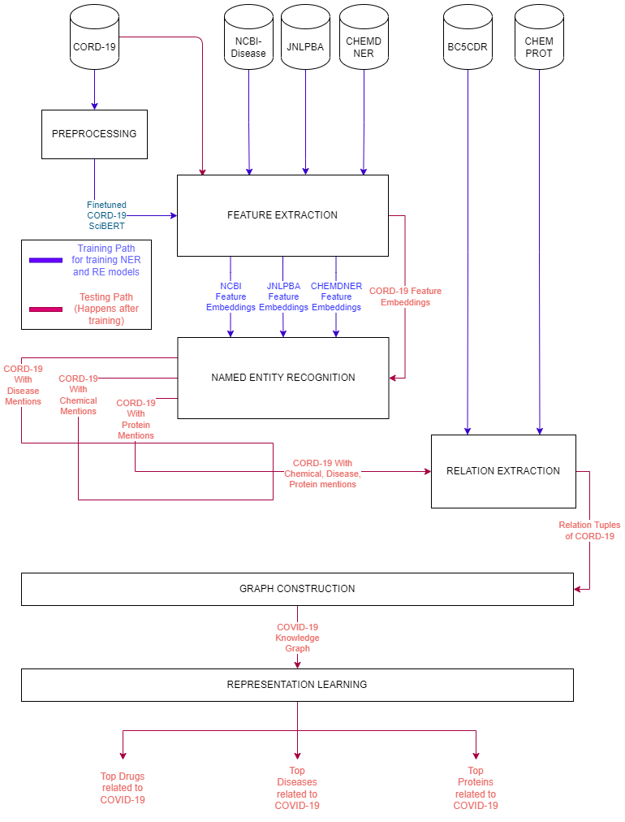
ARCHITECTURE DIAGRAM

Slide 7
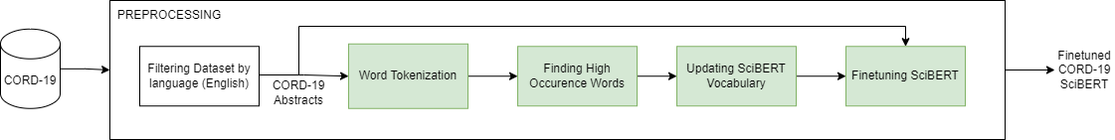
PREPROCESSING MODULE
Input : CORD-19 Dataset
Output : Fine tuned CORD-19 SciBERT

Slide 8
PREPROCESSING MODULE
function Preprocessing:
dataset=read(cord-19)
dataset=dataset.where(language==”english”)
abstracts=dataset.abstracts
words=word_tokenize(abstracts)
counter=Counter(words)
for word in words:
if counter(word)>450:
scibert.add_word(word)
return scibert.train(abstracts,epochs=5)

Slide 9
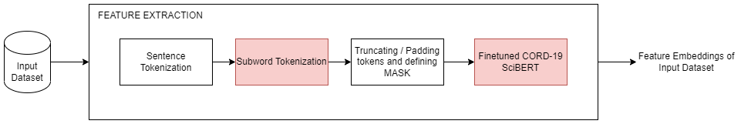
FEATURE EXTRACTION MODULE
Input : NER training and testing datasets (NCBI Disease, JNLPBA, CHEMDNER, CORD-19)
Output : Feature Embeddings of input dataset

Slide 10
FEATURE EXTRACTION MODULE
Initially the dataset is loaded with all the sentences and their corresponding NER tags.
Then the dataset is sentence tokenized.
Then each sentence is tokenized using the CORD-19 SciBERT tokenizer.
Then each sentence is padded / truncated and the corresponding attention mask is generated.
Then the sentence is passed to the CORD-19 SciBERT model and the final hidden state of 768 dimension is taken as features for NER.

Slide 11
FEATURE EXTRACTION MODULE
function FeatureExtraction(dataset):
data=dataset.load()
sentences,tags=sentence_tokenize(data)
embeddings=[]
for sentence in sentences:
tokens=scibert.tokenizer.tokenize(sentence)
tokens,mask=padOrTruncate(tokens,256)
embeddings.append(scibert(tokens,mask))
return embeddings

Slide 12
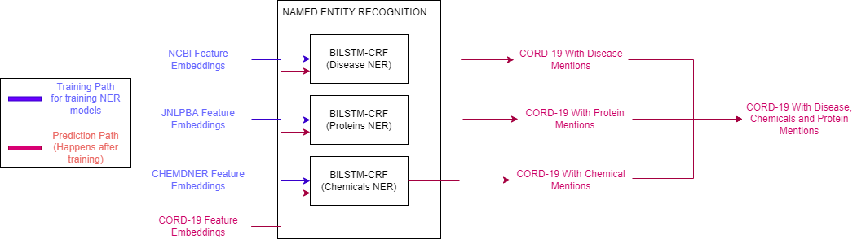
NAMED ENTITY RECOGNITION MODULE
Input : Feature Embeddings of Training and Testing dataset( NCBI-Disease, JNLPBA, CHEMDNER, CORD-19)
Output : CORD-19 with disease, chemical and protein mentions.

Slide 13
NAMED ENTITY RECOGNITION MODULE
The sentence’s features are fed into the CORD-19 SciBERT model which will be used as embedding layer.
The output is then passed to the BiLSTM layer and is passed to the fully connected layer via Dropout layer.
Then the FC layer output is passed to the CRF layer, where the transition table is learned and the best possible tag sequence is generated. CRF layer produces negative log likelihood which will be used as a loss function.
NCBI, CHEMDNER, JNLPBA sentences are training via three different BERT-BiLSTM-CRF models.
Then the CORD-19 sentences is passed into the 3 models and the disease, chemical, protein mentions in the dataset are obtained.
Then the mentions are combined and stored in the database for relation extraction.

Slide 14
NAMED ENTITY RECOGNITION MODULE
function NER_Tr(dataset_sentence_features):
embeddings=cord_scibert(dataset_
sentence_features)
lstm_out=biLSTM(embeddings)
drop_out=dropout(lstm_out)
linear_out=Linear(lstm_out,
len(labels))
tag,loss=CRF(linear_out)
return tag,loss
function NER_Te(cord_dataset):
diseaseNER=NER_Tr(ncbi)
chemicalNER=NER_Tr(chemdner)
proteinNER=NER_Tr(protein)
outputs=[]
for sent in cord_dataset:
output.append(
diseaseNER(sent),
chemicalNER(sent),
proteinNER(sent)
)
return outputs

Slide 15
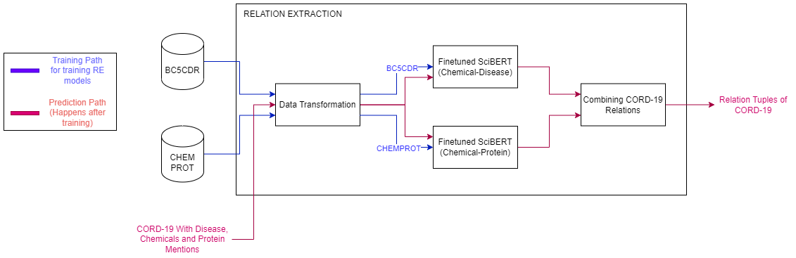
RELATION EXTRACTION MODULE
Input : BC5CDR, CHEMPROT, CORD-19 with entity mentions
Output : Relation tuples of CORD-19

Slide 16
RELATION EXTRACTION MODULE
The 2 datasets are preprocessed where the tokens are associated with its entities, and the sentences are processed as the first sentence contains the relation entities and the second sentence contains the text containing the relations.
The BC5CDR dataset is fed into the SciBERT model with fully connected layer which produces the positive/negative relations between Chemical and Disease.
The CHEMPROT datasets are fed into SciBERT model with fully connected layer and is fine-tuned to find one of 9 relations between Chemical and Protein.
The CORD-19 with entity mentions is fed into the two models and tuples are found.

Slide 17
RELATION EXTRACTION MODULE
function RE_Tr(dataset, number_of_relations):
bert_model=bert(“SciBERT”)
for row in dataset:
text=dataTransformation(row)
features=featureExtraction(text)
pooled_output=bert_model(features)
loss=linear(pooled_output,
number_of_relations)
loss.backwards()
return bert_model
function RE_Te(cord_with_ent):
cid_re=RE_Tr(bc5cdr,
len(bc5cdr.relations))
cpr_re=RE_Tr(chemprot,
len(chemprot.relations))
relations=[]
for sent,ent1,ent2 in cord_with_ent:
relations.append(cid_re(sent,ent1
,ent2))
relations.append(cpr_re(sent,ent1,
ent2))
return relations

Slide 18
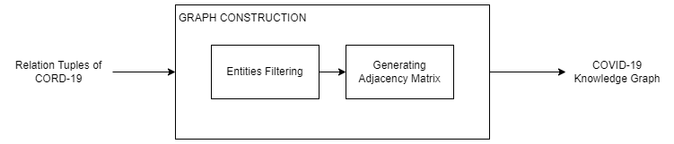
GRAPH CONSTRUCTION MODULE
Input : CORD-19 Relations along with their entities
Output : COVID-19 Knowledge Graph

Slide 19
GRAPH CONSTRUCTION MODULE
We construct a KG which is defined as KG = (E, R, G), where,
E: a set of nodes representing disease/ protein/ drug entities
R: a set of labels representing chemical-protein relation or chemical-disease relation
G ( E × R × E ) : a set of edges that represent facts connecting entity pairs.
Entities with no relations or in-degree less than 5 can be removed which helps with the density of the resultant knowledge graph.
The knowledge graph is stored in Neo4j graph database.

Slide 20
GRAPH CONSTRUCTION MODULE
function GraphConstruction(relations):
counter= Counter(relations[“entity1”],relations[“entity2”]
final_relations=relations[counter[“entity1”]>5 or counter[“entity2”]>5]
for relation in final_relations:
database.add_node(relation[“entity1”])
database.add_node(relation[“entity2”])
database.add_edge(relation[“entity1”],relation[“entity2”])
return database

Slide 21
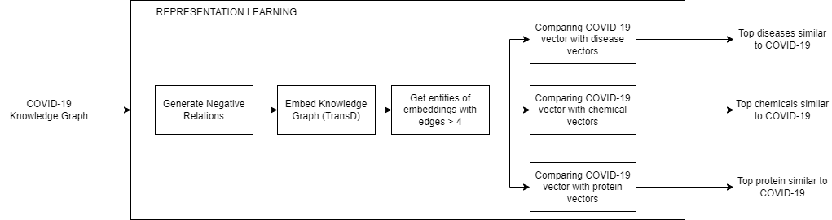
REPRESENTATION LEARNING MODULE
Input : COVID-19 Knowledge Graph
Output : Top Diseases, Chemicals, Proteins related to COVID-19

Slide 22
REPRESENTATION LEARNING MODULE
We get the Knowledge Graph in the form of table.
We generate negative relations by taking random entities from the KG.
We Embed the KG by training the TransD model on the Knowledge Graph’s positive and negative relations.
We get the embeddings of entities with edges greater than or equal to 5.
We compare the embeddings with the embeddings of coronavirus using cosine similarity
We take the top 25 entities based on the similarity scores for each entity type.

Slide 23
REPRESENTATION LEARNING MODULE
function RepresentationLearning(kg_relations):
neg_relations=get_random_entities(kg_relations)
model=TransD(kg_relations,neg_relations)
embeddings=model[“entities_weight”]
for ent in kg_relations[“entities”]:
filtered_embeddings.append(embeddings[ent] if count[ent] >= 5)
scores=find_scores(filtered_embeddings,embeddings[“coronavirus”])
return sorted(scores)[:25]

Slide 24
DATASET
CORD-19 - 500,000 articles related to COVID-19. With over 200,000 full text articles.
NCBI-DISEASE - Text Corpus with annotated 6,892 disease mentions of 793 Abstracts.
CHEMDNER - Text Corpus with annotated 84,355 chemical mentions of 10,000 Abstracts.
JNLPBA - Text Corpus with annotated protein mentions of over 2,000 abstracts.
BC5CDR - Text Corpus with annotated 3116 chemical-disease interactions.
CHEMPROT - Text Corpus with annotated drug-protein relations of 1,820 PubMed abstracts

Slide 25

IMPLEMENTATION DETAILS - PREPROCESSING
Detect language and add it as a column to CORD-19 dataset.
Remove the rows where language is not English.
Get the abstracts from dataset and word tokenize them.
Find the words with the high occurrence count and add it to the SciBERT vocabulary.
Some of the newly added vocabulary words are as follows, covid19, coronavirus-2, betacoronavirus, antivirals etc.,
SciBERT is fine tuned using Masked Language Modeling (MLM).

Slide 26
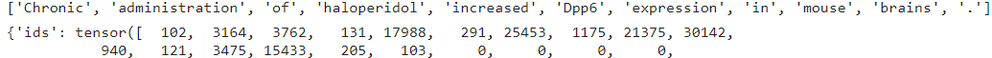
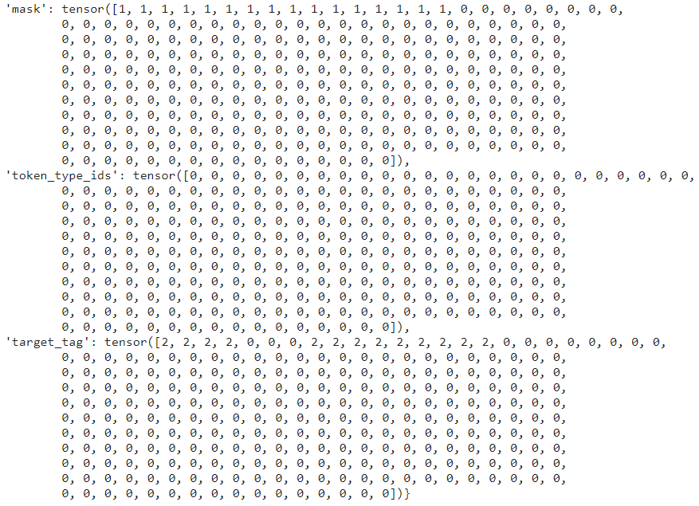
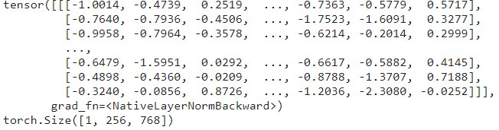
IMPLEMENTATION DETAILS - FEATURE EXTRACTION
The dataset is loaded and is sentence tokenized.
Then individual sentences are subword tokenized using SciBERT tokenizer.
Then the sentence is padded or truncated and input ids is generated.
The mask is generated based on the padding tokens. The labels are also encoded into integers. They are passed to SciBERT to get features.

Slide 27
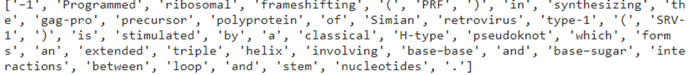
IMPLEMENTATION DETAILS - NER
BERT-BiLSTM-CRF model is trained using 3 datasets to get 3 NER models.
CORD-19 dataset title, abstract and full text are combined and is sentence and word tokenized.
The output is passed to the 3 NER models to detect diseases, chemicals and proteins respectively.
Entity Type | Total # | Unique #
Disease | 1,00,441 | 17,672
Chemical | 66,212 | 7,841
Protein | 3,66,963 | 1,29,972
Model | Labels | Epochs | Batch Size | Seq Length
NCBI Disease | 3 | 10 | 16 | 256
CHEMDNER | 3 | 6 | 16 | 256
JNLPBA | 11 | 4 | 16 | 256

Slide 28
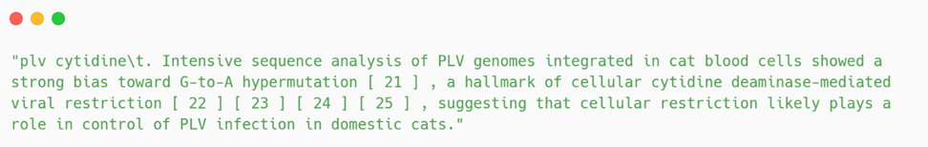
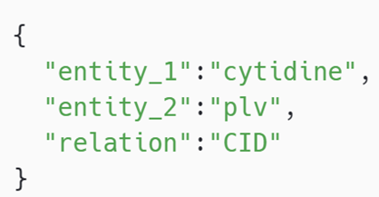
IMPLEMENTATION DETAILS - RE
Get entities, relations for each sentence from dataset.
Forming Sentences for text classification (Entities in sentence + ”\t” + text)
Get input ids, mask for the sentence and finetune the SciBERT model.
2 Relation datasets are used to finetune 2 SciBERT models.
CORD-19 sentence with more than one type of entity is converted into “entity1 entity2\t. text” and is fed into appropriate model to find relations.
Relation Type | Total # | Unique #
CID | 5,425 | 4,071
CPR | 87,794 | 72,891
Dataset | Relation Types | Seq Length | Epoch
BC5CDR | 2 | 512 | 3
CHEMPROT | 9 | 512 | 4

Slide 29
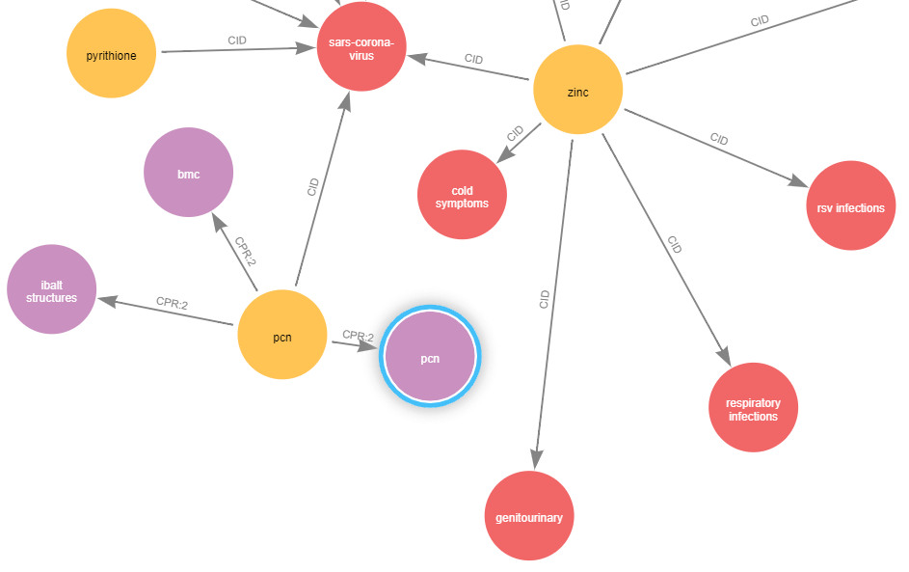
IMPLEMENTATION DETAILS - GRAPH CONSTRUCTION
Initially, the relation with either entities not occurring more than 5 times are removed.
Then from the final relations the Knowledge graph is constructed and is stored in the Neo4j Database.
RED | Disease
ORANGE | Chemical
PURPLE | Protein

Slide 30
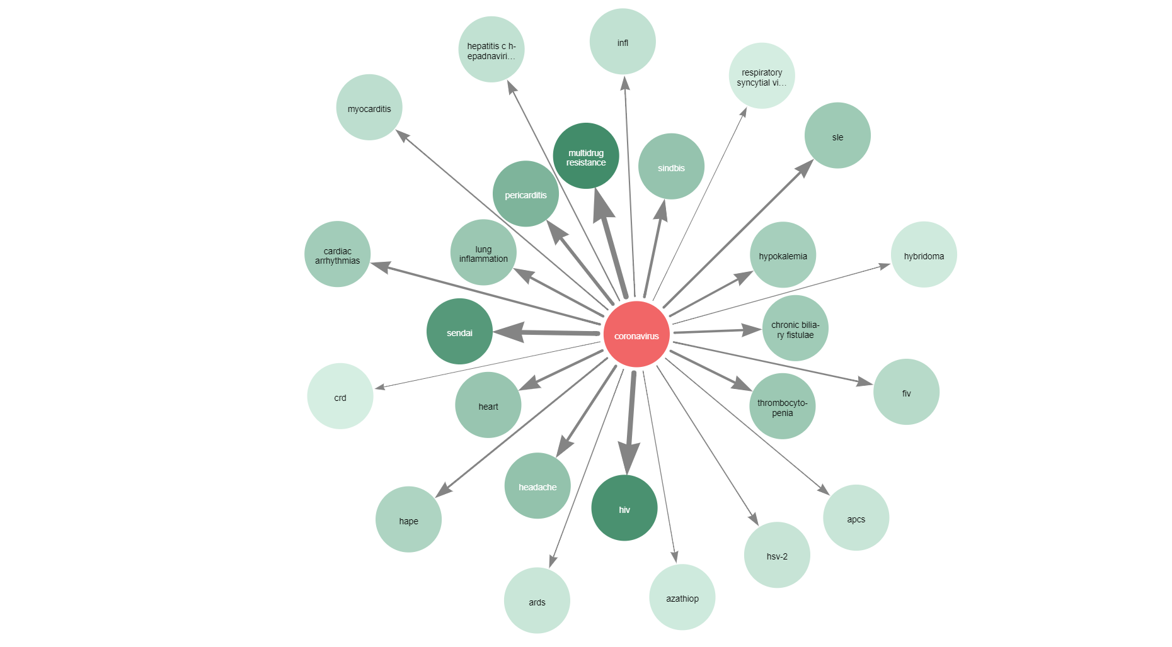
IMPLEMENTATION DETAILS - REPRESENTATION LEARNING
TOP DISEASES
TransD method is trained to embed the Knowledge Graph.
Then the embeddings of entities which has more than 4 edges are taken.
Then these embeddings are compared with the embedding score of coronavirus to get the top 25 entities related to COVID-19.
In the graphs, Darker colour and thicker arrow indicates strong relationship.
Red coloured node is coronavirus.

Slide 31
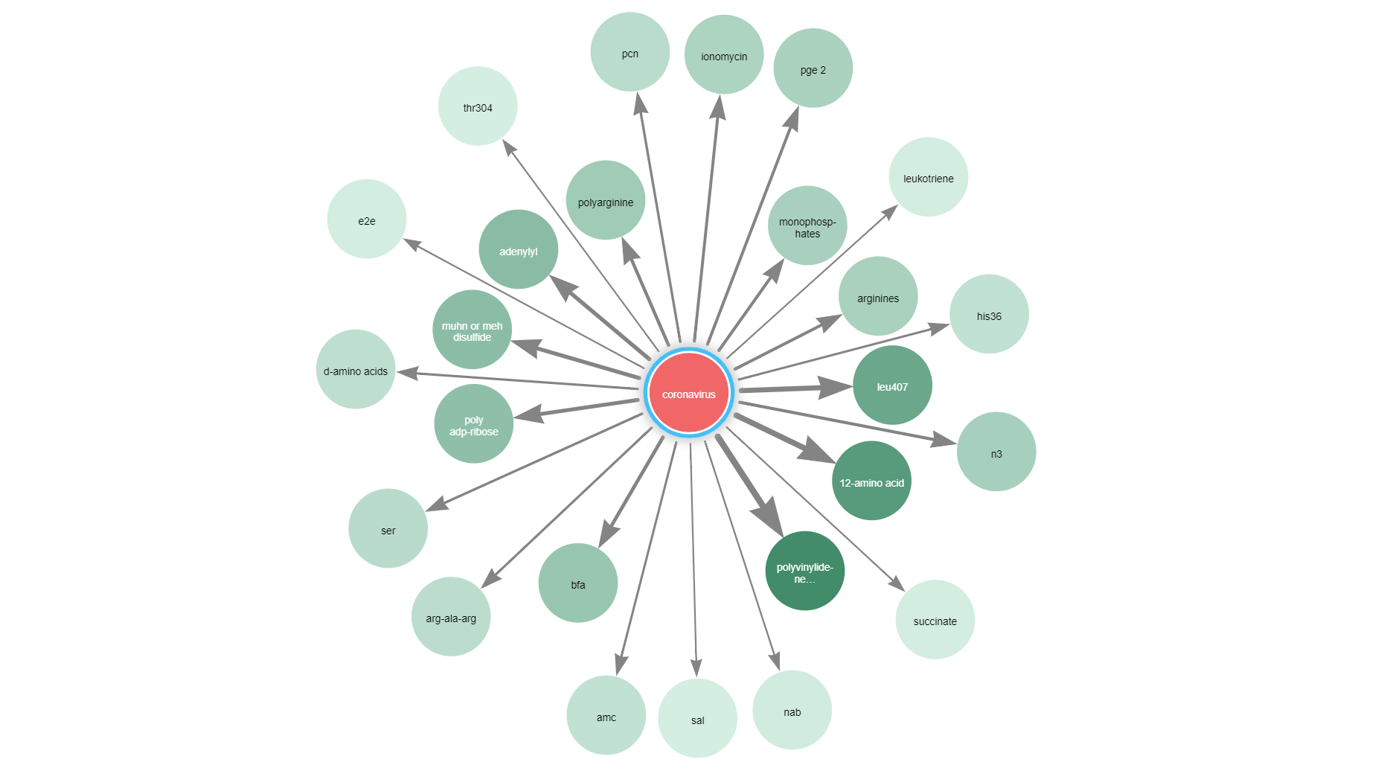
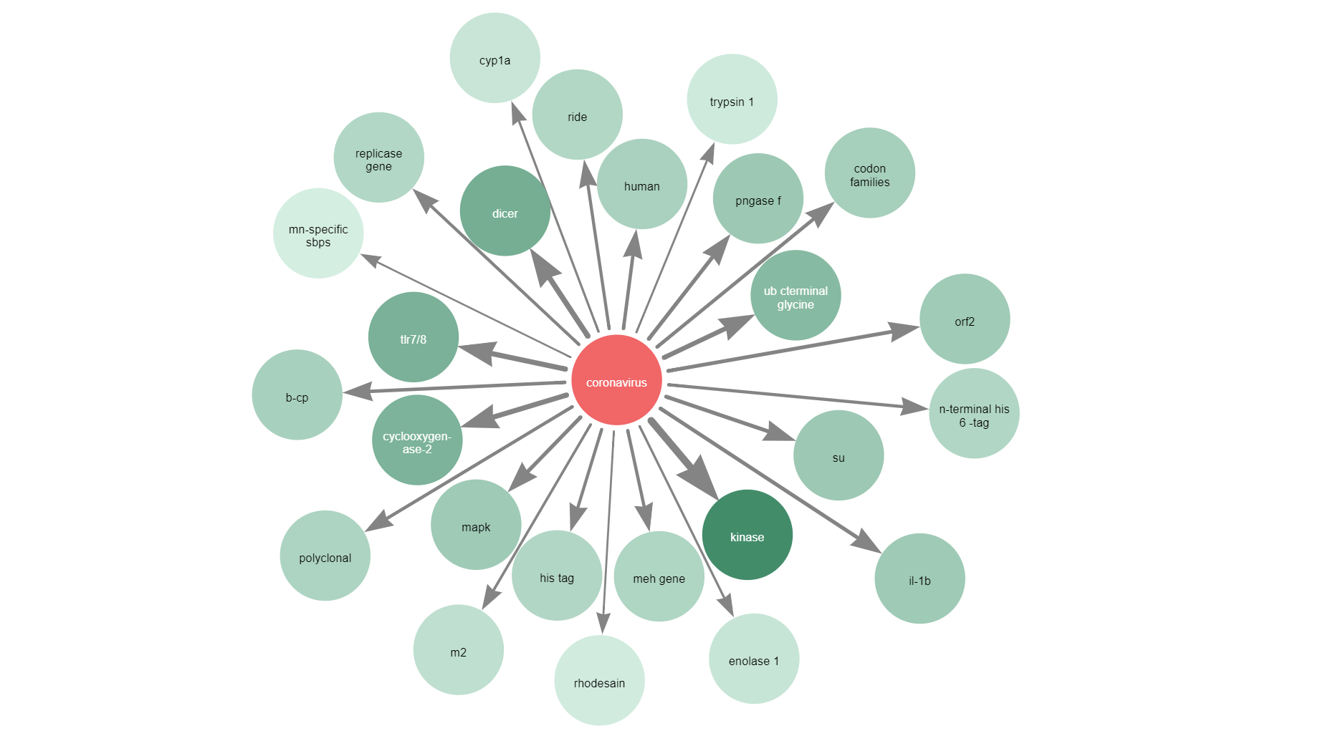
TOP CHEMICALS
TOP PROTEINS

Slide 32
PERFORMANCE METRICS - NER
BERT-BiLSTM-CRF model is evaluated here.
Precision : Percentage of named entities found by the algorithm that are correct.
Recall : Percentage of named entities defined in the corpus that were found.
F1 : 2 * Precision * Recall / (Recall + Precision)
Dataset | Precision | Recall | F1
NCBI-Disease | 88.49 | 89.02 | 88.76
JNLPBA | 71.25 | 81.5 | 76.06
CHEMDNER | 90.88 | 92.25 | 91.56

Slide 33
PERFORMANCE METRICS - RE
SciBERT model is evaluated here.
Precision : TP / (TP + FP)
Recall : TP / (TP + FN)
F1 : 2 * Precision * Recall / (Recall + Precision)
TP = True Positive, FP = False Positive, FN = False Negative
Dataset | Precision | Recall | F1
BC5CDR | 74.00 | 73.00 | 73.00
CHEMPROT | 72.00 | 71.00 | 71.00
Due to lack of gold standard data for CORD-19 dataset, the performance of the Relation Extraction module is taken as the Performance of the System

Slide 34
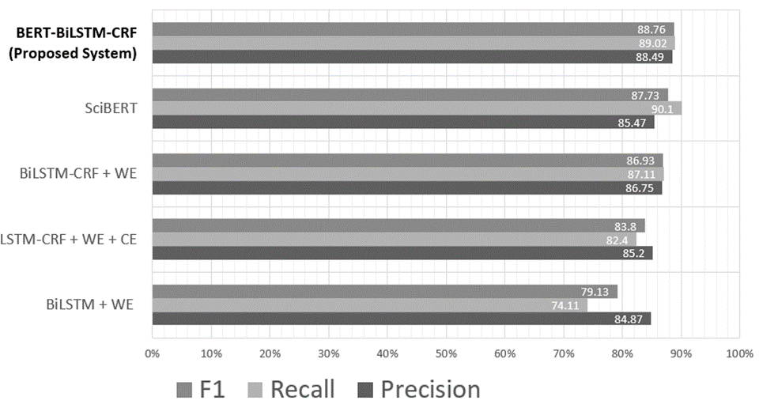
COMPARATIVE ANALYSIS - NER

Slide 35
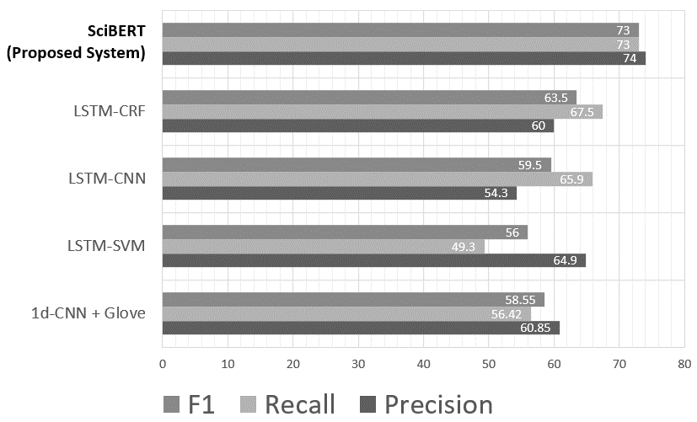
COMPARATIVE ANALYSIS - RE

Slide 36
TEST CASES
Test Case | Input | Expected Output | Actual Output
Only non-English rows from CORD-19 to be removed. (Preprocessing) | Mycobacterium tuberculosis (M.tb) is responsible for more deaths globally. | Should not be removed | Removed
Similarity between unrelated entities to be smaller. (Feature Extraction) | “coronavirus” BERT embedding “computer” BERT embedding | <0.4 | 0.65
Finding highly COVID-19 related entities from Knowledge Graph (Representation Learning) | Extracted Complete Knowledge Graph | Only diseases, chemicals and proteins. | “heart” (not a disease) as disease entity related to COVID-19

Slide 37
TEST CASES
Test Case | Input | Expected Output | Actual Output
Tagging entities correctly. (Named Entity Recognition) | The degeneracy in sequences recognized by the OTFs may be important in widening the range over which gene expression can be modulated and in establishing cell type specificity. | “OTFs” - Protein | “OTFs” - DNA
Finding all the entities. (Named Entity Recognition) | In whole cell experiments at 37 degrees C, nuclear binding of [ 125I ] T3 was saturable ( Kd 34 +/- 6 pmol/l ) and of finite capacity ( approximately equal to 350 sites/cell ) | “[125I] T3” - Protein | “[125I] T3” – O
Tagging adjectives when necessary. (Named Entity Recognition) | Multiple B lineage genes | “Multiple B lineage genes” - DNA | “B lineage genes” – DNA
Tagging entities completely. (Named Entity Recognition) | Recombination of the MPC11 plasma B-cell derived NF-Y A: B: C complex with the low molecular mass protein fraction, NF-Y-associated factors (YAFs). | “B-cell derived NF-Y A: B: C complex” - Protein | “NF-Y A: B: C complex” – Protein

Slide 38
TEST CASES
Test Case | Input | Expected Output | Actual Output
Not finding all relations. (Relation Extraction) | Moderate to high dose corticosteroid use is recognized as a major risk factor for src. Furthermore, there have been reports of thrombotic microangiopathy precipitated by cyclosporine in patients with ssc. | CID relation between “ssc” and “corticosteroid” | No relation
Misclassifying relations (Relation Extraction) | Dimemorfan pre-treatment also attenuated the KA-induced increases in c-fos c-jun expression, activator protein-1 DNA-binding activity, and loss of cells in the CA1 and CA3 fields of the hippocampus. | CPR:4 relation between “Dimemorfan” and “c-fos” | CPR:3 relation between “Dimemorfan” and “c-fos”

Slide 39
CONCLUSION
We created a Automatic Information Extraction Pipeline to extract Knowledge Graph from the given literature.
We created a custom SciBERT which is finetuned on CORD-19 abstracts to include new vocabulary.
We proposed BERT-BiLSTM-CRF model for BioNER and it performs better than BERT base model.
We proposed SciBERT finetuning for BioRE.
We proposed TransD for Knowledge Graph embedding to extract embeddings of entities.

Slide 40
REFERENCES
Ayoub Harnoune, Maryem Rhanoui, Mounia Mikram, Siham Yousfi, Zineb Elkaimbillah, Bouchra El Asri, BERT based clinical knowledge extraction for biomedical knowledge graph construction and analysis, Computer Methods and Programs in Biomedicine Update, Volume 1, 2021, 100042,ISSN2666-9900, https://doi.org/10.1016/j.cmpbup.2021.100042.
W. E. Zhang and Q. Nguyen, "Constructing COVID-19 Knowledge Graph from A Large Corpus of Scientific Articles," 2021 IEEE International Conference on Big Knowledge (ICBK), 2021, pp. 237-244, doi: 10.1109/ICKG52313.2021.00040
Zheng, S., Rao, J., Song, Y., Zhang, J., Xiao, X., Fang, E., Yang, Y. and Niu, Z., 2020. PharmKG: a dedicated knowledge graph benchmark for biomedical data mining. Briefings in Bioinformatics,.
Daniel Domingo-Fernandez, Shounak Baksi, Bruce´ Schultz, Yojana Gadiya, Reagon Karki, Tamara Raschka, Christian Ebeling, Martin Hofmann Apitius, and Alpha Tom Kodamullil. 2020. Covid19 knowledge graph: a computable, multimodal, cause-and-effect knowledge model of covid-19 pathophysiology. bioRxiv.
Kim, T.; Yun, Y.; Kim, N. Deep Learning-Based Knowledge Graph Generation for COVID-19. Sustainability 2021, 13, 2276. https://doi.org/10.3390/su13042276.
Peng, Y., Wei, CH. & Lu, Z. Improving chemical disease relation extraction with rich features and weakly labeled data. J Cheminform 8, 53 (2016). https://doi.org/10.1186/s13321-016-0165-z.

