Slide 1

YOUR company your family
Employee Attrition
Alexandra Thibeaux, DDS Analytics
athibeaux@smu.edu
A recording of this presentation can be found at https://youtu.be/h0gjqM3-jDo

Slide 2

Turnover rates

Slide 3






Industry outlook
2.7%
16.09%
6-9M Salary
47%
40%
Average Quit Rate for the Manufacturing Industry *
Quit Rate for Frito Lay
Average Cost to replace an employee **
Former Employees would recommend Frito Lay to a friend***
Employees who are considering leaving their job in next year****
Problem

Slide 4
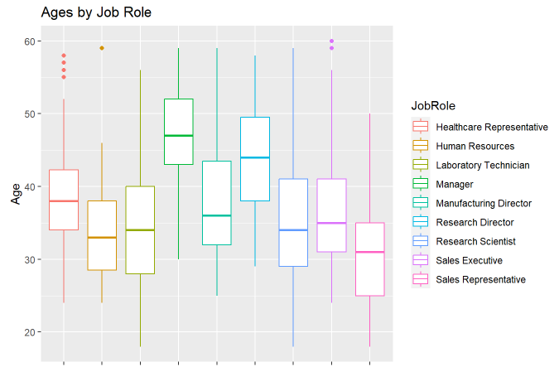
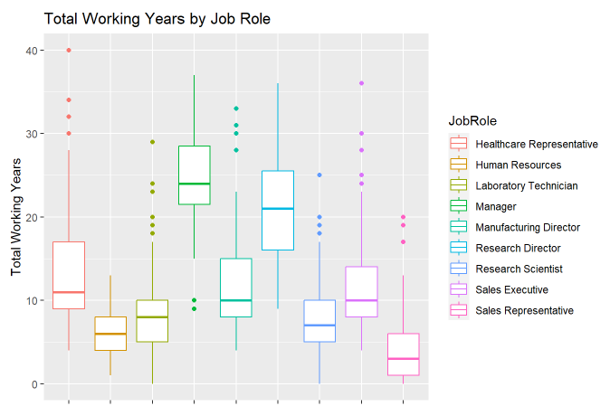
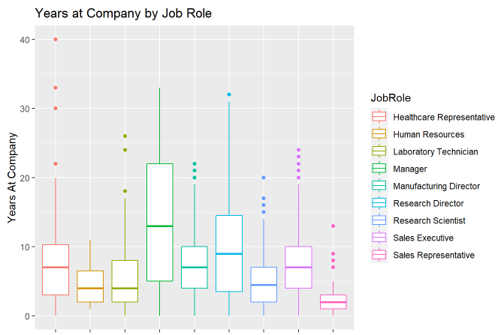
Employee data trends
Distribution of Ages
Distribution of Total Working Years
Distribution of Years at Company
Most Employees are between 30 and 40 years old
Senior Positions, on average, are held by those in the 40 – 50 years old range
Those Managerial Positions might be wanting to retire soon
Most Employees have been working for the company between 5 – 15 years.
Employees with the most work experience tend to hold the Senior Positions.
Positions with 75% of employees with less than 10 years of work experience are Lab Technicians and Sales Representatives. (Entry-Level Positions)
Senior Positions have the largest spread. 50% of Managerial Positions have worked for Frito Lay longer than 10 years.
75% of Research Directors have worked for Frito Lay for less than 15 years.
With the exception of a few outliers, Sales Representatives are almost exclusively 5 years or less at Frito Lay.

Slide 5
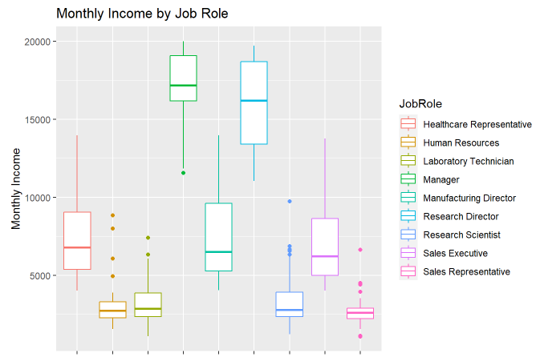
Income distribution
THE REASON WE ARE ALL HERE TODAY
Explore these parameters yourself on my Rshiny app!

Slide 6
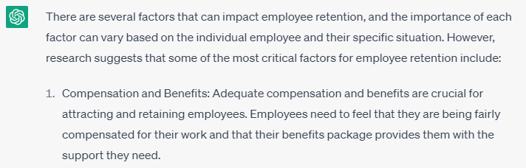
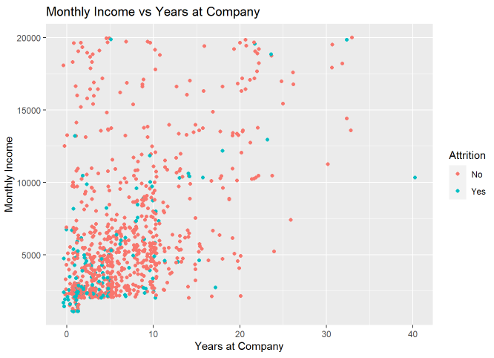
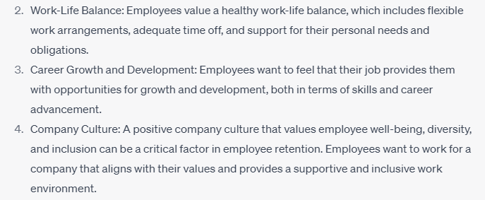
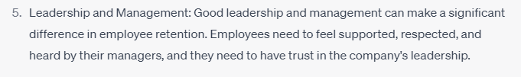
Expected factors
1. Compensation and Benefits

Slide 7
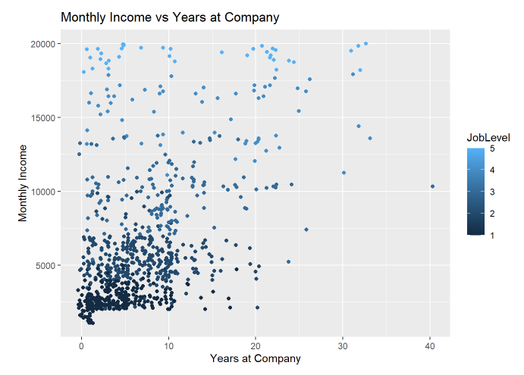
Expected factors
1. Compensation and Benefits

Slide 8
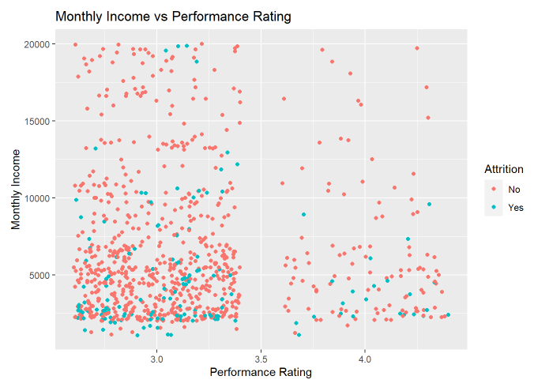
Expected factors
1. Compensation and Benefits

Slide 9
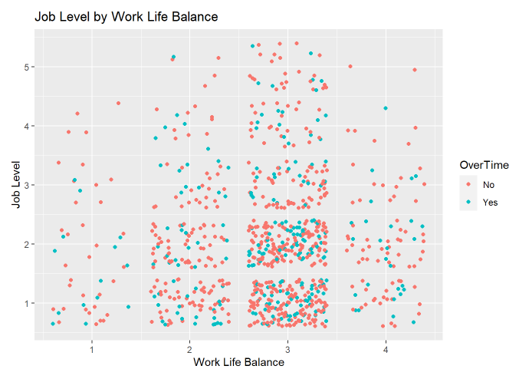

Expected factors
2. Work Life Balance

Slide 10
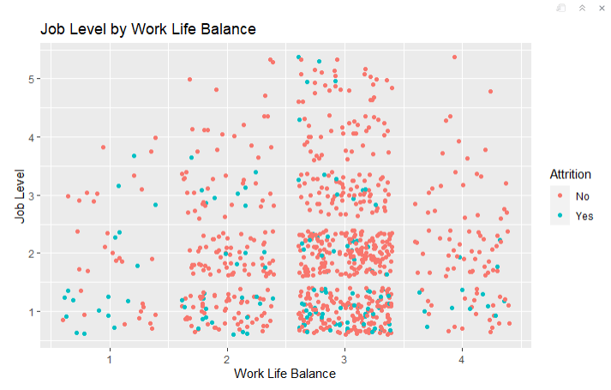
Expected factors
2. Work Life Balance

Slide 11
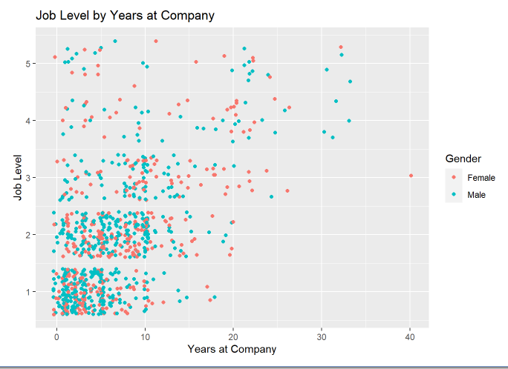
Expected factors
3. Career Growth and Development

Slide 12
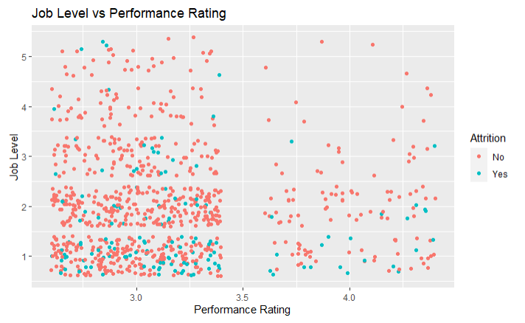
Expected factors
3. Career Growth and Development

Slide 13
Expected factors
4. Company Culture
Requires further data gathering
Event Attendance
Diversity & Inclusion Initiatives
GlassDoor Reviews
5. Leadership and Management
Requires further data gathering
One Variable: Relationship Satisfaction
> But pValue was 0.74

Slide 14
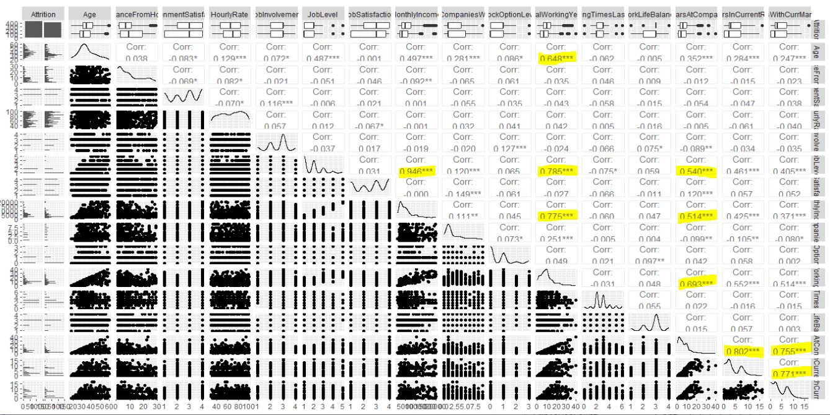
FUNDING
What Factors are most important to
FRITO LAY Attrition?
21%
39%
Other Investment
$110,000 – 21%
Debt Investor
$200,000 – 39%
Bank
$100,000 – 20%
Owner Equity
$100,000 – 20%
20%
20%

Slide 15

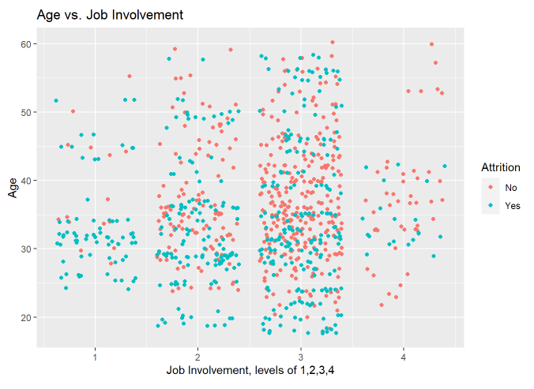

Job involvement

Slide 16

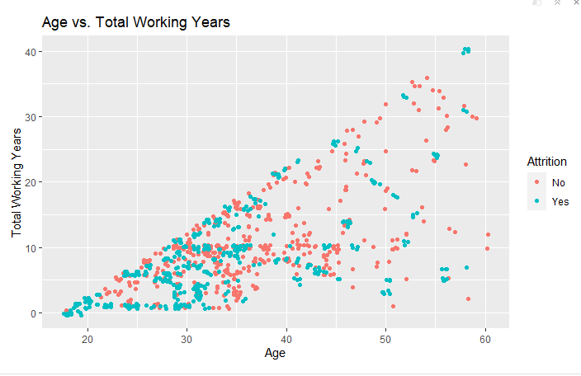
Age and total working years
This Photo by Unknown Author is licensed under CC BY-SA

Slide 17
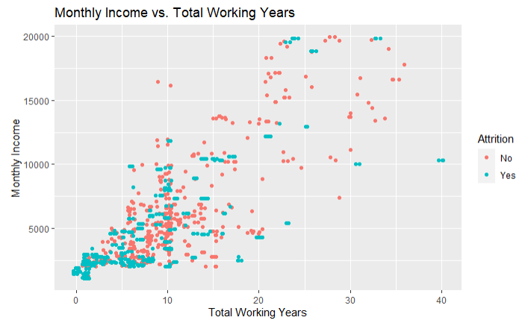
Monthly income & total working years
This Photo by Unknown Author is licensed under CC BY-SA

Slide 18





Best K-Nearest-Neighbor Model
Job Involvement
Monthly Income
Total Working Years
age
Stock options
Accuracy: 78.16%
Sensitivity: 66.67%
Specificity: 90.48%
This Photo by Unknown Author is licensed under CC BY-NC-ND

Slide 19

Thank you
Alexandra Thibeaux
DDS Analytics Data Scientist
athibeaux@smu.edu

