Slide 1

IaC – With Terraform
Exploring Infrastructre as Code
This Photo by Unknown Author is licensed under CC BY-NC
Notes:
Host PIN - 914 180

Slide 2
Outline
What is Infrastructure as code?
Terraform Examples
End-to-End Demo
IaC Implementations
Why is it important? / What problem does it solve?

Slide 3
What is Infrastructure as Code?
The management of infrastructure ( networks, servers, databases ) in a descriptive model, using the same version control techniques as you would for application code.
What is Iac?
Second Skill
Third Skill
Conclusion

Slide 4
Why is IaC Important?
Solves the issue of Configuration Drift
Configuration / Environment Drift
Each environment eventually becomes unique
Inconsistency causes Deployment Issues
Maintenance is manual
Changes are difficult to document and track
Why is IaC Important?
What is Iac?
Third Skill
Conclusion
Notes:
Conceptual Differences
Pets vs Cattle
Pets
Indispensible (unique)
Manually built
Managed by hand (fed)
Updated in Place
Cattle
Can be killed and easily replaced
Created by automated tools
No server is unique

Slide 5
Why is IaC Important?
IaC – Provides Idempotence
Idempotence
the principle of certain operations where they can be applied multiple times without changing the result beyond the initial application
Each Deployment can be repeated and achieve the exact same result
Infrastructure Now Get all the benefits of source control
Versioning
Pull Requests / Code Reviews
Why is IaC Important?
What is Iac?
Third Skill
Conclusion
Notes:
Idempotence Example – HTTP Get requests are (supposed to be) idempotent. Meaning they can be executed multiple times without altering the state of your data or application
IaC Idempotence - The IaC deployment command always sets the environment to the same configuration regardless of its starting state. Typically done by discarding the current environment and re-creating a fresh environment.

Slide 6



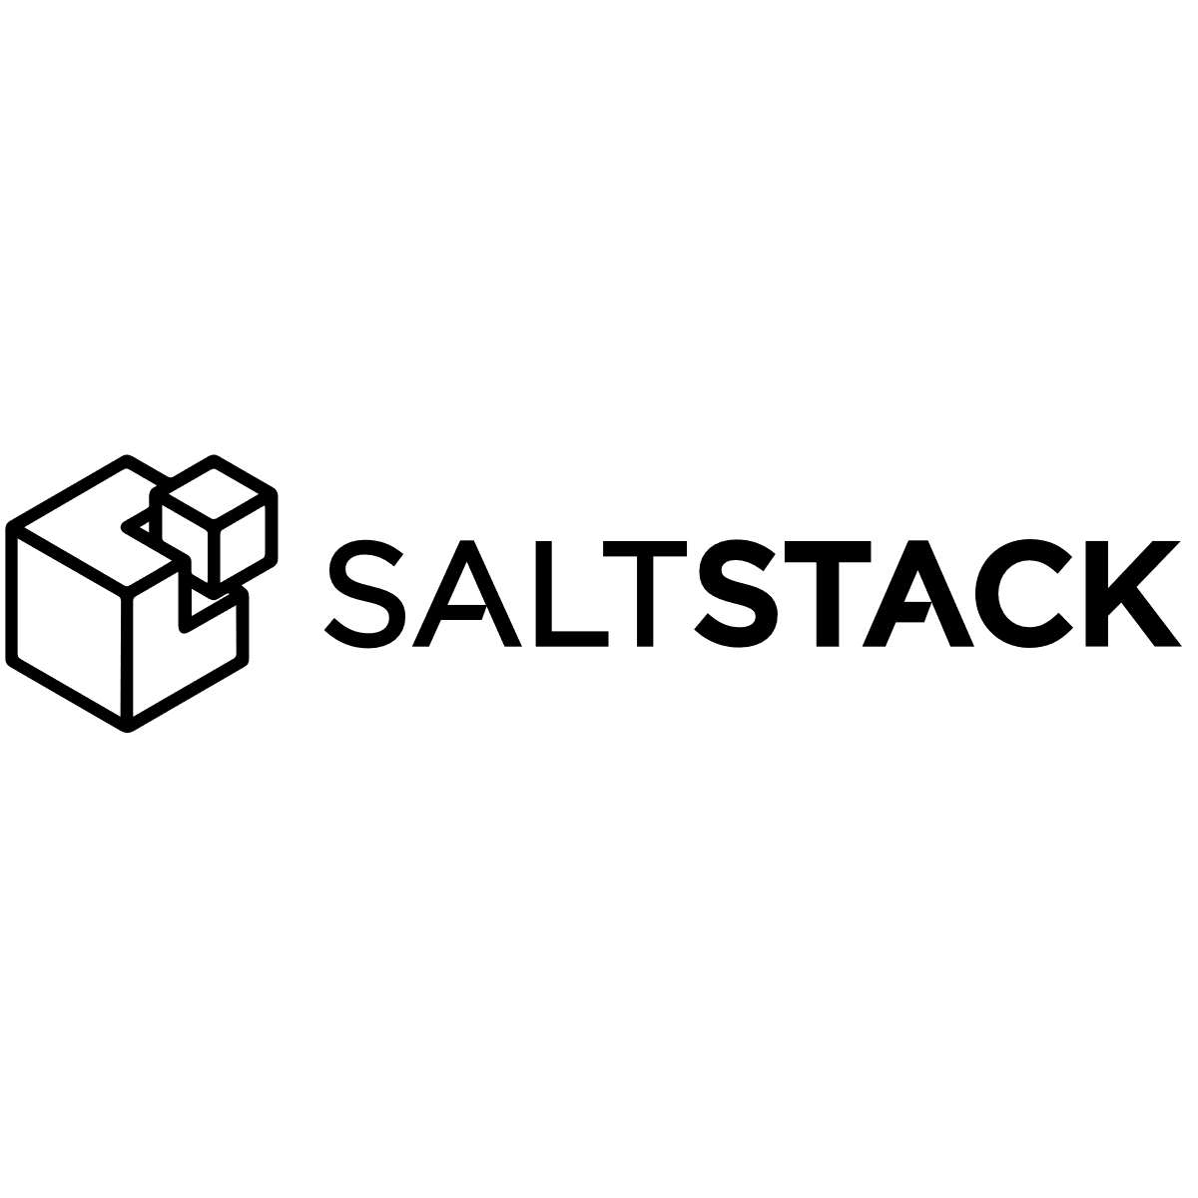
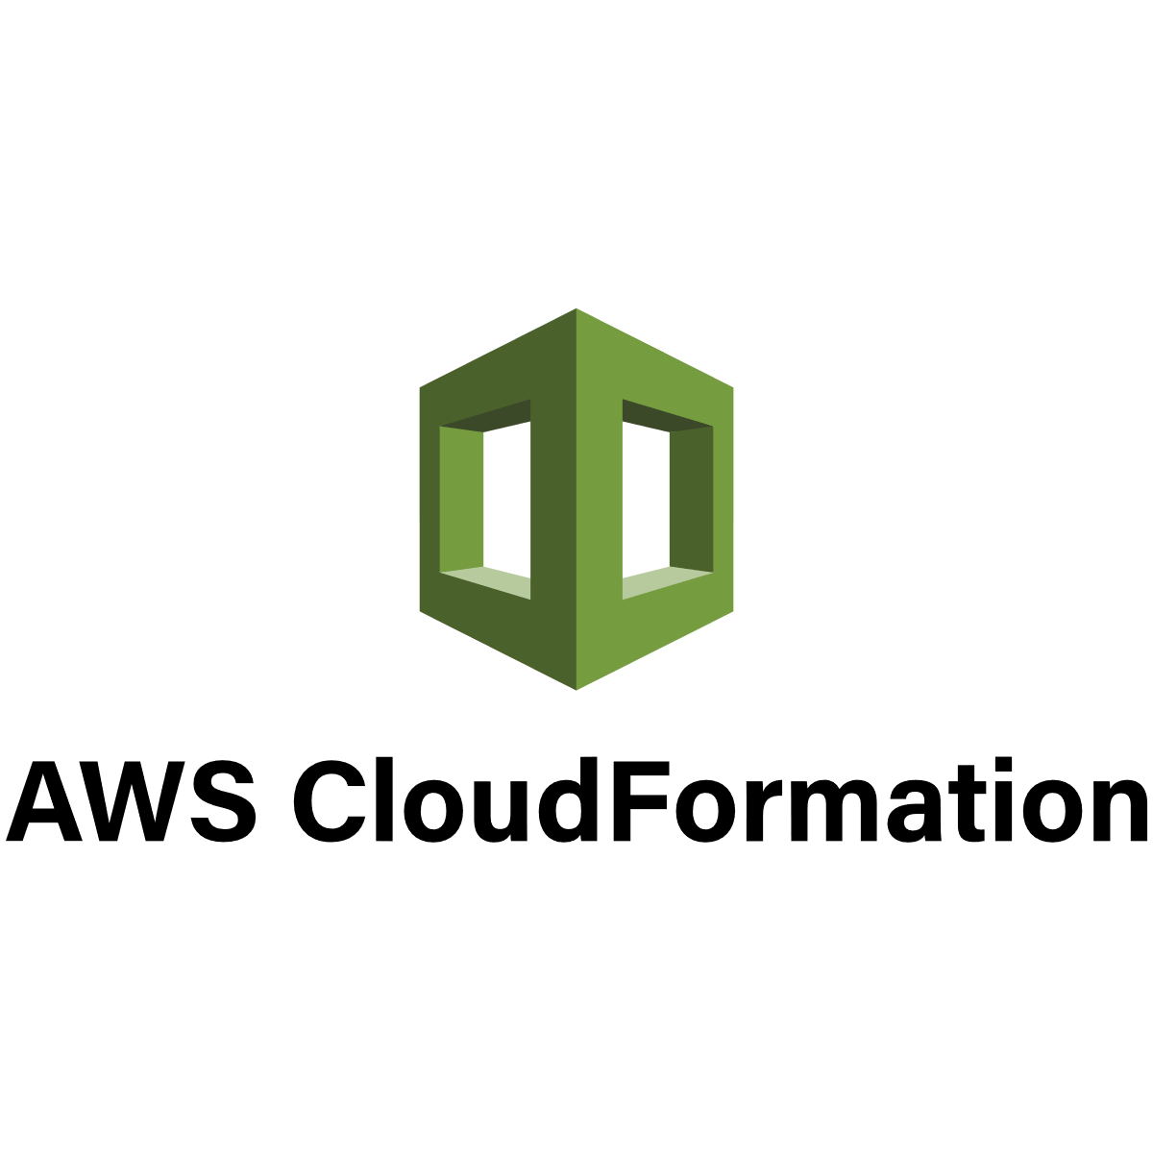

IaC - Implementations
IaC Implementations
What is Iac?
Why is IaC Important?
Conclusion
Notes:
Here is a list of some of the popular IaC implementations. This is not meant to be prescriptive or exhaustive. There are other ways of doing IaC without using one of these implementations.
ARM Templates ( Azure Resource Manager )
Library of Scripts
Azure CLI
Powershell
Bash
One thing to note about CloudFormation is it is proprietary to AWS.
Bill Sinks Had mentioned another Farm Credit is utilizing Chef currently

Slide 7
Why Terraform?
Provisioning vs Configuration Management
Declarative vs Procedural
Other attributes
Mutable vs Immutable Infrastructure
Agent vs Agentless
Community Size
Maturity
IaC Implementations
What is Iac?
Why is IaC Important?
Conclusion
Notes:
Provisioning over Configuration management
Chef, Puppet, Ansible and Salt Stack are all configuration management tools, meaning they are designed to install and manage software on existing servers.
Terraform and CloudFormation are provisioning tools, meaning they are designed to create the servers ( and other resources ) themselves.
For the project I was using Terraform for, I am utilizing a combination of Azure and AWS so I have no physical servers to manage. I found terraform to be a better fit for the task.
These two attributes are not mutually exclusive. Configuration Management tools can do some amount of provisioning and provisioning tools can do some sort of configuration management. Some tools are just better suited for different types of tasks
Declarative over Procedural
Terraform uses a declarative style language. Meaning you write your configuration code that specifies the desired end state and then terraform itself figures out the changes necessary to achieve that end state. ( Cloud Formation, SaltStack, Puppet also declarative )
Contrary to Declarative is the procedural style language which Chef and Ansible use. This is where you write step by step configuration code to achieve your desired end state.
(Show Ansible and Terraform Example)

Slide 8
Why Terraform?
 | Source | Cloud | Type | Infra. | Language | Community | Maturity
Chef | Open | All | Config. Mgmt. | Mutable | Procedural | Large | High
Puppet | Open | All | Config. Mgmt. | Mutable | Procedural | Large | High
Ansible | Open | All | Config. Mgmt. | Mutable | Procedural | Huge | Med
SaltStack | Open | All | Config. Mgmt. | Mutable | Declarative | Large | Med
CloudFormation | Closed | AWS | Provisioning | Immutable | Declarative | Small | Med
Terraform | Open | All | Provisioning | Immutable | Declarative | Huge | Low
IaC Implementations
What is Iac?
Why is IaC Important?
Conclusion

Slide 9
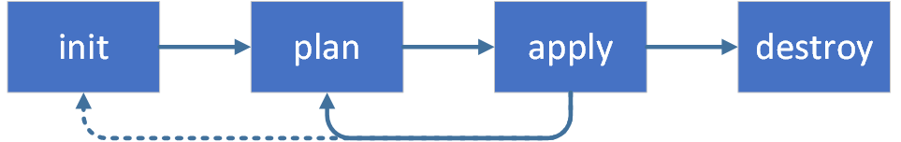
Terraform Examples
Examples
What is Iac?
Why is IaC Important?
IaC Implementations

Slide 10
Terraform Examples
Terraform Example 1 - Basic
Terraform Example 2 – Less Basic
Terraform Example 3 – End to End Example
Examples
What is Iac?
Why is IaC Important?
IaC Implementations

Slide 11
End-to-End Architecture
classicguildbank.com
Had existing ‘prod’
Needed a test infrastructure
Client – Serverless Angular Application
AWS S3 Storage Bucket
AWS CloudFront Distribution (CDN)
SSL Certificate
AWS Route53 DNS Entries
Server – ASP Net Core Web Api
Azure App Service
Db Connection Strings
CORS
Database – MS SQL Server
Azure Sql Server
Restore DB From Backup in Azure storage
Examples
What is Iac?
Why is IaC Important?
IaC Implementations

Slide 12
Slides / Examples
https://github.com/athielking/TerraformExamples
Examples
What is Iac?
Why is IaC Important?
IaC Implementations

