Slide 1

IaC – with Terraform
Exploring Infrastructure as Code
This Photo by Unknown Author is licensed under CC BY-NC
Notes:
Host PIN - 914 180

Slide 2

Intro
Background in Software Engineering
Pluralsight Author:
Cloud Architecture
DevOps Practices
https://www.pluralsight.com/authors/andrew-thielking
Co-Founder / Founding Engineer of MuniCheck
Cross Platform Mobile Inspection application
More Info: https://thielking.dev/

Slide 3
Outline
What is Infrastructure as code?
Basic Examples
End-to-End Demo
IaC Implementations
Why is it important? / What problem does it solve?

Slide 4
What is Infrastructure as Code?
The management of infrastructure ( networks, servers, databases ) in a descriptive model, using the same version control techniques as you would for application code.
What is Iac?
Why is Iac Important?
IaC Implementations
Demo

Slide 5
Why is IaC Important?
Solves the issue of Configuration Drift
Configuration / Environment Drift
Each environment eventually becomes unique
Inconsistency causes Deployment Issues
Maintenance is manual
Changes are difficult to document and track
Why is IaC Important?
What is Iac?
IaC Implementations
Demo
Notes:
Configuration Drift
Environments Slowly become unique
Just one change here, another change there in the portal and over time that leads to entirely different environments
Conceptual Differences
Pets vs Cattle
Pets
Indispensible (unique)
Manually built
Managed by hand (fed)
Updated in Place
Cattle
Can be killed and easily replaced
Created by automated tools
No server is unique

Slide 6
Why is IaC Important?
IaC – Provides Idempotence
Idempotence
the principle of certain operations where they can be applied multiple times without changing the result beyond the initial application
Each Deployment can be repeated and achieve the exact same result
Infrastructure now gets all the benefits of source control
Versioning
Pull Requests / Code Reviews
Why is IaC Important?
What is Iac?
IaC Implementations
Demo
Notes:
Idempotence Example – HTTP Get requests are (supposed to be) idempotent. Meaning they can be executed multiple times without altering the state of your data or application
IaC Idempotence - The IaC deployment command always sets the environment to the same configuration regardless of its starting state. Typically done by discarding the current environment and re-creating a fresh environment.

Slide 7
Why is IaC Important?
Useful Situations / Scenarios
Disaster Recovery
Short Lived Specific Environments
QA
Performance
Why is IaC Important?
What is Iac?
IaC Implementations
Demo
Notes:
DR
One region goes down, can quickly restore to another region
Environments
Specific testing scenario
Like Perf Testing can be run and destroyed without incurring extra cost

Slide 8

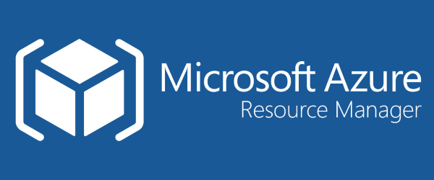

IaC - Implementations
IaC Implementations
What is Iac?
Why is IaC Important?
Conclusion
Notes:
Here is a list of some of the popular IaC implementations. This is not meant to be prescriptive or exhaustive. There are other ways of doing IaC without using one of these implementations.
Library of Scripts
Azure CLI
Powershell
Bash
CloudFormation is proprietary to AWS and ARM / Bicep is Proprietary to Azure, Google Cloud doesn’t have a proprietary implementation. They instead leverage terraform

Slide 9
Why Terraform?
Provisioning vs Configuration Management
Declarative vs Procedural
Other attributes
Mutable vs Immutable Infrastructure
Agent vs Agentless
Community Size
Maturity
IaC Implementations
What is Iac?
Why is IaC Important?
Conclusion
Notes:
Project / Presentation Background – High Level This presentation was born out of a side project I was working on a couple of years ago. There were some different attributes of tools I needed, and I’ll explain some of the major ones which influenced my decision
Provisioning Tools vs Configuration management tools
Chef, Puppet, Ansible are all configuration management tools, meaning they are designed to install and manage software on existing servers.
Terraform, ARM/Bicep, CloudFormation are provisioning tools, meaning they are designed to create the servers / other cloud resources themselves.
These two attributes are not mutually exclusive. Configuration Management tools can do some amount of provisioning and provisioning tools can do some sort of configuration management. Some tools are just better suited for different types of tasks
Declarative vs Procedural
Terraform, ARM/Bicep, CloudFormation use a declarative style language. Meaning you write your configuration code that specifies the desired end state and then tooling figures out the changes necessary to achieve that end state Contrary to Declarative is the procedural style language which Chef and Ansible use. This is where you write step by step configuration code to achieve your desired end state.
(Show Ansible and Terraform Example)

Slide 10
Why Terraform?
 | Source | Cloud | Type | Infra. | Language
Chef | Open | All | Config. Mgmt. | Mutable | Procedural
Puppet | Open | All | Config. Mgmt. | Mutable | Procedural
Ansible | Open | All | Config. Mgmt. | Mutable | Procedural
SaltStack | Open | All | Config. Mgmt. | Mutable | Declarative
CloudFormation | Closed | AWS | Provisioning | Immutable | Declarative
Terraform | Open | All | Provisioning | Immutable | Declarative
ARM / Bicep | Closed | Azure | Provisioning | Immutable | Declarative
IaC Implementations
What is Iac?
Why is IaC Important?
Conclusion
Notes:
Why Terraform?
At the time of working on and releasing this project I was familiar with Azure App services and had hosted a few API’s hosted on the platform previously
Found their static website hosting for Single Page Applications lagged behind what AWS offered, so I decided on a multi-cloud approach. (I believe Azure has caught up in that regard now)
I also knew I wanted to use a declarative model, so of all the provisioning tools I was looking at I could either maintain separate proprietary provisioning code for the front end and back end, or utilize a tool which supported multiple cloud providers

Slide 11
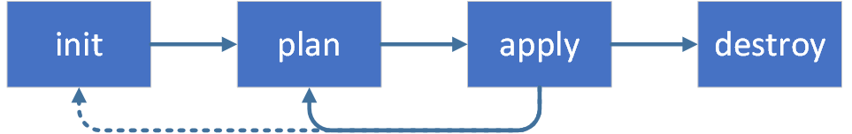
Terraform Examples
Examples
What is Iac?
Why is IaC Important?
IaC Implementations

Slide 12
Terraform Examples
https://github.com/athielking/TerraformExamples
Example 1 – Basic
Terraform
Bicep
Example 2 – Less Basic
Terraform
Bicep
Example 3 – End to End Example
Terraform Only
Examples
What is Iac?
Why is IaC Important?
IaC Implementations

Slide 13
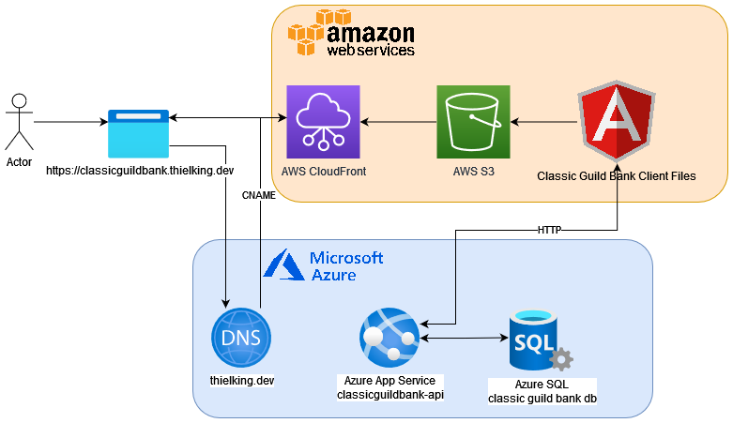
End-to-End Architecture
Client – Serverless Angular Application
AWS S3 Storage Bucket
AWS CloudFront Distribution (CDN)
SSL Certificate
CloudFlare DNS Entries
Server – ASP Net Core Web Api
Azure App Service
Db Connection Strings
Database – MS SQL Server
Azure Sql Server
Azure DevOps Pipeline
Infrastructure
Build + Deploy
Examples
What is Iac?
Why is IaC Important?
IaC Implementations

Slide 14
Slides / Examples
https://github.com/athielking/TerraformExamples
Examples
What is Iac?
Why is IaC Important?
IaC Implementations
Notes:
Be cautious of technical detail in examples
Do Terraform Examples First
TF1 and TF2 then B1 B2
Local State in examples 1&2, remote state example 3
Example 1 simplify
More detail on non-technical benefits
-Risk Mitigation
-Disaster Recovery

