Slide 1
POS system for Asian Distributors
Project & Professional Aspects
Course Code: IT1210
Lecturer- Mr. Roshan Jayawardana

Slide 2

Group Members
IT20766450 – M.Z.A.Rahman
IT20761264 – M.N.Salmanul Faris
IT20764548 – H.K.Najumudeen
IT20044640 – F.A.Ozeer
IT20764616 – H.N.Ahamed
IT20044640 – F.A. Ozeer

Slide 3

Introduction
An android application for our client “Asian Distributors”.
IT20044640 – F.A. Ozeer

Slide 4
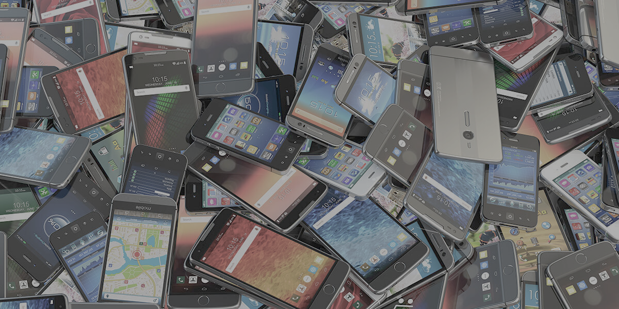
About client
It is a mobile phone distribution company.
Based in Rathnapura district.
Asian Distibutors
IT20766450 – M.Z.Athif Rahman

Slide 5
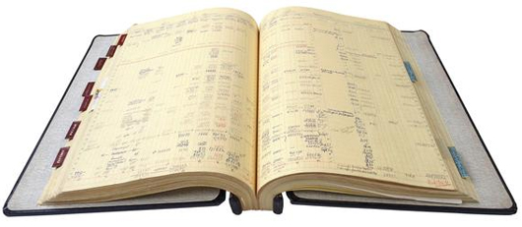
Current Problems
Cannot identify the profit
To check the stoke every time should count and see.
Cannot identify the balance that has to come from customers directly. Should go through the book to calculate total balance.
IT20764616 – H.N. Ahamed

Slide 6
Solution
Create an interactive UI.
Admin can add, update, and delete stokes.
Give best performance for the user.
IT20761264 – M.N. Salmanul Faris

Slide 7
Conclusion
Client can manage his business easily.
Give best performance for the user.
User-friendly interface that is easily accessible.
IT20764548 – H.K. Najumudeen

Slide 8
Thank You.

Slide 9
Questions?

