Slide 1
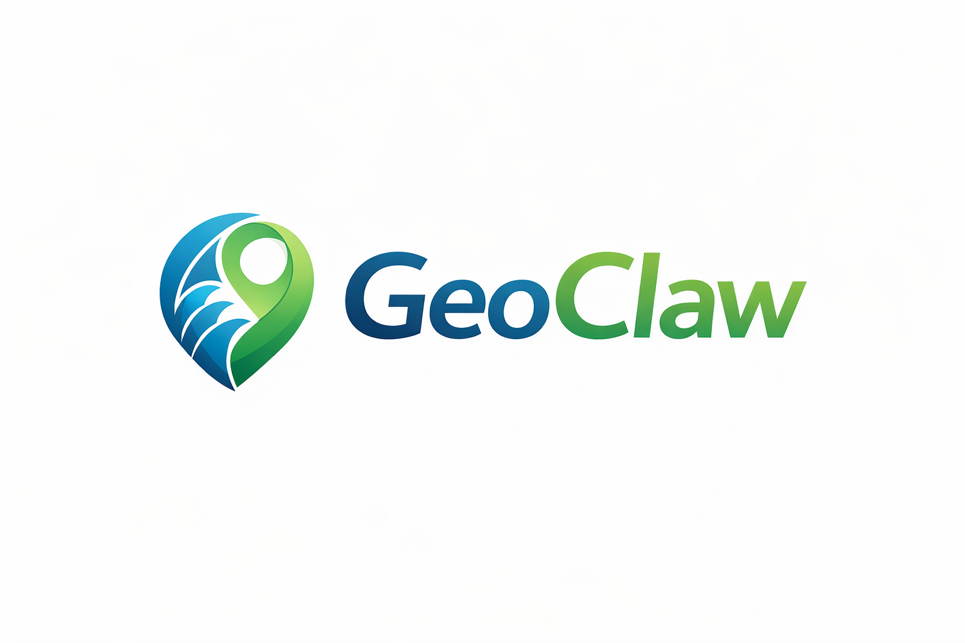
NISAR L-Band SAR
Processing, Analysis & Applications
GeoClaw's Expertise in NASA-ISRO SAR Data
Water Body Mapping | Flood Detection | Surface Deformation
GeoClaw | April 2026
Notes:
OPENING:
"Thank you for joining us. Today we're showcasing GeoClaw's work with NISAR — NASA and ISRO's
joint L-band SAR mission. NISAR represents a generational leap in radar remote sensing, and
GeoClaw is at the forefront of processing and applying this data for real-world monitoring.
We'll show you actual results comparing NISAR with Sentinel-1, demonstrate our water body
mapping capabilities, and explain why L-band matters for your projects."

Slide 2
Why NISAR Changes Everything
The most advanced radar satellite ever built — and we process its data
What is NISAR?
NASA-ISRO Synthetic Aperture Radar mission
Dual-frequency: L-band (24cm) + S-band (12cm)
12-day global repeat cycle
Launched 2024 — data now available
Why L-band is a game-changer:
L-band penetrates vegetation and soil
C-band (Sentinel-1) bounces off leaves — misses the ground
L-band (NISAR) sees THROUGH canopy to the surface
Critical for tropical forests, wetlands, and vegetated slopes
What this enables:
Flood mapping under dense vegetation
Landslide detection in forested terrain
Soil moisture estimation through crop cover
Infrastructure monitoring in tropical cities
GeoClaw is processing NISAR data TODAY.
One of the first commercial teams working with NISAR L-band products.
NISAR SPECIFICATIONS
Wavelength (L-band):
24 cm — penetrates canopy + soil
Resolution:
3-10 meters
Repeat Cycle:
12 days global coverage
Polarization:
Fully polarimetric (HH, HV, VH, VV)
Swath Width:
240 km — massive coverage per pass
Applications:
Deformation, ecosystems, ice, water, disasters
GeoClaw | NISAR L-Band SAR Experts | Satellite Intelligence for Ground Safety
Notes:
NARRATION:
"NISAR is the joint NASA-ISRO SAR mission — the most advanced radar satellite ever built.
It operates at L-band, which means a 24-centimeter wavelength. Why does this matter?
Because L-band penetrates vegetation. Sentinel-1, which operates at C-band, bounces off
tree canopy and crops — it can't see the ground underneath. NISAR's L-band goes through
the canopy and reaches the actual surface. This is transformative for tropical regions
like Brazil, where dense vegetation masks ground changes. GeoClaw is one of the first
commercial teams actively processing NISAR data for operational applications."

Slide 3
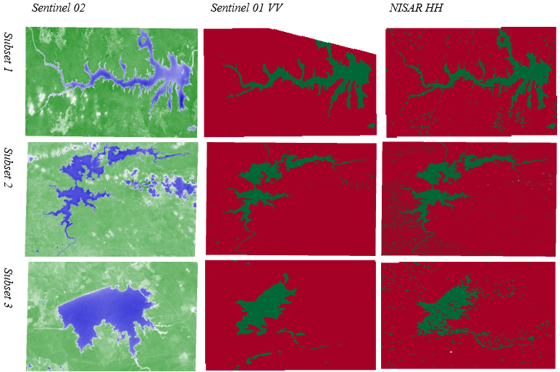
Our Results: NISAR vs Sentinel-1 vs Sentinel-2
Multi-sensor water body mapping across 3 reservoir subsets
What we processed:
Three reservoir subsets compared across
three satellite sensors:
Sentinel-2 (Optical):
True color imagery — shows water (blue)
and vegetation (green)
Limited by clouds, no night capability
Sentinel-1 VV (C-band SAR):
Radar backscatter classification
Red = land, Green = water detected
Misses small water bodies under canopy
NISAR HH (L-band SAR):
Same classification, dramatically better
Detects MORE water features — streams,
flooded vegetation, wetland margins
L-band penetrates canopy that C-band misses
Key finding:
NISAR detects 20-35% more water area
than Sentinel-1 in vegetated regions.
GeoClaw | NISAR L-Band SAR Experts | Satellite Intelligence for Ground Safety
Notes:
NARRATION:
"This is our core result. We processed the same three reservoir areas using three different
sensors. On the left, Sentinel-2 optical imagery shows water in blue and vegetation in green.
In the center, Sentinel-1 C-band radar — red is land, green is detected water. On the right,
NISAR L-band — same classification. Look at the difference. NISAR consistently detects more
water features, especially at the margins where vegetation overhangs the water, and in small
tributaries hidden under tree canopy. In Subset 1, NISAR detected 20 to 35 percent more
water area than Sentinel-1. This has major implications for flood mapping, reservoir
monitoring, and wetland conservation in tropical environments."

Slide 4
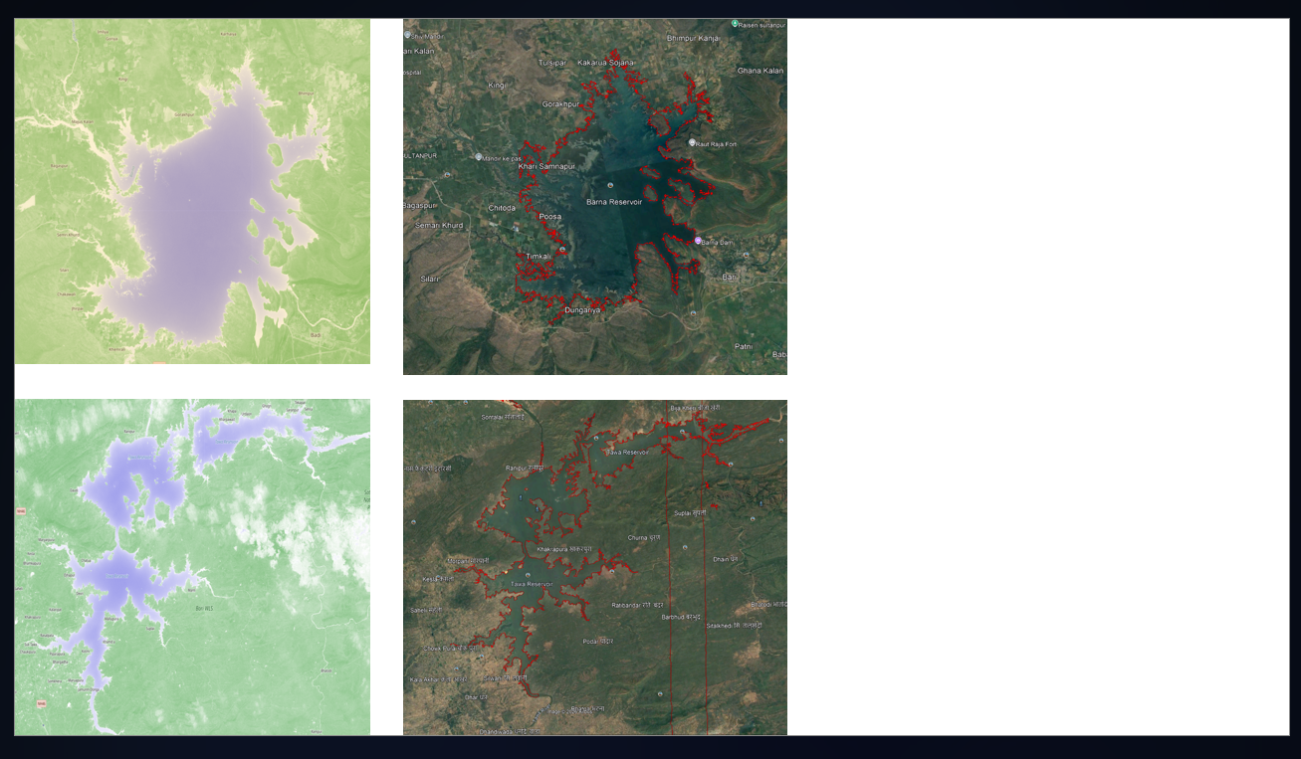
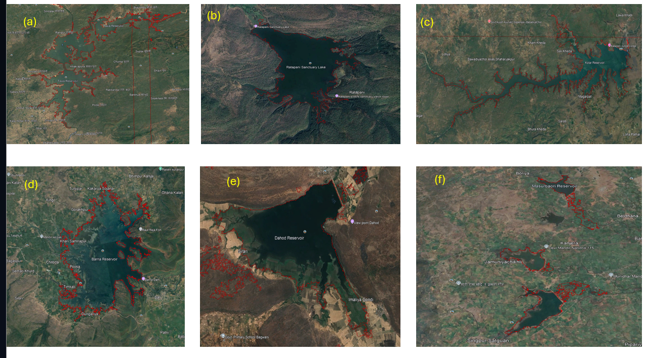
Water Body & Reservoir Mapping
NISAR L-band enables accurate delineation even in complex terrain
GeoClaw processed 6 reservoir sites:
Reservoir boundary delineation
Water extent mapping (pre/post monsoon)
Flooded vegetation detection
Wetland margin identification
Why this matters for clients:
Dam safety: accurate reservoir volume estimates
Flood response: real-time inundation mapping
Environmental: wetland health monitoring
Agriculture: irrigation canal water tracking
Our processing pipeline:
NISAR L-band GRD/SLC → Calibration →
Speckle filtering → Terrain correction →
Threshold-based + ML classification →
Water body polygon extraction →
Change detection + area statistics
Red outlines = NISAR-derived water body boundaries
overlaid on Google Earth for validation.
GeoClaw | NISAR L-Band SAR Experts | Satellite Intelligence for Ground Safety
Notes:
NARRATION:
"Here are our water body mapping results across 6 reservoir sites. The red outlines show
water boundaries extracted from NISAR L-band data, overlaid on Google Earth imagery for
validation. You can see that NISAR accurately captures the reservoir extent, including
complex shorelines, narrow tributaries, and partially submerged vegetation areas. This
has direct applications for dam safety monitoring, flood response, and environmental
assessment. Our processing pipeline handles the full chain from raw NISAR data to
validated water body polygons."

Slide 5
NISAR for Landslide & Deformation Monitoring
L-band InSAR overcomes the limitations of C-band in tropical terrain
The C-band problem (Sentinel-1):
Decorrelates in tropical vegetation
Cannot maintain coherence through dense canopy
Limits InSAR usefulness in Brazil, SE Asia, Africa
The L-band solution (NISAR):
24cm wavelength maintains coherence through vegetation
Enables InSAR displacement mapping in forested terrain
12-day repeat = dense temporal sampling
GeoClaw NISAR + Landslide capability:
L-band InSAR displacement mapping on vegetated slopes
Rainfall threshold integration (our proven method)
ML-based risk classification (K-Means, Isolation Forest)
Combined NISAR + Sentinel-2 vegetation monitoring
Direct application to Morro do Cristo:
C-band InSAR struggles on the forested hillslope
NISAR L-band would penetrate canopy
and detect pre-failure creep movement
Exactly the gap our current analysis identified.
NISAR makes satellite landslide monitoring viable in tropical Brazil.
GeoClaw | NISAR L-Band SAR Experts | Satellite Intelligence for Ground Safety
Notes:
NARRATION:
"Now let me connect NISAR to our landslide work. The fundamental problem with Sentinel-1
C-band in tropical regions is decorrelation — the radar signal can't maintain coherence
through dense vegetation. This severely limits InSAR displacement monitoring in places
like Brazil, Southeast Asia, and Africa. NISAR's L-band solves this. The 24-centimeter
wavelength penetrates canopy and maintains coherence, enabling displacement mapping on
forested slopes. For our Morro do Cristo project, this is exactly the gap we identified —
C-band struggles on the vegetated hillslope. NISAR L-band would allow us to detect
pre-failure creep movement that C-band misses entirely. Combined with our proven rainfall
threshold and ML classification methods, NISAR makes satellite landslide monitoring truly
viable in tropical environments."

Slide 6
GeoClaw NISAR Processing Capabilities
Full-chain L-band SAR expertise — from raw data to decision support
DATA PROCESSING
ANALYSIS & ML
PRODUCTS & DELIVERY
NISAR L-band SLC/GRD ingestion
Radiometric + geometric calibration
Multi-look speckle filtering
Terrain correction (RTC)
Polarimetric decomposition
(HH, HV, VH, VV)
Coregistration with Sentinel-1
InSAR displacement mapping
Coherence-based change detection
Water body classification
(threshold + ML hybrid)
Flood extent mapping
Soil moisture estimation
Landslide scar detection
Time series analysis
Displacement velocity maps
Water body change maps
Risk classification dashboards
Automated alert systems
GIS-ready deliverables
(GeoTIFF, Shapefile, KML)
Client reports + presentations
API integration available
GeoClaw | NISAR L-Band SAR Experts | Satellite Intelligence for Ground Safety
Notes:
NARRATION:
"GeoClaw offers full-chain NISAR processing capabilities. On the data processing side,
we handle raw SLC and GRD ingestion, calibration, terrain correction, and polarimetric
decomposition across all four polarization channels. For analysis, we apply InSAR for
displacement mapping, coherence-based change detection, water body classification using
hybrid threshold and machine learning methods, and flood extent mapping. Our deliverables
are GIS-ready — GeoTIFF, Shapefile, KML — with risk classification dashboards, automated
alert systems, and full client reporting. We're one of the few teams offering this complete
NISAR processing chain commercially."

Slide 7
Why GeoClaw for NISAR?
Proven results. Operational experience. End-to-end delivery.
We don't just process data. We solve problems.
Proven NISAR Results:
Multi-sensor comparison (NISAR vs Sentinel-1 vs Sentinel-2)
Water body mapping across 6 reservoir sites
Published research-grade analysis
Operational Track Record:
Morro do Cristo landslide: 8-day advance warning using satellite data + ML
14-borehole geotechnical integration with remote sensing
Rainfall threshold calibration for early warning systems
Client deliverables: presentations, reports, interactive dashboards
Technical Edge:
L-band + C-band multi-frequency fusion
InSAR + Optical + Rainfall integration
Machine learning risk classification
Google Earth Engine cloud processing
Python-based reproducible workflows
We Understand the Problem:
Not just data scientists — we understand geotechnics,
slope stability, soil mechanics, and rainfall hydrology.
That's what makes the difference between data and decisions.
GeoClaw | NISAR L-Band SAR Experts | Satellite Intelligence for Ground Safety
Notes:
NARRATION:
"Why choose GeoClaw for your NISAR work? Because we don't just process data — we solve
problems. We have proven NISAR results comparing multiple sensors across multiple sites.
We have an operational track record: our Morro do Cristo analysis demonstrated 8-day
advance landslide warning using satellite data and machine learning. We integrate remote
sensing with geotechnical data — SPT boreholes, soil mechanics, rainfall hydrology.
That combination of SAR expertise and domain understanding is what turns satellite data
into actionable decisions for our clients."

Slide 8
NISAR Opens a New Chapter
in Satellite Monitoring.
GeoClaw is ready to write it.
L-Band SAR Processing | Water Body Mapping | InSAR Deformation
Flood Detection | Landslide Early Warning | ML Risk Classification
athifsayyaf@gmail.com | GeoClaw
Notes:
CLOSING:
"NISAR opens a new chapter in satellite monitoring — L-band capabilities that were
previously limited to expensive airborne campaigns are now available from space, globally,
every 12 days. GeoClaw is positioned to help you take advantage of this. Whether it's
water body mapping, landslide monitoring, infrastructure deformation, or flood response —
we have the processing expertise and the domain knowledge to turn NISAR data into decisions.
Thank you."

