Slide 1

SYMPTOCARE
ATHILA ASHRAF MES24MCA-2025
Department of Computer Applications
MES College of Engineering, Kuttippuram
20/08/2025

Slide 2
PRODUCT OWNER
Mrs. RESHMI K
ASSISTANT PROFESSOR
DEPARTMENT OF COMPUTER APPLICATIONS
MES COLLEGE OF ENGINEERING, KUTTIPPURAM

Slide 3

TABLE OF CONTENTS
1. Introduction
2. Objective
3. Existing System
4. Proposed System
5. Motivation
6. Functionalities
7. Module Description
8. Developing Environment
9. Sprint Backlog
10. Product Backlog
11. User Story
12. Project Plans
13. Data Flow Diagrams
14. ER Diagram
Department of Computer Applications
Slides:
3
/ 20

Slide 4
SYMPTOCARE
• Timely and accurate
information is essential for disease management.
health
effective
• Many patients face challenges understanding medical terms accessing reliable diagnoses.
in
and
• Platform leverages data mining and recommendation systems for early disease prediction and specialist
suggestions.
Department of Computer Applications Slides: 4 / 20

Slide 5
SYMPTOCARE
• Developed using Flutter, CSS,
(frontend) and Python (backend).
• Modules:
HTML
a) Admin: Manage dataset, analyze data,
view users, doctors, and ratings.
b) Doctor: Handle appointments,
requests, manage schedule,
respond to users.
view
and
c) User: Register symptoms,
predictions, consult doctors,
manage bookings.
get
and
Department of Computer Applications Slides: 5 / 20

Slide 6
SYMPTOCARE
FEATURES:
• Symptom-based disease prediction.
• Doctor’s recommendation system.
• Rating & review system for doctors.
• Booking and history tracking.
• Schedule and appointment management.
Department of Computer Applications Slides: 6 / 20

Slide 7
OBJECTIVES
• Intelligent
platform
for
early
disease
prediction using user-reported
symptoms.
• Recommends
medical
specialists
via
a
smart recommendation engine.
• Designed for users with limited medical
knowledge; user-friendly and accessible.
• Focus on data security through robust
authentication and privacy measures.
Department of Computer Applications Slides: 7 / 20

Slide 8
EXISTING SYSTEM
• Many users rely on online platforms
for health info, diagnoses, and
treatment.
• Challenge:
Difficult
medical
terms
and overwhelming information.
•
Platforms like Zocdoc, Healthgrades, and RateMDs use patient reviews to guide choices.
Department of Computer Applications Slides: 8 / 20

Slide 9
PROPOSED SYSTEM
•
Uses review mining + user-friendly UI
for better healthcare decisions.
• Aggregates and analyzes patient
reviews to assess doctor performance.
• Recommends doctors based on
predicted diagnosis.
• Adds medication suggestions based
on reviews, guidelines, and patient
needs.
Department of Computer Applications
Slides:
9
/ 20

Slide 10
MOTIVATIONS
• Users struggle with complex medical terms,We
simplify information using layman-friendly
language.
• centralizes trusted data and patient reviews in one
platform.
• Offers instant disease prediction and smart doctor
recommendations.
• suggests suitable medicines based on reviews and
patient profiles.
• provides an intuitive, accessible UI for all users.
• uses AI to suggest specialists based on symptoms
and history.
Department of Computer Applications Slides: 10 / 20

Slide 11
FUNCTIONALITIES
• User Registration & Login – Secure sign-up and
authentication for patients, doctors, and hospitals.
• Symptom-Based Disease Prediction – Predict
possible diseases using entered symptoms.
• Specialist Recommendation – Suggest relevant
doctors based on predicted disease.
• Doctor & Hospital Search – View profiles with
details, ratings, and reviews.
• Review & Rating System – Patients can rate and
review doctors after consultation.
• Schedule Management – Doctors set availability;
hospitals manage doctor schedules.
Department of Computer Applications Slides: 11 / 20

Slide 12
FUNCTIONALITIES
• Appointment Booking
consultations with doctors token numbers.
–
and
Book
receive
• Prescription Management – Doctors
provide digital prescriptions with medicines and instructions.
• Leave Management – Doctors request and
manage leave dates.
• Admin Dashboard – Manage users,
hospitals, doctors, departments, diseases, and feedback.
Department of Computer Applications Slides: 12 / 20

Slide 13
MODULE DESCRIPTION
1.Admin module:
• Dataset Management : manage disease prediction datasets.
•
Request Management: View & manage disease prediction requests from users.
• Doctor Management : view registered doctors,& manage
recommendations.
• Hospital Management : Verify hospitals,view verified hospitals.
2.Doctor Module:
• View & edit profile.
• View their schedule.
• View users bookings.
• Add,delete & edit prescription for users.
• View their ratings.
Department of Computer Applications
Slides:
13
/ 20

Slide 14
MODULE DESCRIPTION
3.User Module
• Registration & Profile Management : register & manage their
profiles.
• Disease Prediction : input symptoms & view prediction
results.
• Doctor Recommendations : view recommended doctors based
on predicted diseases.
• Rating & Feedback:Rate doctors& view booking history.
• Change Passwords.
Department of Computer Applications Slides: 14 / 20

Slide 15
MODULE DESCRIPTION
4.Hospital Module
• Registration & profile Management:Register & manage their
profiles.
• Doctor Management:add,edit & manage doctor profiles.
• Schedule Management:Manage doctor schedules &
availability.
• Bookings:View bookings made by users.
• View leave:can view the doctors who are on leave and the
reason of leave.
Department of Computer Applications Slides: 15 / 20

Slide 16
DEVELOPING ENVIRONMENT
• Operating System: Windows / Linux
• Front End: HTML, CSS, Bootstrap,
JavaScript, Flutter (Dart).
• Back End: Python with Django Framework.
• Database: MySQL (Relational Database).
• Mobile App Development: Flutter SDK.
• IDE: Android Studio (Flutter), PyCharm
(Django).
• Version Control: Git & GitHub
Department of Computer Applications
Slides:
16
/ 20

Slide 17
PRODUCT BACKLOG
Department of Computer Applications
ID | NAME | PRIORITY | ESTIMATE | STATUS
1 | User Registration / Login | High | 5 | IN PROGRESS
2 | Symptom Input & Disease Prediction | High | 12 | IN PROGRESS
3 | Specialist Recommendati on System | High | 10 | IN PROGRESS
4 | Hospital Module Management | High | 8 | IN PROGRESS
5 | Doctor Module Management | HIGH | 8 | IN PROGRESS
Slides:
17
/ 20

Slide 18
PRODUCT BACKLOG
Department of Computer Applications
ID | NAME | PRIORITY <high/medium/low> | ESTIMATE (Hours) | STATUS <Planned/In progress/Completed>
6 | Appointment Booking & Scheduling | High | 10 | IN PROGRESS
7 | Admin Dashboard & Data Monitoring | MEDIUM | 8 | IN PROGRESS
8 | Performance Insights & Reporting | MEDIUM | 6 | IN PROGRESS
9 | Secure Authentication & Privacy Setup | High | 6 | IN PROGRESS
10 | Notifications (Email/SMS) | MEDIUM | 5 | IN PROGRESS
Slides:
18
/ 20

Slide 19
USER STORY
Department of Computer Applications
User Story ID | As a type of User | I want to | So that i can
1 | USER | Register & login | Securely access health care services.
2 | USER | Enter Symptoms | Get possible dissease predictions.
3 | USER | View specialist recommendations | Find the right doctor for my conditions.
4 | USER | Book appointments | Schedule a consultation easily.
5 | USER | View medical history | Track past consultations &prescriptions.
Slides:
19
/ 20

Slide 20
USER STORY
Department of Computer Applications
User Story ID | As a type of User | I want to | So that i can
6 | USER | Rate &Review Doctors. | Share feedback &help others.
7 | ADMIN | Manage hospitals &doctors. | Keep records updated &accurate
8 | ADMIN | Monitor system usage. | Ensure smooth performance of the platform.
9 | Doctor | View patient appointments. | Prepare for upcoming consultations.
10 | Doctor | Upload Prescription. | Provide patients with medicine details.
Slides:
20
/ 20

Slide 21
PROJECT PLAN
Department of Computer Applications
User StoryID | Task Name | Start Date | End Date | Days | Status
1 | SPRINT 1 | 06/09/2025 | 11/09/2025 | 31 | In Progress
2 |  | 12/09/2025 | 22/09/2025 |  | In Progress
3 |  | 23/09/2025 | 05/09/2022 |  | In Progress
4 | SPRINT 2 | 06/09/2025 | 11/09/2025 | 17 | In Progress
5 |  | 12/09/2025 | 17/09/2025 |  | In Progress
6 |  | 18/09/2025 | 22/09/2025 |  | In Progress
Slides:
21
/ 20

Slide 22
PROJECT PLAN
Department of Computer Applications
User StoryID | Task Name | Start Date | End Date | Days | Status
7 | SPRINT 3 | 23/09/2025 | 29/09/2025 | 12 | In Progress
8 |  | 30/10/2025 | 04/10/2025 |  | In Progress
9 | SPRINT 4 | 05/10/2025 | 09/10/2025 | 8 | In Progress
10 |  | 10/10/2025 | 12/10/2025 |  | In Progress
Slides:
22
/ 20

Slide 23
SPRINT BACKLOG
Department of Computer Applications
Backlog tem | Status And Completion Date | Original Estimatio n in Hours | Day 1 hrs | Day 2 hrs | Day 3 hrs | Day 4 hrs | Day 5 hrs | Day 6 hrs | Day 7 hrs | Day 8 hrs | Day 9 hrs | Day 10 hrs
SPRINT1
Database Design (MySql) | 06/08/2025 | 3 | 1 | 1 | 1 | 0 | 0 | 0 | 0 | 0 | 0 | 0
UI/UX Wireframing( Flutter&web) | 15/08/2025 | 4 | 1 | 1 | 1 | 1 | 0 | 0 | 0 | 0 | 0 | 0
User Authenticatio n Setup | 24/08/2025 | 4 | 1 | 1 | 1 | 1 | 0 | 0 | 0 | 0 | 0 | 0
Slides:
23
/ 20

Slide 24
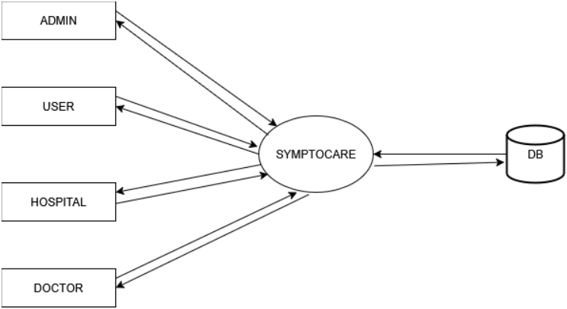
DATA FLOW DIAGRAM
• LEVEL 0
Slides: / 20

Slide 25
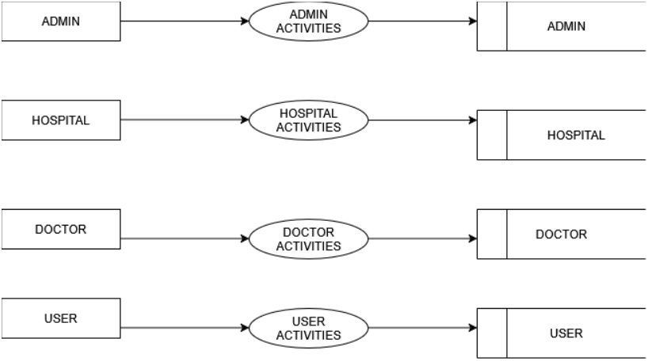
DATA FLOW DIAGRAM
• Level 01
Department of Computer Applications
Slides:
25
/ 20

Slide 26
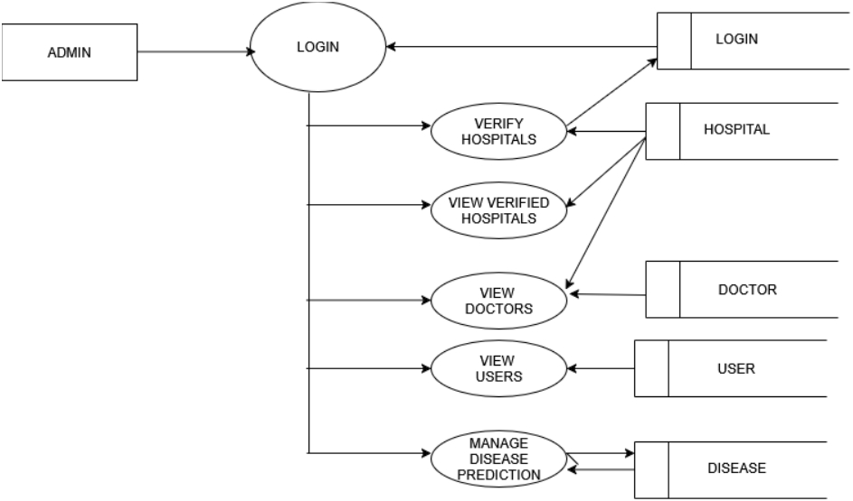
DATA FLOW DIAGRAM
• Level 02:ADMIN
Department of Computer Applications
Slides:
26
/ 20

Slide 27
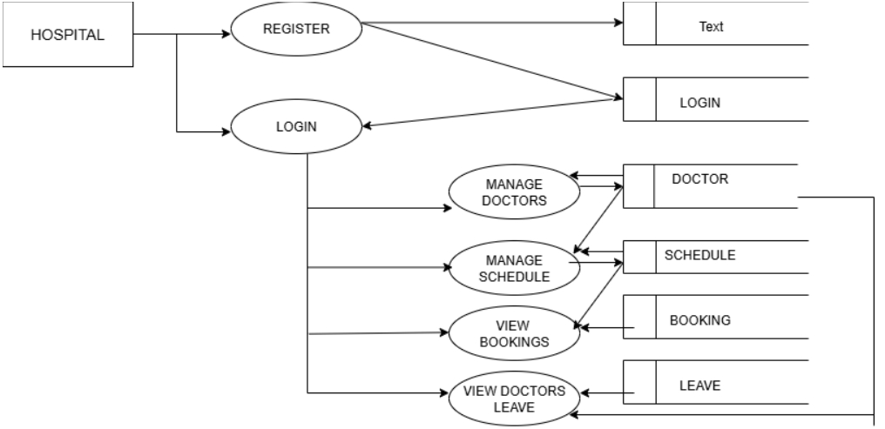
DATA FLOW DIAGRAM
• Level 2.1:Hospital
Department of Computer Applications
Slides:
27
/ 20

Slide 28
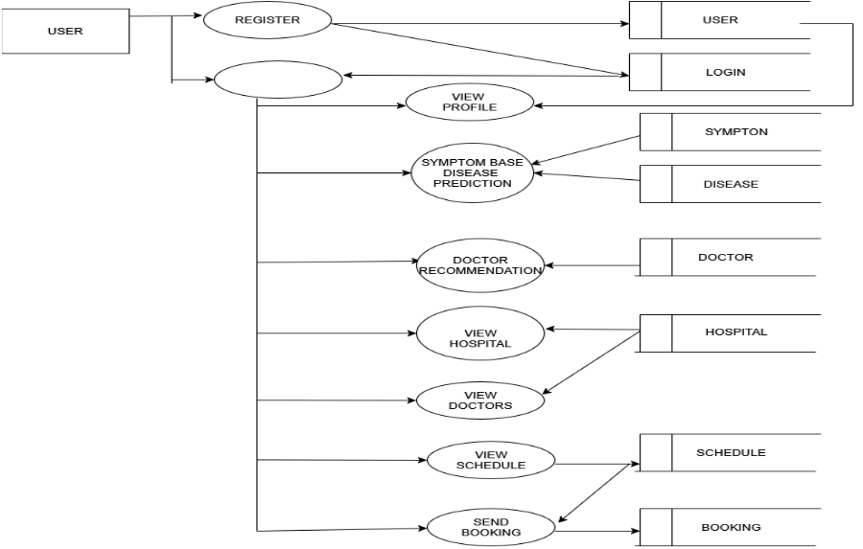
DATA FLOW DIAGRAM
• LEVEL2.3:USER
Department of Computer Applications
Slides:
28
/ 20

Slide 29
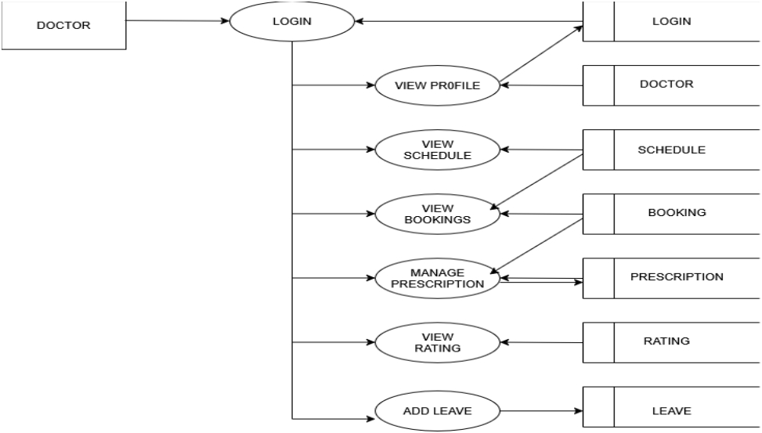
DATA FLOW DIAGRAM
• LEVEL2.2:Doctor
Department of Computer Applications
Slides:
29
/ 20

Slide 30
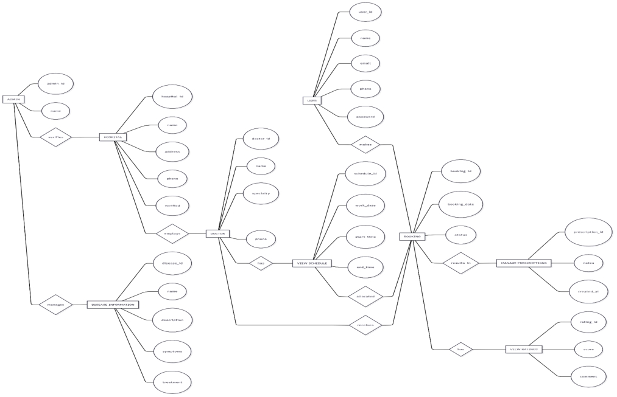
ER DIAGRAM
Department of Computer Applications
Slides:
30
/ 20

Slide 31
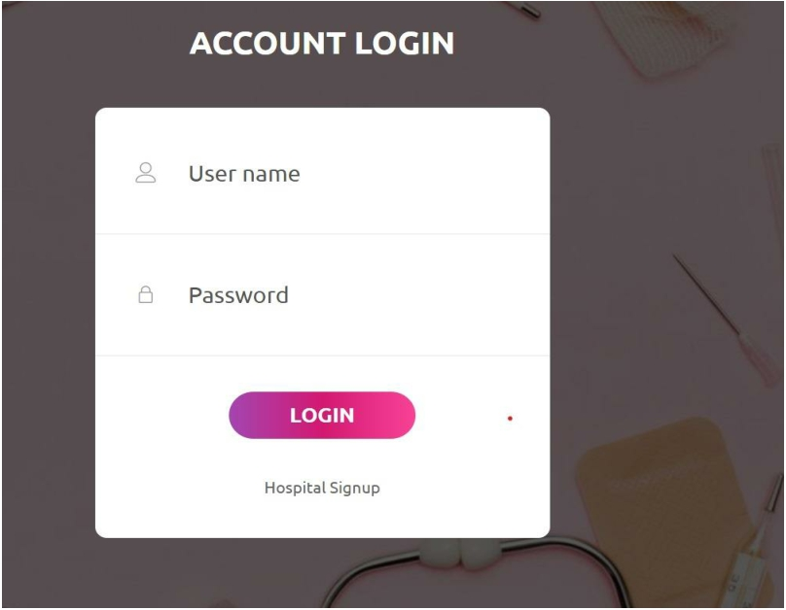
INTERFACE
Department of Computer Applications
Slides:
31
/ 20

Slide 32
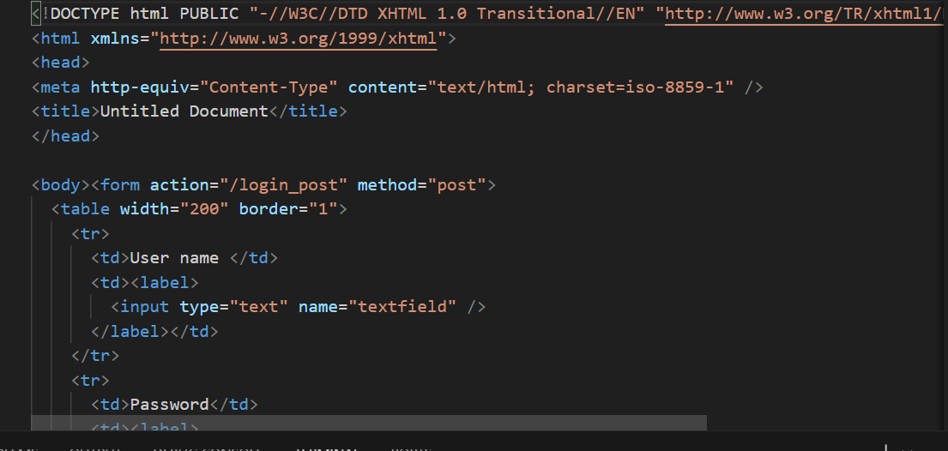
FUNCTIONALITIES
Department of Computer Applications
Slides:
34
/ 20

Slide 33

INTERFACE
Department of Computer Applications
Slides:
32
/ 20

Slide 34
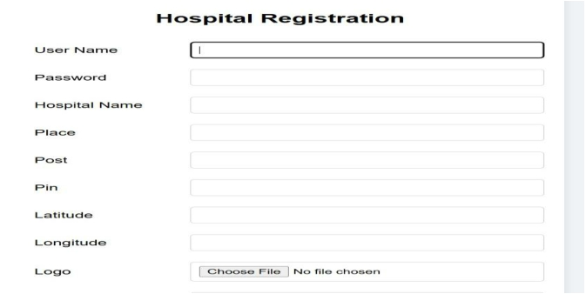
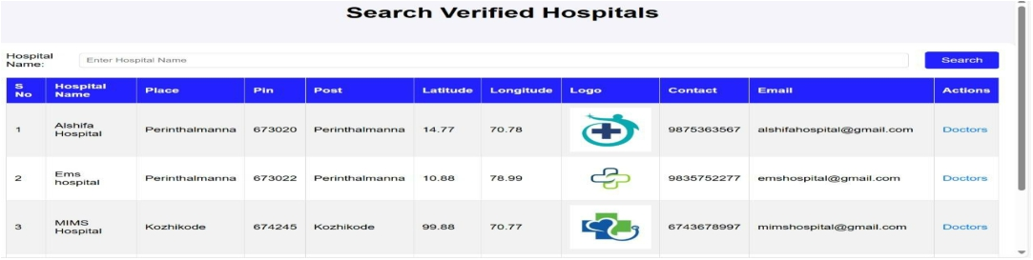
INTERFACE
Department of Computer Applications
Slides:
33
/ 20

Slide 35
FUNCTIONALITIES
Department of Computer Applications
Slides:
35
/ 20

Slide 36
THANK YOU

