Slide 1

Modeling, simulation and optimization of integrated milk pasteurization and membrane filtration processes
Athina Bampzeli
Academic supervisor: Michael Georgiadis
Siemens Industry Software: Lefteris Charakleias
Diploma Thesis
Chemical Engineering Department
Aristotle University of Thessaloniki
Notes:
Hello. My name is Athina Bampzeli, I hold an integrated Master’s degree in Chemical Engineering from Aristotle University of Thessaloniki, and I will present my diploma thesis entitled “Modeling, Simulation and Optimization of Integrated Milk Pasteurization and Membrane Filtration Processes”. The supervising professor was Michael Georgiadis, and the thesis was conducted in collaboration with Siemens, in communication with Lefteris Charakleias, Senior Applications Engineer.

Slide 2
Table of Contents
Introduction
Objectives-Methodology
Theoretical Background
Dynamic Modeling and Simulation
Global System Analysis
Optimization
Conclusions
Notes:
This presentation briefly consists of an introduction, the objectives and methodology followed in this work, the theoretical background of the processes, modeling, system analysis, optimization, and conclusions.

Slide 3
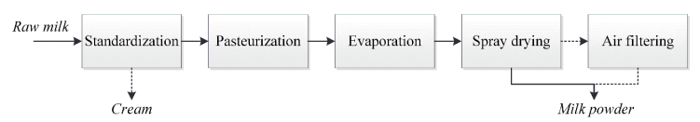
1. Introduction to Dairy Industry
Energy, Water
Cost
Value-added products
Milk powder
Low milk price
Membrane filtration
Figure 1: Main processes during milk powder production (Moejes, 2019)
Moejes, S. N. (2019). Redesign of the milk powder production chain: Assessment of innovative technologies [Doctoral dissertation, ProQuest Dissertations & Theses Global] https://www.proquest.com/dissertations-theses/redesign-milk-powder-production-chain-assessment/docview/2518745891/se-2​
Notes:
The dairy industry includes processes with high energy and water consumption, which leads to increased operating costs. Since the selling price of milk remains low, the current trend is a shift toward high value-added products such as cheeses, yogurts, concentrates, and milk powders. Milk powder occupies a smaller volume and can be stored outside refrigeration for a longer period compared to liquid milk. The figure presents the processes involved in milk powder production. Pasteurization aims at the inactivation of enzymes harmful to human health. This is followed by milk concentration processes that require heating. Membrane filtration can precede evaporation and drying, allowing part of the concentration to be achieved with lower energy consumption, while producing a concentrate enriched in proteins.

Slide 4
2.1 Objectives of the Study
Modeling and simulation of the integrated process
Concentrated milk with 20% solids
Physicochemical, biological phenomena
Operating conditions, parameters
Uncertainty reduction, control, optimal decisions
Optimization of the integrated process
To the best of our knowledge, no previous work in the literature has addressed the modeling, simulation, optimization, and sensitivity/uncertainty analysis of the integrated milk pasteurization and membrane filtration process.
Notes:
The objectives of this thesis are:
To model and simulate the integrated pasteurization and membrane filtration process for the production of concentrated milk with 20% total solids.
To evaluate how physicochemical and biological phenomena, operating conditions, and model parameters affect overall performance. This contributes to reducing the impact of parameter uncertainty, focusing control and experiments on the most influential factors, and supporting better-informed operational decisions.
Another objective is to economically optimize both process stages individually as well as the integrated process, while satisfying quality and safety constraints.
It is important to emphasize the novelty of this study, as no prior work in the literature addresses the modeling, simulation, optimization, and sensitivity and uncertainty analysis of the integrated pasteurization and membrane filtration process.

Slide 5
2.2 Methodology
Pasteurization Model
Simulation
Sensitivity Analysis
Uncertainty Analysis
Optimization
Membrane Filtration Model
Simulation
Sensitivity Analysis
Uncertainty Analysis
Optimization
Integrated Model
Simulation
Sensitivity Analysis
Uncertainty Analysis
Optimization
gPROMS™ FormulatedProducts v2015.1.0 (Siemens Digital Industries Software)
Notes:
Regarding the methodology, two dynamic state models are initially developed, one for each process, and subsequently simulated. Exploration of the design space is performed using Global System Analysis through sensitivity and uncertainty analyses. Then, optimization of the pasteurization and membrane filtration models is carried out. The results and decisions from the optimization of the individual models are incorporated into the integrated dynamic model, which is then simulated. Corresponding sensitivity and uncertainty analyses follow. Finally, optimization of the integrated processes is performed. All of the above are implemented in the gPROMS FormulatedProducts environment of Siemens Digital Industries Software.

Slide 6
3.1 Technical description of main process equipment
Heat exchangers
Plate, shell-and-tube
Corrugated plates
Narrow channels
Heat transfer, pressure drop, fouling
Modular design
Size
Cleaning, operating time
Ultrafiltration membrane
Retentate, permeate
1-800 kDa cut-off
Milk concentration
Temperature, pressure
Membrane material
Adding stages
Membrane types combination
Notes:
Milk pasteurization can be performed using plate heat exchangers and shell-and-tube heat exchangers. Corrugated plates and narrow channels promote turbulent flow and improved heat transfer, but also result in higher pressure drops. Plate heat exchangers are preferred over shell-and-tube exchangers because they heat milk gradually, reducing protein denaturation and fouling. Their modular design also allows additional exchangers to be used in series or in parallel. Shell-and-tube exchangers operate for longer periods and require less frequent cleaning when they are larger; however, increased size leads to higher capital cost.
During membrane filtration, the feed is separated into two outlet streams: the retentate -concentrate- and the permeate -filtrate-. The driving force for separation is the pressure difference between the feed and the permeate, which allows substances smaller than the membrane pore size to pass through. Ultrafiltration membranes have a molecular weight cut-off of 1 to 800 kDa. Milk proteins, which are larger than other solids, remain in the retentate, which is the main product. Membranes operate at moderate temperatures and pressures, resulting in low energy consumption, and do not require additional chemicals for separation. Depending on the membrane material, selectivity can be improved. Moreover, adding stages and combining different membrane types can enhance separation performance, although this simultaneously increases capital and operating costs.

Slide 7
3.2 Theoretical background-Phenomena studied
Pasteurization
Enzyme inactivation (phosphatase)
Protein denaturation (β-LG, α-LA, Ig)
Fouling
Microorganism growth (Streptococcus thermophilus)
Membrane filtration
Fouling
Notes:
During pasteurization, milk undergoes thermal stress. Phosphatase is an indicator enzyme for pasteurization success, as its thermal inactivation signifies product safety. However, protein denaturation also occurs in parallel, mainly affecting β-lactoglobulin, α-lactalbumin, and immunoglobulins, which degrades product quality. Fouling and the growth of microorganisms such as Streptococcus thermophilus make strict monitoring of pasteurization conditions and regular equipment cleaning critical. Fouling impedes heat transfer and raises safety concerns if substances enter the bulk milk. During membrane filtration, solids deposit on membrane pores, forming a layer that hinders separation.

Slide 8

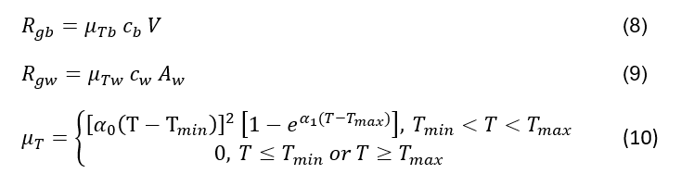
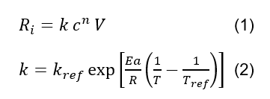

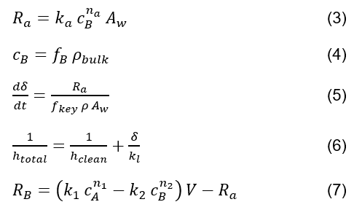
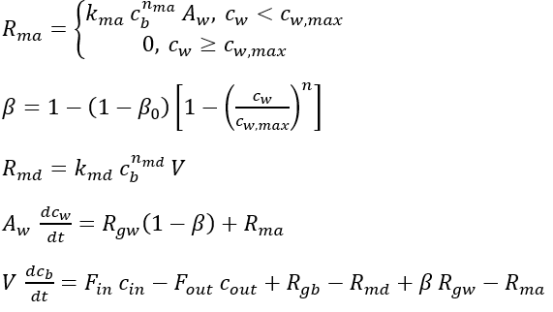

4.1.1 Mathematical equations of the pasteurization process
Notes:
The key equations of the pasteurization model are presented below. On the left are equations describing protein denaturation kinetics, phosphatase inactivation kinetics, fouling formation, and their effect on the heat transfer coefficient. The pasteurization unit (PU) represents the degree of pasteurization due to overall thermal exposure. On the right are equations describing the growth, destruction, and adsorption kinetics of Streptococcus thermophilus, as well as overall mass balances in the bulk milk and on the exchanger walls.

Slide 9
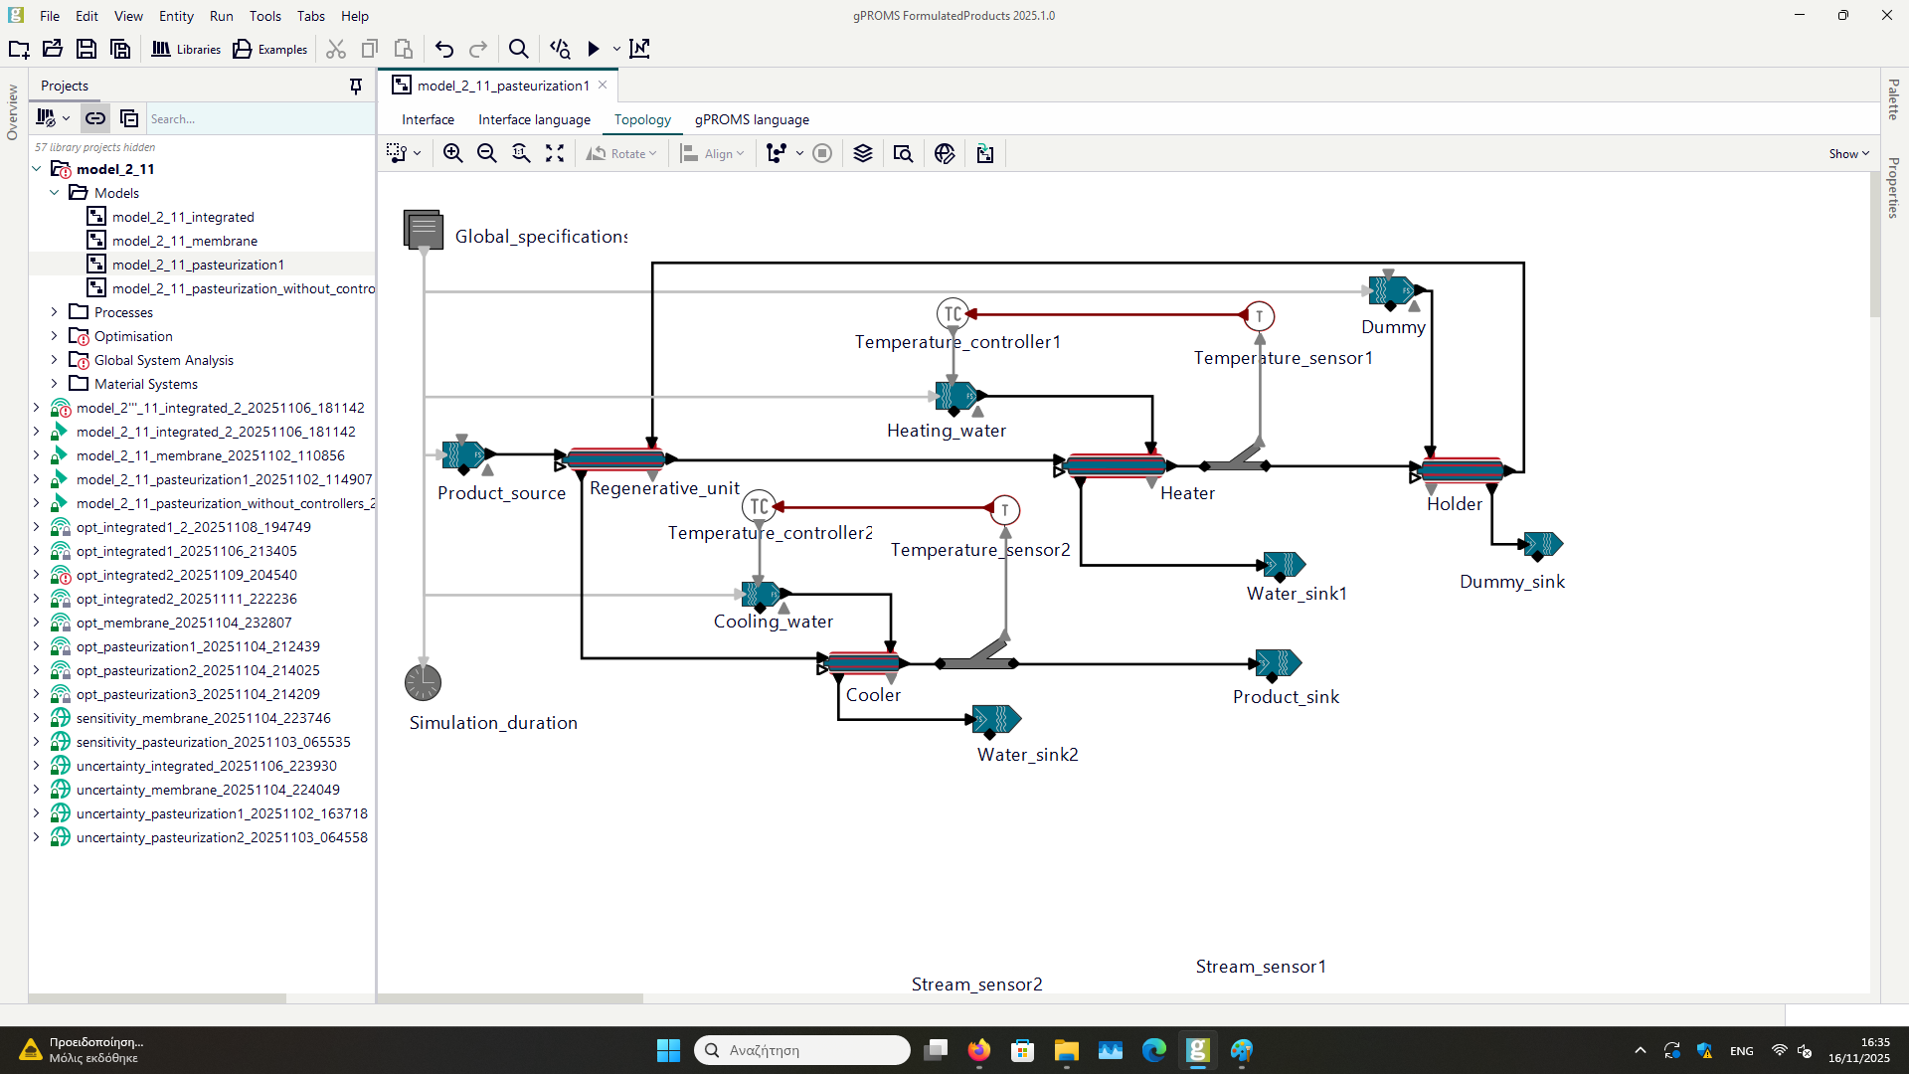
4.1.2 Pasteurization model-Specifications
75 °C
90 °C
1700 kg/h, 5 °C
75 °C
5 °C
20 °C
Notes:
The pasteurization model includes three plate heat exchangers -regenerative unit, preheater, and cooler-, one holding tube, and two controllers. Milk at a flow rate of 1700 kg/h enters the regenerative unit at 5°C, where it is heated by recycled pasteurized milk. It is then heated in the preheater to the pasteurization temperature of 75°C, which is the setpoint of the first controller. The controller adjusts the hot water flow at 90°C entering the shell side of the preheater. The milk then remains in the holding tube at the pasteurization temperature and subsequently flows through the shell side of the regenerative unit, where it is cooled by the incoming cold milk. Finally, the milk is further cooled in the cooler to 20°C, which is the setpoint of the second controller, regulating the cooling water flow at 5°C.

Slide 10
4.1.3 Pasteurization model-Simulation results (1/5)
75 °C
90 °C
1700 kg/h, 5 °C
42 °C
75 °C
6616 kg/h, 84 °C
5 °C
38 °C
20 °C
2278 kg/h, 18 °C
Notes:
The simulated variable values are shown in red. High hot and cold utilities flow rates of approximately 6600 kg/h and 2300 kg/h are observed compared to the milk flow of 1700 kg/h.

Slide 11
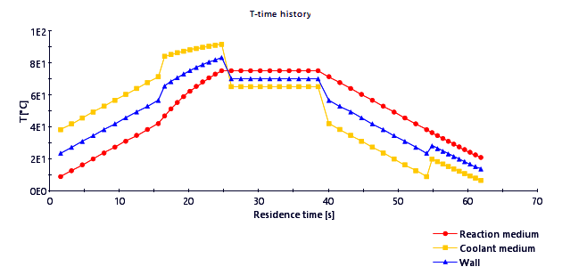
4.1.3 Pasteurization model-Simulation results (2/5)
Regenerative unit
Heater
Holder
Regenerative unit
Cooler
Figure 2: Temperature of the milk, utilities and wall of the heat exchangers to the residence time in the pasteurization section
Notes:
Milk temperature along the heat exchangers is shown in red. The yellow line represents the auxiliary streams’ temperature, and the blue line corresponds to wall temperature, which always lies between the other two.

Slide 12
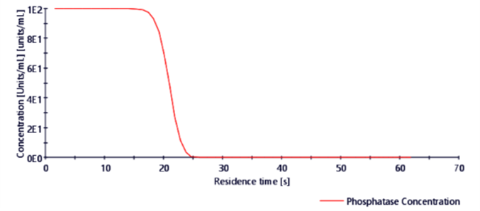
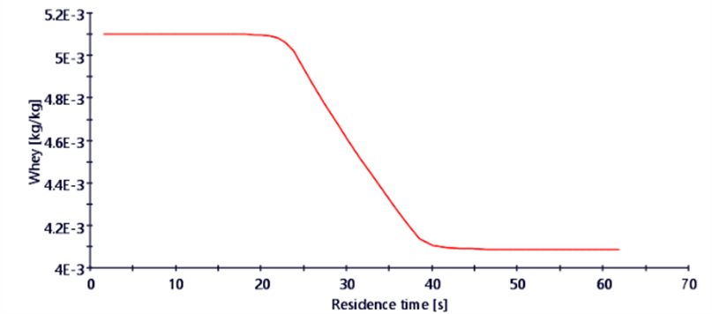
4.1.3 Pasteurization model-Simulation results (3/5)
Figure 3: Phosphatase concentration to the residence time in the pasteurization section
Figure 4: Whey protein concentration to the residence time in the pasteurization section
Regenerative unit
Heater
Regenerative unit
Cooler
Holder
Notes:
Phosphatase inactivation mainly occurs in the preheater, while protein denaturation primarily takes place in the holding tube. This highlights optimization potential. Among the three whey proteins studied, β-lactoglobulin shows the highest tendency for denaturation and deposition.

Slide 13
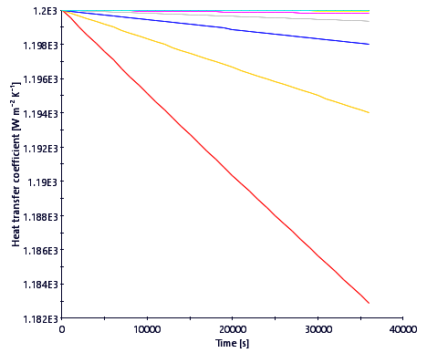
4.1.3 Pasteurization model-Simulation results (4/5)
Figure 5: Heat transfer coefficient in the shell of the regenerative unit
Notes:
Fouling occurs mainly on the shell side of the regenerative unit but does not significantly affect heat transfer. The heat transfer coefficient decreases primarily at the inlet section of the shell, from 1200 to 1182 W/(m²·K).

Slide 14
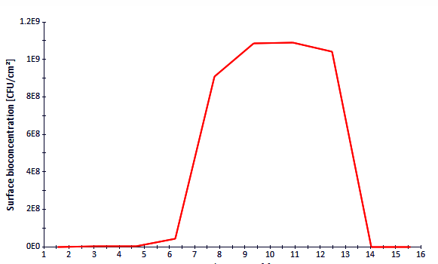
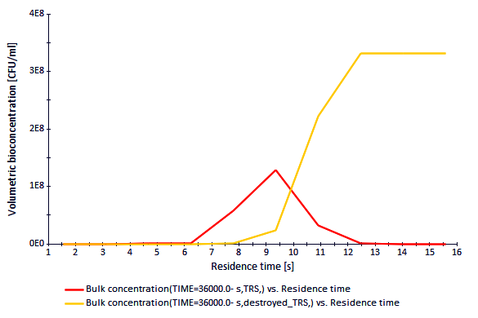
4.1.3 Pasteurization model-Simulation results (5/5)
Figure 6: S.thermophilus surface concentration in the regenerative unit to the residence time
Figure 7: S.thermophilus and destroyed S.thermophilus bulk concentration in the regenerative unit to the residence time
Notes:
The presence of Streptococcus thermophilus on the walls of the regenerative unit is more critical than its concentration in the bulk milk. At the midpoint of the exchanger, the surface concentration reaches approximately 1×10⁹ CFU/cm².

Slide 15
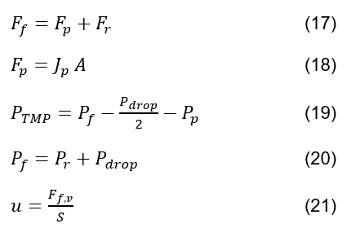
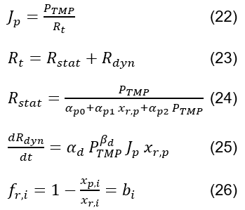
4.2.1 Mathematical equations of the membrane filtration process
Notes:
The equations of the membrane filtration model include mass balances, static and dynamic flow resistance due to membrane characteristics and fouling, and the retention factor that determines solids rejection.

Slide 16
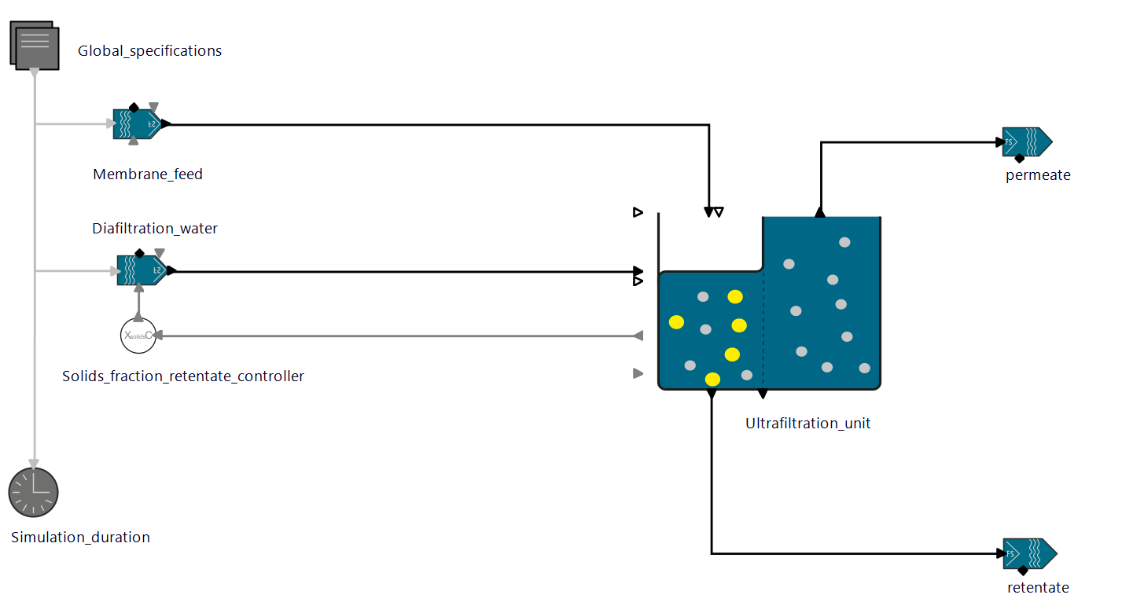
4.2.2 Membrane filtration model-Specifications
1700 kg/h, 20 °C
20 °C
20% solids
Notes:
Milk enters the filtration model at 1700 kg/h and 20°C, matching the outlet temperature of the pasteurization model. Diafiltration water also enters at 20°C. The goal is to separate the feed into two outlet streams, with the retentate containing 20% total solids, mainly proteins. This solids concentration is the controller setpoint regulating diafiltration water flow.

Slide 17
4.2.3 Membrane filtration model-Simulation results (1/2)
1700 kg/h, 20 °C
1721 kg/h, 20 °C
20 °C
377 kg/h
356 kg/h, 20 °C
20% solids
Notes:
The permeate flow is 4.8 times higher than the retentate flow, due to milk’s high water content and the addition of 377 kg/h of diafiltration water.

Slide 18
4.2.3 Membrane filtration model-Simulation results (2/2)
Water
80% in retentate
95.3% in permeate
Figure 8: Comparative diagram of the retentate and permeate concentration in solids
Notes:
The composition of solids in the retentate and permeate is compared. The retentate shows higher protein and total solids content, while water remains the dominant component in both streams.

Slide 19
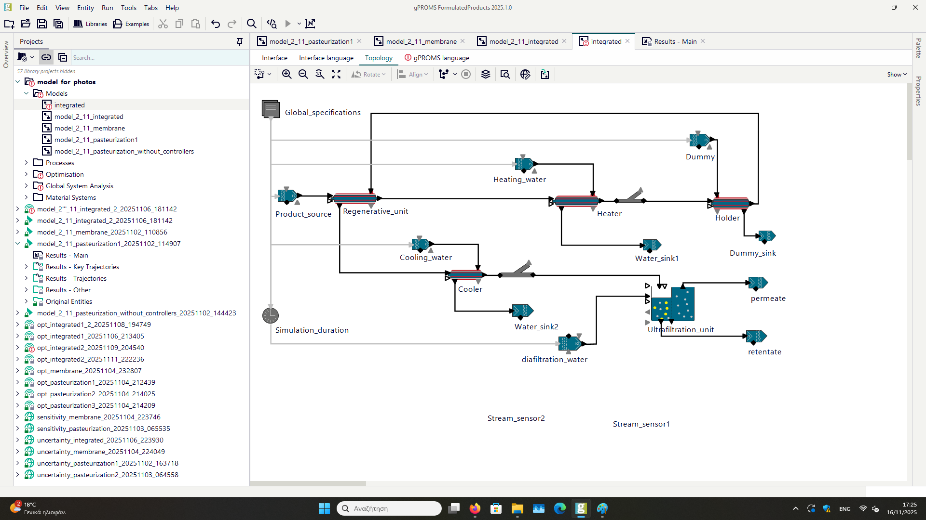
4.3.1 Integrated model-Specifications
3095 kg/h, 90 °C
1700 kg/h, 5 °C
2278 kg/h, 5 °C
226 kg/h, 20 °C
Notes:
The integrated model uses the equipment presented in the previous two models, excluding controllers. The flow rates of the hot and cold utilities are set based on the optimization results of the individual models.

Slide 20
4.3.2 Integrated model-Simulation results (1/4)
72 °C
3095 kg/h, 90 °C
1700 kg/h, 5 °C
40 °C
72 °C
2278 kg/h, 5 °C
76 °C
37 °C
19 °C
1579 kg/h, 19 °C
226 kg/h, 20 °C
17 °C
347 kg/h, 19 °C, 20% solids
Notes:
Pasteurization temperature is reduced from 75°C to 72°C. The permeate-to-retentate flow ratio is 4.6, compared to 4.8 previously.

Slide 21
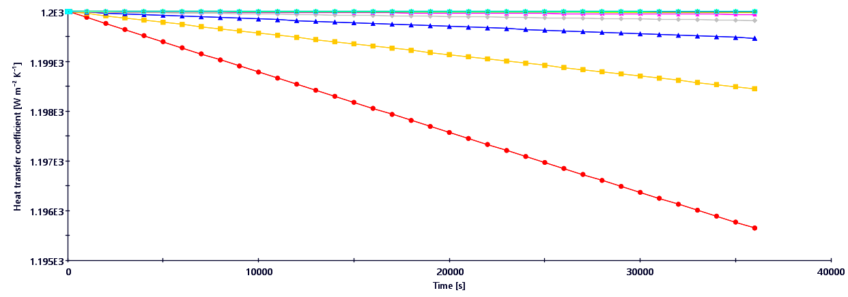
4.3.2 Integrated model-Simulation results (2/4)
Figure 5: Pasteurization model
Figure 9: Heat transfer coefficient in the shell of the regenerative unit in the integrated model
Notes:
The heat transfer coefficient decreases in the regenerative unit shell. At the shell inlet, it decreases from 2000 to 1195 W/(m²·K) compared to 1182 W/(m²·K) in the pasteurization model, due to reduced protein denaturation at the lower pasteurization temperature.

Slide 22
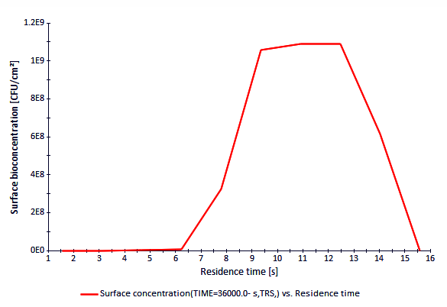
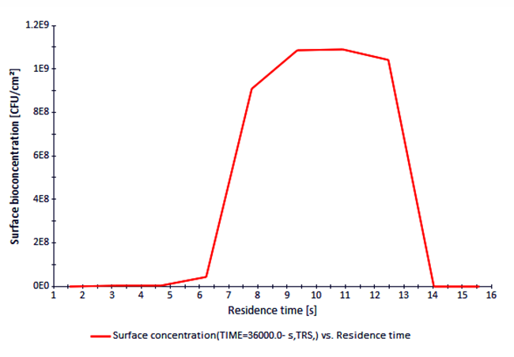
4.3.2 Integrated model-Simulation results (3/4)
Figure 10: S.thermophilus surface concentration in the regenerative unit to the residence time in the integrated model
Figure 6: Pasteurization model
Notes:
The S. thermophilus concentration profile on the regenerative unit walls remains similar.

Slide 23
4.3.2 Integrated model-Simulation results (4/4)
Water
79.8% in retentate
94.8% in permeate
Figure 11: Comparative diagram of the retentate and permeate concentration in solids in the integrated model
Figure 8: Membrane filtration model
Notes:
No major differences are observed in the solid compositions of permeate and retentate between the integrated and membrane filtration model. Proteins and total solids remain proportionally higher in the retentate.

Slide 24
5.1 System analysis and Cost analysis
Global System Analysis tool
Sensitivity analysis
Uncertainty analysis
Heating water cost | 1.5 USD/t
Cooling water cost | 0.1 USD/t
Diafiltration water cost | 0.96 USD/t
Concentrated milk revenue | 585 USD/t
Table 1: Cost and revenue of the streams
Notes:
System analysis is conducted using Global System Analysis. Sensitivity analysis identifies parameters with the greatest impact on key performance indicators, while uncertainty analysis quantifies their effect due to parameter uncertainty. Economic quantification includes auxiliary utility costs and revenues from concentrated milk production.

Slide 25
5.2 System analysis-Responses
Pasteurization | Membrane filtration | Integrated model
Heating water consumption (kg) | Diafiltration water flow (kg/h) | S.thermophilus surface concentration in the regenerative unit (CFU/cm²)
Cooling water consumption (kg) | Retentate flow (kg/h) | S.thermophilus bulk concentration in retentate (CFU/mL)
 | Casein mass fraction in retentate (kg/kg)
Table 2: Reponses during the system analysis of the models
Notes:
The table presents system analysis responses for the three models. In the pasteurization model, total heating and cooling water consumption is considered. In the membrane filtration model, diafiltration water flow, retentate flow, and casein mass fraction in the retentate are evaluated. In the integrated model, S. thermophilus concentrations on exchanger walls and in bulk milk are examined.

Slide 26
5.3 Integrated model-Sensitivity analysis
Factor | Uniform distribution |  | Reason
 | Lower boundary | Upper boundary
E_{a} adsorption (kJ mol⁻¹) | 0 | 400 | Uncertainty
E_{a} destruction (kJ mol⁻¹) | 400 | 900
α₀ (K⁻¹ s^{-0.5}) | 0.0001 | 0.002
α₁ (K⁻¹) | 0.01 | 0.2
T_{min} (°C) | 10 | 25
T_{max} (°C) | 50 | 60
n | 1 | 2
c_{b,feed} (CFU mL⁻¹) | 500 | 1500
Simulation duration (h) | 4 | 12 | Operational decision
Table 3: Factors examined in the sensitivity analysis of the integrated model and their distributions
Notes:
For time efficiency, only the integrated model sensitivity and uncertainty analysis are presented. The table lists examined factors, their distributions, and the reasons for their selection.

Slide 27
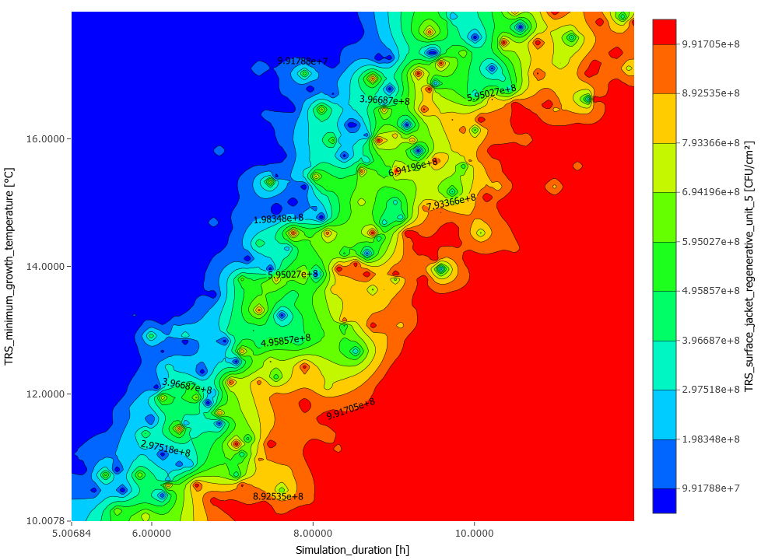
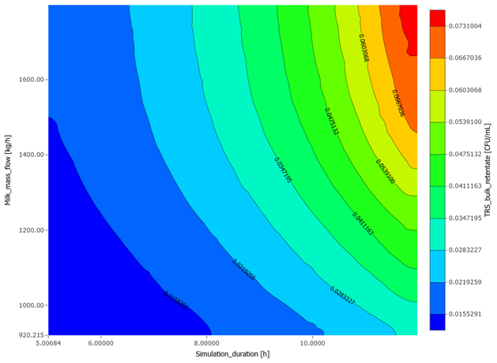
5.4 Integrated model-Uncertainty analysis
Figure 12: Impact of the simulation duration and the minimum growth temperature of S.thermophilus to its surface concentration in the regenerative unit
Figure 13: Impact of the simulation duration and the feed flow to the S.thermophilus bulk concentration in retentate
Notes:
Key factors affecting S. thermophilus concentration on regenerative unit walls and in the retentate are presented. Increased simulation duration and lower minimum growth temperature lead to higher surface concentration, while longer duration and higher feed flow increase retentate concentration.

Slide 28
6. Optimization
CVP_SS solver
DAEBDF solver for differential algebraic equations
max/min f(x) (27)
subject to h(x)=0 (28)
g(x)≤0 (29)
Notes:
Optimization involves maximizing or minimizing the objective function subject to equality constraints, mainly model equations, and inequality constraints related to quality and safety standards.

Slide 29
6.1 Pasteurization model-Optimization
Variable | Type | Lower boundary | Upper boundary | Optimized value | Value before optimization | Profit
Heating water consumption (kg) | Objective function | - | - | 30948 | 66158 | 53%
Heating water cost (USD h⁻¹) | - | - | - | 4.64 | 9.92 | 53%
Heater outlet temperature (°C) | Decision variable | 72 | 80 | 72 | 75 | -
Cooler outlet phosphatase concentration (units mL⁻¹) | Restriction | 0 | 3.5×10⁻⁴ | 1.1×10⁻⁶ | 4.8×10⁻¹⁰ | Successful pasteurization
β-LG denaturation in holder (%) | Restriction | 0 | 20 | 13.2 | 26.39 | -
Table 4: Variables, distributions, initial and final values in the optimization of the pasteurization model
Notes:
Optimization of the pasteurization model reduces heating water consumption by approximately 53% due to lowering pasteurization temperature from 75°C to 72°C.

Slide 30
6.2 Membrane filtration model-Optimization
Variable | Type | Lower boundary | Upper boundary | Optimized value | Value before optimization | Profit
Diafiltration water consumption (kg) | Objective function | - | - | 2262 | 3776 | 40%
Diafiltration water cost (USD h⁻¹) | - | - | - | 0.22 | 0.36 | 40%
Separation fraction in stage 1 | Decision variable | 0 | 1 | 0 | 0.33 | -
Separation fraction in stage 2 | Decision variable | 0 | 1 | 0 | 0.33 | -
Separation fraction in stage 3 | Decision variable | 0 | 1 | 1 | 0.33 | -
Casein mass fraction in retentate | Restriction | 0.1 | 1 | 0.129 | 0.128 | -
Table 5: Variables, distributions, initial and final values in the optimization of the membrane filtration model
Notes:
After optimizing the membrane filtration model, diafiltration water is introduced entirely in the third and final membrane stage, reducing water consumption by 40%.

Slide 31
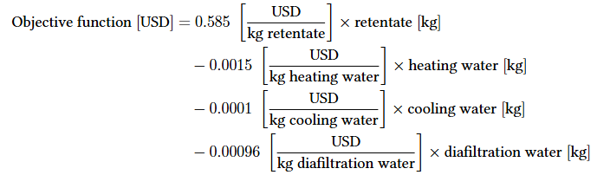
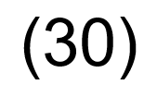
6.3.1 Integrated model-Objective function
Notes:
The objective function used in the optimization of the integrated model equals revenue from concentrated milk minus costs of heating, cooling, and diafiltration water, effectively approximating process profit.

Slide 32
6.3.2 Integrated model-Optimization (1/2)
Variable | Type | Lower boundary | Upper boundary | Optimized value | Value before optimization | Profit
Objective function (USD) (equation 30) | Objective function | - | - | 2240.66 | 1985 | 12.9%
Retentate flow (kg h⁻¹) | - | - | - | 424 | 348 | 21.8%
Simulation duration (h) | - | 5 | 12 | 9.57 | 10 | -
Feed flow (kg h⁻¹) | Decision variable | 500 | 2500 | 1930 | 1700 | -
Heating water flow (kg h⁻¹) | Decision variable | 2000 | 9000 | 9000 | 3095 | -
Colling water flow (kg h⁻¹) | Decision variable | 1500 | 4000 | 1854 | 2278 | 18.6%
Diafiltration water flow (kg h⁻¹) | Decision variable | 100 | 1000 | 221 | 226 | 2.2%
Table 6: Variables, distributions, initial and final values in the optimization of the integrated model
Notes:
The results show that operating time is reduced to 9.57 h from 10 h, and the profit objective function increases by 13%.

Slide 33
6.3.2 Integrated model-Optimization (2/2)
Variable | Type | Lower boundary | Upper boundary | Optimized value | Value before optimization | Profit
Phosphatase concentration in cooler (units mL⁻¹) | Restriction | 0 | 3.5×10⁻⁴ | 3.8×10⁻⁶ | 1.2×10⁻⁶ | Successful pasteurization
Solids in retentate (%) | Restriction | 19.5 | 20.5 | 19.5 | 20 | Successful concentration
Heater outlet temperature (°C) | Restriction | 72 | 72 | 72 | 72 | -
Cooler outlet temperature (°C) | Restriction | 10 | 25 | 22.5 | 19 | -
β-LG denaturation in holder (%) | Restriction | 0 | 20 | 11.7 | 13.18 | -
S.thermophilus concentration in retentate (CFU mL⁻¹) | Restriction | 0 | 100 | 0.048 | 0.047 | -
S.thermophilus surface concentration in regenerative unit (CFU cm⁻²) | Restriction | 0 | 10⁹ | 9.9×10⁸ | 10⁹ | -
Table 6 (continue): Variables, distributions, initial and final values in the optimization of the integrated model
Notes:
Constraints include achieving pasteurization and concentration targets, heating and cooling temperatures, β-lactoglobulin denaturation, and S. thermophilus concentration.

Slide 34
7.1 Conclusions-Restrictions of the integrated process
Economic/Environmental | Safety | Quality
productivity | pasteurization/phosphatase | concentration/20% solids
operating time | S.thermophilus | protein denaturation
water | fouling
energy
Table 7: Specifications and restrictions of the integrated milk pasteurization and membrane filtration process
Notes:
Proceeding to the conclusions, this is a summary of the economic, environmental, safety, and quality constraints of the integrated process.

Slide 35
7.2 Conclusions
Influential factor: milk feed flow (1930 kg/h)
Costly variable: heating water (129 USD)
Phosphatase: inactivation mainly in the heater
Proteins: denaturation mainly in the holder (11.7%)
Fouling: negligible, mainly in the regenerative unit
Streptococcus thermophilus: growth mainly in the surface of the regenerative unit, process shutdown at 9.57 h
Optimization of the integrated model: 13% increase in profit
Notes:
The most influential factor is milk feed flow rate. The most costly variable is heating water. Phosphatase is mainly inactivated in the preheater, while protein denaturation, especially of β-lactoglobulin, occurs mainly in the holding tube. Fouling is negligible and mainly appears in the regenerative unit. S. thermophilus grows primarily in the regenerative unit and leads to process shutdown at 9.57 h. Optimization of the integrated model increases profit by 13%.

Slide 36
7.3 Future Research
Model validation using pilot or industrial scale data
Pasteurization temperature control policy
Cleaning operations scheduling
Effect of the feed flow rate on the integrated production chain
Impact of design parameters
Notes:
Future research could include evaluation of the model using pilot or industrial-scale data. Another suggestion is the development of a control policy for pasteurization temperature and the scheduling of cleaning operations based on the integrated model. Finally, the effect of the feed flow rate on the integrated production chain could be studied, as well as the impact of design parameters on key performance indicators.

