Slide 1
Evan Baker
EAB_HW02
29 January 2014
matrixMult
Output:
>>EAB_HW02_P01
Matrix A = [ 2 -1 ; 8 3 ; 6 7 ];
Matrix B = [ 4 9 1 -3 ; -5 2 4 6 ];
[A]*[B] = [C] =
13 16 -2 -12
17 78 20 -6
-11 68 34 24
% Evan Baker
% EAB_HW02_P01 [matrixMult.m]
% 29 January 2014
% This function gets passed two matrices, multiplies them together, and
% returns them.
function M3 = matrixMult(M1,M2)
% M1 = input('Matrix 1 = '); % get user to input matrices to mult
% M2 = input('Matrix 2 = ');
[rowM1,colM1] = size(M1); % size the matrices for useful dims
[rowM2,colM2] = size(M2);
if colM1 ~= rowM2 % error check for dim mismatch
disp('M1, M2 dimensions mismatched, cannot multiply.') % throw error
else % if dims match
M3 = zeros(rowM1,colM2); % generate the soln matr to be populated in the loop
% This loop builds a seperate soln matr for each set of indexed terms
% that are added together in the final soln, then adds them together to
% generate the soln matr. Essentially a 3D loop that flattens to a 2D
% matrix for the soln.
for x = 1:colM1 % loop over summed terms
for m = 1:rowM1 % loop over rows in M1
for n = 1:colM2 % loop over cols in M2
M3(m,n) = M1(m,x)*M2(x,n) + M3(m,n); % do the math bit
end
end
end
end
end
P01 Driver Func
% Evan Baker
% EAB_HW02_P01
% 29 January 2014
% This is just a shell to run
% the function matrixMult
clc
format compact
A = input('Matrix A = ');
B = input('Matrix B = ');
disp('[A]*[B] = [C] =')
C = matrixMult(A,B);
disp(C)

Slide 2
P02_driverRoutine
% Evan Baker
% EAB_HW02_P02_driverRoutine
% 28 January 2014
% this is the driver routine for the compute mean and std routine for HW02
format long
format compact % set long format and no addtl newline
data = randn(1,10000); % generate 10k normal random datapoints
[m, s] = computeMeanStd(data); % do my mean std func
disp([m, s]) % disp my results
disp([mean(data), std(data)]) % do and display matlab's mean & std results
P02_computeMeanStd
% Evan Baker
% EAB_HW02_P02 (computeMeanStd.m)
% 29 January 2014
% This function takes a data set input and returns a mean and std
function [meanValue, stdValue] = computeMeanStd(data)
sumMean = 0; % initialize sum vars
sumStd = 0;
for i = 1:length(data) % loop through data
sumMean = data(i) + sumMean; % get the sum of data
end
meanValue = sumMean / length(data); % get the average of data
for i = 1:length(data) % loop through data again
sumStd = (data(i) - meanValue)^2 + sumStd; % get the sum used in Std for data
end
stdValue = sqrt(sumStd / (length(data) - 1)); % get the stdDev of data
end
Output:
>>EAB_HW02_P02_driverRoutine 0.001659431211725 0.991477675152633
0.001659431211725 0.991477675152633

Slide 3
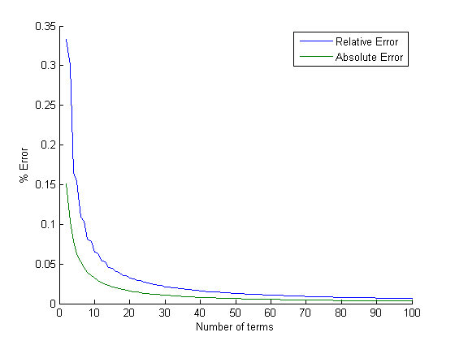
P03_piFunc
% Evan Baker
% EAB_HW02_P03_piFunc
% 29 January 2014
% A slow converging algorithm to compute pi
% n: numbers of terms to sum
% pi_approx: approximate value of pi
n = input('Number of elements to sum, n= ');
[pi_approx,absErr,relErr] = piFunc(n);
hold on
ni = 2:100;
plot(ni,relErr(2:100),ni,absErr(2:100))
xlabel('Number of terms')
ylabel('% Error')
legend('Relative Error','Absolute Error')
piFunc
% Evan Baker
% EAB_HW02_P03 (piFunc)
% 29 January 2014
% A slow converging algorithm to compute pi
% n: numbers of terms to sum
% pi_approx: approximate value of pi
function [pi_approx,absErr,relErr] = piFunc(n)
pi_approx = 0;
pi_list = zeros(n,1);
relErr = zeros(n,1);
absErr = zeros(n,1);
for i = 1:n
pi_approx = pi_approx + 4*(-1)^(i+1)/(2*i-1);
pi_list(i) = pi_approx;
end
for i = 2:n
absErr(i) = abs((pi_list(i) - pi)/pi);
relErr(i) = abs((pi_list(i) - pi_list(i-1)) / pi_list(i-1));
end
Output:
>>EAB_HW02_P03_piFunc
Number of elements to sum, n= 100

