Slide 1
Evan Baker
EAB_HW04_P01
12 February 2014
P01 Function (Excluding gaussJ.m from the lab):
% Evan Baker
% EAB_HW04_P01
% 12 February 2014
% This script will solve a pre-pivoted matrix of nth dimension
% First we call a modified version of the lab Gauss-Jorden
% script written in Lab04 - gaussJ.m - to do the actual solving
% We then call the lab script again but modify the input
% arguments to recieve [a]^-1 from the elimination
function EAB_HW04_P01(a, b)
%a = input('Input prepivoted matr a = '); % get coeff matr
%b = input('Input adjusted soln matr b = '); % get soln matr
sizeA = size(a); % get size of a for next step
solnAB = gaussJ(a,b) % call elimination script
matlabSolnAB = a \ b
b = eye(sizeA(1)); % make an identity matrix b for inverting a
invA = gaussJ(a,b) % call elimination script with a,b to invert a
matlabInvA = a \ b%;
function solnAB = gaussJ(a,b)
...
end
end
Output:
>> EAB_HW04_P01(A1,B1)
solnAB =
-67.1576
-284.9310
202.6158
168.6108
672.6847
130.6010
matlabSolnAB =
-67.1576
-284.9310
202.6158
168.6108
672.6847
130.6010
invA =
-0.3626 0.6729 -0.8286 2.3320 -2.4251 0.5734
-1.2414 2.7931 -3.0000 7.5172 -8.9828 1.7241
0.9163 -1.8473 2.1429 -5.4532 6.3325 -1.1773
0.8049 -1.6325 1.8857 -4.7616 5.4099 -1.0719
3.0749 -6.4542 6.9429 -17.5360 21.0498 -4.0532
0.5823 -1.2030 1.3714 -3.3783 4.0645 -0.8611
matlabInvA =
-0.3626 0.6729 -0.8286 2.3320 -2.4251 0.5734
-1.2414 2.7931 -3.0000 7.5172 -8.9828 1.7241
0.9163 -1.8473 2.1429 -5.4532 6.3325 -1.1773
0.8049 -1.6325 1.8857 -4.7616 5.4099 -1.0719
3.0749 -6.4542 6.9429 -17.5360 21.0498 -4.0532
0.5823 -1.2030 1.3714 -3.3783 4.0645 -0.8611
As can be seen here, Gauss Jorden elimination can be used to both solve a system of equations in matrix form [a][x]=[b], and solve the special case of [b] being the identity matrix, which gives [x] = [a]^-1.

Slide 2
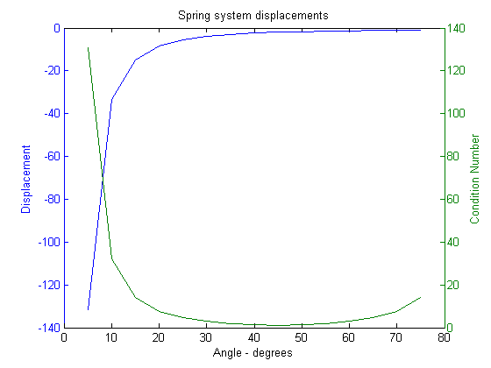
EAB_HW04_P02
P02 Function code:
% Evan Baker
% EAB_HW04_P02
% 12 February 2014
function EAB_HW04_P02
F = input('Force (assume 1), F = ');
k = input('k (assume 1), k = ');
% th = input('angle theta = ');
iL = input('Lower bound of theta = '); % get angle lower bound
iU = input('Upper bound of theta = '); % get angle upper bound
iS = input('Step increment of theta = '); % get angle step
sol = linspace(iL,iU,iL-iU/iS); % prealloc sol vector
for i = iL:iS:iU % loop through every angle step
th = i;
sol(i/5,1) = i;
[sol(i/5,2),sol(i/5,3)] = springSys(th,F,k); % solve the %system at angle th
end
disp(sol) % disp matr sol [angle displacement condition]
graph = plotyy(sol(:,1),sol(:,2),sol(:,1),sol(:,3)); % plot the %above matr soln
axes(graph(1));ylabel('Displacement');
axes(graph(2));ylabel('Condition Number');xlabel('Angle - degrees');title('Spring system displacements');
function [yDisp, cn] = springSys(th,F,k) % solves the matrix %system of eqs for the % spring sys
A1 = k.*[ cosd(th)^2, 0; 0, sind(th)^2]; % def matr a
B1 = [ 0; -F]; % def matr b
soln = A1\B1; % divide for soln matr
yDisp = soln(2,1); % pull y disp out of soln matr
cn = cond(A1); % get cond of a
end
end
Output:
A.
>> EAB_HW04_P02
Force (assume 1), F = 1
k (assume 1), k = 1
Lower bound of theta = 5
Upper bound of theta = 75
Step increment of theta = 5
5.0000 -131.6461 130.6461
10.0000 -33.1634 32.1634
15.0000 -14.9282 13.9282
20.0000 -8.5486 7.5486
25.0000 -5.5989 4.5989
30.0000 -4.0000 3.0000
35.0000 -3.0396 2.0396
40.0000 -2.4203 1.4203
45.0000 -2.0000 1.0000
50.0000 -1.7041 1.4203
55.0000 -1.4903 2.0396
60.0000 -1.3333 3.0000
65.0000 -1.2174 4.5989
70.0000 -1.1325 7.5486
75.0000 -1.0718 13.9282
B.
>> EAB_HW04_P02
Force (assume 1), F = 1
k (assume 1), k = 1
Lower bound of theta = 1e-7
Upper bound of theta = 1e-6
Step increment of theta = 1e-7
Attempted to access sol(2e-08,1); index must be a positive integer or logical.
Error in EAB_HW04_P02 (line 15)
sol(i/5,1) = i;
Matlab errors here because the step size for theta is too small. However, we can imagine that at such a small theta displacement, the y displacement would actually be very small. However, the condition of the matrix at very small theta is going to be large, telling us that the calculations Matlab carries out for this solution would be wrong anyway.

