Slide 1
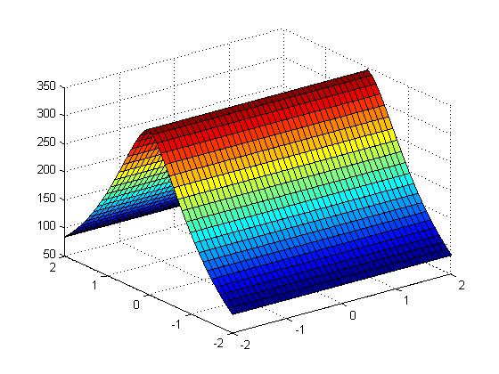
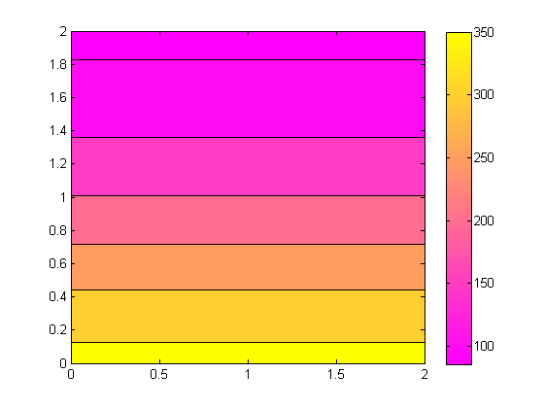
Evan Baker
EAB_HW06
26 February 2014
P01 Function code:
% Evan Baker
% EAB_HW06_P01
% 26 February 2014
figure(1) % set that we're working in window 1
[ x, y ] = meshgrid(-2:0.1:2,-2:0.1:2); % build our mesh size
r = sqrt(x.^2 + y.^2);
z = exp(-r)*cos(4*x)*cos(4*y); % build our height map
shading flat % set shading flat
surf(x, y, z) % draw the surface
figure(2) % move to window 2 while keeping window 1
[ x, y ] = meshgrid(0:0.05:2,0:0.05:2); % new meshgrid from 0 to 2, same size
r = sqrt(x.^2 + y.^2);
z = exp(-r)*cos(4*x)*cos(4*y); % build our new height map
colormap(spring) % set to ugly colors
contourf(x, y, z) % draw the contour plot
colorbar % draw the colorbar for scale
This scrip will create a surface plot and contour of the surface plot with a colorbar for the positive x and y range.

Slide 2
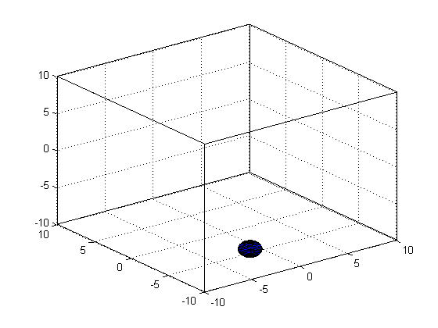
HW06_P02
Function Code:
% Evan Baker
% EAB_HW06_P02
% 26 February 2014
function EAB_HW06_P02
v = 1; % velocity vector
s = 10; % side length of the box
fps = 1; % frame rate resolution of simulation - higher = smoother particle motion
time = 20; % run for 20 seconds normally
safe = s - 1;
p = [randi(safe), randi(safe), randi(safe)]; % define pseudorandom initial position vector
v = [randi(v), randi(v), randi(v)]; % define velocity vector
[xs, ys, zs] = sphere; % build sphere mesh, default radius is 1
count = 0;
j = 1;
% for frames = 1:(fps*time) % generate (seconds)*(frames per second) frames
while count <= 10 % this while loops for a bunch of bounces
clf
drawBox
[v, count] = collision(p,v,count);
p = v/(fps) + p;
% at every time, the new position is the previous position + velocity * time(1), so p + 1 * v
surf(xs+p(1), ys+p(2), zs+p(3))
M(j) = getframe(gcf);
j = j + 1;
end
movie2avi(M, 'bounce.avi', 'compression', 'none');
function [v, count] = collision(p,v,count)
for i = 1:3
if p(i) <= -safe
v(i) = abs(v(i));
count = count + 1;
elseif p(i) >= safe % check the edges for collision
v(i) = -abs(v(i)); % if a collision state is present, bounce
count = count + 1;
end
end
end
This function models an ideal gas molecule bouncing around in a 3D 10x10x10 cube and animates the movement through several bounces. The initial velocity vector and position is psuedorandomized at runtime. Above is a plot of the final frame of the animation.

