Slide 1
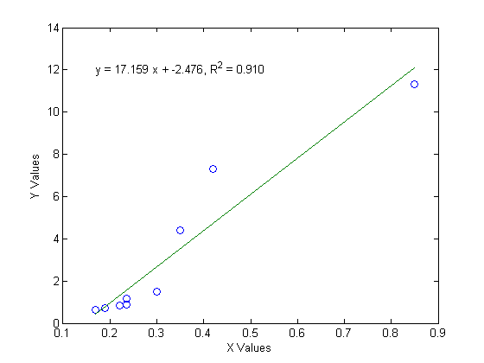
Evan Baker
EAB_LAB05_P01
14 February 2014
P01 Function code:
% Evan Baker
% EAB_LAB05_P01
% 14 February 2014
% This script will do a linear regression of some data
function EAB_LAB05_P01
xy =[0.17, 0.63; 0.19, 0.7; 0.22, 0.82; 0.235, 0.88; 0.235, 1.15; 0.3, 1.5; 0.35, 4.4; 0.42, 7.3; 0.85, 11.3];
x = xy(:,1);
y = xy(:,2);
p = polyfit(x,y,1);
Rsquared = 1 - ( sum((y-(polyval(p,x))).^2) / sum((y-mean(y)).^2) );
fx = [min(x) max(x)];
fy = polyval(p,fx);
plot(x,y,'o',fx,fy);xlabel('X Values');ylabel('Y Values');
text(min(fx),max(fy),sprintf('y = %.3f x + %.3f, R^2 = %.3f',p(1),p(2),Rsquared))
end
Output:

Slide 2
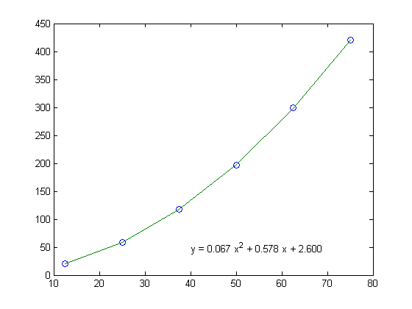
EAB_LAB05_P02
P02 Function code:
% Evan Baker
% EAB_LAB05_P02
% 14 February 2014
% This script will fit a quadratic to a given data set
function EAB_LAB_P02
v = [12.5 25 37.5 50 62.5 75];
V = linspace(min(v),max(v),6);
d = [20 59 118 197 299 420];
p = polyfit(v,d,2);
D = polyval(p,v);
plot(v,d,'o',V,D)
text(40,50,sprintf('y = %.3f x^2 + %.3f x + %.3f ',p(1,1),p(1,2),p(3)))
end
Output:

