Slide 1
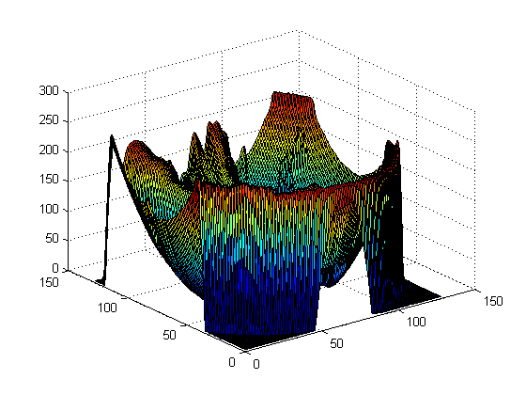
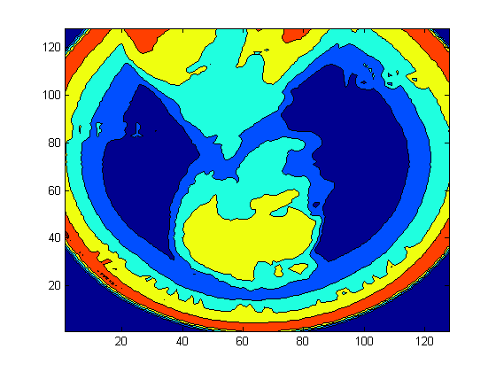
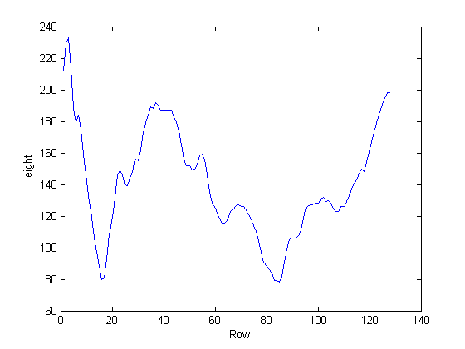
Evan Baker
EAB_LAB07
1 March 2014
Function Code:
% Evan Baker
% EAB_LAB07
% 1 March 2014
clear all
close all
[filename, pathname] = uigetfile({'*.xlsx','Excel Sheets (*.xlsx)'},'Select File'); % Prompt user to load an Excel file
m = xlsread([pathname, filename], 'sheet1'); % Pull sheet 1 out of the xlsx
dims = size(m); % Get the dimensions of the spreadsheet
slice = m(:,dims(2)/2); % Slice to the (left) center column of the sheet
figure(1)
surf(m) % Draw the 3D surface in Window 1
figure(2)
contourf(m) % Draw a contour plot in Window 2
figure(3)
x = 1:dims(1);
plot(x,slice);xlabel('Row');ylabel('Height'); % Plot the (left) center column values as height (y) vs row number (x)
save('slice.dat','m','-ascii'); % Write the sliced column to a text file
Output:
This function makes 3 figures, a 3D surface, a contour plot, and the center column values (y) vs row number (x). It then saves the sliced center column to a text file called slice.dat
The data is a height map of a penny, mirrored and upside down.

