Slide 1
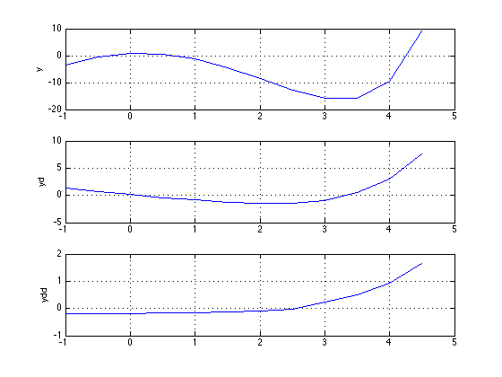
Evan Baker
EAB_LAB09
Function Code:
% Evan Baker
% EAB_LAB09
% 28 March 2014
% This function will determine the first and second derivatives of a set of
% data - discrete points with equal spacing.
function [yd, ydd] = FrstScndDeriv(x,y);
h = y(2) - y(1);
len = length(x);
yd = zeros(1,len);
ydd = zeros(1,len);
for i = 1:len-2; % get most of the first + second derivative by forward differencing
yd(i) = (-3*y(i) + 4*y(i+1) -y(i+2)) / (2*h);
end
for i = 1:len-3;
ydd(i) = (2*y(i) - 5*y(i+1) + 4*y(i+2) -y(i+3)) / (h^2);
end
for i = len-2:len; % get the last couple plots by backwards differencing
yd(i) = (y(i-2) - 4*y(i-1) + 3*y(i)) / (2*h);
end
for i = len-3:len;
ydd(i) = (-y(i-3) + 4*y(i-2) - 5*y(i-1) + 2*y(i)) / (h^2);
end
figure(1) % plotting f(x),f'(x),f''(x) in a stacked plot
subplot(3,1,1)
plot(x,y);ylabel('y');grid
subplot(3,1,2)
plot(x(1:len),yd(1:len));ylabel('yd');grid
subplot(3,1,3)
plot(x(1:len),ydd(1:len));ylabel('ydd');grid
end
Function Output:

Slide 2
Evan Baker
EAB_LAB09B
Function Code:
% Evan Baker
% EAB_LAB09B
% 28 March 2014
% This function will approximate pi using trapz and then simpson's 1/3
% method with 6 interval steps
n = 6;
% trapz method
% pi = 1/2 int -1 to 1 of 4/(1+x^2) dx
x = linspace(-1,1,n+1); % build the x array
y = 4./(1+(x.^2)); % calculate the y array
trapzPi = .5*trapz(x,y) % get the approximate
% simpson's method
h = (1-(-1))/n;
simpsonsPi = (h/6)*(y(1)+y(n+1)+4*sum(y(2:2:n))+2*sum(y(3:2:n-1))) % get half the integral by Simpson's method
Function Output:
>> EAB_LAB09B
trapzPi =
3.1231
simpsonsPi =
3.1419

