Slide 1
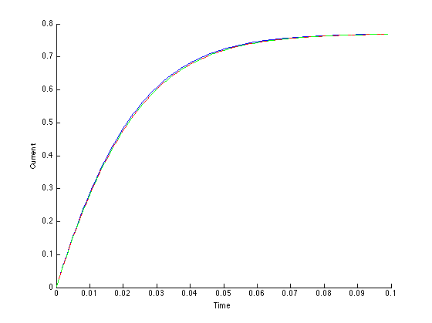
Evan Baker
EAB_LAB11
11 April 2014
Function Code:
clear all
close all
% This script will solve an ODE for a simple circuit
% dI/dt = Vo/L - R/L * I
Vo = 500; % Volts
L = 15; % Henries
% Nonlinear resistor
R = @ (i) 500 + 250*(i^2); % ohms
f = @ (I,t) Vo/L - (R(I)/L)*I;
h = .001;
t(1:100) = 0;I(1:100) = 0;
% 1: Euler's Method
for i = 2:100;
t(i) = t(i-1) + h;
I(i) = I(i-1) + h*f(I(i-1));
end
hold on
figure(1);plot(t,I,'b');xlabel('t');ylabel('I');
% 2: 4th order Runge-Kutta
for i = 2:100
k1 = f(I(i-1));
k2 = f(I(i-1) + k1*h/2);
k3 = f(I(i-1)+k2*h/2);
k4 = f(I(i-1)+k3*h);
I(i) = I(i-1)+(k1+2*k2+2*k3+k4)*h/6;
end
plot(t,I,'r');
f1 = @ (t,I) Vo/L - (R(I)/L)*I;
% 3: ode45
[X, Y] = ode45(f1,t,0);
plot(X,Y,'-.g');
This function will solve for the current in a first order circuit by approximating the solution to the ODE solution with three different methods and then plotting them out on to the same graph.

